Slide 1
Lecture 16a
Metal Carbonyl Compounds

Slide 2
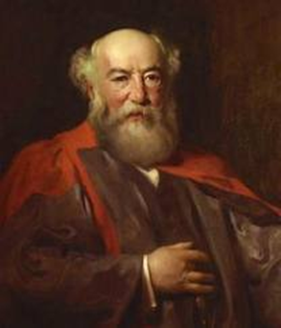

Introduction
The first metal carbonyl compound described was Ni(CO)₄ (Ludwig Mond, ~1890), which was used to refine nickel metal (Mond Process)
  Ni(CO)₄ is very volatile (b.p. =40 ºC) and also very toxic!
Metal carbonyl compounds are used in many industrial processes producing organic compounds i.e., Monsanto process (acetic acid), Fischer Tropsch process (gasoline, ethylene glycol, methanol) or Reppe carbonylation (vinyl esters) from simple precursors (CO, CO₂, H₂, H₂O)
Vaska’s complex (IrCl(CO)(PPh₃)₂) absorbs oxygen reversibly and serves as model for the oxygen absorption of myoglobin and hemoglobin (CO and Cl-ligand are disordered in the structure, two CO ligands are shown in the structure)

Slide 3
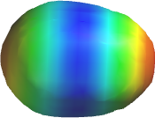
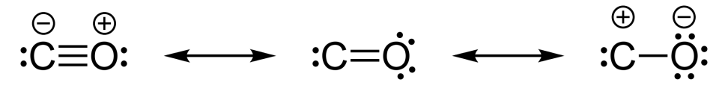
Carbon Monoxide
Carbon monoxide is a colorless, tasteless gas that is highly toxic because it strongly binds to the iron in hemoglobin
The molecule is generally described with a triple bond
because the bond distance of d=113 pm is too short for
a double bond i.e., formaldehyde (H₂C=O, d=121 pm)
The structure on the left is the major contributor because both atoms have an octet in this resonance structure (μ=0.122 D)
The lone pair of the carbon atom is located in a sp-orbital

Slide 4
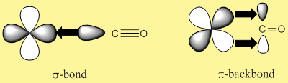
Bond Mode of CO to Metals
The CO ligand usually binds via the carbon atom to the metal
The lone pair on the carbon forms a σ-bond with a suitable
d-orbital of the metal (i.e., d_{(x2-y2)})
The metal can form a π-backbond via the π*-orbital of the
CO ligand (i.e., d_{(xy)})
Electron-rich metals i.e., late transition metals in low oxidation states are more likely to donate electrons for the backbonding
A strong π-backbond results in a shorter the M-C bond and
a longer the C-O (II) bond due to the population of an anti-bonding orbital in the CO ligand (see infrared spectrum)
xy-plane

Slide 5
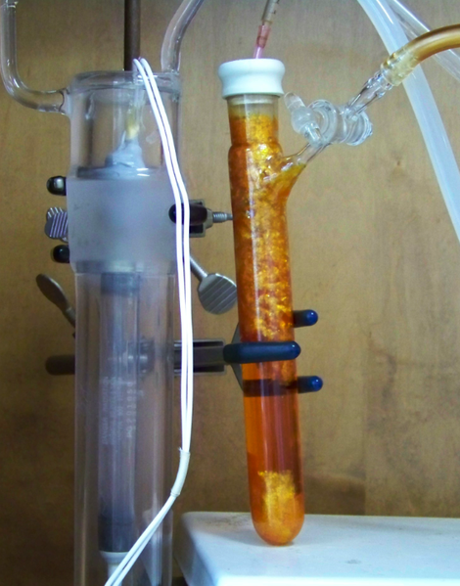
Synthesis
Some compounds can be obtained by direct carbonylation of a metal at room temperature or elevated temperatures
In other cases, the metal has to be generated in-situ by reduction
of a metal halide or metal oxide
Many polynuclear metal carbonyl compounds can be obtained
using photochemistry which exploits the labile character of many
M-CO bonds

Slide 6
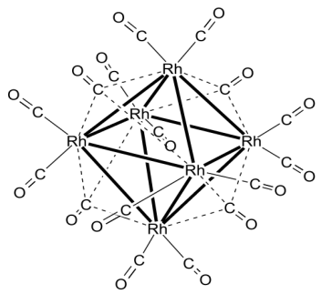
Structures I
Three bond modes found in metal carbonyl compounds
The terminal mode is the most frequently one mode found exhibiting a carbon oxygen triple bond i.e., Ni(CO)₄
The double or triply-bridged mode is found in many polynuclear metals carbonyl compounds with an electron deficiency i.e., Rh₆(CO)₁₆ (four triply bridged CO groups)
Which modes are present in a given compound can often
be determined by infrared and ¹³C-NMR spectroscopy

Slide 7
Structures II
Mononuclear compounds
Dinuclear compounds
M(CO)₆ (O_{h}) M(CO)₅ (D_{3h}) M(CO)₄ (T_{d})
i.e., Cr(CO)₆ i.e., Fe(CO)₅ i.e., Ni(CO)₄
M₂(CO)₁₀ (D_{4d}) Fe₂(CO)₉ (D_{3h})
i.e., Re₂(CO)₁₀
Co₂(CO)₈ Co₂(CO)₈
(solid state, C_{2v}) (solution, D_{3d})

Slide 8
Infrared Spectroscopy
Free CO: 2143 cm⁻¹
Terminal CO groups: 1850-2125 cm⁻¹
μ₂-brigding CO groups: 1750-1850 cm⁻¹
μ₃-bridging CO groups: 1620-1730 cm⁻¹
Non-classical metal carbonyl compounds can have ν(CO) greater than the one observed in free CO
Compound | ν(CO) [cm⁻¹] | d(CO) [pm]
Ni(CO)₄ | 2057 | 112.6
Fe(CO)₅ | 2013, 2034 | 112.2, 114.6
Cr(CO)₆ | 2000 | 114.0
Re₂(CO)₁₀ | 1976, 2014, 2070 | 112-113, 114.7
Fe₂(CO)₉ | 1829, 2019, 2082 | 112.6, 116.0
Rh₆(CO)₁₆ | 1800, 2026, 2073 | 115.5, 120.1
Ag(CO)₂⁺ | 2185 | 108.0

Slide 9
¹³C-NMR Spectroscopy
Terminal CO: 180-220 ppm
Bridging CO: 230-280 ppm
Examples:
  M(CO)₆: Cr: 211 ppm, Mo: 201.2 ppm, W: 193.1 ppm
  Fe(CO)₅
    Solid state: 208.1 ppm (equatorial) and 216 ppm (axial) in a 3:2-ratio
    Solution: 211.6 ppm (due to rapid axial-equatorial exchange)
  Fe₂(CO)₉ (solid state): 204.2 ppm (terminal), 236.4 ppm (bridging)
  Co₂(CO)₈
    Solid state: 182 ppm (terminal), 234 ppm (bridging)
    Solution: 205.3 ppm

Slide 10
Application I
Collman’s reagent
  This reagent is obtained from iron pentacarbonyl and sodium hydroxide in an ether i.e., 1,4-dioxane
  It exploits the labile character of the Fe-C bond of alkyl iron compounds which allows for the insertion of a CO ligand, which technically generates a “RC=O⁻”.
  Advantages: high degree of chemoselectivity, produces high yields
  (70-90 %), bears low cost and is relatively environmental friendly

Slide 11
Application II
Fischer Tropsch Reaction/Process
  The reaction was discovered in 1923
  The reaction employs hydrogen, carbon monoxide and
  a “metal carbonyl catalyst” to form alkanes, alcohols, etc.
  Ruhrchemie A.G. (1936)
    Used this process to convert synthesis gas into gasoline using
    a catalyst Co/ThO₂/MgO/Silica gel at 170-200 ºC at 1 atm
    The yield of gasoline was only ~50 % while about 25 % diesel
    oil and 25 % waxes were formed (How many candles do you need today? ☺)
  An improved process (Sasol) using iron oxides as catalyst,
  320-340 ºC and 25 atm pressure affords 70 % gasoline

Slide 12
Application III
Second generation catalyst are homogeneous i.e., [Rh₆(CO)₃₄]²⁻
Union Carbide: ethylene glycol (antifreeze) is obtain at high pressures (3000 atm, 250 ºC)
Production of long-chain alkanes is favored at a temperature around 220 ºC and pressures of 1-30 atm
Gasolines

Slide 13
Application IV
Monsanto Process (Acetic Acid)
  This process uses cis-[(CO)₂RhI₂]⁻ as catalyst to convert methanol and carbon dioxide to acetic acid
  The reaction is carried out at 180 ºC and 30 atm pressure
  Two separate cycles that are combined with each other
Oxidative
Addition
(+I to +III)
CO Insertion
Reductive
Elimination
(+III to +I)
CO Addition

Slide 14
Application V
Hydroformylation
  It uses cobalt catalyst to convert an alkene, carbon monoxide and hydrogen has into an aldehyde
  The reaction is carried at moderate temperatures (90-150 ºC) and high pressures (100-400 atm)

Slide 15
Application VI
The Pauson–Khand reaction is a [2+2+1] cycloaddition reaction between an alkene, alkyne and carbon monoxide to form an α,β-cyclopentenone.
Originally it was catalyzed by dicobalt octacarbonyl, more recently also by Rh-complexes (i.e., Wilkinson’s complex with silver triflate as co-catalyst)

Slide 16
Application VII
Reppe-Carbonylation
  Acetylene, carbon monoxide and alcohols are reacted in
  the presence of a catalyst like Ni(CO)₄, HCo(CO)₄ or Fe(CO)₅ to yield acrylic acid esters
  If water is used instead of alcohols, the carboxylic acid is obtained (i.e., acrylic acid)
  The synthesis of ibuprofen uses a palladium catalyst on
  the last step to convert the secondary alcohol into a carboxylic acid

Slide 17
Application VIII
Doetz reaction
  Carbonyl compounds are reactant to form metal- carbene complexes (Fischer carbenes)
  The addition of an alkyne leads to the formation of a metallacycle
  Next, one of the carbonyl groups is inserted into the Cr-C bond
  The electrophilic addition of the carbonyl function to the phenyl group affords a naphthalene ring

