Slide 1
Lecture 14a
Metallocenes

Slide 2
Synthesis I
Alkali metal cyclopentadienides
  Alkali metals dissolve in liquid ammonia with a dark blue color at low concentrations (and bronze color at high concentrations) due to solvated electrons that are trapped in a solvent cage (video)
  The addition of the cyclopentadiene to this solution causes the color of the solution to disappear as soon as the alkali metal is consumed completely (titration)
  Sodium hydride (NaH) can be used as a base, which leads to the formation
  of hydrogen as well
Magnesium
  It is less reactive than sodium or potassium because it often possesses a thick oxide layer (hence the problems to initiate the Grignard reaction) and does
  not dissolve well in liquid ammonia ☹
  Its lower reactivity compared to alkali metals demands elevated temperatures (like iron) to react with cyclopentadiene

Slide 3
Synthesis II
Transition metals are generally not reactive enough for the direct reaction except when very high temperatures are used i.e., iron
(see original ferrocene synthesis)
A metathesis reaction is often employed here
  The reaction of an anhydrous metal chloride with an alkali metal cyclopentadienide
  The reaction can lead to a complete or a partial exchange depending
  on the ratio of the metal halide to the alkali metal cyclopentadienide
  The choice of solvent determines which of the products precipitates

Slide 4
Synthesis III
Problem: Most chlorides are hydrates, which react with the
Cp-anion in an acid-base reaction ☹
  The acid strength of the aqua ion depends on the metal and its charge
  The smaller the metal ion and the higher its charge, the more acidic
  the aqua complex is
  All of these aquo complexes have higher K_{a}-values than CpH itself (K_{a}=1.0*10⁻¹⁵), which means that they are stronger acids
Aqua complex | K_{a}
[Fe(H₂O)₆]²⁺ | 3.2*10⁻¹⁰ (~hydrocyanic acid)
[Fe(H₂O)₆]³⁺ | 6.3*10⁻³ (~phosphoric acid)
[Co(H₂O)₆]²⁺ | 1.3*10⁻⁹ (~hypobromous acid)
[Ni(H₂O)₆]²⁺ | 2.5*10⁻¹¹ (~hypoiodous acid)
[Al(H₂O)₆]³⁺ | 1.4*10⁻⁵ (~acetic acid)
[Cr(H₂O)₆]³⁺ | 1.6*10⁻⁴ (~formic acid)

Slide 5
Synthesis IV
Anhydrous metal chlorides can be obtained from various commercial sources but their quality is often questionable ☹
They can be obtained by direct chlorination of metals at elevated temperatures (~200-1000 ºC)
The dehydration of metal chloride hydrates with thionyl chloride or dimethyl acetal to consume the water in a chemical reaction
Problems:
  Accessibility of thionyl chloride (restricted substance because it used
  in the illicit drug synthesis)
  Production of noxious gases (SO₂ and HCl) which requires a hood
  Very difficult to free the product entirely from SO₂
  Anhydrous metal chlorides are often poorly soluble in organic solvents

Slide 6
Synthesis V
The hexammine route circumvents the problem of the conversion of the hydrate to the anhydrous form of the
metal halide
The reaction of ammonia with the metal hexaaqua complexes affords the hexammine compounds
  Color change: dark-red to pink (Co), green to purple (Ni)
  Advantages
    A higher solubility in some organic solvents
    The ammine complexes are less acidic than aqua complexes because ammonia itself is significantly less acidic than water!
    They introduce an additional driving force for the reaction
  Disadvantage
    [Co(NH₃)₆]Cl₂ is very air-sensitive because it is a 19 VE system.
    It changes to [Co(NH₃)₆]Cl₃ (orange) upon exposure to air.

Slide 7
Synthesis VI
The synthesis of the metallocene uses the ammine complex
The solvent determines which compound precipitates
  THF: the metallocene usually remains in solution, while sodium chloride precipitates
  DMSO: the metallocene often times precipitates, while sodium chloride remains dissolved
The reactions are often accompanied by distinct color changes i.e., CoCp₂: dark-brown, NiCp₂: dark-green
Ammonia gas is released from the reaction mixture, which makes the reaction irreversible and highly entropy driven 

Slide 8
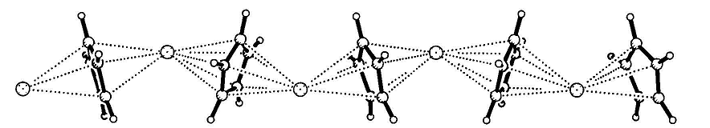
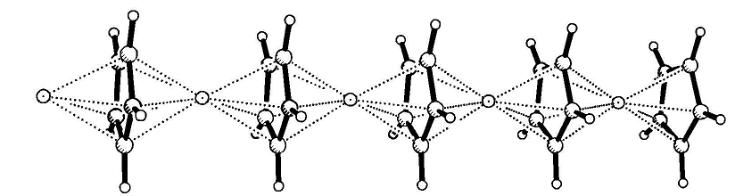
Properties I
Alkali metal cyclopentadienides are ionic i.e., LiCp, NaCp, KCp, etc.
  They are soluble in many polar solvents like THF, DMSO, etc. but they are insoluble in non-polar solvents like hexane, pentane, etc.
  They react readily with protic solvents like water and alcohols (in some cases very violently)
  Many of them react with chlorinated solvents as well because
  of their redox properties
KCp
LiCp, NaCp

Slide 9
Properties II
Many divalent transition metals form sandwich complexes
i.e., ferrocene, cobaltocene, nickelocene, etc.
  These compounds are non-polar if they possess a sandwich structure
  but become increasingly more polar if the Cp-rings become tilted with respect to each other i.e., Cp₂MCl₂.
  The M-C bond distances differ with the number of total valence electrons (i.e., FeCp₂: ~204 pm, FeCp₂⁺: ~207 pm; CoCp₂: ~210 pm, CoCp₂⁺: ~203 pm, NiCp₂: ~214 pm, NiCp₂⁺: ~206 pm )
  They are often soluble in non-polar or low polarity solvents like hexane, pentane, diethyl ether, dichloromethane, etc. but are usually poorly soluble in polar solvents
  Their reactivity towards chlorinated solvents varies greatly because
  of their redox properties
  Many of the sandwich complexes can also be sublimed because they are non-polar i.e., ferrocene can be sublimed at ~80 ºC in vacuo

Slide 10
Properties III
Cobaltocene is a strong reducing reagent (E⁰= -1.33 V vs. FeCp₂) because it is a 19 valence electron system with its highest electron
in an anti-bonding orbital
The oxidation with iodine leads to the light-green cobaltocenium ion
It is often used as counter ion to crystallize large anions (158 hits in the Cambridge database)
The reducing power can be increased by substitution on the Cp-ring with electron-donating groups that raise the energy of the
anti-bonding orbitals i.e., Co(CpMe₅)₂: (E⁰= -1.94 V vs. FeCp₂)
Placing electron-accepting groups on the Cp-ring make the reduction potential more positive i.e., acetylferrocene (E⁰= 0.24 V vs. FeCp₂), cyanoferrocene (E⁰= 0.36 V vs. FeCp₂)

Slide 11

Properties IV
HgCp₂ can be obtained from aqueous solution
The compound is light and heat sensitive
The X-ray structure displays two σ-bonds between the
mercury atom and one carbon atom of each ring
HgCp₂ does undergo Diels-Alder reactions as well as aromatic substitution
(i.e., coupling with Pd-catalyst)
In solution, it only exhibits one signal in the ¹H-NMR spectrum because of
a fast exchange between different bonding modes (η¹, η⁵-bonding)
A similar mode is found in BeCp₂, Zn(CpMe₅)₂

Slide 12
Applications I
Schwartz reagent: Cp₂Zr(H)Cl
It reacts with alkenes and alkynes in a hydrozirconation reaction similar (syn addition) to B₂H₆
Selectivity: terminal alkyne > terminal alkene ~ internal alkyne > disubstituted alkene
It is much more chemoselective and easier to handle than B₂H₆

Slide 13
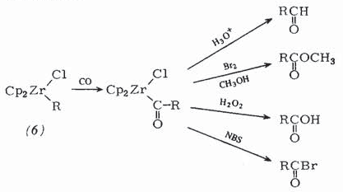
Applications II
Schwartz reagent: Cp₂Zr(H)Cl
After the addition to an alkene, carbon monoxide can be inserted into the labile Zr-C bond leading to acyl compounds
Depending on the subsequent workup, various carbonyl compounds can be obtained from there

Slide 14
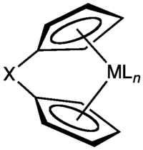
Applications III
Cyclopentadiene compounds of early transition metals
i.e., titanium, zirconium, etc. are Lewis acids because of the incomplete valence shell i.e., Cp₂ZrCl₂ (16 VE)
Due to their Lewis acidity they have been used as
catalyst in the Ziegler-Natta reaction
(polymerization of ethylene or propylene)
Of particular interest for polymerization reactions
are ansa-metallocenes because the bridge locks
the Cp-rings and also changes the reactivity of
the metal center based on X

Slide 15
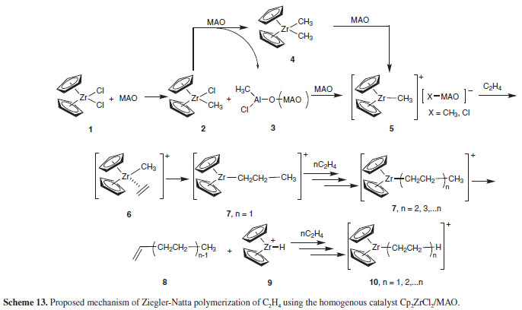
Applications IV
Mechanism of Ziegler-Natta polymerization of ethylene
MAO=Methyl alumoxane

