Slide 1
Lecture 12b
Protective group chemistry

Slide 2
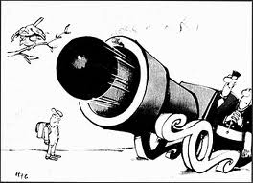
Problems
The need of protective groups arises from
the poor chemoselectivity of many reagents
The use of protective groups usually adds
two (or more) steps to the reaction sequence
  This generates additional cost and additional waste
  This also decreases atom economy (=atoms used that are part of the final product versus atoms used in the reaction sequence)
Therefore the need for new reagent arises that only target one specific functional group

Slide 3
Nitroanilines I
Synthesis of Nitroanilines
  The direct nitration of aniline leads to a 50:50 mixture of the meta- and para-isomer. Why?
  The amine function in aniline is protected by an acetyl group to form an anilide
  The nitration of the anilide affords mainly the para isomer due to the steric hindrance caused by the protective group
  In order to obtain the ortho isomer preferentially, the para position has to be temporarily protected by a sulfo group (-SO₃H), which is possible because the sulfonation reaction is reversible!

Slide 4
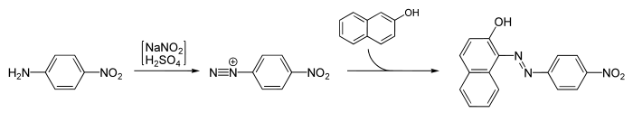
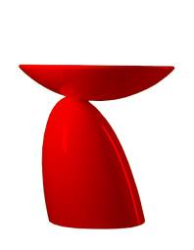
Nitroanilines II
The direct nitration of the anilide does not afford the meta isomer because of the ortho/para directing effect of this functional group (-NHCOCH₃)
  The nitration of nitrobenzene affords mainly m-dinitrobenzene
  The selective reduction with a sulfide yields one ammonium function, while the second one remains
Nitroanilines are used as starting materials to prepare dyes via their diazonium salts i.e., Para red, Ponceau 4R (food coloring)

Slide 5
Grignard Reaction I
When performing Grignard reactions, many groups can react with the Grignard reagent due to various reasons
  Some functional groups protonate the Grignard reagent because they possess hydrogen atoms are acidic:
  -OH (pK_{a}~16-18), -NH_{x} (pK_{a}~35), -SH (pK_{a}~9-12),
  -COOH (pK_{a}~3-5)
  Some functional groups react with the reagent because
  they contain electrophilic atoms: -CHO, -COR, -CONR₂,
  -COOR, -C≡N, -NO₂, -SO₂R, epoxides (ring opening)
If more than one of these groups is present, groups that are not suppose to react will have to be protected

Slide 6
Grignard Reaction II
Example 1: Reaction of a ketone in the presence of a phenol group
In both reactions, the same product is obtained in the end, but the first pathway requires two equivalents of the Grignard reagent, which becomes
a problem if the precursor is available in limited quantities
After the protection of the phenol function with the TMS-group only one equivalent of the Grignard reagent is required.

Slide 7
Grignard Reaction III
Example 2: Reaction of a ketone in the presence of
an aldehyde function
  Aldehydes are generally more reactive than ketones
  The higher reactivity is used in the formation of the acetal using 1,3-propanediol
  After the Grignard reaction, the protective group is removed during the acidic workup, which restores the aldehyde function

Slide 8
Peptide Synthesis I
If the two amino acids, glycine (Gly) and alanine (Ala), were reacted, four dipeptides (aside of polypeptides) would be possible: Gly-Gly, Gly-Ala, Ala-Gly and Ala-Ala ☹
In order to obtain one specific dipeptide i.e., Gly-Ala only, several protective groups have to be used during the dipeptide formation
The amino group in glycine is protected using the Boc-group
The carboxylic acid group of alanine is protected by a benzyl group (benzyl ester)

Slide 9
Peptide Synthesis II
The protected forms of the amino acids are then reacted to form one specific dipeptide
DCC is used to activate the carboxylic acid
The treatment of the initial product with
  Acid removes the BOC group (CO₂, tert.-BuOH)
  Pd-C/H₂ removes the benzyl group as toluene
The resulting dipeptide is Gly-Ala only!

Slide 10
Reduction of Chalcones
The reduction of α,β-unsaturated ketones (chalcones) with simple metal hydrides (i.e., NaBH₄) leads to formation of a mixture of allylic alcohols (a) via a 1,2-reduction and ketones (b) via a 1,4-reduction and an alcohol (c) via a combination of both reductions
The use of LiNH₂*BH₃ in THF leads to the preferential formation of allylic alcohol in 78-93% yield which can be used as reactants in the Sharpless epoxidation
(a)
(b)

