Slide 1
Lecture 12b
Acetyl Ferrocene

Slide 2

Ferrocene I
Ferrocene
  It was discovered by two research groups by serendipity in 1951
    P. Pauson: Fe(III) salts and cyclopentadiene
    S. A. Miller: Iron metal and cyclopentadiene at 300 ºC
  It is an orange solid
  Thermodynamically very stable due to its 18 VE configuration
Cobaltocene (19 VE) and Nickelocene (20 VE) are very sensitive towards oxidation because they have electrons in anti-bonding orbitals
Ferrocene can be oxidized electrochemically or by silver nitrate to form
the blue ferrocenium ion (FeCp₂⁺)
Alternative 1 | Alternative 2
Iron(0) = 8 electrons (4s² 3d⁶) | Iron(II) = 6 electrons (3d⁶)
2 Cyclopentadiene = 5 electrons each | 2 Cyclopentadienide = 6 electrons each
Total = 18 electrons | Total = 18 electrons

Slide 3

Ferrocene II
  Pauson proposed a structure containing two cyclopentadiene rings that are connected to the iron atom via σ-bonds
  During the following year, G. Wilkinson (NP 1973)
  determined that it actually possesses sandwich structure,
  which was not known at this point
    The molecule exhibits D_{5d}-symmetry (staggered Cp-rings), but is highly distorted in the solid state because of the low rotational barrier around the Fe-Cp bond (~4 kJ/mol)
    All carbon atoms display the same distance to the Fe-atom (204 pm)
    The two Cp-rings have a distance of 332 pm (ruthenocene: 368 pm, osmocene: 371 pm)

Slide 4
Ferrocene III
In solution, a fast rotation is observed due to the low rotational barrier around the Fe-Cp axis:
  One signal is observed in the ¹H-NMR spectrum
  (δ=4.15 ppm)
  One signal in the ¹³C-NMR spectrum (δ=67.8 ppm)
  Compared to benzene the signals in ferrocene are shifted upfield
    This is due to the increased π-electron density (1.2 π-electrons per carbon atom in ferrocene vs. 1 π-electron per carbon atom in benzene)
    The higher electron-density causes an increased shielding of the hydrogen atoms and carbon atoms in ferrocene
    The shielding is larger compared to the free cyclopentadienide ligand (NaCp: δ_{Η}=5.60 ppm (THF), δ_{C}=103.3 ppm)

Slide 5
Ferrocene IV
Cyclopentadiene
  It tends to dimerize (and even polymerize) at room temperature
  via a Diels-Alder reaction
  It is obtained from the commercially available dimer by
  cracking, which is a Retro-Diels-Alder reaction (ΔHº= 77 kJ/mol, ΔSº= 142.3 J/mol*K, ΔGº = 34.6 kJ/mol, K_{eq}(25 ºC)=8.6*10⁻⁷, K_{eq}(180 ºC)=3.6*10⁻²)
  The monomer is isolated by fractionated distillation (b.p.=40 ºC
  vs. 170 ºC (dimer)) and kept at T= -78 ºC prior to its use
  Note that cyclopentadiene is very flammable, forms explosive peroxides and also a suspected carcinogen

Slide 6
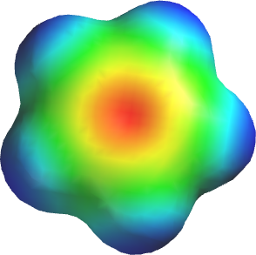
Ferrocene V
Acidity of Cyclopentadiene
  Cyclopentadiene is much more acidic (pK_{a}=15) than other hydrocarbon compounds i.e., cyclopentene (pK_{a}=40) or cyclopentane (pK_{a}=45)
  The higher acidity is due to the resonance stabilized anion formed in the reaction
  The cyclopentadienide ion is aromatic because it meets
  all requirements: planar, cyclic, conjugated, possesses
  6 π-electrons

Slide 7
Ferrocene VI
The high acidity implies that cyclopentadiene can be (partially) deprotonated with comparably weak bases
already i.e., OH⁻, OR⁻
Potassium cyclopentadienide (KCp) is ionic and only dissolves well in polar aprotic solvents i.e., DMSO, DME, THF, etc.
The reaction has to be carried out under the exclusion of air because KCp is oxidized easily (often pyrophoric when obtained as a fine powder), which is accompanied by a color change from white over pink to dark brown

Slide 8
Ferrocene VII
The actual synthesis of ferrocene is carried out in DMSO because FeCl₂ is ionic as well
The non-polar ferrocene precipitates from the relatively polar solution (solubility: 3.3 % in DMSO) while potassium chloride remains dissolved
If a less polar solvent was used (i.e., THF, DME), the potassium chloride would precipitate while the ferrocene would remain in solution

Slide 9
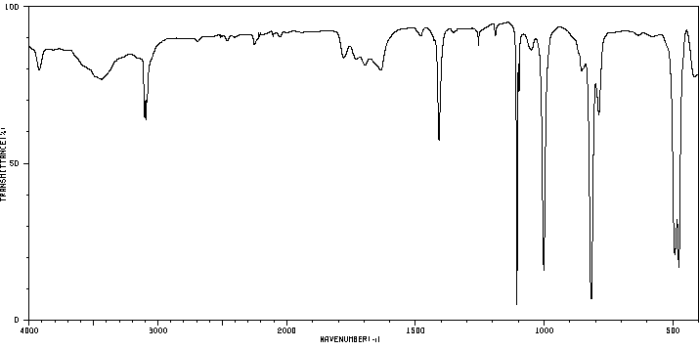
Characterization I
Infrared spectrum
  ν(CH, sp²)=3085 cm⁻¹
  ν(C=C)=1411 cm⁻¹
  asym. ring breathing: ν=1108 cm⁻¹
  C-H in plane bending: ν=1002 cm⁻¹
  C-H out of plane bending: ν=811 cm⁻¹
  asym. ring tilt: ν=492 cm⁻¹
  sym. ring metal stretch: ν=478 cm⁻¹
Despite the large number of atoms (21 total), there are only very few peaks observed in the infrared spectrum….why?
ν(CH, sp²)
ν(C=C)
asym. ring
breathing

Slide 10
Acetyl Ferrocene I
The Friedel-Crafts acylation of ferrocene can be accomplished different reagents and catalysts
  Acetyl chloride and AlCl₃
    Often large amounts of diacylation are observed in the reaction with FeCp₂ because both Cp-rings act as nucleophile
    It requires the use of dichloromethane
    It requires a very dry environment to keep the catalyst active and
    prevent the hydrolysis of the acetyl chloride
  Acetic acid anhydride and mineral acid
    Advantage:
      It usually display a better yield for the mono-acylation product
      No need for strictly anhydrous conditions

Slide 11
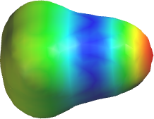
Acetyl Ferrocene II
The acylium ion is electrophile in the reaction
  It is formed from acetic acid anhydride and conc. phosphoric acid
  The acylium ion is resonance stabilized with the triple bonded form being the major contributor
  The CO bond length in [CH₃CO]SbF₆ is d=110.8 pm (<CCO=179.2º), which is close to a triple bond (free CO: d=112.8 pm)
  The value of ν(CO)=2302 cm⁻¹ also indicates the presence of a triple bond (free CO: ν=2143 pm)
  The isotropic shift for the carbon atom in the acylium ion is δ=154 ppm
  (for comparison: acetonitrile: ~117 ppm)
  The acylium ion is a weak electrophile due to the fact that the resonance structure with the positive charge on the carbon atom is a minor contributor
    It usually only reacts with aromatic systems that are more reactive than benzene (electron-donating substituent or high π-electron density)
    Diacylation on the same ring is rarely observed because the first acylation leads to a deactivation of the ring

Slide 12
Acetyl Ferrocene III
Acylation
The reaction requires elevated temperatures (80-85 ºC)
After the reaction is completed, the reaction mixture
usually contains some unreacted ferrocene, acetyl ferrocene, 1,1’-diacetylferrocene and some oxidation products
If the reaction was performed correctly, the reaction yield would be about 70 % according to the literature

Slide 13
Experimental I
Dissolve the ferrocene in acetic acid anhydride in round-bottomed flask
Slowly add the concentrated phosphoric acid
Attach a drying tube
Heat the mixture in a water bath to 80-85 ºC for 20 min
Cool the reaction mixture
Which observation should the student make here?
Which observation should the student make here?
Why is the drying tube attached?
Why is this temperature chosen?
A red solution
The solution turns darker red
To keep the water out
To increase the rate of the reaction
without causing too much oxidation

Slide 14
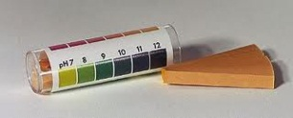
Experimental II
Pour the reaction mixture into sodium acetate solution
Adjust the pH-value to pH=5-7 by adding solid sodium bicarbonate
Extract the mixture with ethyl acetate
Which purpose does this step serve?
Which glassware should be used here?
Which observation should the student make here?
How is the pH-value determined?
How many extractions should be performed?
To raise the pH-value and
precipitate the product
A large beaker
1. Increased amount of precipitate
2. Heavy foaming
3x10 mL
Bottom line: If it does not dissolve in ethyl acetate, it is not the product !

Slide 15
Experimental III
Extract the combined organic layers with water and sodium bicarbonate solution
Dry the organic layer over anhydrous magnesium sulfate
Remove the solvent using the rotary evaporator
Purify the crude product using flash chromatography
Why is this step performed?
How does the product look like at this point?
Why is this technique used here?
To remove the remaining acids
from the organic layer
Red-brown solid
All compounds (FcH, FcAc, FcAc₂) are neutral

Slide 16
Experimental IV
Pack the column like before
Suspend the crude in petroleum ether:ethyl acetate (98:2) and apply all of the suspension to the column
Use petroleum ether:ethyl acetate (98:2) to elute the ferrocene off the column
Use a solvent mixture petroleum ether:ethyl acetate (90:10) to elute acetyl ferrocene
Collect fraction that contain acetyl ferrocene only
Is the pretreatment with 1 % NEt₃ solution needed here?
What is petroleum ether?
Why does the crude not dissolve completely in solvent mixture?
How does the student know that he is done?
How does the student know that he is done?
How does the student identify these fractions?
NO
The compounds are too polar
The eluent is colorless
The eluent is light yellow
Using TLC

Slide 17
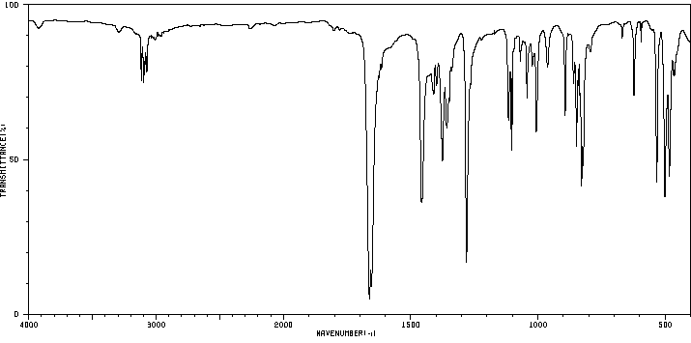
Characterization I
Melting point
Infrared Spectrum
  ν(C=O)=1655, 1662 cm⁻¹
  ν(CH, sp²)=3079, 3097, 3116 cm⁻¹
  δ(CH₃)=1378, 1457 cm⁻¹
  asym. ring breathing: ν=1102 cm⁻¹
  C-H out of plane bending: ν=822 cm⁻¹
  asym. ring tilt: ν=502 cm⁻¹
  sym. ring metal stretch: ν=484 cm⁻¹
UV-Vis Spectrum
  λ=220 nm (24000), 266 nm (5600), 319 nm (1140), 446 nm (335)
  The product appears a little darker orange-red than ferrocene itself due a bathochromic shift
ν(C=O)

Slide 18
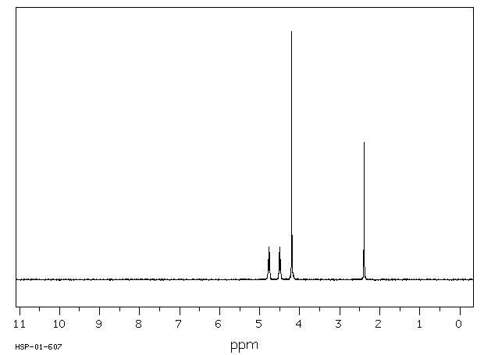
Characterization II
¹H-NMR Spectrum
  δ=2.39 ppm (3 H, s, F)
  δ=4.20 ppm (5 H, s, A)
  δ=4.50 ppm (2 H, “s”, B)
  δ=4.77 ppm (2 H, “s”, C)
The coupling constants on the cyclopentadienide ring are very small (J₃~2 Hz)
The α-protons (C) are more shifted that the β-protons (B) due to the resonance with the carbonyl group
A
F
C
B

Slide 19
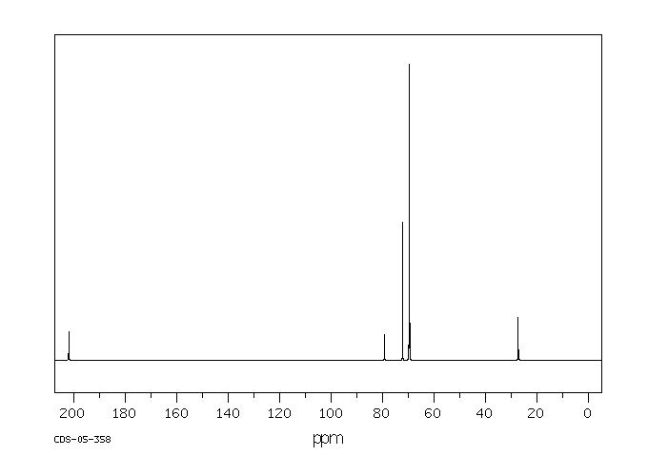
Characterization III
¹³C-NMR Spectrum
  δ=27 ppm (F)
  δ=202 ppm (E)
  δ=79 ppm (D)
  δ=72 ppm (C)
  δ=69.8 ppm (A)
  δ=69.6 ppm (B)
The carbon atoms of the unsubstituted ring are all equivalent and give rise to one very large signal
A
C
E
B
F
D

Slide 20
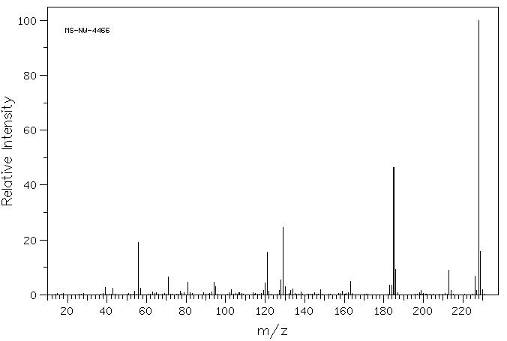
Characterization IV
Mass Spectrum
  Fe-isotopes: 54 (5.8 %), 56 (91.7 %), 57 (2.2 %), 58 (0.28 %)
m/z=228
Fe(C₅H₅)(C₅H₄COCH₃)
m/z=185
Fe(C₅H₅)(C₅H₄)
m/z=129
C₅H₅-C₅H₄
m/z=56
Fe
m/z=121
Fe(C₅H₅)
m/z=213
Fe(C₅H₅)(C₅H₄CO)

Slide 21
Common Mistakes
Using acetic acid as solvent instead of acetic acid anhydride
Lack of use of concentrated phosphoric acid as catalyst
Overheating of the reaction mixture during the reaction
Trying to neutralize the reaction mixture to pH=7.00
Using the wrong solvent (too polar) to dissolve the crude sample to apply the sample to column
Not applying the entire crude to the column
Using the wrong mobile phase resulting in poor separation
(if eluted too quickly) or too many fractions (if mobile phase was too low in polarity)
Pretreating the column with triethylamine solution
Packing the column incorrectly

