Slide 1
Lecture 10b
Nitration

Slide 2
Theory I
The nitration of aromatic systems is an example of an electrophilic aromatic substitution (EAS)
Statistically, an EAS on a mono-substituted arene should afford
40 % of the ortho (two positions), 40 % of the meta (two positions)
and 20 % of the para (one position) product
The observed product distributions in EAS look very different
i.e., nitration reactions for mono-substituted benzene rings
Substituent | ortho | meta | para
CH₃ | 33 % | 5 % | 62 %
OCH₃ | 43 % | 1 % | 56 %
NO₂ | 6 % | 93 % | 1 %
CHO | 19 % | 72 % | 9 %
NH₂ | 1 % | 50 % | 49 %

Slide 3
Theory II
Substituents can be categorized into three groups
Among ortho/para directing substituents, an additional steric effect has to be considered when predicting the product distribution
  A larger substituent on the ring causes the increased formation of the para isomer
  i.e., methyl (58:37), isopropyl (30:62), tert.-butyl (16:73) in nitration reactions
  A larger electrophile also favors the para position i.e., sulfonation (99 %, V=50 Å³)
  and bromination (87 %, V=29 Å³) affords more para product than chlorination
  (55 %, V=24 Å³) and nitration (70 %, V=30 Å³) in the reaction with chlorobenzene
  Size does not always favor para-substitution: the nitration of fluorobenzene affords
  88 % of the para-product while the nitration of iodobenzene yields only 60 % of the
  para-product despite the larger size of the substituent. Why?
Inductive Effect | Resonance Effect | Activity in EAS | Direction | Examples
positive | positive | high | ortho/para | OR, NR₂, CR₃, O(C=O)R
negative | positive | low | ortho/para | F, Cl, Br, I, NO
negative | negative | very low | meta | NO₂, COR, CF₃, CN

Slide 4
Theory III
Electron-donating substituents, mostly bonded via heteroatoms with lone pairs, are ortho/para directing because the additional resonance structure contributes significantly to the stabilization of the positive charge
Electron-withdrawing substituents favor meta addition in order to avoid
the concentration of the positive charges on the ipso-carbon

Slide 5
Theory IV
If both types of groups are present, the strongest activating substituent will win out over weakly activating or a deactivating substituent when it comes to the directing effect.
H₂SO₄/HNO₃
25 ºC
99%

Slide 6
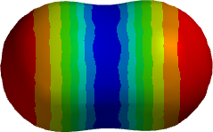
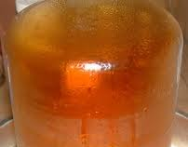
Nitration I
The nitration reaction uses the nitronium ion (NO₂⁺) as electrophile
Sources (mostly in-situ)
  Diluted or concentrated HNO₃
  Mixture of concentrated HNO₃ and concentrated H₂SO₄
  N₂O₅ in CCl₄ (NO₂⁺ + NO₃⁻) (Note: N₂O₅ is made from NO₂ and O₃
  While NO₂ is a brown gas, N₂O₅ forms a white solid!)
  KNO₃/H₂SO₄ in CH₂Cl₂
  Nitronium salts (NO₂⁺BF₄⁻, NO₂⁺PF₆⁻, both do not dissolve well in
  organic solvents)
  Metal nitrates (i.e., calcium nitrate, iron(III) nitrate) with acetic acid
  The nitronium ion is a very strong electrophile because only one resonance form with positive charge mostly on the nitrogen atom (red=negative charge, blue=positive charge)
  The calculated bond order for the NO bond is 1.84
  (HF/6-31G**) which is close to a double bond. The
  nitrogen atom almost bears a full positive charge.

Slide 7
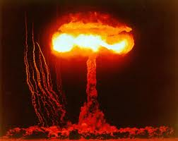
Nitration II
Because methyl benzoate is an electron deficient arene, a mixture of concentrated nitric acid and concentrated sulfuric acid is used to generate
the nitronium ion
The strongly electrophilic character of the nitronium ion and the exothermic nature of the nitration reaction poses a problem in terms of polynitration
Many polynitration compounds are explosive i.e., TNT, nitroglycerin,
1,3,5-trinitro-1,3,5-triazacyclohexane (main component in C4), etc.
The reaction in the lab affords the ortho isomer and para isomer as well
E_{A}=79 kJ/mol
E_{A}=107 kJ/mol

Slide 8
Experimental I
Dissolve the methyl benzoate in concentrated sulfuric acid
Cool the mixture in an ice-bath
Slowly add the mixture of concentrated nitric acid and concentrated sulfuric acid (provided by lab support) while stirring
Why is the ester dissolved in conc. sulfuric acid?
What is an ice-bath?
Does the student have to prepare the mixture himself?
Why is the mixture added slowly?
Why is it important to stir the mixture?
Which observations should the student make/not make?
The ester is not soluble in the
nitration mixture
A mixture of water and some ice
NO
To keep the temperature low
To obtain a homogeneous mixture
which provides better control
1. A color change to orange observed which is normal
2. The formation of a brown gas is a sign of undesirable side reactions

Slide 9
Experimental II
Take the mixture out of the ice-bath and place in a room temperature water bath for
15 min
Pour reaction mixture over ice
Isolate the solid by vacuum filtration
Recrystallize the crude from methanol:water (4:1)
After characterization (final product: m.p., IR, NMR (CDCl₃), GC/MS (EtOAc), crude: HPLC
(1 mg/mL isopropanol)), submit the final product to the teaching assistant
Why is the reaction mixture stirred in a water bath?
Why is ice used here and not water?
Why is a solvent used here?
What are the criteria?
To precipitate the crude product
without hydrolyzing the ester
The product dissolves too well in
methanol at low temperature
Quantity, color, crystallinity, dryness,
proper labeling

Slide 10

Common Mistakes
The ester is not dissolved in concentrated sulfuric acid
The reaction mixture is not cooled properly
The mixture is not stirred during the reaction
The nitration mixture is added too fast
The reaction is placed in warm/hot water bath
The reaction mixture is poured into water
The crude is recrystallized from water:methanol (4:1)
The water jacketed condenser is “inspected” after the reaction

Slide 11
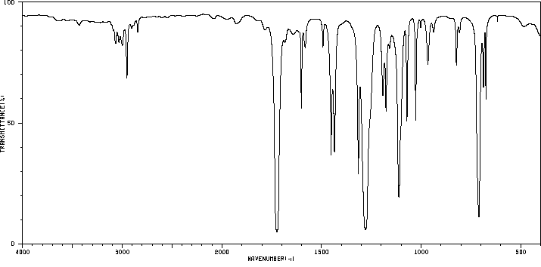
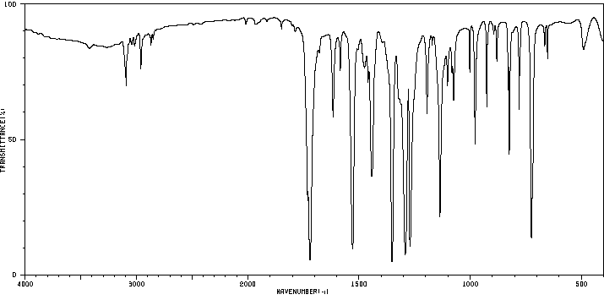
Characterization I
Melting point
Infrared spectrum
  Methyl benzoate
    ν(C=O)=1724 cm⁻¹
    ν(COC)=1112, 1279 cm⁻¹
  Methyl m-nitrobenzoate
    ν(C=O)=1721 cm⁻¹
    ν(COC)=1137, 1293 cm⁻¹
    ν(NO₂)=1352, 1528 cm⁻¹
ν_{s}(COC)
ν(C=O)
ν_{as}(COC)
ν_{s}(COC)
ν(C=O)
ν_{as}(COC)
ν_{s}(NO₂)
ν_{as}(NO₂)

Slide 12
Characterization II
¹H-NMR spectrum
  Aromatic range exhibits
  a singlet, two doublets
  and a triplet (7.2-8.9 ppm)
  Methoxy group at 3.9 ppm
s
d d
t

Slide 13
Characterization III
¹³C-NMR spectrum
  Carbonyl carbon (~166 ppm)
  Aromatic range exhibits
  six signals (124-148 ppm)
  Methoxy group at 52 ppm

Slide 14
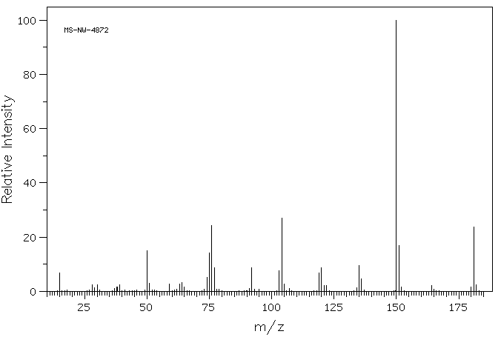
Characterization IV
Mass spectrum (EI)
  m/z=181 ([M]⁺)
  m/z=150 ([M-OCH₃)]⁺)
  m/z=104 ([M-OCH₃-NO₂)]⁺)

