Slide 1
Lecture 10a
Esterification

Slide 2
Introduction
Esters can be obtained by a broad variety of reactions
  Acyl chloride
    Accessibility of SOCl₂
  Anhydride
    Availability of anhydride
  Methyl iodide
    CH₃I is a carcinogen
  Steglich Esterification
    DCC is used as reagent
    4-Dimethylaminopyridine (DMAP)
    as catalyst
    DCU is the thermodynamic sink

Slide 3
Fischer Esterification I
In the lab, a Fischer esterification is used for the synthesis of methyl benzoate
  It uses a carboxylic acid and an alcohol as reactants
  It is cheap method but suffers a low equilibrium constant (typically K_{eq}~1-10, here: 2.3)
  Thus, the reaction requires special considerations to afford decent yields (Le Châtelier Principle)
    Either one or all products have to be removed from equilibrium
    An excess of one the reactants has to be used

Slide 4
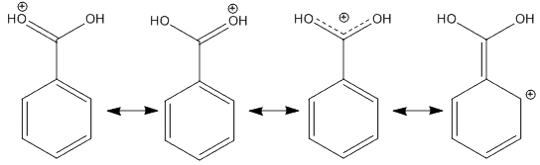
Fischer Esterification II
The reaction in the lab uses an excess of the alcohol
  The alcohol can act as the solvent and as a reactant
  The reaction usually uses an 4-10 fold excess
  The carboxylic acid is a solid and cannot be used in excess here because a heterogeneous reaction mixture would be formed
A very strong mineral acid is used as catalyst
  The carboxylic acid is a weak electrophile ☹
  The mineral acid protonates the carbonyl carbon atom and makes
  it a little bit better electrophile

Slide 5
Fischer Esterification III
Other considerations
  Despite the addition of the catalyst, the rate of the reaction is still very low at room temperature
    Reflux the mixture to increase the rate of the reaction
  Water has to be excluded from the reaction right from the start because it is one of the products
    Very dry reagents (i.e., benzoic acid should be dried under the heating lamp)
    Dry glassware
    Keeping the reagent bottles closed when not in use because absolute methanol and concentrated sulfuric acid are hygroscopic

Slide 6
Experiment I
Dry the benzoic acid thoroughly
Place the benzoic acid and methanol in a 25 mL RBF
Add a few drops of conc. sulfuric acid
Reflux the mixture for 60-75 min
Cool the mixture down
Why is this necessary?
How is this accomplished?
Does the benzoic acid have to dissolve completely?
How many drops of H₂SO₄ are appropriate here?
Why does this imply?
Why is the mixture refluxed for such a long time?
What in the most efficient way here?
What should not be observed here?
By placing it under the heating lamp
NO
4-5 drops
Boiling and a reflux ring
Placing the flask in cold water
A larger amount of a white solid

Slide 7
Experiment II
Add ice-cold water to the reaction mixture
Remove the product
Extract the aqueous layer with diethyl ether
Why is the water added?
How much water is added?
In which container should this step be performed?
In which layer is the product?
Why is the aqueous layer extracted with ether?
How much ether should be used here?
Until a clear phase separation
is observed
Centrifuge tube
Usually the lower layer
ρ(PhCOOMe)=1.09 g/mL (15 ºC)
To collect suspended product
2* 2 mL

Slide 8
Experiment III
Extract the combined organic layers with sodium bicarbonate solution
Dry the organic layer is dried over anhydrous sodium sulfate
Remove the solvent using the rotary evaporator
What does the term combined organic layers refer to?
What is the purpose of this step?
How much solution should be used for each extraction?
How often should this step be repeated?
What is left at this point?
The combination of the product
and the two ethereal extracts
To neutralize the acids (PhCOOH,
H₂SO₄) in the organic layer
2 mL per extraction
Until the CO₂ formation ceases
A small amount of a tan colored oil

Slide 9
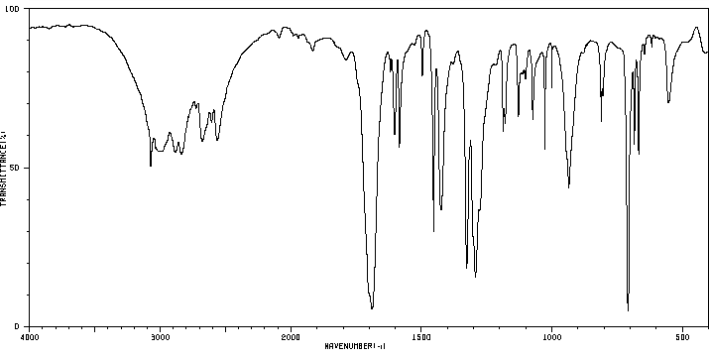
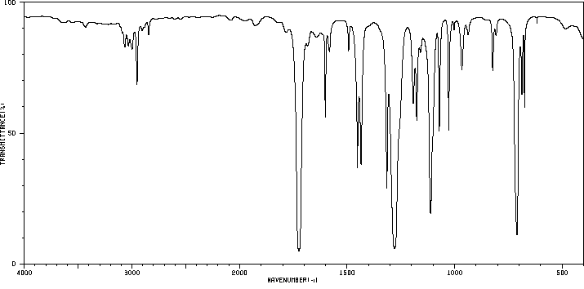
Characterization I
Infrared spectrum
  Benzoic acid
    ν(C=O)=1689 cm⁻¹
    ν(OH)=2300-3300 cm⁻¹
    ν(C-OH)=1294 cm⁻¹
  Methyl benzoate
    ν(C=O)=1724 cm⁻¹
    ν(COC)=1112, 1279 cm⁻¹
    (absence of OH peak!)
ν(OH)
Wet acid
ν(C=O)
ν(C-OH)
ν(C=O)
ν_{s}(COC)
ν_{as}(COC)

Slide 10
Common Mistakes
The benzoic acid is not properly dried
No concentrated sulfuric acid added
Adding of too much concentrated sulfuric acid
The reaction mixture is not properly refluxed
The used glassware that is too large for the quantities handled
Confusion about the layer containing the product
Improper extraction of the benzoic acid
Incomplete removal of methanol

