Slide 1
Lecture 10a
Drugs design

Slide 2
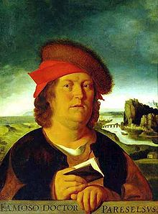
Introduction I
Drug development consideration
  Toxicity: “All substances are poisons; there is none
  that is not a poison. The right dose differentiates a
  poison and a remedy” (Paracelsus, 1538)
  Drug absorption
    Injection: intravenous, intramuscular, subcutaneous
    Inhalation: aerosol (i.e., drugs for the treatment of emphysema, asthma, chronic obstructive pulmonary disease (COPD))
    Insufflation: snorted (i.e.,, psychoactive drugs)
    Oral: needs to pass through the stomach
    Sublingual (i.e., cardiovascular, steroids, barbiturates)
    Transdermal (i.e., lidocaine, estrogen, nicotine, nitroglycerin)
    Rectal (i.e., suppository against fever)

Slide 3
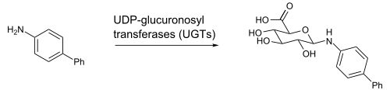
Introduction II
Drug development consideration (cont.)
  Drug distribution
    Blood-brain barrier (BBB)
      Only small molecules pass i.e., water, oxygen, carbon dioxide
      Lipophilic compounds permeate as well, but not polar or ionic compounds (log K_{OW} is important here)
  Drug redistribution and storage
    Body fat
  Drug metabolism and excretion
    Phase I: biotransformation in the liver
    Phase II: conjugation (glucuronic acid)

Slide 4
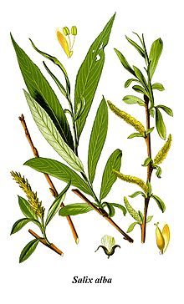
Aspirin I
Salicylic acid
  It was known to reduce fever (Hippocrates, 5th century BC)
  It was isolated from the bark of willow trees
  Problem: It causes nausea and vomiting
Aspirin
  Chemical Name: acetylsalicylic acid
  It was first obtained by Gerhardt in 1853
  The Bayer AG started to promote it as replacement for salicylic acid in 1899
  It is a pro-drug for salicylic acid and generally has less
  side-effects (gastrointestinal bleeding, hives, etc.)

Slide 5
Aspirin II
How does aspirin work?
It transfers an acetyl group to a serine group and suppresses the prostaglandin synthesis

Slide 6
Morphine I
It is used as treatment for dull, consistent pain
It acts by elevating the pain threshold by decreasing
pain awareness
Side effects
  Depression of respiratory center
  Constipation (used in the treatment of diarrhea)
  Excitation
  Euphoria (used in the treatment of terminally ill patients)
  Nausea
  Pupil constriction
  Tolerance and dependence (leads to withdrawal symptoms)

Slide 7
Codeine
The methylation of the phenol function leads to the formation of codeine (morphine: log K_{ow}=0.89, codeine: log K_{ow}=1.19)
The analgesic activity of codeine is only 0.1 % of morphine. But because codeine is converted to morphine by the liver (the OCH₃ group has to be replaced by the phenol group) it becomes 20 % as strong as the latter overall
Thus, the free phenol groups seems to be very important
Codeine is considered a pro-drug of morphine
The greatly reduced initial activity is a result of the stable ether function

Slide 8
6-Acetylmorphine
The modification of the alcohol function in morphine leads to enhanced analgesic activity (4-5 times)
In particularly the acetyl compound (R=CH₃CO) has shown to be much more effective (log K_{ow}=1.55)
  It is less polar than morphine because of the loss of one OH group
  Thus, it can cross lipophilic blood-brain barrier (BBB) better which means that is has a faster onset

Slide 9
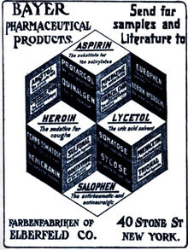
Diacetylmorphine
The acetylation of both OH groups in morphine affords the diacylation product (Heroin, Bayer AG, (1898-1910))
Its analgesic activity compared to morphine only about doubles
It is significantly less polar than morphine (log K_{OW}=2.36) because
it does not possess a free phenol group, but the ester function rapidly hydrolyzed in the brain
Heroin was used as cough suppressant and as non-addictive morphine substitute until it was found that it is habit forming as well

Slide 10
Morphine II
If the NMe group is replaced by a NH function, the analgesic activity will decrease to 25 %, most likely due to the increased polarity of the compound (additional hydrogen bonding)
If the nitrogen atom is missing from the structure, the compound displays no activity at all ☹
The aromatic ring is important as well because without it the compound is inactive as well
The ether bridge does not seem to be important
An extension of the NMe group i.e., NCH₂CH₂Ph group affords a compound that is 14 times more active than morphine itself
An allyl group on the nitrogen (i.e., nalorphine) makes a compound an antagonists which counters morphine’s effect

Slide 11
Morphine III
Important parts of the molecule
  Hydrogen bond
  Certain R-groups for van der Waals interactions
  Ionic interaction
  Chirality center
Unimportant parts
  Ether bridge
  Double bond

Slide 12
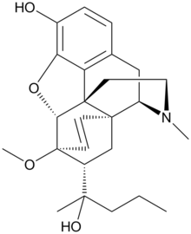
Pharmacophore I
Ultimately, the structure can be reduced to a pharmacophore, which is the “active part” of
a drug involved in the molecular recognition
However, not everything that contains the pharmacophore is active as well
Levorphanol (5x)
Bremazocine (200x)
Etorphine (1000-3000x)
Zero activity!

Slide 13
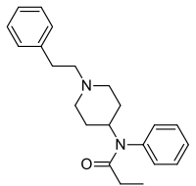

Pharmacophore II
Fentanyl
  It possesses most of the key parts of the morphine family (only missing the OH-group on the benzene ring)
  About 100 times more potent compared to morphine
  Mainly used for anesthesia in operating rooms
3-Methylfentanyl
  About 400-6000 times more potent compared to morphine (cis isomers are more potent than the trans isomers)
  Used as chemical weapon (i.e., 2002 Moscow Theatre Hostage Crisis in which 130 hostages died in a gas attack)

Slide 14
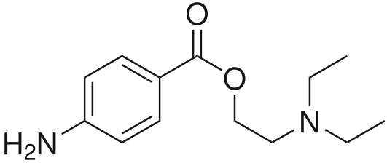
Procaine/Lidocaine
Procaine
  First synthesized in 1905 (A. Einhorn)
  Trade name: Novocain(e)
  Good local anesthetic, used in dentistry
  Short lasting due to the hydrolysis of the ester function (half-life: 40-84 s, log K_{ow}=2.14, pK_{a}=8.05)
Lidocaine
  Ester function replaced by amide function, which is chemically more robust
  Two ortho-methyl group protect the amide from enzymatic degradation (half-life: 1.5-2 hours, log K_{ow}=2.44, pK_{a}=7.90)

Slide 15
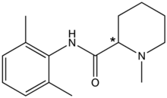
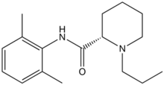

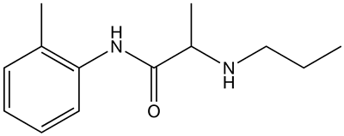
Local anesthetics
  Mepivacaine: local anesthetic, faster onset
  than procaine, (log K_{ow}=1.95, pK_{a}=7.70)
  Ropivacaine: local anesthetic, half-life:
  1.5-6 hours, (log K_{ow}=2.90, pK_{a}=8.07)
  Trimecaine: local anesthetic, half-life:
  1.5 hours, (log K_{ow}=2.41, pK_{a}= ~8)
  Prilocaine: local anesthetic (dentistry),
  half-life: 10-150 minutes, (log K_{ow}=2.11,
  pK_{a}=8.82)

