Slide 1
Lecture 4b
Phase Transfer Oxidation of Benzoin

Slide 2
Introduction I
Oxidation reactions are often carried out using heavy metal compounds i.e., chromium (chromate (VI), PCC), manganese (permanganate, MnO₂), osmium (OsO₄), etc.
Heavy metals are often used in stoichiometric amounts
as well in catalytic systems
Problem: many heavy metals are very toxic and/or carcinogens i.e., Cr(VI), Mn(VII), Os(VIII), etc.
Oxidation with oxygen or more environmentally friendly compounds (i.e., hydrogen peroxide) are known, but often need special catalysts (i.e., MoO₂dtc₂, special forms of alumina, heteropoly acids, etc.)

Slide 3
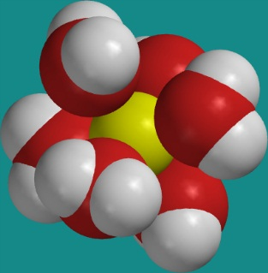
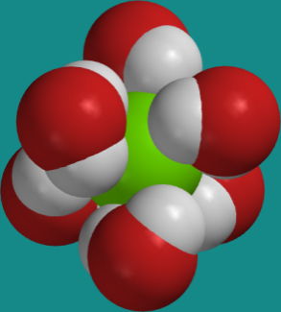
Introduction II
Why are solvents used in chemical reactions?
  They are necessary to bring reactants together
  They reduce the reactivity of charged species i.e., electrophile and nucleophile due to the formation of a solvent cage
  Recall that S_{N}2 reactions proceed much faster in aprotic, polar solvents than in protic solvents because the nucleophile is less solvated in an aprotic solvent
  Problem: aprotic solvents like DMF and DMSO are difficult to dry and also expensive ☹
  One possible solution: Phase Transfer Catalysis Reaction 

Slide 4
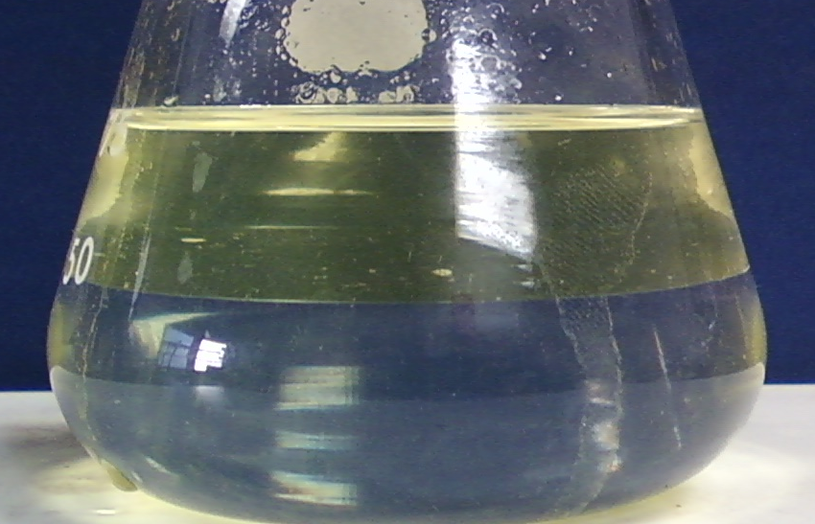
Phase Transfer Reaction I
Mechanism (only species of interest are included here)

Slide 5
Phase Transfer Reaction II
What are the main points of the reaction?
  The oxidant in the reaction is the hypochlorite ion (OCl⁻), which
  is one of the components in household bleach (~5 % solution)
  The ammonium salt transports the hypochlorite ion to the organic layer and the chloride ion back to the aqueous layer
  Only a catalytic amount of the tetrabutylammonium salt (~10 mole %)
  is needed as catalyst in the reaction
  The product (benzil) remains in the organic layer
  A moderately polar solvent i.e., ethyl acetate is used because benzoin
  is polar and does not dissolve in hexane
  The buffer is necessary to reduce side reactions i.e., decomposition and rearrangement of benzil in basic solution, chlorination at low pH-values due to the formation of HOCl
  Proper mixing is very important to ensure an efficient mass transfer

Slide 6

Experimental I
Dissolve the benzoin and the TBHS in ethyl acetate
Mix the bleach and the disodium hydrogen phosphate with water
Combine the two solutions in an Erlenmeyer flask and stir vigorously
Make sure that the hot plate is cold, the flask sealed and properly clamped!
What does the student do if he does not have the enough benzoin?
Why is the mixture stirred vigorously?
Supplement his/her benzoin with
benzoin from lab support

Slide 7
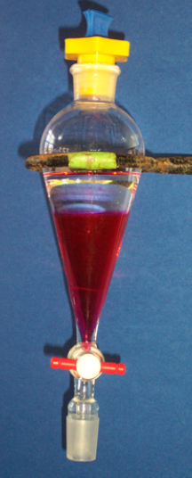
Experimental II
After 60-90 minutes, separate the two layers
Extract the organic layer with saturated sodium bicarbonate solution
Extract the organic layer with water
Dry the organic layer over anhydrous MgSO₄
Use the rotary evaporator to remove the majority of the solvent to a final volume of 4-5 mL
Which observation should the student make here?
Which equipment should be used here?
Purpose?
How much drying agent
is added?
Why is the solvent not removed completely?
Remove the catalyst from
the organic layer
A concentrated solution is needed
for the chromatographic step and
ethyl acetate is used as a solvent
here as well

Slide 8
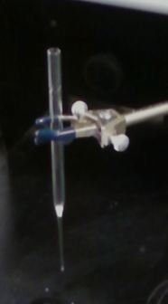
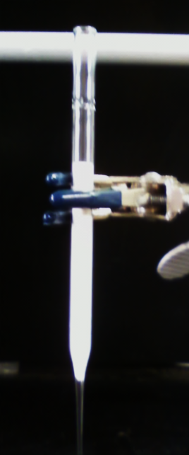
Experimental III
Purification by column chromatography
  Place a small cotton ball in the tip of the pipette
  (smaller than shown in the picture!)
  Add alumina to the pipette (up to ~ 1 cm from
  the top, hint: scoop the alumina in!)
  Clamp a 5.25’’ Pasteur pipette straight and
  securely
  Wet the column with ethyl acetate
  Make sure that there are no cracks or bubbles
  in the column
  When the solvent reaches the top, add the
  sample solution (all of it in small batches!)
1 cm

Slide 9
Experimental IV
As soon as the sample was applied to the column, the fractions should be collected
More ethyl acetate is added to elute the yellow product off the column
The yellow fractions (if the several fractions were collected) are combined and the solvent is completely removed using the rotary evaporator
Why is the solution collected so early?
When should the elution be discontinued?
How can we verify that those are the correct fractions?
To prevent that the target
compound ends up in the
waste container
When the eluent is colorless
because the benzoin also moves
slowly through the column
In this experiment, the color
is used as indicator while later
one would use TLC

Slide 10
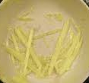
Experimental V
The residue is recrystallized from boiling 95 % ethanol
After the solid is isolated by vacuum filtration, the solid is washed with ice-cold ethanol
Why is 95 % ethanol used here?
How much of it?
How can this be accomplished if
the sample is in the round-bottomed flask at this point?
How much solvent is used here?
How does the final product look like?
The impurity (benzoin) is more polar
than target compound (benzil)
~2 mL
Dissolve the crude in the hot solvent
Transfer the hot solution to a small
beaker
Rinse the round-bottomed flask with
a small amount of the hot solvent

Slide 11
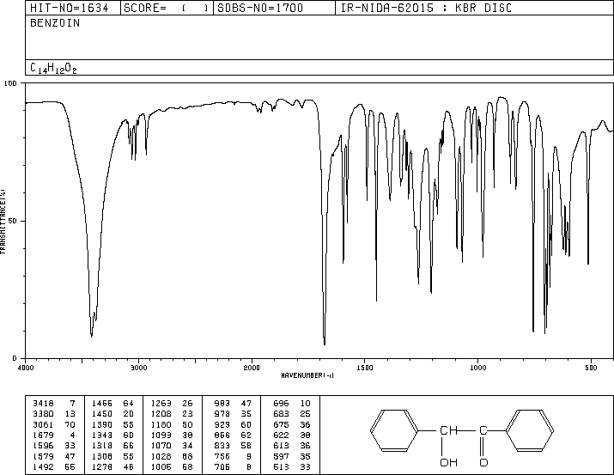
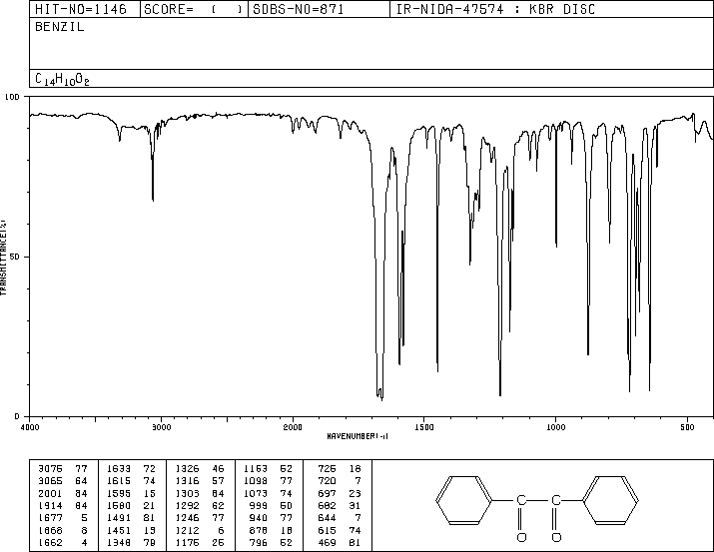
Characterization I
Melting point
HPLC: 1 mg/mL isopropanol
Infrared spectrum
Benzoin
  ν(OH)= 3380, 3418 cm⁻¹
  ν(C=O)= 1679 cm⁻¹
  ν(CH, sp³)= 2935 cm⁻¹
Benzil
  ν(C=O)= 1662 (sym), 1677 (asym) cm⁻¹
  ν_{as}(CCC)= 1212 cm⁻¹
  no ν(OH), ν(CH, sp³)!
  Somewhat also less peaks because of
  higher symmetry
ν(CH, sp³)
ν(OH)
ν(C=O)
ν(C=O)
ν_{as}(CCC)

Slide 12
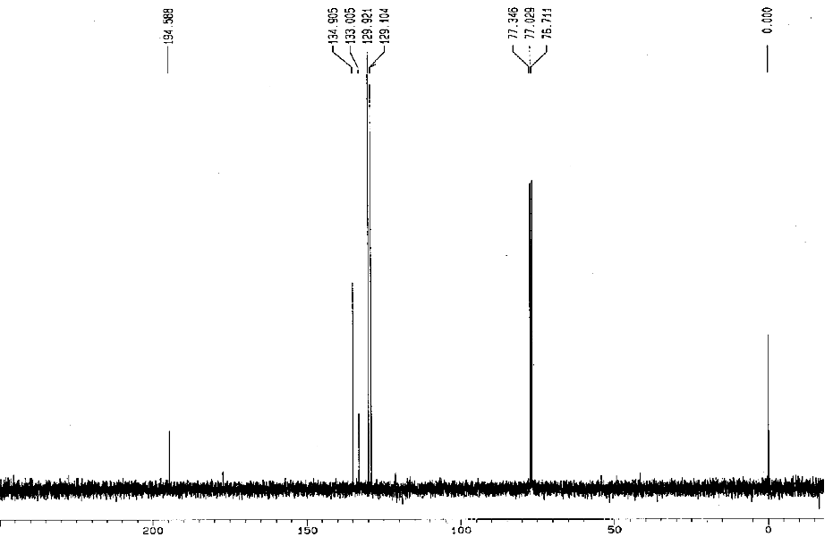
Characterization II
¹³C{¹H}-NMR spectrum
3,4
5
CDCl₃
TMS
1
2

