Slide 1
Lecture 4a
Gas Chromatography

Slide 2
Introduction
Gas chromatography is used in many research labs, industrial labs (quality control), forensic (arson and drug analysis, toxicology, etc.), environmental labs (water, soil, air), and even in the popular TV culture (crime shows like NCIS (Major Mass Spec), CSI, etc.)
  Used for the quantitation of compounds
  Often combined with a mass spectrometer for identification using
  the fragmentation (by comparison with literature spectra)
Traditional equipment requires the use of compounds that are stable enough to be vaporized without decomposition
  Mainly useful for small or non-polar molecules but not for large molecules i.e., proteins, polymers, etc.
  Sometimes polar molecules can be converted into derivatives
  by using i.e., trifluoromethylacetyl groups (F₃CC≡O) to increase
  their volatility

Slide 3
Basic setup
Parts: Injection block, column, oven, detector, carrier gas, computer system
The temperature of the injection block has to be above 200 ºC to ensure
a rapid and complete evaporation of the injected sample
The temperature of the detector has to be 20-30 ºC above the final column temperature to prevent condensation of the compounds

Slide 4
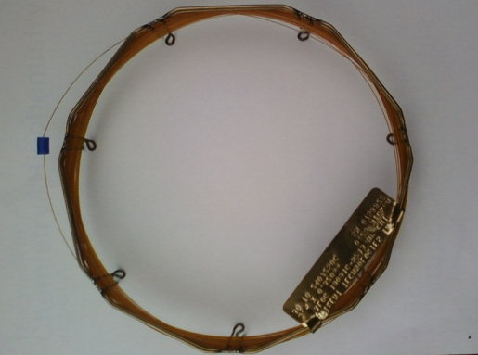
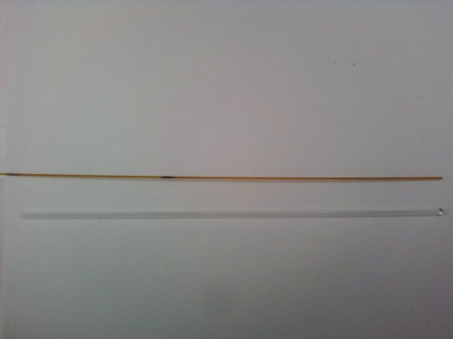
Theory of Gas Chromatography I
The separation of compounds in a mixture is based on different polarities in
a direct (interaction with stationary phase i.e., solubility) or indirect way
(physical properties i.e., boiling point)
The gas chromatography column consists of solid support that is covered with
a high-boiling liquid in a thin capillary tube
In the example above, compound “X” has a higher
affinity towards the stationary phase compared to
compound “O”
Compound “O” elutes before compound “X”
because it displays a lower boiling point and
a weaker interaction with the stationary phase
‖
time
O X

Slide 5
Theory of Gas Chromatography II
What influences the outcome in the GC run?
  The boiling point of the compound
    The higher the boiling point is, the slower the compound is going to migrate through the column resulting in a longer retention time
  The polarity of the compound compared to the polarity of the column
    The stronger the interaction of the compound with the stationary phase is going to be, which increases the
    retention time
  The column temperature
    A lower temperature allows for more interaction of the compound with the stationary phase resulting in longer retention times with improved separation

Slide 6
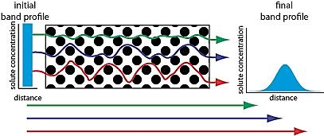
Theory of Gas Chromatography III
  Carrier gas flow rate
    A higher flow rate allows for less interaction of the compound with
    the stationary phase resulting in shorter retention times with poorer separation
  Column length
    A longer retention time with better
    separation will be observed but also
    peak broadening due to increased
    longitudinal diffusion
  Amount of the material injected
    If too much material is injected, close peaks will overlap, which makes the identification (i.e., mass spectrometry) and the quantitation of the compounds more difficult if not impossible
  The conditions have to be adjusted for each separation problem, which will be very difficult if the compounds
  to be separated have similar very properties. The goal
  is to optimize the separation and the retention time for
  a given separation problem.

Slide 7
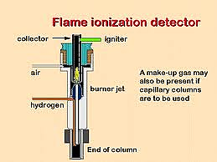
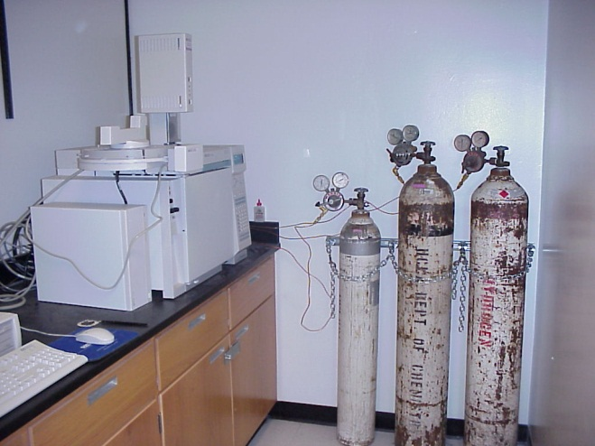
Detectors I
FID (Flame Ionization Detector)
  Advantages:
    It is very sensitive for most organic compounds (1 pg/s, DLL: 0.1 ppm)
    Low sensitivity for small molecules i.e., N₂, CO, CO₂, H₂O
  Disadvantages:
    The sample is destroyed ☹
    It requires three gases (carrier gas (i.e., helium, argon, nitrogen), hydrogen and air/oxygen)

Slide 8
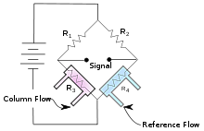
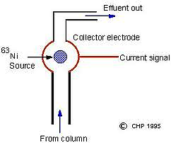
Detectors II
TCD (Thermal Conductivity Detector)
  Advantages:
    The sample is not destroyed and can be collected
    after passing through the column
    Only one gas with a high thermal conductivity
    needed i.e., helium, hydrogen
  Disadvantages:
    The method possesses a significantly lower sensitivity compared to FID
    (usually 2-3 magnitudes, DLL: 10 ppm)
ECD (Electron Capture Detector)
  Advantages:
    It is very sensitive for chlorinated compounds i.e., TCDD,
    PCB, etc. and organometallic compounds (DLL: 0.1 ppb)
  Disadvantages:
    Since a radioactive source is used, a special license and
    area is required for its operation
    Several carrier gases needed for the ionization
    i.e., argon/methane

Slide 9
Sample Identification
Mass spectrometer
Spiking: the sample is run with and without the addition of a spike,
which is an authentic sample of compound to be identified
Original spectrum
Spike B added
If compound A was added as the spike, peak A would increase in area
If the spike that was added to the mixture was not a compound in the mixture, an additional peak would be observed
This method is semi-quantitative
A
B

Slide 10
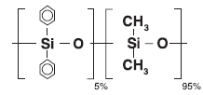
Analysis of Gas Chromatogram I
Complete spectrum (HP-5, weakly polar, achiral)
The GC spectrum is dominated by the solvent peak
The peak for (-)-isoborneol and (+)-borneol are not visible in the full spectrum because of their low concentration (1 mg/mL)

Slide 11
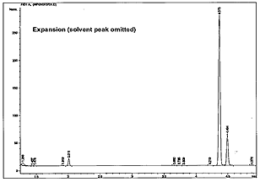
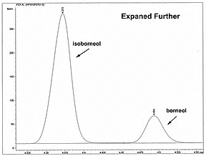
Analysis of Gas Chromatogram II
Expansions
Expanded further

Slide 12
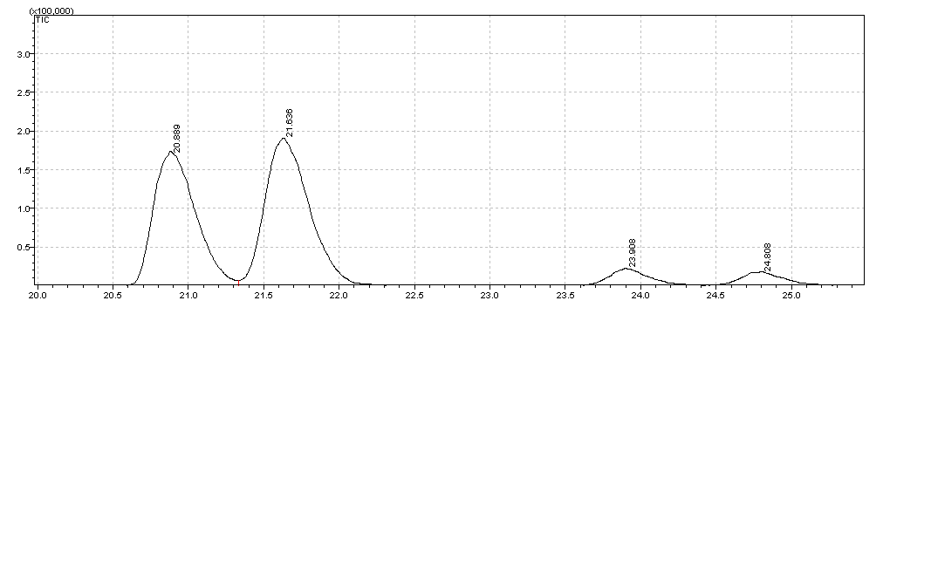
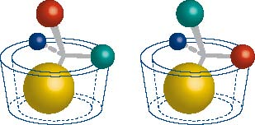
Chiral GC Column
Modified version of β-cyclodextrin (Column: Restek (Rt-bDEXse),
30 m x 0.32 mm x 0.25 mm, Conditions: T_{i}=85 ºC, isothermal)
Peak areas in pairs are identical  racemic
The assignments of the enantiomers were made
on the reduction product of D-(+)-camphor that
yields a mixture of (-)-isoborneol and (+)-borneol
Rt-bDEXse, 30 mx0.32 mmx0.25 mm,
T_{i}=85 ºC, isothermal
Isoborneol
Borneol
(+)-isoborneol (-)-isoborneol
(-)-borneol (+)-borneol

Slide 13
Elution Sequence
Camphor displays the highest vapor pressure of the three compounds at T=158 ºC, a temperature that is close to the average temperature of the GC run (140 to 180 ºC).
Based on the vapor pressures, one can predict an elution sequence at temperatures above T=158 ºC: camphor, isoborneol and borneol
Compound | p(351 K, 78 ºC) | p(431 K, 158 ºC)
camphor | 1.07 mmHg | 25.7 mmHg
isoborneol | 1.68 mmHg | 24.1 mmHg
borneol | 0.30 mmHg | 17.4 mmHg

