Slide 1
Lecture 6c
UV-Vis Spectroscopy

Slide 2
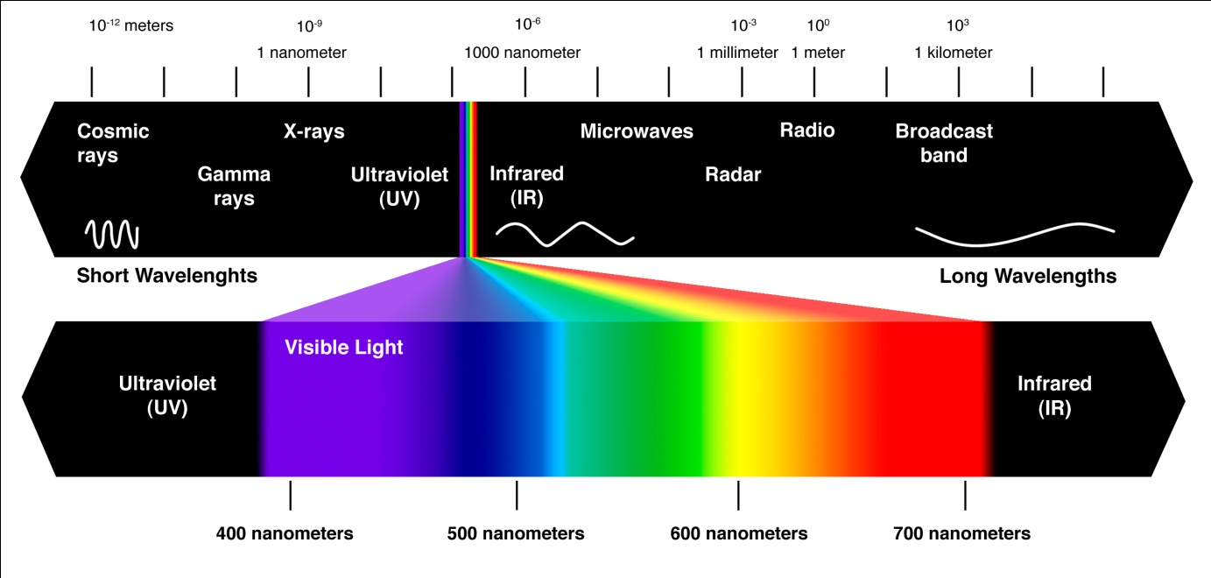
Introduction
Electromagnetic spectrum
Visible range: λ=380-750 nm
Ultra-violet: λ=190-380 nm
High energy
Low energy

Slide 3
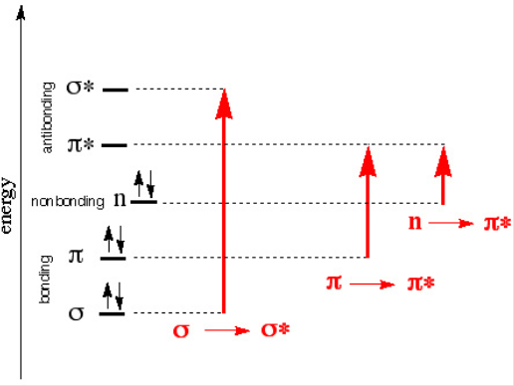
Electronic Transitions
Most molecules absorb electromagnetic radiation in the visible and/or the ultraviolet range
The absorption of electromagnetic radiation causes electrons to be excited, which results in a promotion of an electron from a bonding (σ or π) or
non-bonding orbital (n) to an anti-bonding orbital (σ* or π*)
The larger the energy gap is, the higher the frequency and the shorter the wavelength of the radiation required is (h= Planck’s constant)
Allowed transitions i.e., σ-σ*, π-π* are
usually strong (large ε), while forbidden
transitions (low ε) i.e., n-σ*, n-π* are
much weaker compared to these
Many transition metal compounds are
colored because the d-d transitions fall in
the visible range (note that the d-orbitals
are not shown to keep the diagram simple)
h= 6.626*10⁻³⁴ J*s
c= 3.00*10⁸ m/s

Slide 4
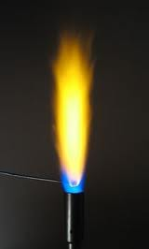
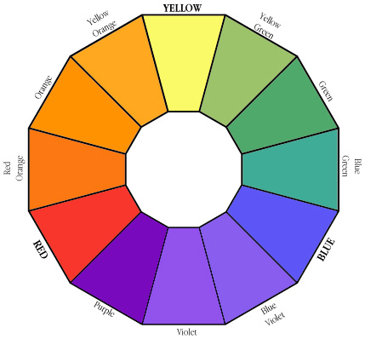
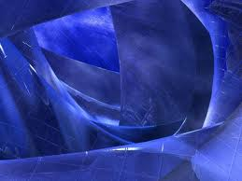
Color Wheel
When determining a color, one has to know if the process that causes the color is due to emission or due to absorption of electromagnetic radiation
Example 1: Sodium atoms emit light at λ=589 nm
resulting in a yellow-orange flame
Example 2: Indigo absorbs light at λ=605 nm which
is in the orange range  the compound assumes the complementary color (blue-purple)

Slide 5
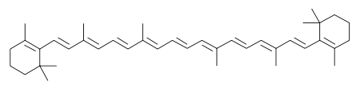
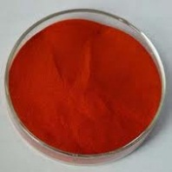
What determines the wavelength?
Compound | λ_{max}(nm) | ε(cm⁻¹*mol⁻¹*L) | Chromophore
1,4-Pentadiene | 178 | 26000 | isolated C=C
2-Pentanone | 180 | 900 | isolated C=O
β-Carotene | 480 | 133000 | conjugated C=C
3-Pentenone | 224 | 12590 | conjugated C=O
Acetophenone | 246 | 9800 | conjugated C=O
Most simple alkenes and ketones absorb in the UV-range because the π−π* and the n-π* energy gaps are quite large
Conjugation causes a bathochromic shift (red shift)
Increased conjugation often also increases the peak size
as well (hyperchromic)

Slide 6
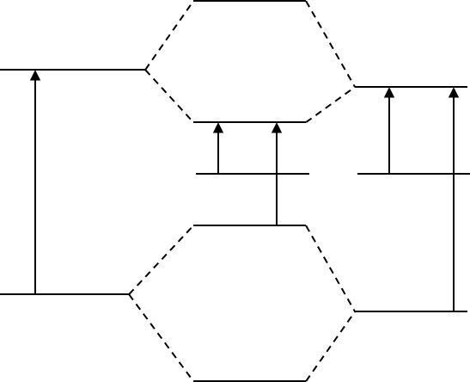
Conjugation
The π-π* energy gap for the C=C bond is large
The π-π* and the n-π* energy gap in a C=O bond are both
relatively large as well
The combination of these two
groups affords a new orbital
set in which n-π* and the
π-π* gaps are much smaller
compared in the isolated bonds
If less energy is required to
excite the electrons, a shift to
higher wavelengths for the
excitation will be observed
i.e., λ(n-π*) > λ(π-π*)
π∗
π∗
π∗
π∗
n
n
π
π
π
π
C=C
C=C-C=O
C=O

Slide 7
UV-Vis Spectrum of TPCP
Tetraphenylcyclopentadienone
Bottom line: The exact peak location (λ) and absolute peak intensity (ε) depend to a certain degree on the solvent used in the measurement
π-π*
330 nm
Solvent | λ(nm) | ε
Methanol | 500 | 1120
 | 331 | 6460
 | 258 | 24500
Dioxane | 504 | 1410
 | 332 | 7080
 | 260 | 26000
Cyclohexane | 512 | 1320
 | 335 | 7100
 | 262 | 27100
n-π*
500 nm
300 nm
600 nm

Slide 8
Beer Lambert Law I
It describes the attenuation of electromagnetic radiation
The cell dimension (l) is usually 1 cm
The ε-value is wavelength dependent  a spectrum is a plot of
the ε-values as the function of the wavelength
The larger the ε-value is, the larger the peak is going to be
The data given in the literature only list the wavelengths and
ε-values (or its log value) of the peak maxima i.e., 331 (6460)
The desirable concentration of the sample is determined by the largest and smallest ε-values of the peaks in the spectral window
to be measured

Slide 9
Beer Lambert Law II
The absorbance readings for the sample have to be in the range from A_{min}=0.1 and A_{max}=1 in order to be reliable
The concentration limitations are due to
  Association at higher concentrations (c>10⁻⁴ M)
  Linear response of the detector in the UV-spectrophotometer
1.0
Absorbance
Linear range
0.1
c_{min}
c_{max}
Concentration

Slide 10
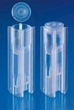
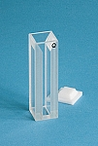
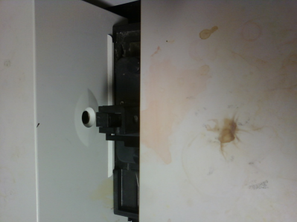
Practical Aspects of UV-Vis I
Cuvette
  It cannot absorb in the measurement window
    Plastic cuvettes absorb more or less in the UV-range already
    Most test tubes (borosilicates) start to absorb around 340 nm
    Quartz cuvettes have a larger optical window but are very expensive (~$100 each)
  It has to be stable towards the solvent and the compound
    Most plastic cuvettes are etched or dissolved by low polarity solvents and can only be used with alcohols or water
    Quartz cuvettes are stable when used with most organic solvents
Polystyrene
Polymethacrylate
Quartz
lamp
detector
Polyethylene
cuvette

Slide 11
Practical Aspects of UV-Vis II
Solvent
Hydrocarbons and alcohols possess the largest optical windows
Note that “spectrograde” solvents should be used whenever possible because many non-spectrograde solvents contain additives i.e., 95 % ethanol contains a lot of aromatics that are active in the UV range
Solvent | lower limit (λ in nm) | Absorbance for l=1 cm
Acetone | 330 | 335 (0.30), 340 (0.08), 350 (0.003)
Acetonitrile | 190 | 200 (0.10), 210 (0.046), 230 (0.009)
Chloroform | 265 | 250 (0.40), 260 (0.05), 270 (0.006)
Cyclohexane | 210 | 210 (0.70), 220 (0.32), 230 (0.11), 240 (0.04)
Dichloromethane | 235 | 230 (1.30), 240 (0.15), 250 (0.02)
Ethanol (abs.) | 210 | 210 (0.70), 220 (0.4), 240 (0.1), 260 (0.009)
Hexane | 210 | 210 (0.30), 220 (0.1), 230 (0.03), 240 (0.016)
Methanol | 210 | 220 (0.22), 230 (0.1), 240 (0.046), 250 (0.02)
Water | 191

Slide 12
Practical Aspects of UV-Vis III
Important pointers
  Since most measurements require a serial dilution, it is imperative that the entire compound is dissolved when preparing the stock solution
  For the calculation of the new concentration, the student needs to keep in mind that the total volume is important
  i.e., if 1 mL of the stock solution was used and 9 mL of additional solvent, the concentration is one tenth of the original concentration
  The student has to run a full spectrum, which requires
  the software to be set to “spectrum” mode and not to
  “fixed wavelength” mode (see pop down window in
  the upper left hand corner)

