Slide 1
Lecture 6b
Diels-Alder Reaction

Slide 2
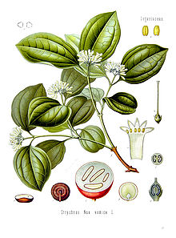
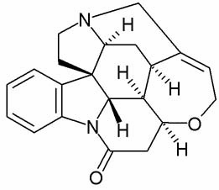
Introduction I
The synthesis of biologically active compounds often
requires many steps because of the complexity of the
molecules i.e., size, stereocenters, etc.
Example 1: Strychnine
  The compound can be isolated from a tree (Strychnos nux vomica) found in Southern Asia and Australia (the seeds
  contain about 1.5 %)
  It was used as drug i.e., stimulant, laxative, etc.
  It was first synthesized by R.B. Woodward in 1954 in 28 steps with six stereocenters and 6*10⁻⁵ % yield. ☹
  An improved synthesis was published in 2000
  (10 steps, 1.4 % yield, ~20,000 higher)
  Today it is mainly used as pesticide (rat killer)
  because it is toxic (30-120 mg deadly!)

Slide 3
Introduction II
The synthesis of complex organic compounds can be accomplished via linear or convergent approach
  Linear approach: many intermediates,
  the yield decreases quickly (example:
  yield for each step 80 %)
  Convergent approach: generally a better yield and there are less intermediates
(0.80)¹⁰=11% overall

Slide 4
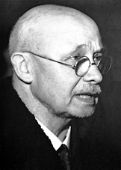
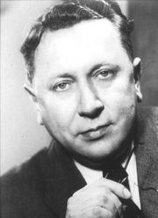
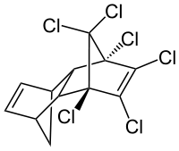
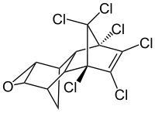
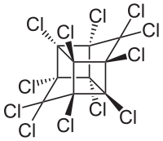
Diels-Alder Reaction (Theory I)
Discovered by Otto Diels and Kurt Alder
in 1928 (Noble Prize in Chemistry, 1950)
It allows to prepare bicyclic compounds
i.e., Aldrin, Dieldrin, Chlordane, Mirex
that were used as insecticides and pesticides
(not anymore because of the high chlorine content)
A diene and a dienophile undergo cycloaddition
  Prototype: butadiene and ethylene (4+2)π-addition
diene dienophile “aromatic TS” cycloadduct

Slide 5
Theory I
The reaction of tetraphenylcyclopentadienone (TPCP) with anthranilic acid and isopentyl nitrite (IPN) affords tetraphenylnaphthalene (TPN)
-H₂O

Slide 6
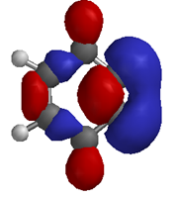
Theory II
First step: Generation of ortho-benzyne
  Ortho-benzyne is very reactive because of a ‘triple bond’
  in a six-membered ring, which results in large ring strain.
  The triple bond demands a 180º angle, which is very
  difficult to accommodate in a six-membered ring
  (benzyne is 395 kJ/mol higher in ΔH_{f} compared to benzene)
  Benzyne is not available commercially and has to be generated in-situ
  All steps until the last one before the
  benzyne formation are reversible
  (diazonium salts can be isolated at
  low temperatures)
  Benzyne acts as the dienophile
  in this Diels-Alder reaction
  It tends to dimerize in the absence
  of a diene

Slide 7
Theory III
Second step: Cycloaddition leads to a bicyclic system
Third step: Retro-Diels-Alder reaction affords TPN
Driving forces for the reaction
  Entropy: three reactant molecules are converted into
  six product molecules, three of them are gases (CO, CO₂ and N₂) ↑
  Enthalpy: the product is highly conjugated and therefore thermodynamically very stable

Slide 8

Experimental I
Dissolve TPCP and anthranilic acid in 1,2-dimethoxyethane in a 10 mL round
bottomed flask
Bring the solution to a gentle boil
Add a solution of isopentyl nitrite (IPN) in 1,2-dimethoxyethane drop wise
Why is 1,2-dimethoxyethane used in the reaction?
Why is it advisable to use a 10 mL round-bottomed flask for the reaction?
Which equipment is needed here?
Which precautions should be taken here?
Which observation should the student make here?
How can the reaction be troubleshot?
Because of its higher boiling point
(85 ºC) and higher polarity
Because of the evolution of gases
Do not breathe the vapors of IPN
1. Heavy foaming due to gas formation
2. Color change from purple to orange
1. Add more isopentyl nitrite
2. Add more anthranilic acid

Slide 9

Experimental II
Reflux the reaction mixture for about 10 minutes
Pour the reaction mixture into a mixture of methanol and water
Isolate the solids using a Büchner funnel and a clean filter flask
Recrystallize the crude product from hot isopropanol
Why is a solvent mixture used here?
Why is a Büchner funnel used here despite the small amount?
Why is a clean filter flask used?
Which observation should the student make here?
To make the two phases miscible
The crude precipitates as a fine
powder which often times clogs
up the filter paper
Often times additional product
precipitates in the filter flask
Very slow dissolution and very slow precipitation….PATIENCE!

Slide 10
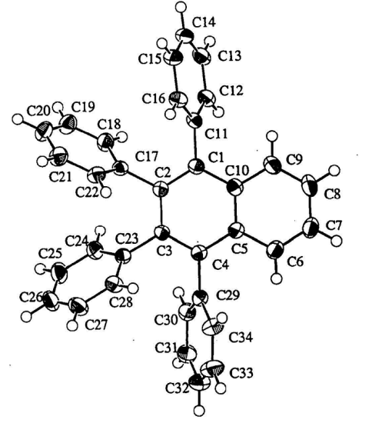
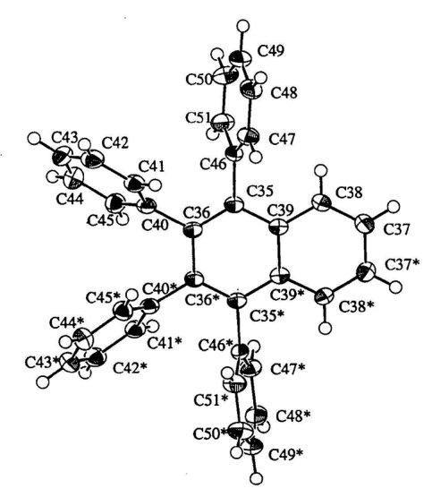
Characterization I
Melting point
  The compound exhibits a double melting point due to polymorphism
  The crystal structure of the compound obtained from isopropanol exhibits two slightly different molecular structures in the crystal that mainly vary by the tilt angles of the phenyl groups (i.e., <(C2-C1-C11-C16)=64.9º, <(C36-C35-C46-C51)= -76º)
  The second melting point is higher because of a more dense packing in the newly formed crystal structure, which is probably due to the better arrangement of the phenyl groups around the naphthalene ring that allows for a more efficient packing
  The double melting point will only be observed if the compound is pure and properly crystallized

Slide 11
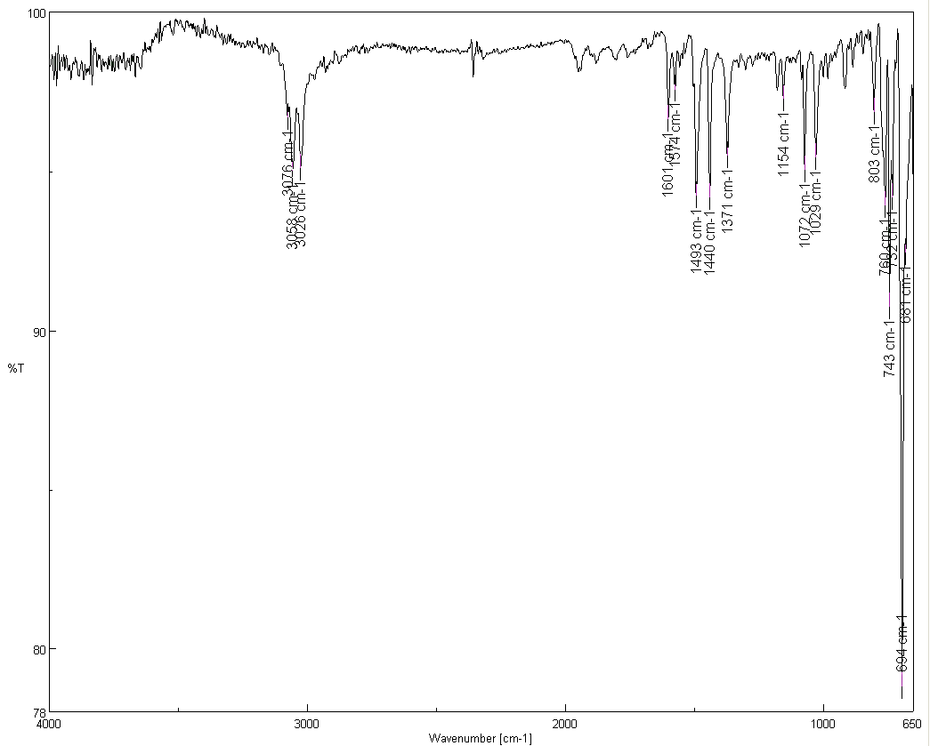
Characterization II
Infrared spectrum
  Despite the large number of atoms in the molecule only a small numbers of peaks is observed due to the high symmetry, most
  of them are weak due to the low polarity
  ν(CH, sp²)=3026, 3058, 3076 cm⁻¹
  ν(C=C)=1493, 1601 cm⁻¹
  OOP (mono-subst. arene)=694, 743 cm⁻¹
ν(CH, sp²)
ν(C=C)
oop

Slide 12
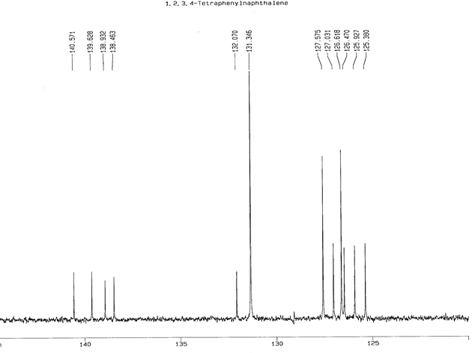
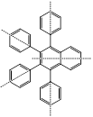
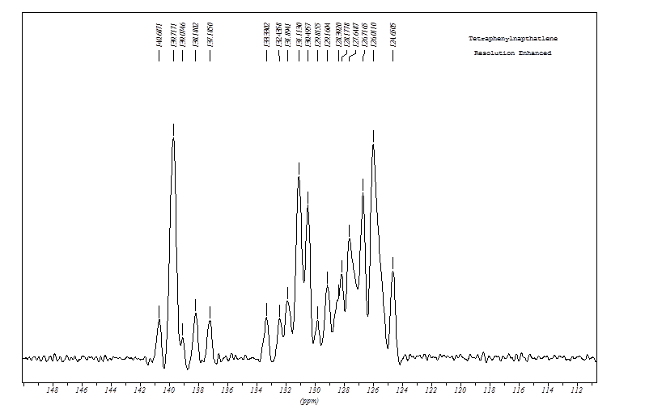
Characterization III
¹³C-NMR spectrum
  In solution: Thirteen signals because
  we assume a free rotation about the
  σ-bonds (marked in red) resulting in
  a high (apparent) degree of symmetry
    Ipso: five small signals (no H-atom)
    Ortho/meta: four large signals (2 each)
    Para/naphthalene: four medium
    signals (1 each)
  In solid: At least seventeen signals
  because of the hindered (slow) rotation
  about the σ-bonds leads to lower
  degree of symmetry in the phenyl rings
  (six signals instead of four signals as
  expected for mono-substituted phenyl
  ring because of the hindered rotation)
Overlap of
two tall signals
overlap of two tall signals

