Slide 1
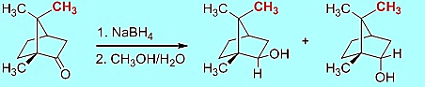
Lecture 3
Reduction of D-(+)-Camphor

Slide 2
Introduction
Reduction of Ketones and Aldehydes
Transfer of either two hydrogen atoms from H_{2,} from an H⁻ and H⁺ or by disproportion
Reactant | Product | Reagent | Name
Ketone | Alkane | Zn/HCl N₂H₄/KOH | Clemmensen Wolff-Kishner
Ketone | Alcohol | H₂/Ni | Raney Nickel
Ketone | Alcohol | Al(OCH(CH₃)₂)₃ | Meerwein-Ponndorf
Ketone | Alcohol | NaBH₄, LiAlH₄
Aldehyde | Alcohol + Acid | KOH | Cannizzaro
Ketone | Diol | Mg-metal hν/(CH₃)₂CHOH | Pinacol Pinacol for aromatic ketones

Slide 3
Mechanism I
In Chem 30BL, sodium borohydride (NaBH₄) will be used as the reducing agent
Driving force for reaction is the formation of a very strong B-O bond
vs. the π-bond of the carbonyl group and the B-H bond as well as the formation of a new σ(C-H) and a new O-H bond.
The light elements of group 3 often form compounds that possess a
partial double bond character in the E-X bond, if X has one or more
lone pairs i.e., N, O, F, etc.

Slide 4
Mechanism II
Ultimately, two hydrogen atoms are added to the ketone: one originates from the hydride (:H⁻), which forms the C-H function, and the other one from the protic solvent (H⁺) that leads to the formation of the hydroxyl function

Slide 5
Mechanism (Stereochemistry I)
The reduction of 2-pentanone affords a racemic mixture of 2-pentanol because the activation energies (ΔG‡) for the two alternate pathways are identical
The reduction of D-(+)-camphor affords a mixture of two diastereomeric alcohols. The exo product (=(-)-isoborneol) is formed in larger quantity compared to the endo product (=(+)-borneol) because the activation energy for the formation of the exo product is lower

Slide 6
Mechanism (Stereochemistry II)
The stereochemistry of the reaction can be explained using HOMO-LUMO concept
  The hydride is the nucleophile in the reaction which provides
  the electrons for the newly formed C-H bond
  The carbonyl group is the electrophile in the reaction and therefore has to provide an empty orbital for the reaction (π*(C=O), LUMO)
100-120º

Slide 7
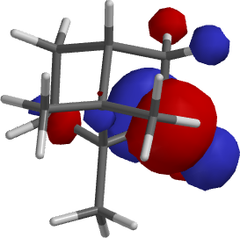
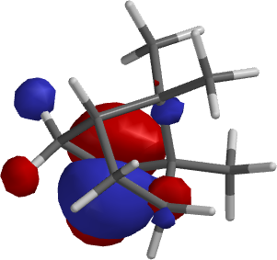
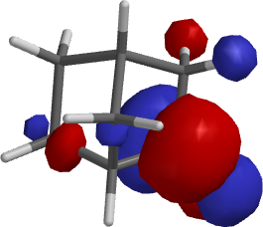
Mechanism (Stereochemistry III)
Exo approach Endo approach Exo approach
Bottom line:
  Camphor: exo approach is sterically more hindered resulting in
  a higher activation energy for this pathway and a lower quantity
  of the endo product (=borneol)
  2-norbornanone: the exo approach is less hindered resulting in
  the endo product as major product
camphor
camphor
2-norbornanone

Slide 8
Mechanism (Stereochemistry IV)
The stereoselectivity for the reaction would be higher
  if the R-group on the side of the carbonyl function was increased in size
  if the size of the nucleophile was increased
  if the reaction temperature was lowered
Reducing agent | 2-Norbornanone (endo product) | Camphor (exo product)
NaBH₄ | 86 % | 86 %
LiAlH₄ | 89 % | 92 %
LiAlH(OMe)₃ | 98 % | 99 %
LiBH(n-Bu)₃ | 98 % | 98 %
LiBH(sec-Bu)₃ | 99.6 % | 99 %
LiBH(iso-amyl)₃ | >99.5 % | 99.3 %

Slide 9
Experimental Design
Choice of Reducing Agent
  LiAlH₄ : leads to higher stereoselectivity, more reactive (can even be pyrophoric); requires very dry diethyl ether or very dry tetrahydrofuran as a solvent 
  NaBH₄ : lower degree of stereoselectivity but much safer but strong enough of
  a reducing reagent to reduce the ketone 
Choice of Solvent
  NaBH₄: moderately soluble in water, insoluble in diethyl ether
  Camphor: very poorly soluble in water (0.1 g/100 mL), well soluble in diethyl ether
  The solvent choice is a compromise in terms of polarity: methanol dissolves both
  compounds reasonably well (NaBH₄: 13 g/100 mL, camphor: 63.1 g/100 mL)
  Problem: Sodium borohydride reacts with protic solvents 
  Solution
    A large excess of the reducing agent is used to ensure the complete reduction of
    the camphor✓
    Camphor is dissolved in a small amount of methanol before the NaBH₄ is added,
    which takes advantage of the fact the reduction of the camphor is faster than
    hydrolysis of NaBH₄✓

Slide 10
Experiment I
Dissolve the camphor in a small amount of methanol in a 25 mL Erlenmeyer flask
Add the sodium borohydride in three portions
Bring the suspension to a gentle boil
After the reaction is completed, place the solution in a cold water bath
Add ice-cold water to the reaction mixture
Isolate the solid using vacuum filtration
Suck air through the solid for at least 10 minutes
What is the setup here?
Why?
Why is water added?
Why is air sucked through the solid?
Watch glass with ice
Boiling stick of
appropriate length
To have better control over the reaction
during the addition of the water
To complete the hydrolysis and
to precipitate the organic compounds
(1.2 mg/mL borneol in water at 25 ºC)
To remove the bulk of the water from
the solid

Slide 11
Experiment II
Dissolve the solid in a small amount of diethyl ether
Add a small amount of drying agent (MgSO₄)
Remove the drying agent
Extract the drying agent with a small amount of diethyl ether
Remove the solvent using the rotary evaporator
Why is the solid dissolved again?
What are you looking for here?
How is accomplished?
Why is this step necessary?
Why is the drying agent removed?
Why is the rotary evaporator used?
How this piece of equipment work?
In order to dry it
1. Some free flowing drying agent
2. A transparent solution
To recover some of the adsorbed product
1. The drying process is reversible
2. The product and the drying agents are both white solids which makes it impossible to separate them later
See video for details

Slide 12
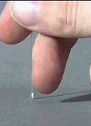
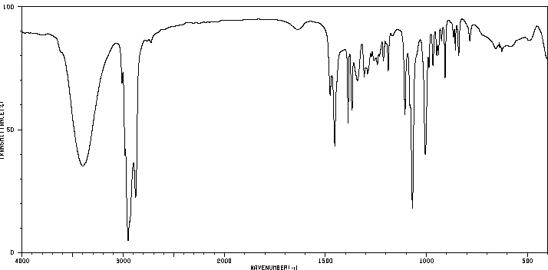
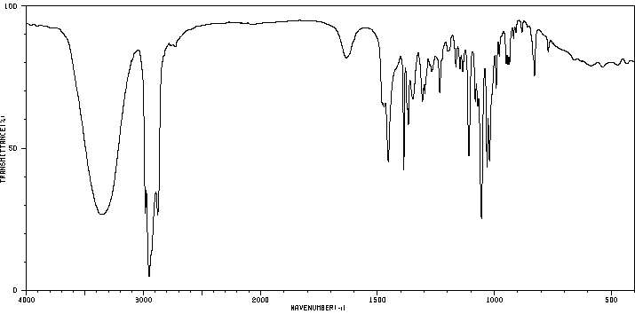
Characterization I
Melting point (~ 1 mm in melting point capillary)
  Too much sample will result in a broader melting point range
Infrared spectrum
Isoborneol (KBr):
  ν(OH)=3398 cm⁻¹
  (broad peak)
  ν(C-OH)=1069 cm⁻¹
  (strong)
  ν(C=O)=1744 cm⁻¹
  is absent!
Borneol (KBr):
  ν(OH)=3352 cm⁻¹
  (broad peak)
  ν(C-OH)=1055 cm⁻¹
  (strong)
ν(C=O)
ν(OH)
Isoborneol
ν(C-OH)
ν(OH)
Borneol
ν(C-OH)

Slide 13
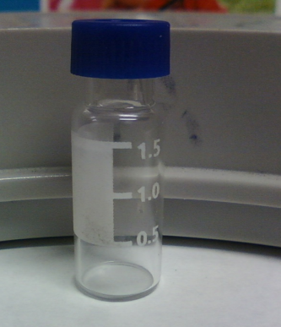
Characterization II
Gas chromatography
  Prepare a solution of the final product in diethyl ether
  (conc: ~1 mg/mL)
  Fill the GC vial to the 1.5 mL mark
  Close the vial with a cap and submit into tray
  The sample cannot contain any undissolved solids or
  water because they will cause significant problems
  during the data acquisition
  Sign the sample in on the sign-in sheet: student name
  and code on the vial (make sure not to remove it).
  Do not forget to record the code in your notebook
  as well.
  Samples that are not signed in will not be run!
  Pick up the printout in YH 3077E during the afternoon
  of the next day

Slide 14
Polarimetry I
Optical activity was discovered by E.L. Malus (1808)
Chiral molecules rotate the plane of polarization of polarized light
The specific optical rotation is a physical property like a melting point or boiling point
Compound | [α]_{D} (in º)
(1R)-(+)-Camphor | +44.26
Sucrose | +66.47
Cholesterol | -31.50
Morphine | -132.00
(-)-TADDOL | -65.50
L-Proline (in water) | -84.00
(S,S)-Jacobsen catalyst | +1175.00

Slide 15
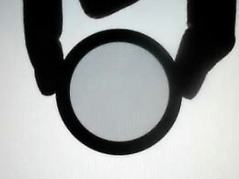


Polarimetry II
How does it work?
  Polarized lenses are used in expensive sunglasses, photo
  lenses, etc. to reduce glare and reflections from surfaces
  Monochromatic light is polarized by a Nicol prism (polarizer)
  The plane-polarized light passes through a polarimetry cell in which
  the plane of the light will be rotated if the cells contains a chiral compound
  The analyzer at the end of the setup rotates the plane of the light back
  to its original orientation
Polarizer
Analyte
Analyzer

Slide 16
Polarimetry III
The value of the optical rotation (a) depends on the wavelength
(the subscript “D” refers to λ=589.3 nm), the path length (l), the concentration (c) and the specific optical rotation for the specific enantiomer and to a lesser degree on the temperature (X)
The sign of the optical rotation is independent from the absolute configuration!
The sign and absolute value can depend on the solvent because
the observer might look at different compounds i.e., cation, anion
or neutral specie for amino acids.
The specific rotation can be used to assess the optical purity of a chiral compound by comparing it with published data

Slide 17
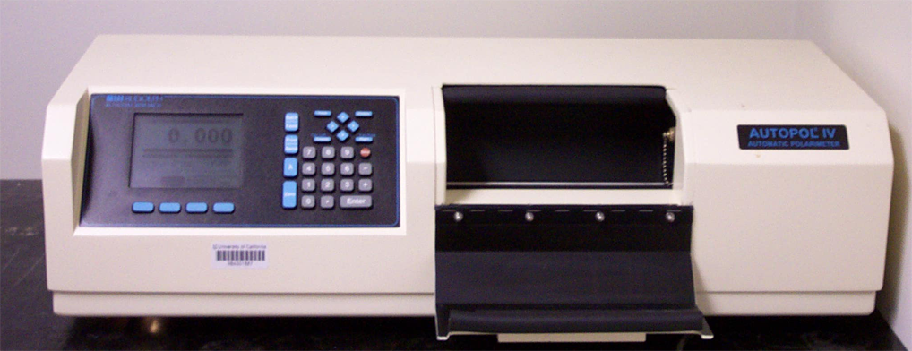
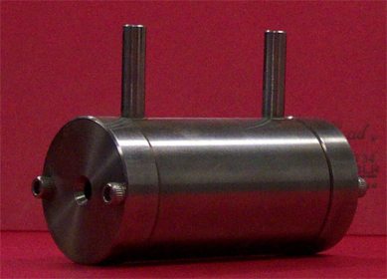
Polarimetry IV
Polarimeter (located in YH 1096 for Chem 30BL)
Concentration: ~1 % in 95 % ethanol (the exact concentration in g/mL has to be known)
It is important that there are no air bubbles in the path of the light because they will cause problems in the measurement (i.e., dark sample error)
The ratio of (-)-isoborneol and (+)-borneol can be calculated by
α_{obs}=x(-34.6º)+(1-x)(+37.7º)
α_{obs}=specific optical rotation of the sample after concentration correction
x =the mole fraction of isoborneol in the sample
[α]_{D}= +37.7º for (+)-borneol and [α]_{D}= -34.6º for (-)-isoborneol

Slide 18
Polarimetry V
What influences the result in the polarimetry measurement?
  The concentration of the sample
  A wet sample will yield a less negative value because the concentration is less than assumed, which results in a lower reading for the sample
  The presence of unreacted camphor ([α]_{D}= +44.26º )
  The ratio of the (-)-isoborneol and (+)-borneol i.e., a 80:20 mixture should result in a value of [α]= ~ -20º after the concentration correction

