Slide 1
Lecture 9a
Polarity

Slide 2
Why this discussion?
Polarity is one of the key concepts to understand the trends observed in many techniques used in many laboratory courses:
  Physical Properties: melting point, boiling point,
  viscosity, solubility, dielectric
  Chromatography: thin-layer chromatography,
  column chromatography, HPLC, gas chromatography
  Chemical Properties: nucleophile, electrophile,
  acidity, reactivity
  Spectroscopy: Infrared, NMR, UV-Vis

Slide 3
What determines Polarity?
The atoms that are involved in the bonds:
  Polarity is only observed in bonds formed by two atoms exhibiting a significant difference in electronegativity (or hybridization).
C-C C-H C-O C-F
EN 2.5 2.5 2.5 2.1 2.5 3.5 2.5 4.0
ΔEN 0 0.4 1.0 1.5
Polar no weakly medium very

Slide 4
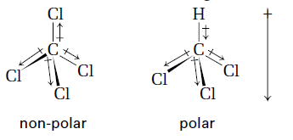
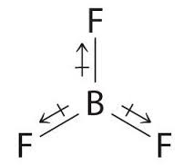
What determines Polarity?
The structure of the molecule:
  A molecule can have polar bonds but is non-polar
  (i.e., CCl₄, CF₄, BF₃, CO₂) overall because the molecule
  is symmetric  the individual dipole moments cancel
  each other in a perfectly symmetric structure like a tetrahedron, trigonal planar or linear arrangement.
  An asymmetric molecule with polar bonds will be polar overall (i.e., CO, H₂O, CHCl₃) particularly if it contains one or more lone pairs.

Slide 5
Intermolecular Forces
Ion-Dipole
Increase in bond strength
Hydrogen Bonding
Dipole-Dipole
London Dispersion

Slide 6
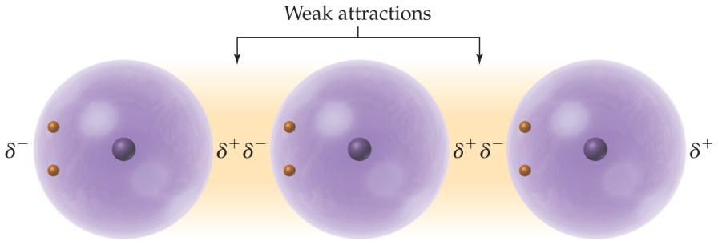
London Dispersion Forces
London Dispersion Forces
  They are found in every molecule
  independent from its polarity because
  a small induced dipole can be formed
  at any time in any molecule.
  The magnitude is about 0-4 kJ/mol for small atoms and small molecules
  (i.e., methane), larger for large molecules (i.e., 1,2,3,4-tetraphenylnaphthalene).
  They grow with the number of electrons and with
  the size/surface area of the molecule (AM1):
    Within a homologous series, larger molecules
    have higher boiling points than small molecules
    i.e., hexane (b.p.=69 ºC, 153.3 Å²), heptane
    (b.p.=98 ºC, 173.4 Å²), octane (b.p.=126 ºC,
    193.5 Å²) (green triangles).
    Linear molecules have higher boiling points than branched molecules
    i.e., hexane (b.p.=69 ºC, 153.3 Å²), 2-methylpentane (b.p.=60 ºC, 151.0 Å²),
    2,3-dimethylbutane (b.p.=58 ºC, 146.9 Å²), 2,2-dimethylbutane (b.p.=50 ºC,
    146.5 Å²) (red squares).
Helium

Slide 7
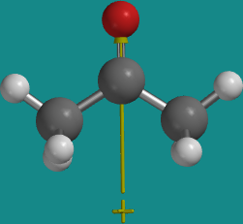
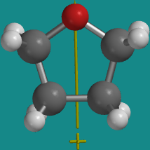
Dipole-Dipole Interaction
A dipole is defined by the product of charge being separated and the distance: the larger the charge is being separated and the distance, the larger the dipole moment is for the compound (measured in Debye) i.e., different isomers of disubstituted benzene rings with donor-acceptor substitution.
Dipole-dipole interaction are only found between molecules that possess
a permanent dipole moment.
The strength of this interaction depends on the individual dipoles involved and ranges typically from 2-10 kJ/mol.
Compounds like acetone (m.p.= -95 ºC, b.p.=56 ºC, μ=2.88 D)
or tetrahydrofuran (m.p.= -108 ºC, b.p.=66 ºC, μ=1.74 D) possess
dipole moments because they contain an oxygen atom, which leads
to a charge separation.
Compared to the corresponding hydrocarbons of similar mass
(i.e., acetone: iso-butane (m.p.= -160 ºC, b.p.= -12 ºC, μ=0.132 D),
tetrahydrofuran: cyclopentane (m.p.= -94 ºC, b.p.=49 ºC, μ=0 D),
these compounds exhibit a significantly higher boiling point.
Why is the dipole moment larger for acetone than for tetrahydrofuran?

Slide 8
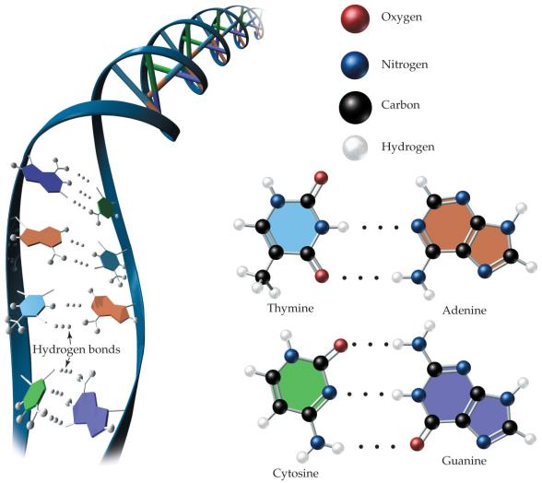
Hydrogen Bonding
Hydrogen bonding is found in compounds in which the hydrogen atom is directly bonded to nitrogen, oxygen or fluorine.
This bond mode is comparably strong (10-40 kJ/mol):
  Many biological systems use this
  bond mode to stabilize a specific
  structure (i.e., DNA base pairing).
  Thymine forms two hydrogen bonds
  with adenine while cytosine forms
  three hydrogen bonds with guanine.

Slide 9
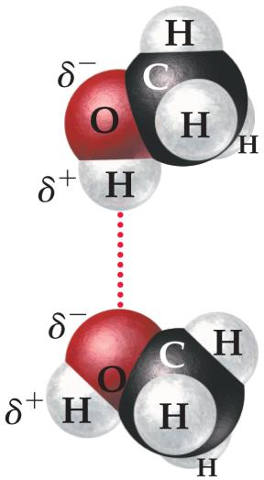
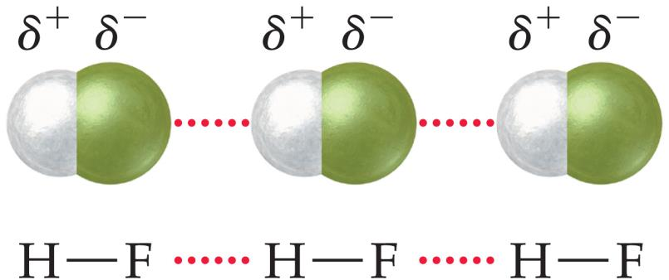
Hydrogen Bonding
  The relatively high boiling points of alcohols (i.e., methanol (64 ºC)) and carboxylic acids (i.e., formic acid (100.8 ºC)) can also be attributed to this bond mode as well i.e., dimers for benzoic acid (b.p.: 249 ºC).
Group 14 | Group 15 | Group 16 | Group 17
CH₄ (-161 ºC) | NH₃ (-33 ºC) | H₂O (100 ºC) | HF (20 ºC)
SiH₄ (-112 ºC) | PH₃ (-88 ºC) | H₂S (-60 ºC) | HCl (-85 ºC)
GeH₄ (-88 ºC) | AsH₃ (-62 ºC) | H₂Se (-41 ºC) | HBr (-67 ºC)
SnH₄ (-52 ºC) | SbH₃ (-17 ºC) | H₂Te (-2 ºC) | HI (-35 ºC)

Slide 10
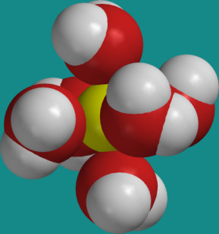
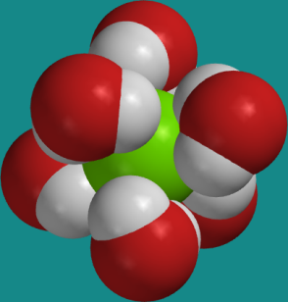
Ion-Dipole Interaction
Even though this the strongest of the non-covalent forces that are discussed here (40-80 kJ/mol), it is still much weaker than most covalent bonds (i.e., C-C ~350 kJ/mol).
It is observed when an ionic compound is solvated
i.e., sodium chloride in water:
  The oxygen atom of water interacts with
  the Na⁺-ion while the hydrogen atoms
  interact with the Cl⁻ -ion.
  This interaction is very important in the explanation why sodium chloride dissolve in water but not in hexane.
  The strength of the ion-dipole interaction can also be used to
  explain why the boiling point increases when salts are dissolved
  in water (colligative properties).

Slide 11
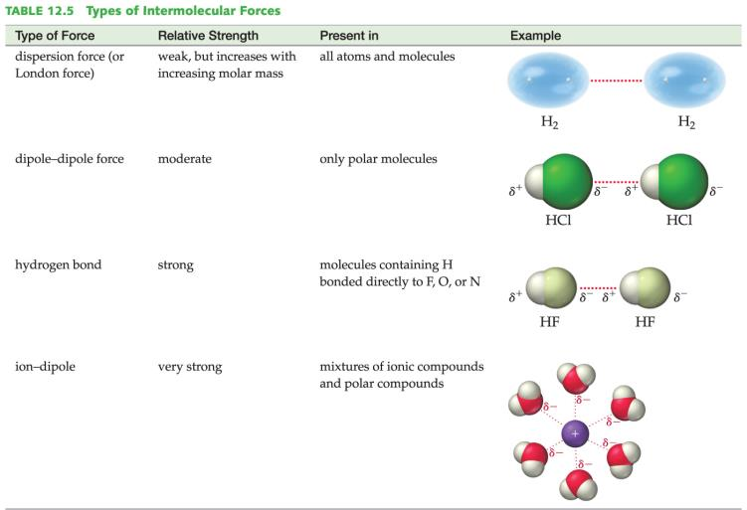
Summary of Intermolecular Forces

Slide 12
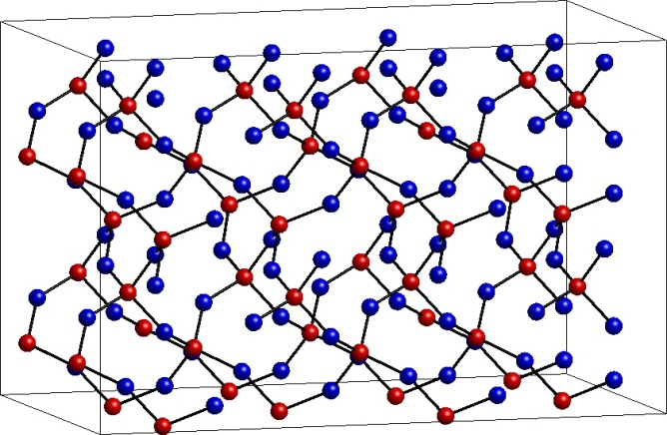
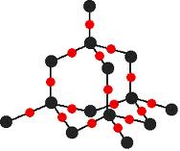
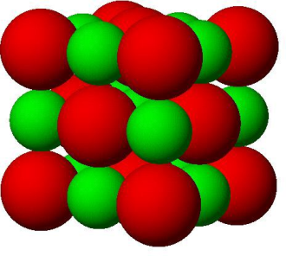
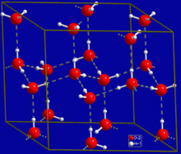
Physical Properties I
  Melting Point (Effect of Intermolecular Forces)
  Compounds with covalent network structures have
  very high melting points i.e., silicon dioxide (~1700 ºC), aluminum oxide (2072 ºC), tungsten carbide (2870 ºC).
  Ionic Compounds also exhibit very high melting points
  i.e., sodium chloride (801 ºC), sodium sulfate (884 ºC), magnesium sulfate (1124 ºC).
  Covalent Compounds:
    Hydrogen Bonding: water (0 ºC), acetic acid (16 ºC),
    phenol (41 ºC), benzoin (137 ºC), benzopinacol (181 ºC), isoborneol (212 ºC), dihydropyrimidinones (~200 ºC), hymecromone (194 ºC)
    Dipole-Dipole: tetrahydrofuran (-108 ºC), acetone (-93 ºC),
    ethyl acetate (-84 ºC), benzophenone (49 ºC), benzil (95 ºC), camphor (176 ºC), tetraphenylcyclopentadienone (218 ºC)
    London Dispersion: pentane (-130 ºC), hexane (-95 ºC),
    benzene (5 ºC), camphene (52 ºC), naphthalene (80 ºC),
    1,2,3,4-tetraphenylnaphthalene (196 ºC), anthracene
    (C₁₄H₁₀, 218 ºC), tetracene (C₁₈H₁₂, 357 ºC)

Slide 13
Physical Properties II
Melting Point (Symmetry)
  Symmetric organic compounds exhibit a higher melting point than
  non-symmetric molecules (Carnelley Rule, 1882).
  This observation is counterintuitive because in the case of a symmetric substitution the most symmetric compound would exhibit the lowest dipole moment if X=Y!
  Symmetric molecules can be packed more efficiently, which results
  in stronger intermolecular forces in the lattice and a lower entropy
  in the solid.
Compound | ortho | μ(D) | meta | μ(D) | para | μ(D)
difluorobenzene | -34.0 | 2.46 | -59.0 | 1.51 | -13.0 | 0.00
dichlorobenzene | -16.7 | 2.50 | -26.3 | 1.72 | 54.0 | 0.003
dibromobenzene | 6.7 | 2.12 | - 7.2 | 1.44 | 87.2 | 0.001
diiodobenzene | 26.7 | 1.70 | 35.4 | 1.27 | 129.2 | 0.00
dimethylbenzene | -27.9 | 0.64 | -49.4 | 0.30 | 13.3 | 0.07
dinitrobenzene | 116.0 | 6.48 | 90.0 | 3.75 | 172.0 | 0.78

Slide 14
Physical Properties III
Melting Point (Intramolecular Hydrogen Bonds)
If intramolecular hydrogen bonds can be formed, the effect will be observed the strongest
in the ortho-isomer i.e., X= -NO₂, -CHO, -COCH₃, -COOCH₃.
Compounds that can form intermolecular hydrogen bonds have higher melting points and boiling points than compounds that cannot i.e., p-hydroxyacetophenone (147 ºC, 330 ºC)
vs. p-methoxyacetophenone (37 ºC, 256 ºC), p-nitrophenol (114 ºC, 279 ºC) vs. p-nitroanisole (53 ºC, 260 ºC), etc.
If intra- or intermolecular hydrogen bonds are not observed, the boiling points of the
different isomers will be very similar i.e., methoxybenzaldehydes (ortho: 238 ºC, meta: 235 ºC, para: 248 ºC), methoxyacetophenones (ortho: 245 ºC, meta: 240 ºC, para: 256 ºC), etc.
X-C₆H₄-Y | Ortho (m.p., b.p.) | Meta (m.p., b.p.) | Para (m.p., b.p.)
X=Cl, Y=OH | 8 ºC, 176 ºC | 34 ºC, 214 ºC | 44 ºC, 220 ºC
X=Br, Y=OH | 5 ºC, 195 ºC | 30 ºC, 236 ºC | 66 ºC, 238 ºC
X=NO₂, Y=OH | 44 ºC, 215 ºC | 97 ºC, 280 ºC | 114 ºC, 279 ºC
X=CH₃, Y=OH | 30 ºC, 191 ºC | 9 ºC, 202 ºC | 33 ºC, 202 ºC
X=Cl, Y=OCH₃ | -27 ºC, 199 ºC | XXX, 194 ºC | -18 ºC, 198 ºC
X=CHO, Y=OH | -7 ºC, 197 ºC | 101 ºC, 290 ºC | 114 ºC, 310 ºC
X=COCH₃, Y=OH | 4 ºC, 218 ºC | 94 ºC, 296 ºC | 147 ºC, 330 ºC
X=COOCH₃, Y=OH | -8.5 ºC, 222 ºC | 69 ºC, 280 ºC | 128 ºC, 280 ºC

Slide 15
Physical Properties IV
Solubility
“Like-dissolves-like”
  Non-polar molecules dissolve well in non-polar solvents like hexane, toluene, petroleum ethers, etc.
  Polar molecules dissolve in polar solvents like acetone, alcohols, water, DMF, DMSO, etc.
  The main reason is the strength of the bonds between the solvent and
  the solute molecules because this part of the dissolution process determines the degree of the exothermic character of the process overall.
  Many solutes that form strong hydrogen bonds with the solvent dissolve exothermically i.e., concentrated sulfuric acid, sodium hydroxide, ammonia, hydrochloric acid, etc.
  Hence, the procedure to dissolves these compounds in water asks to add them to water and not the other way around.

Slide 16
Physical Properties V
Example: Nitrophenols
  The ortho isomer dissolves well in non-polar and weakly
  polar solvents (i.e., benzene, diethyl ether) but significantly
  less in polar solvents (i.e., ethanol):
    It displays the smallest dipole moment of the isomers because
    the proximity of the groups.
    It forms an intramolecular hydrogen bond between the nitro group and the phenol
    function which reduces its ability to form intermolecular H-bonds.
  The para and the meta isomers dissolve poorly in non-polar solvents but better in more polar solvents that are able to form hydrogen bonds:
    The display a larger dipole moment and no intramolecular
    hydrogen bonds, which allows for hydrogen bonds with
    protic solvents i.e., diethyl ether, acetone, ethanol.
Isomer | Dipole moment | Water | Ethanol | Acetone | Diethyl ether | Benzene
ortho | 3.22 | 0.17²⁵, 1.08¹⁰⁰ | 10.2⁰, 200³⁴ | 102⁰, 566³⁰ | 38¹, 916³⁷ | 46⁰, 874⁴⁰
meta | 3.90 | 0.7¹⁰, 3.0⁴⁰ | 117¹, 1106⁸⁵ | 169⁰, 1306⁸⁴ | 106^{0.2}, 179⁴⁰ | 0.63⁶, 571⁸⁵
para | 5.09 | 1.18²⁵, 6.0⁵⁰ | 116⁰, 1017⁹⁰ | 188⁰, 1193⁹⁷ | 110¹, 149³⁸ | 0.65⁸, 62⁸⁵

Slide 17
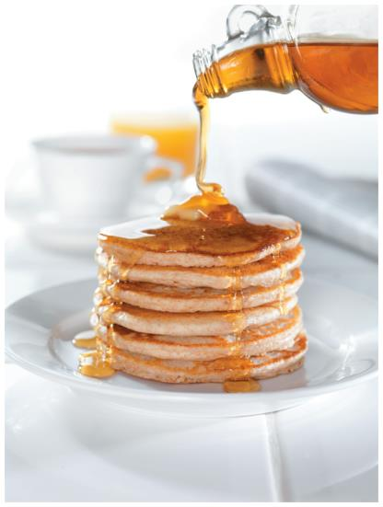
Physical Properties VI
Viscosity
  Viscosity is the resistance of a liquid to flow.
  Why is maple syrup so viscous?
  Viscosity is greater in substances with stronger intermolecular forces because molecules cannot move around each other as freely, hindering flow.
  Non-polar molecules have lower viscosities than polar and protic molecules:
    Viscosity decreases as the temperature is increased (i.e., motor oil).
    It also plays a huge role in HPLC because it determines the back pressure on the column.
Compound | Viscosity (in cp) | Surface tension (mN/m)
Pentane | 0.24 | 16
Ethanol | 1.20 | 22
Methanol | 0.62 | 23
Isopropanol | 2.30 | 22
Water | 1.00 | 72
Sulfuric acid | 25.4 | 55
Glycerol | 1490 | 63
Honey | 2000-10000 | -----

Slide 18
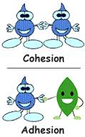

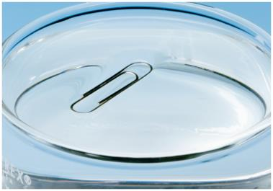
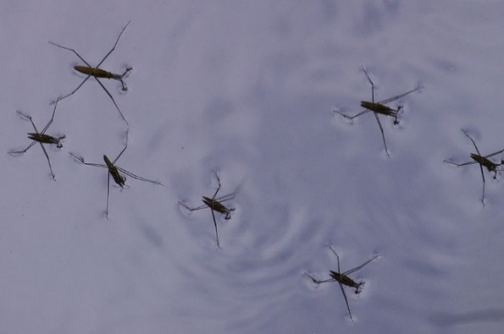
Physical Properties VII
Properties like cohesion (intermolecular force between like molecules i.e., to form drops) and adhesion (intermolecular force between unlike molecule i.e., to adhere to a surface) are also a result of weak intermolecular forces.
Surface tension is a result of strong cohesion forces i.e., formation of spherical water droplets.

Slide 19
Chemical Properties I
Acidity
While a halogen atom or an electron-withdrawing group increases the acidity (pK_{a}(PhOH)=9.95), the effect greatly varies with the position:
  The ortho isomers are usually less acidic than the para isomers because an intramolecular hydrogen bond makes it more difficult to remove the phenolic hydrogen (X=NO₂, CHO, COR, COOR).
  In these cases, the meta isomer is the least acidic one because the electron-withdrawing group does not participate in the resonance that helps to stabilize the phenolate ion.
  A halogen atom in the ortho position increases the acidity more than in the meta or para position due to its inductive effect and poor ability to form H-bonds.
X-C₆H₄-Y | Ortho | Meta | Para
X=F, Y=OH | 8.73 | 9.29 | 9.89
X=Cl, Y=OH | 8.56 | 9.12 | 9.41
X=Br, Y=OH | 8.45 | 9.03 | 9.37
X=I, Y=OH | 8.51 | 9.03 | 9.33
X=CH₃, Y=OH | 10.29 | 10.09 | 10.26
X=CHO, Y=OH | 8.37 | 8.98 | 7.61
X=COCH₃, Y=OH | 10.06 | 9.19 | 8.05
X=COOCH₂CH₃, Y=OH | 9.92 | 9.05 | 8.34
X=NO₂, Y=OH | 7.23 | 8.36 | 7.15

Slide 20
Chemical Properties II
Acidity of Dinitrophenols
  Since nitro groups are strongly electron-withdrawing groups, they increase the acidity of many organic compounds because they help stabilizing the anion.
  The strength of their effect depends largely on the position of the
  nitro group in regard to the anion resulting in a pK_{a}-difference of
  about 3 pK_{a} units for dinitrophenols.
  If the nitro group in located ortho or para to
  the phenolate group, the acidity is great
  increased (i.e., 2,6-isomer) compared to the
  meta position (i.e., 3,5-isomer).
  Note that 2,4,6-trinitrophenol displays a
  pKa=0.4 and is commonly called picric acid.
Positions | pKa
2,3 | 4.92
2,4 | 4.10
2,5 | 5.15
2,6 | 3.63
3,4 | 5.42
3,5 | 6.70

Slide 21
Chromatography
When using polar stationary phases (i.e., silica, alumina), polar molecules will interact more strongly with the stationary phase resulting in low R_{f}-values.
This trend holds particularly true for compounds that can act as hydrogen bond
donor and hydrogen bond acceptor.
The size of the molecule has to be considered as well.
The ability of a solvent to interact with stationary phase determine its eluting power.
The ability of a solvent to form hydrogen bonds, dipole-dipole interactions as well
as dispersion are quantified in the various solvent parameter tables (i.e., Hanson solubility parameters).
 | Donor | Acceptor | Dipole | Eluting power (on SiO₂) | Example (eº on SiO₂)
Alcohols, amides | strong | strong | large | very high | MeOH (0.73), DMF (0.76)
Ketones, esters, ethers | none | moderate | moderate | medium to high | acetone (0.47), ethyl acetate (0.38), diethyl ether (0.38)
Chlorinated solvents | none | none | weak to moderate | weak to moderate | dichloromethane (0.32)
Hydrocarbons | none | none | low | very low | hexane (0.0), toluene (0.23)

Slide 22
Infrared Spectroscopy
The intensity of the infrared band depends on the change in dipole moment during the absorption of electromagnetic radiation (I²~ dq/dr).
The larger the dipole moment of a functional group is, the higher the intensity of the peak in the infrared spectrum (i.e., C-O, C=O, C-Cl, C-F, O-H).
Functional groups with a low dipole moment appear as medium or weak peaks in the infrared spectrum unless there are many of them present
(i.e., C-H (sp³), C-C) or they are polarized by adjacent groups (i.e., C=C).
The presence of heteroatoms also changes the exact peak locations because they either increase or decrease the bond strength of other groups due to their inductive or resonance effect:
  The symmetric stretching mode of a methyl group appears at 2872 cm⁻¹
  (421 kJ/mol in C₂H₆). The stretching modes for methoxy groups are found
  at 2810-2820 cm⁻¹ (402 kJ/mol in (CH₃)₂O), while methyl amino groups are located from 2780-2820 cm⁻¹ (364 kJ/mol in CH₃NHCH₃) due to the weaker C-H bonds.
  The symmetric stretching mode of a methyl group in CH₃X (X=halogen)
  appears at 2950-2960 cm⁻¹ because the presence of the halogen atoms
  strengthen the C-H bond (~420-430 kJ/mol).

Slide 23
NMR Spectroscopy I
The presence of heteroatoms in organic compounds leads to deshielding of nuclei
in ¹H- and ¹³C-NMR spectroscopy (shifts compared to carbon or hydrogen atoms
in benzene).
The inductive effect is pronounced for electronegative elements like fluorine, oxygen
and nitrogen while less electronegative elements like bromine, sulfur, etc. cause less
of a downfield shift of the ipso-carbon atom in a benzene ring.
The effect is different for the ortho and para carbon atoms because the resonance effect dominates for fluorine, oxygen and nitrogen.
The resonance effect can also be observed in the ¹H-NMR spectrum in which the ortho and para protons are shifted upfield.
Group | Ipso carbon in Ph-X (in ppm) | Ortho/Para carbon | Ortho/Para hydrogen
F | 35.1 | -14.3, -4.4 | -0.26, -0.20
OH | 26.9 | -12.6, -7.6 | -0.56, -0.45
NH₂ | 19.2 | -12.4, -9.5 | -0.75, -0.65
Cl | 6.4 | 0.2, -2.0 | 0.03, -0.09
SH | 2.2 | 0.7, -3.1 | -0.08, -0.22
CH₃ | 9.3 | 0.6, -3.1 | -0.18, -0.20

Slide 24
NMR Spectroscopy II
If two electronegative elements are “attached” to the same hydrogen
atom (i.e., hydrogen bonding), the deshielding effect will increase
(i.e., carboxylic acids, δ=10-12 ppm).
Strong intramolecular hydrogen bonds also lead to a significant shift
in the ¹H-NMR spectrum as it is found in ortho substituted phenols
(i.e., o-nitrophenol: δ=10.6 ppm, m-nitrophenol: δ=6.0 ppm,
p-nitrophenol: δ=6.5 ppm (all in CDCl₃)).
The same downfield shift for the phenolic proton will be observed as well
if the ¹H-NMR spectrum is acquired in a more basic solvent like DMSO
(i.e., p-nitrophenol: δ=11.1 ppm) or acetone (i.e., p-nitrophenol: δ=9.5 ppm) because a hydrogen bond is formed with the oxygen atom in DMSO (or acetone).

Slide 25
NMR Spectroscopy III
Similar trends are found in hydroxy-substituted benzaldehyde (and acetophenones) (shift of the phenolic proton in ppm).
The chemical shift in the ortho compound is similar in both solvents because in both cases a hydrogen bonding is observed.
The chemical shifts are vary with the solvent for the meta and the para isomer because in CDCl₃ no hydrogen bonding is observed with the solvent, while a strong hydrogen bonding is observed with DMSO and CD₃CN.
Substitution | CDCl₃ | DMSO-d₆ | CD₃CN
ortho | 11.0 | 10.7 | 9.78
meta | 6.7 | 10.0 | ???
para | 6.2 | 10.6 | 9.82

