Slide 1
Lecture 8b
Synthesis of Benzopinacol via
Photoreduction of Benzophenone

Slide 2
Introduction
Photochemistry is one sub-division of chemistry that possesses many everyday applications i.e., photosynthesis, in which plants use the sunlight to convert carbon dioxide and water into glucose and oxygen
Many processes in the atmosphere are initiated by photons i.e., ozone hole catalyzed by chlorine radicals, smog, etc. Chloroform is converted to the highly toxic phosgene (COCl₂) upon prolonged exposure to oxygen and light.
hν
6 CO₂ + 6 H₂O C₆H₁₂O₆ + 6 O₂
hν
2 CHCl₃ + O₂ 2 COCl₂ + 2 HCl

Slide 3
Introduction
Many medicine bottles are brown in color as well because the sunlight would convert triplet oxygen into singlet oxygen, which is highly reactive i.e., converts C-H groups into C-OH groups, which can further be oxidized, thus destroying the drug.
Since light is a form of energy, it also used in many reactions chemical reaction like [4n]π-cycloaddition and other pericyclic reactions, radical reactions involving hydrocarbons and halogens (i.e., chlorination of toluene to form benzyl chloride in industry) and the isomerization of alkenes (i.e., trans-stilbene is converted in cis-stilbene).
Many polymerizations are started by photoinitiators (i.e., AIBN, benzoyl peroxide). These compounds decompose upon absorbing light to produce the free radicals for radical polymerization.

Slide 4
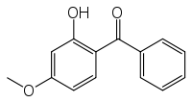
Benzophenone
Benzophenone itself is used as UV-initiator in UV-curing applications such as inks, imaging and clear coatings.
It is also added to perfumes and soaps to protect their colors and scents.
Its addition to plastics allows for a clear packaging while still being protected from UV-light (λ_{max}=252, 333 nm in cyclohexane).
Substituted benzophenones are used in some sunscreens (i.e., oxybenzone, dioxybenzone), but their use is also controversial.

Slide 5
Theory I
The sunlight excites an electron of the π-bond into an anti-bonding orbital (π*), resulting first in a singlet state that rearranged to a triplet state (more details below).
The highly reactive benzophenone diradical abstracts a hydrogen atom from isopropanol, which results in the formation of two radicals.

Slide 6
Theory II
Next, the isopropoxy radical reacts with another benzophenone molecule to form acetone and form a second benzhydroxy radical. Two of the benzhydroxy radicals then combine to form benzopinacol, which terminates the radical propagation.
Overall

Slide 7
Jablonski Diagram
Excitation
The transition S₀ to S₁ is symmetry forbidden (λ=333 nm), which means that the transition from S₀ to S₂ (λ=252 nm) is the transition with the lowest energy.
The resulting singlet S₂(π, π*) excited state quickly decays into the energetically lower S₁(n, π*) state.
Aryl ketones like benzophenone then undergo rapid intersystem crossing (isc) of the S₁(n, π*) excited state to an energetically very close T₂(π, π*) state. The latter quickly and quantitatively decays to the lower energy T₁(n, π*).
The reverse process requires a photon with a wavelength of λ=525 nm. If no other reagents are present this excited states will return to S₀ primarily by phosphorescent decay (P).
π* ↓
n ↑↓
π ↑ z
S₂(π,π*)
π* ↑ a
n ↑↓ a
π ↑ z
π* ↓
n ↑ a
π ↑↓ z
S₁(n,π*)
T₂(π,π*)
isc
T₁(n,π*)
π* ↑ a
n ↑ a
π ↑↓ z
hν
P
π* a
n ↑↓ a
π ↑↓ z
S₀

Slide 8
Experiment
The rate of the reaction depends on various parameters i.e., the amount of UV-light, the absence of quenchers, the absence of bases, etc.
It is very important that the vial used in the reaction is clean and transparent to UV-light. The storage in bright sunlight, which has a high UV-Vis component, will then allow the reaction to proceed smoothly.
The absence of quenchers (i.e., oxygen) is critical as well to ensure that the benzhydroxyl radical can be formed in reasonable quantities and can react as described above.
It is also important that there are no bases present because the reaction would afford benzhydrol instead of benzopinacol. Since traces of alkali leach out of many cheap glasses, a trace amount of glacial acetic acid is added to the reaction mixture.

Slide 9
Experiment
Benzophenone is dissolved in hot isopropanol together with one drop glacial acetic acid.
The hot solution is immediately transferred to the reaction vial and closed tightly.
The vial is labeled on the cap only.
Submit the vial to the teaching assistant.
Why is it important to heat the solvent?
Why is the glacial acetic acid added?
Why is it important to transfer the hot solution immediately and close the vial?
Why is label placed on the cap?
Why is it important that the benzophenone remains in solution?
The reaction mixture is placed in the sun light for 5 days.
Benzophenone does not dissolve well in cold isopropanol
The acid is added to neutralize the bases that leach out of the glassware
The solution heats up when it is stored in the sunlight resulting in a pressure buildup
The glassware has to be transparent for the UV-light
The reaction does not work well in the solid state

Slide 10
Experiment
Upon return, store the vial in an ice-bath for 20-30 minutes.
Isolate the solids by vacuum filtration. Wash the crystals with a small amount of isopropanol before allowing them to dry in air.
The yield and the melting point are determined
The infrared spectrum for the dry compound is acquired.
A sample for HPLC analysis (1 mg/mL isopropanol) is submitted
The clean 10 mL reaction vial is returned to lab support
What can be done if the compound does not precipitate?
How can the sample dried quickly?
The sample is placed in a HPLC vial (black cap)
Scratch the vial on the inside
Place the sample under heat lamp

Slide 11
Characterization I
Crystal Structure
In solid state, the two hydroxyl groups are antiperiplanar
The central carbon atoms and the hydroxyl groups are highly disordered. Only one of position is shown on the right.

Slide 12
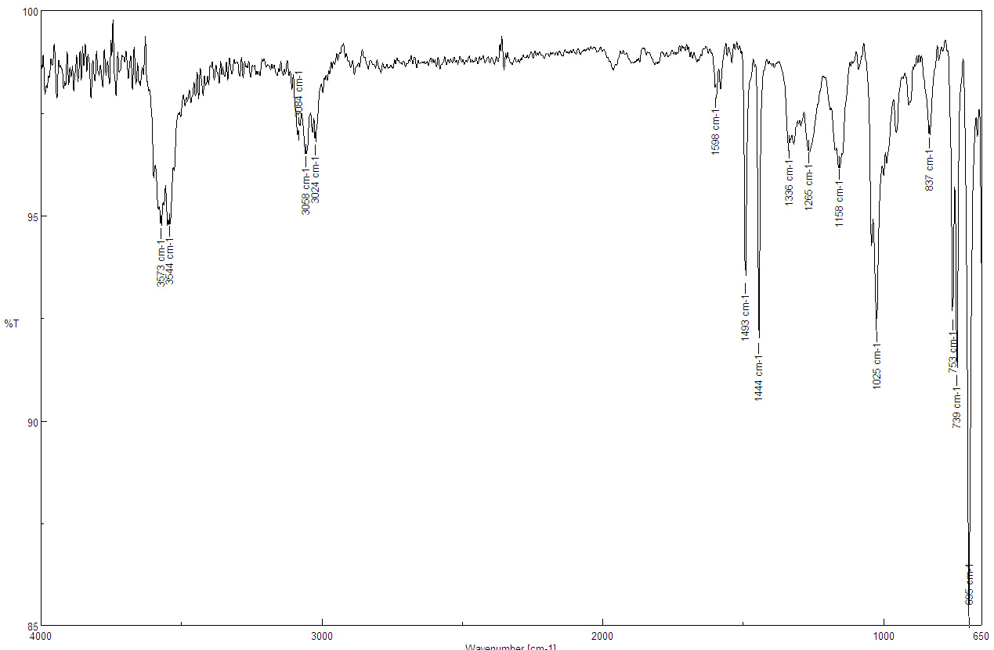
Characterization II
Infrared Spectrum (ATR)
ν(OH)=3644, 3673 cm⁻¹
ν(CH, sp²)=3024, 3058 cm⁻¹
ν(C=C)=1493, 1598 cm⁻¹
ν(C-O)=1025 cm⁻¹
ν(C=C)
ν(CH, sp²)
ν(OH)
ν(C-O)

Slide 13
Characterization III
¹H-NMR Spectrum
Arene-H 20 H
OH 2 H

Slide 14
Characterization IV
¹³C{¹H}-NMR Spectrum (in CDCl₃)
δ=126.9, 127.3, 128.4 and 144.2 ppm (aromatic carbons)
δ=83.1 ppm

