Slide 1
Lecture 8a
Grignard reaction

Slide 2
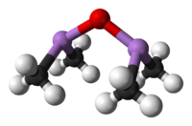
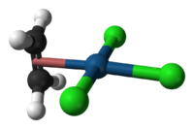

Introduction I
Metal organic compounds have carbon in the compound but
no direct metal-carbon bond i.e., sodium acetate
Organometallic compounds have a direct metal-carbon bond
i.e., methyl lithium (LiCH₃), Grignard reagents (CH₃MgBr),
organocuprates ([(CH₃)₂Cu]Li), etc.
Organometallic compounds are known for more than 250 years
  Cadet’s fuming liquid (~1760, “((CH₃)₂As)₂O”) is the first
  organometallic compound described in the literature
  Zeise’s Salt (1827, K[PtCl₃(CH₂=CH₂)]) is used as starting
  material for cisplatin (cis-PtCl₂(NH₃)₂, anti-cancer drug)
  Nickel tetracarbonyl (1890, Ni(CO)₄) is used to refine
  Ni-metal
  Ferrocene (Fe(C₅H₅)₂) that was discovered in 1951 by
  P. Pauson and S. A. Miller introduced a new bond model
  (sandwich complexes) for transition metal compounds

Slide 3
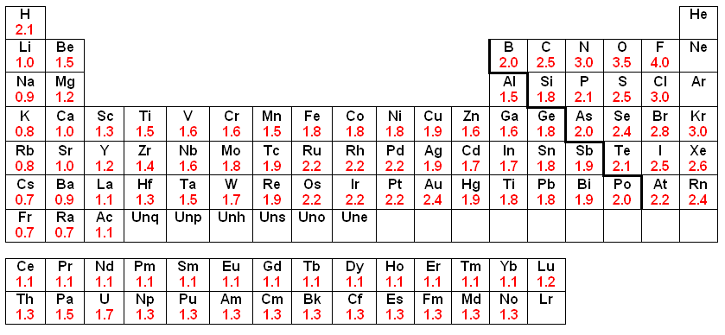
Introduction II
In many organic compounds i.e., carbonyl compounds (i.e., ketones, aldehyde, ester), organohalides (R-X), etc., the carbon atom possesses
an electrophilic character, which means that these compounds do not
react with these carbon atoms directly to form C-C bonds
Organometallic compounds are covalent but the carbon atom exhibits a different bond polarity compared to most organic compounds (Umpolung)
In organometallic compounds,
the carbon atom displays a higher
electronegativity (EN: C=2.5)
than the metal atom (EN<2.5),
which makes the carbon atom
nucleophilic
X

Slide 4
Introduction III
Organometallic compounds have been proven to be very good synthetic tools in organic chemistry
  Gilman reagents (organocuprates compounds)
    They are used to perform substitution reactions on sp²-carbon atoms that cannot be performed in the same fashion like on sp³-carbon atoms (S_{N}1
    and S_{N}2)
    Organocuprates are considered very mild nucleophiles due to weak bond polarity (EN: Cu=1.9, C=2.5  ΔEN=0.6)
    Thus, they usually favor 1,4-additions on α,β-unsaturated carbonyl compounds

Slide 5
Introduction IV
Palladium catalyzed substitution reactions on sp²-carbons
  Heck-reaction, Stille reaction, Suzuki coupling, Negishi coupling (not shown below)
  Catalysts: Pd/C, Pd(PPh₃)₄, PdCl₂, Pd(OAc)₂, Pd₂dba₃
  Nobel Prize in Chemistry (2010): Heck, Negishi and Suzuki

Slide 6
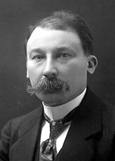
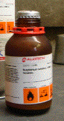
Grignard Reagents I
Grignard reagents were discovered around 1900
by the French chemist Victor Grignard (NP 1912)
These reagents are formed by the reaction of
magnesium metal with alkyl or aryl halides
Most of the time these reagents are produced in-situ
Many commonly used Grignard reagents i.e., PhMgBr, MeMgI, MeMgBr, EtMgBr, AllylMgBr, etc. are commercially available as solutions in diethyl ether, tetrahydrofuran or solvent mixtures (i.e., THF/hexane)
These reagents are often handled under inert gas to prevent their hydrolysis and due to their potentially pyrophoric character (delivered in Sure-Seal bottles)

Slide 7

Grignard Reagents II
The preparation of Grignard reagents requires certain considerations:
Nature of the halide substrate
  Fluorides are usually not suitable due to the high C-F bond strength
  Iodides constitute the most reactive class of reagents but they are
  also very expensive and labile (often they are sensitive towards light, decompose at room temperature and upon exposure to air)
  Bromides are most commonly used because they exhibit only a slightly lower reactivity compared to iodides but come with a significantly lower price tag than iodides
  Alkyl halides are more reactive than aryl halides as can be seen by comparison of the bond lengths. The higher bond strength found in
  aryl halides is due to the higher s-character in the C-X bond.
C-X bond | Dissociation Energy for C-X bond in kJ/mol | d(C-X) in CyX^{HF/6-31G*} | d(C-X) in PhX^{HF/6-31G*} | Cost per mole of PhX
C-F | 460 (Me), 526 (Ph) | 138.5 pm | 133.1 pm | $12
C-Cl | 350 (Me), 400 (Ph) | 181.2 pm | 174.5 pm | $5
C-Br | 294 (Me), 336 (Ph) | 198.1 pm | 190.5 pm | $6
C-I | 239 (Me), 272 (Ph) | 213.2 pm | 210.8 pm | $57

Slide 8
Grignard Reagents III
Solvent
  Solvents that contain acidic protons (i.e., alcohols, amine) or/and electrophilic atoms (i.e., ester, ketone, nitro compounds, sulfoxide) are not suitable
  Hydrocarbons are non-polar (or weakly polar) and do not dissolve the moderately polar Grignard reagent well enough
  Ethers are most commonly used as single solvent because they are stable and polar enough to dissolve most Grignard reagents
    Diethyl ether: low boiling point, good phase separation with most
    aqueous layers, the temperature in the system is moderate
    Tetrahydrofuran: higher boiling point, poorer separation with most aqueous layers, more difficult to dry than diethyl ether because it is more hygroscopic
    A comparison of diethyl ether (μ=1.15 D) and THF (μ=1.75 D) shows that THF is a stronger Lewis Base because of its higher dipole moment compared to diethyl ether (d(Mg-O): 209 pm (THF), 213 pm (Et₂O) (HF, 6-31G**) in MeMgBr*2 L).

Slide 9
Grignard Reagents IV
Activity of the Metal
  Magnesium is very reactive in air and is therefore covered with
  an oxide layer than prevents the electron transfer to occur
  To remove the oxide layer, the magnesium turnings have to be crushed or etched using iodine, bromine, CCl₄, etc.
  Highly reactive magnesium metal can be obtained by the reaction
  of MgCl₂ with potassium metal (Rieke magnesium, fine powder
  with a large surface area, no oxide layer  pyrophoric)

Slide 10
Theory for In-lab experiment I
The reaction of an asymmetric ketone (R¹R²C=O) with a Grignard reagent (RMgBr) affords a chiral, tertiary alcohol after an acidic workup
The product is racemic because the approach of the nucleophile
from either side of the carbonyl group is energetically identical leading to the same rate of reaction for the two pathways
The situation will change if alternate pathways involve different degrees of steric hindrance as already seen in the camphor reduction
Using “Cram’s chelate model” or the “Cram Rule”, the outcome of these reactions can be predicted

Slide 11
Theory for In-lab experiment II
Cram’s chelate model
  “If chelation between the carbonyl group and one of the substituents of the α-stereocenter facilitated by a metal cation can occur, the substrate will be locked into conformation, where these two substituents are on the same side. This will place the remaining two substituents on different sides of the carbonyl group. A nucleophile will now preferentially attack the carbonyl group from
  the side of the smaller substituent.”

Slide 12
Theory for In-lab experiment III
How does this apply to the experiment in the lab?
Benzoin has a chiral center in the α-position to the carbonyl group, which is the reaction center for the nucleophilic attack
A “metal cation” is present in the reaction which can facilitate the chelation due its Lewis acidity
There is an additional heteroatom present in α-position to the carbonyl group which is also required for chelation

Slide 13
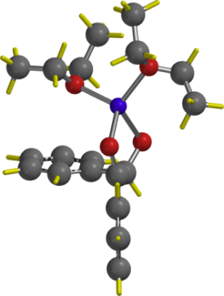
Theory for In-lab experiment IV
Once all these requirements are fulfilled, the chelate is formed which places the hydrogen atom and phenyl groups on different sides of the
five-membered chelate (L=(CH₃CH₂)₂O)
The nucleophile approaches the carbonyl group preferentially from the less hindered side (path B), which is the side of the hydrogen atom
The approach via path A is sterically more hindered leading to significantly less of the corresponding product
Due to the large size difference of the groups controlling the approach, the diastereoselectivity is very high for the reaction (97:3, d.e.=94 %)

Slide 14
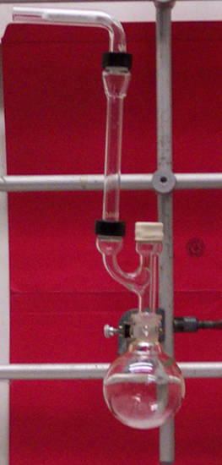
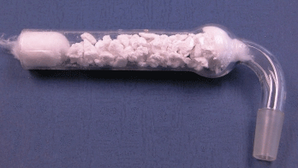

Experiment I
Setup
  The lab support will pass out two-necked, three-necked or a simple round bottomed flask
  If you receive a two-necked or three-necked flask, you will not have to use the Claisen adapter
  All joints have to be lightly lubricated to provide
  a tighter seal
  The air condenser is placed on the side arm of the Claisen adapter (do not forget the wet paper towels)
  The rubber septum is placed on the straight neck and has to be folded over in order to seal properly
  The drying tube is packed as shown (~5 cm granular CaCl₂ sandwiched between two cotton balls) and then placed on the top of the air condenser
  The flask has to be clamped at the neck with a proper-sized clamp
  Do not forget to add a stir bar into the flask
Rubber septum
Claisen adapter

Slide 15
Experiment II
Prepare the glassware as previously described and immerse the round-bottomed (or two-necked) flask in
the ice-bath
Ask the TA to dispense the MeMgBr solution into the flask
Add additional diethyl ether
Prepare a solution of benzoin in tetrahydrofuran
Add the benzoin solution slowly to the Grignard solution while the flask is placed in an ice-bath and the mixture is stirred
What is an ice-bath?
Why is the flask placed in an ice-bath here?
Why does the TA dispense the
Grignard reagent?
Why is more diethyl ether added?
Which precautions should be taken here?
Which observation should the student make?
Lots of water with some ice
To slow down the reaction
in the beginning
Because MeMgBr is pyrophoric
Close the container when dissolving the benzoin to keep the water out
Foaming (methane)
Color change to yellowish

Slide 16
Experiment III
After the benzoin solution is added, reflux the reaction mixture gently
Place the reaction mixture in
an ice-bath
While stirring, add chilled
10 % sulfuric acid slowly
How is this accomplished?
Why is this necessary here?
Why is the diluted sulfuric acid added here?
Why is everything cooled prior to its addition?
Why is important that the addition of the acid is performed slowly?
Does the entire acid have to added slowly?
Warm water-bath (~50 ºC)
No, only the initial 5 mL

Slide 17
Experiment IV
Stir the reaction mixture at room temperature
Separate the two layers
Extract the aqueous layer with diethyl ether
Wash the organic layer with sodium bicarbonate solution
Dry the organic layer over anhydrous magnesium sulfate
Remove the solvent using the rotary evaporator
What should the student observe here?
Which equipment is used here?
Which layer is the organic layer here?
Why is this step performed?
How much ether is used?
Why is this step performed?
Which precautions should be taken here?
Organic layer=top layer
10 mL
To remove any acid from
the organic layer
Minimize the amount because
the diol adsorbs strongly

Slide 18
Experiment V
Recrystallize the residue (oil or solid) from high-boiling petroleum ether
Repeat the recrystallization until the melting point is constant
What is high boiling petroleum ether?
Which precaution have to be taken here?
What is the melting point for the pure compound?
How many recrystallization are needed usually?
How does the final product look like?
A mixture of hydrocarbons
i.e., octanes, nonanes, etc.
Do not place the solution
in an ice-bath!
2-3
White solid

Slide 19
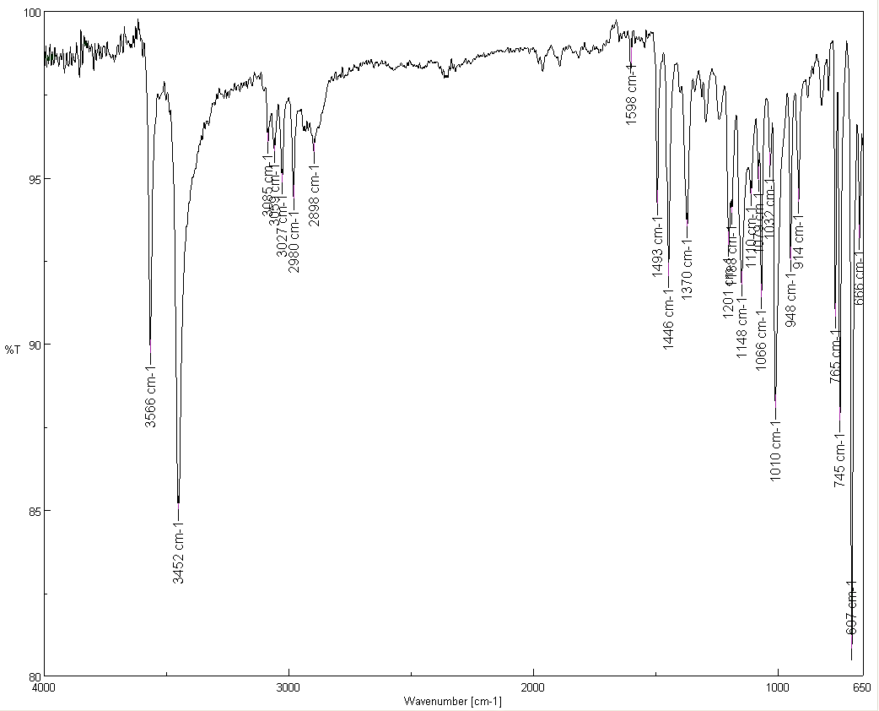
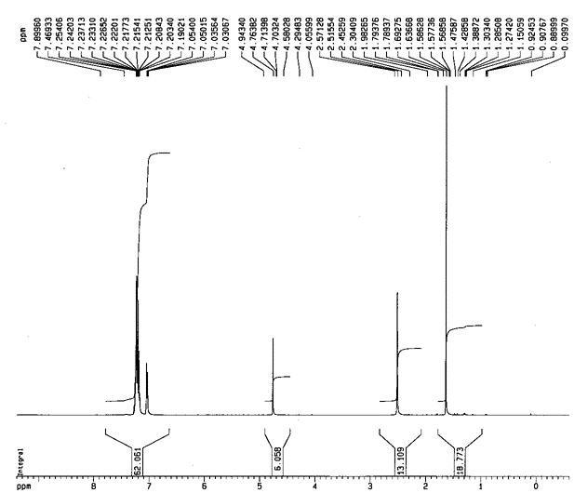
Characterization I
Melting point
Infrared spectrum
  ν(OH)=3454, 3566 cm⁻¹
  ν(C-O)=1010, 1066 cm⁻¹
  Νο ν(C=O)=1679 cm⁻¹
  Many peaks are observed
  due to the low symmetry
¹H-NMR spectrum
  δ=7-7.5 ppm (10 H, m, A)
  δ=4.70 ppm (1 H, s, B)
  δ=2.45 ppm (2 H, s, C)
  δ=1.63 ppm (3 H, s, D)
ν(OH)
ν(C-O)
D
C
A
B

Slide 20
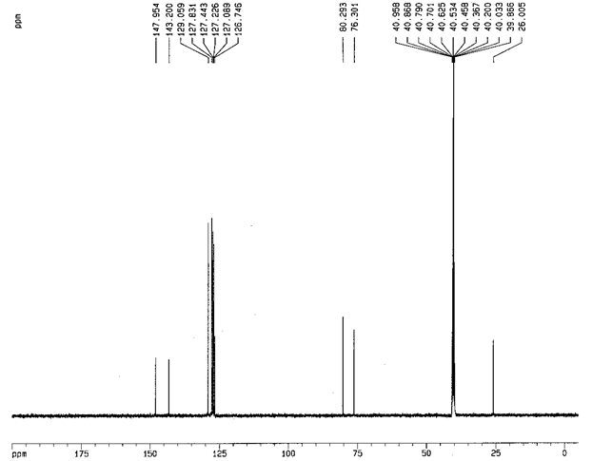
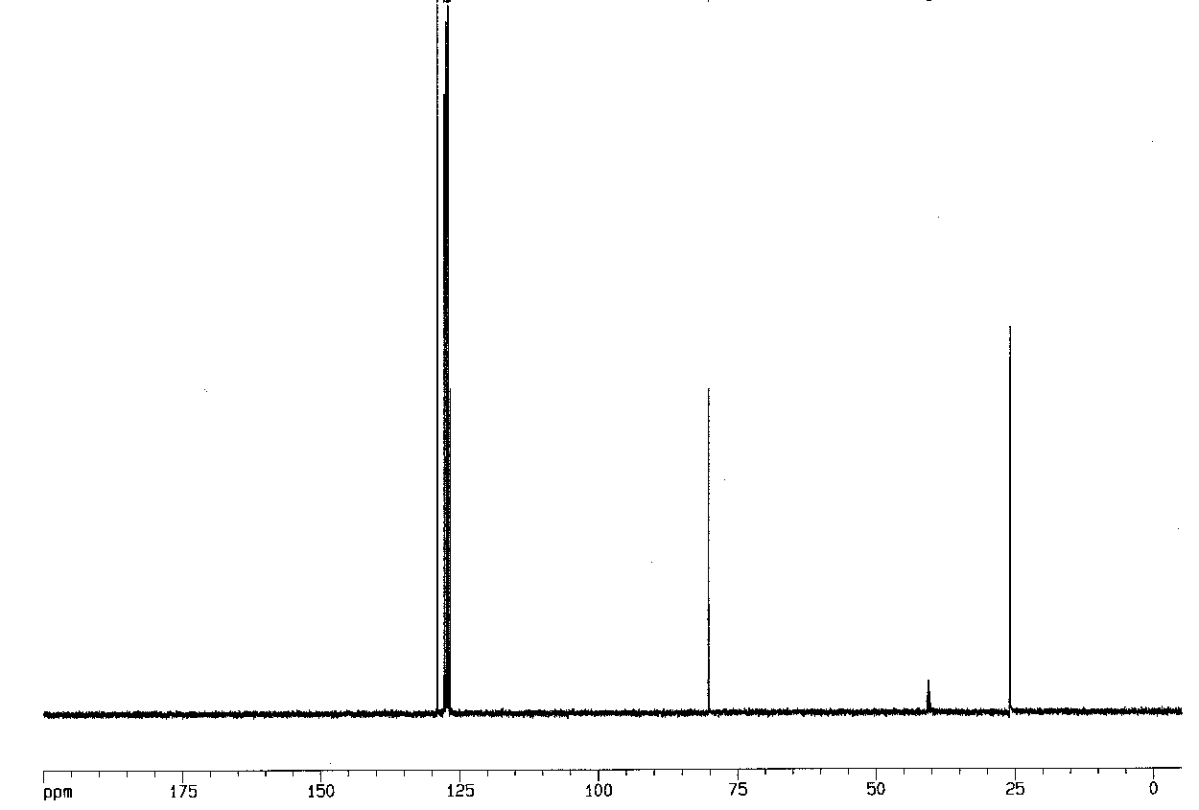
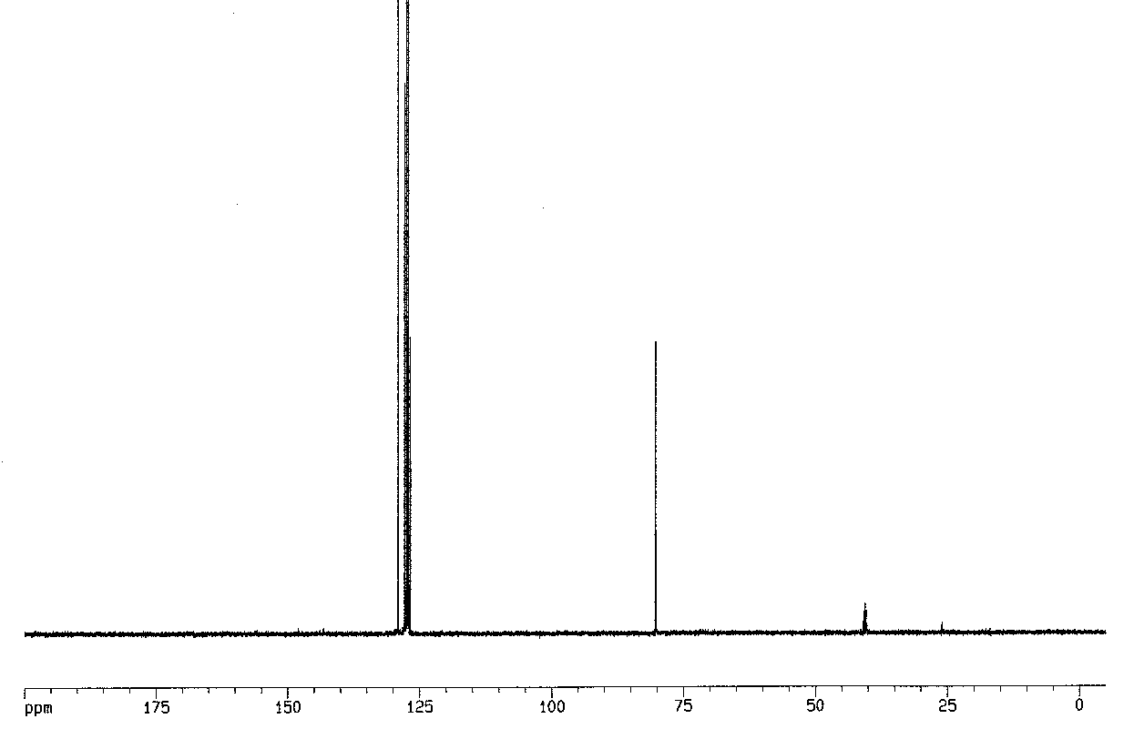
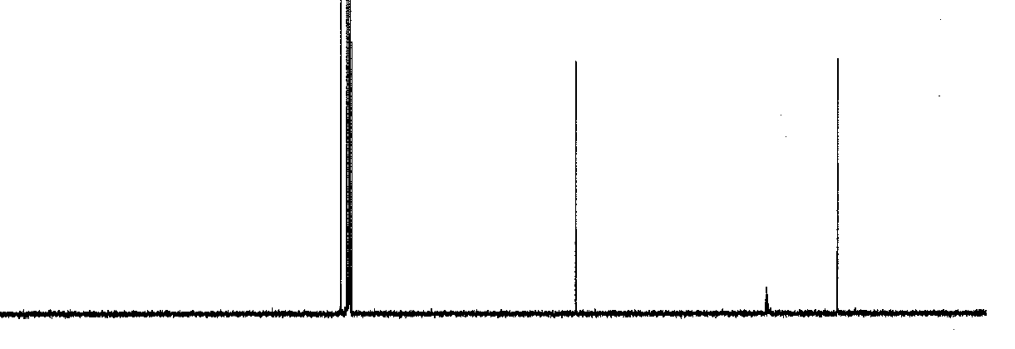
Characterization II
¹³C-NMR spectrum
  Ipso carbons (not observed in
  DEPT spectra)
  Ortho/meta/para carbons
  (observed in all DEPT spectra)
  DMSO-d₆
Full
DEPT 135
DEPT 90
DEPT 45
#H attached | 0 | 1 | 2 | 3
DEPT 135 | 0 | up | down | up
DEPT 90 | 0 | up | 0 | 0
DEPT 45 | 0 | up | up | up

Slide 21
Characterization III
Mass spectrometry
  1,2-diphenyl-1,2-propanediol: 228(5), 209(6), 194(14), 179(23), 121(100), 107(70), 105(83), 77(91), 51(43)

Slide 22
Characterization IV
Mass spectrometry
  1,2-diphenylpropanone: 210(2), 106 (8), 105(100), 78(4), 77(33)

Slide 23
Characterization V
Mass spectrometry (2,2-diphenylpropanal)

