Slide 1
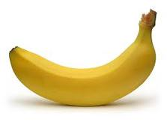
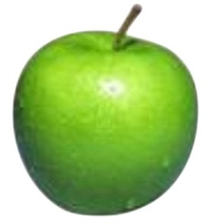
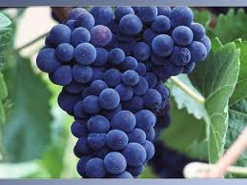
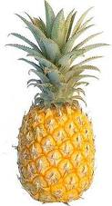
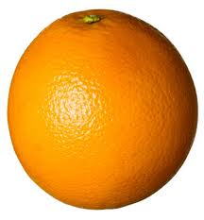
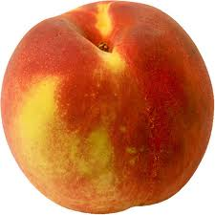
Lecture 8a
Esterification

Slide 2
Introduction
Many esters have pleasant odors and some of them can even be found in nature.
Esters are often used in fragrances or flavoring agents due to their organoleptics properties.
Some esters are used as sex pheromones i.e., isopropyl dodecenoates
(attracts female beetles, used in alternative pest control) or alarm
pheromones i.e., isoamyl acetate (honey bee)).
Ester of p-aminobenzoic acid are used as local anesthetics with a short to moderate half-life (benzocaine (ethyl), procaine (2-(diethylamino)ethyl), propoxycaine, etc.).
Compound | Flavor/Fragrance
Isoamyl acetate | Banana Oil
Ethyl butyrate | Pineapple
Octyl acetate | Orange
Methyl anthranilate | Grape
Methyl butyrate | Apple
Benzyl acetate | Peach
Methyl salicylate | Oil of Wintergreen
Menthyl acetate | Peppermint

Slide 3
Theory I
Esters can be obtained by a broad variety of reactions
  Fischer Esterification (used in Chem 30BL)
    This approach works well for primary and most secondary alcohols,
    but not for tertiary alcohols because of their high tendency to eliminate water instead of forming an ester.
  Acyl chloride
    Works for tertiary alcohols as
    well because of non-acidic
    conditions.
    Accessibility of SOCl₂
  Anhydride
    Accessibility of anhydrides
    Often also requires an acidic
    catalyst i.e., aspirin synthesis.

Slide 4
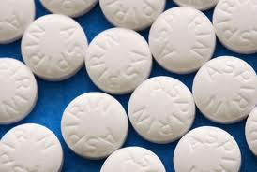
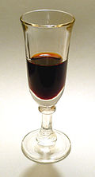
Theory II
  Example 1: Aspirin (Bayer AG,1899)
  It uses salicylic acid, acetic acid anhydride and a mineral acid
  as catalyst (usually conc. phosphoric acid).
  The phenol group acts as the alcohol in the reaction.
  Aspirin is considered a pro-drug for salicylic acid, which was long known (Hippocrates, bitter willow bark extract, 5th century BC) to work against inflammations and fever but it caused vomiting and nausea.
  The reaction of salicylic acid with methanol in the presence of a mineral
  leads to the formation of methyl salicylate (Oil of wintergreen), which is
  used as topical analgesic.
Methyl salicylate
Topical analgesic
The serin group the cyclooxygenase is blocked , which causes a suppression of the prostaglandin synthesis

Slide 5
Theory III
  Intramolecular esterification afford lactones (i.e., coumarins).
  These reactions can usually be carried out under mild conditions.
  Example 2: GHB (γ-hydroxybutyric acid)
    It is used as date rape drug: Liquid Ecstasy.
    It is colorless, odorless and has a slightly salty taste.
    It is very dangerous because the effect of the drug differs greatly.
    More than 200 deaths and more than 5700 overdoses have been attributed to this drug since 1990. The major problem is that humans can have very different reactions to this drug particular in connection with the consumption of alcohol.

Slide 6
Theory IV
Example 3: Biodiesel
It has gained a lot of interest lately due to the ever increasing cost of gasoline over
the past decades.
It uses renewable resources i.e., plant oils, algae, grease, etc.
Trans-esterification: It converts oils into methyl esters that are much more volatile than oils due to their lower molecular weight.
It is important that water is absent during the reaction to avoid the formation of soap (Na⁺ RCOO⁻, where R= C₁₇H₃₅, etc.).
Food vs. Fuel debate (i.e., 80 gal/acre for soy and sunflower):
  42 billion gallons of diesel in 2008 in the US: 525,000,000 acre (21.6 % of the US).
  If the gasoline is also included (135 billion gallons) about 70 % of the area is needed.
  In 2013, industry produced 1.8 billion gallons of biodiesel.

Slide 7
Theory V
In the lab, an unknown carboxylic acid is reacted with an unknown alcohol (both assigned by the TA).
Problems:
  The reaction is an equilibrium reaction with poor yields
  if a 1:1-ratio of the reactants is used.
  The carboxylic acid is a poor electrophile (neutral).
  The alcohol is a poor nucleophile (neutral).
  The reaction is very slow at room temperature.
  Any water in the reaction mixture lowers the yield significantly.

Slide 8
Theory VI
Mechanism of Fischer Esterification
In the neutral state, the resonance structure with the charge separation is
a very minor contributor making the carbonyl function of the carboxylic
acid a poor electrophile.
The situation changes in the protonated form of the carboxylic acid in
which the carbonyl carbon bears a larger positive charge (~0.2 units in
the case of acetic acid), which makes it a better electrophile.

Slide 9
Theory VII
Le Châtelier Principle
  If equimolar amounts of the carboxylic acid and the alcohol were used, the theoretical yield would be low i.e., 67 % (K_{eq}=4).
  One or all products have to be removed from equilibrium, which will not
  work here because water and the esters have higher boiling points than the alcohols.
  Thus, an excess of one the reactants has to be used.
The carboxylic acids cannot be used in excess because all of them are solids.
The reaction in the lab uses an excess of the alcohol:
  The alcohol doubles up as the solvent and as a reactant in the reaction.
  Usually about 4-10 fold molar excess in the literature (a five-fold molar
  excess is used in the Chem 30BL lab i.e., 10 mmol of the carboxylic acid
  are reacted with 50 mmol of the alcohol).

Slide 10
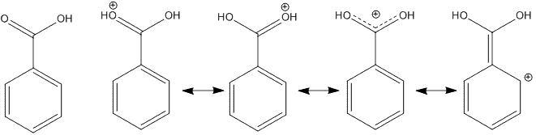
Theory VIII
A strong mineral acid is usually used as catalyst:
  The carboxylic acid is neutral and a weak electrophile.
  The mineral acid protonates the carbonyl carbon atom and increases
  its electrophilic character.
It is very important to reflux the mixture properly to increase the rate of the reaction i.e., for every 10 ºC temperature increase, the rate of the reaction about doubles (Arrhenius equation).

Slide 11
Theory IX
Which compounds are present in the reaction mixture after the reaction is completed?
  Ester, alcohol (used in excess), carboxylic acid (should be a small amount), sulfuric acid (used as the catalyst).
All of the alcohols (log K_{ow}= -0.77 (MeOH), -0.24 (EtOH), 0.05 (iso-PrOH), 0.25 (PrOH)) and the sulfuric acid (log K_{ow}= -2.20) are soluble in water.
The carboxylic acid and the sulfuric acid can be
extracted with a weak base i.e., NaHCO₃ while
the ester and traces of the alcohol remain in the
organic layer. They are separated by a fractionated
vacuum distillation later.
Sodium hydroxide cannot be used for the
extraction step because it would destroy the ester
(saponification) due to its higher nucleophilicity.

Slide 12

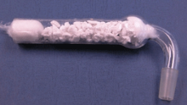
Experiment I
Dissolve the unknown carboxylic acid in the alcohol in a 10 mL round-bottomed flask (both assigned by your TA)
Add a few drops of concentrated sulfuric acid
Reflux the mixture for at least 60 minutes (the longer the better)
How much of the acid is used for the reaction?
How much alcohol should be used here?
Why is a 10 mL round-bottomed flask used here?
How much is appropriate here?
What does this imply in terms of equipment and setup?
1.0 g
5 mol equivalents
3-4 drops
Air condenser with wet paper towel
Stir bar
Drying tube with CaCl₂

Slide 13
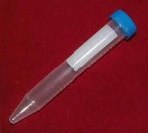
Experiment II
Cool the reaction mixture down
Add ice-cold water to the reaction mixture
Remove the organic layer
How can this be accomplished quickly?
Which container should be
used here?
Why is the water added?
How much water should be added?
What should the student observe/not observe here?
Which one is the organic layer here?
Ice-bath
Centrifuge tube
To cause a phase separation
Usually 4-8 mL
The formation of a solid indicates
a poor conversion of the acid
Usually the bottom layer=ester

Slide 14
Experiment III
Extract the aqueous layer with diethyl ether
Combine all organic layers
Extract the combined organic layers with sodium bicarbonate solution
Why is the aqueous layer extracted with ether?
How much ether should be used here?
Which layers does this referred to?
Why is this step performed?
How much solution is used here?
How many extractions should be performed?
To collect the suspended and
dissolved ester
2 x 3 mL
Ester + two ether layers
1-2 mL portions
Until the CO₂ formation ceases

Slide 15
Experiment IV
Dry the organic layer over anhydrous sodium sulfate
Remove the ether and remaining alcohol using the rotary evaporator
Perform vacuum distillation
Collect product from Hickman head
Acquire an infrared spectrum and the refractive index of the ester. Submit the
rest of the sample, even if it is solid or
semi-solid) for NMR analysis (label vial
and sign in the sample as well)
How much drying should be used?
Why is a vacuum distillation performed here?
What is the setup for the vacuum distillation?
What should the student do if he had a liquid in the Hickman head and also in the flask/vial?
A small amount to start with!
Note that the drying tube
does not contain cotton or CaCl₂!
Acquire an infrared spectrum for
both liquids and only submit the
“ester” for NMR analysis

Slide 16
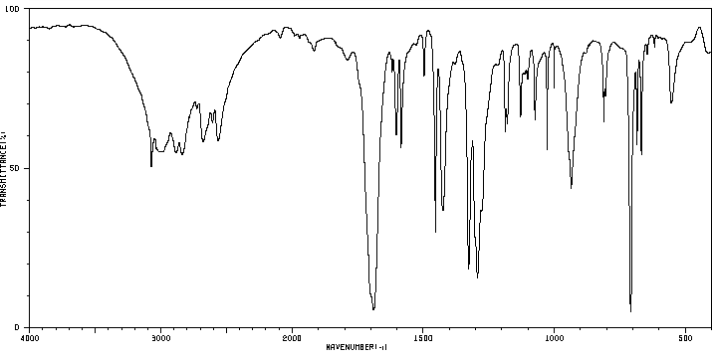
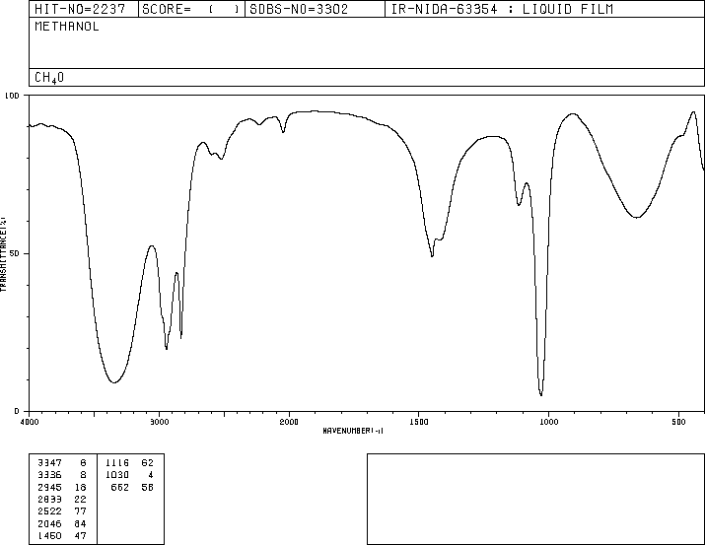
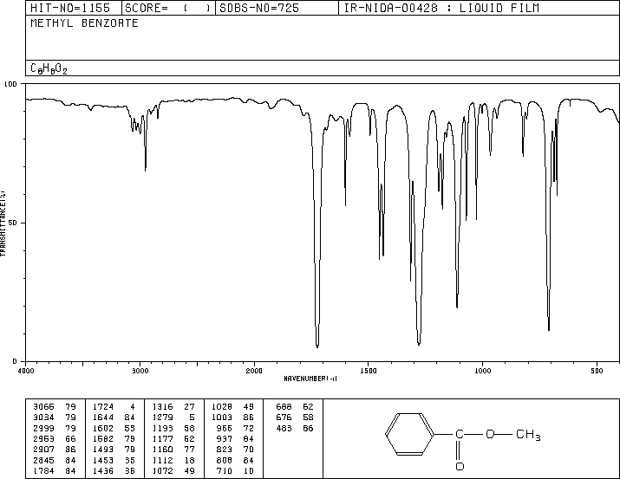
Characterization I
Infrared Spectrum
  Benzoic acid
    ν(C=O)=1689 cm⁻¹
    ν(OH)=2300-3300 cm⁻¹
    ν(C-OH)=1030 cm⁻¹
  Methanol
    ν(OH)=3347 cm⁻¹
    ν(C-OH)=1030 cm⁻¹
  Methyl benzoate
    ν(C=O)=1724 cm⁻¹
    ν(COC)=1112, 1279 cm⁻¹
    No OH peaks in the ester
ν(OH)
ν(C=O)
ν(C-OH)
ν(OH)
ν(C-OH)
ν(C=O)
ν(COC)

Slide 17
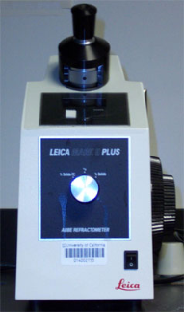
Characterization II
Refractometry
  The refractive index is a physical property
  specific to a compound
  Light is refracted when passing through
  any medium (Snell’s Law)
  In the lab, it is used to determine identity and purity
  of a sample using an Abbé refractometer
  The refractive index is wavelength and temperature
  dependent (λ=589 nm, T=recording temperature)
Adjust the height of the
dark field so that the edge
intersects with the crosshair
before adding sample
to refractometer
after adding sample
to refractometer (ideal)
after adding sample to
refractometer (non ideal)

Slide 18
Characterization III
¹H-NMR Spectrum for Methyl benzoate
d, 2 H
ortho
s, 3 H
OCH₃
t, 2 H
meta
t, 1 H
para

Slide 19
Characterization IV
¹³C{¹H}-NMR Spectrum for Methyl benzoate
CDCl₃
CDCl₃

Slide 20
Characterization V
What is that?

Slide 21
General Hints
The reaction should be started as soon as possible in order to have
a long enough reaction time.
Dry glassware is very important here.
The reaction mixture has to be properly refluxed.
The air condenser has to be properly cooled with a wet paper towel, which has to have an intimate contact with the air condenser (no Hickman head here!!).
The purer the final product is, the easier the analysis of the NMR spectra will be.
The student should submit something even if it is a “solid” that just had a pleasant odor to it.
It is advisable to acquire a refractive index of the alcohol.
Do not obtain the melting point for the carboxylic acid.

