Slide 1
Lecture 7a
Synthesis of Coumarins

Slide 2
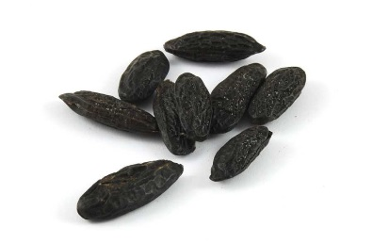
Introduction I
Coumarin (2H-chromen-2-one) was first isolated from the tonka bean (coumarou) or sweet clover in 1820 by A. Vogel. It has a sweet odor that is recognized as the scent of a new-mown hay and a bitter taste.
Since 1882, it has been used in perfumes and as aroma enhancer in pipe tobacco and some alcoholic drinks (i.e., mulled wines). However, it is banned as food additive in the United States due to the concerns of its hepatotoxicity (=chemical-driven liver damage).
Many coumarin derivatives like dicumarol, warfarin and acenocoumarol act as anticoagulant and vitamin K antagonist.
Umbelliferone (7-hydroxyl-coumarin), found in carrots, coriander and garden angelica.
Hymecromone (7-hydroxy-4-methylcoumarin, 4-methyl-umbelliferone), the compound synthesized in the lab, is used in bile therapy. It is also used in the fluorometric determination of enzyme activity.

Slide 3
Introduction II
Coumarin itself has been used as an edema modifier. Like other benzopyrones, it is known to stimulate macrophages to degrade extracellular albumin, allowing faster resorption of edematous fluids.
Umbelliferone absorbs ultraviolet light strongly at several wavelengths, which led to its use as a sunscreen and an optical brightener for textiles as well as gain medium for dye laser. It can also be used as a fluorescence indicator for metal ions such as copper and calcium.
W. H. Perkin, the discoverer of the aniline dyes, first synthesized coumarin in 1868 by the reaction of salicylic aldehyde and acetic acid anhydride in the presence of a base.

Slide 4
Mechanism I
In 1884, H. v. Pechmann developed a condensation reaction using a phenol and a carboxylic acid or ester containing a β-carbonyl group to afford a coumarin.
The reaction can be regarded as an esterification or transesterification followed by the attack of the activated carbonyl group in ortho position to the oxygen atom attached to the ring.
The final step is a dehydration that leads to the formation of an additional double bond in the newly formed six-membered ring.
Alternatively, a mechanism that starts with an attack of the ring to the keto group, which is followed by a transesterification to form the six-membered ring has been proposed.
transesterification
enolization
R’=m-OH
electrophilic attack
dehydration

Slide 5
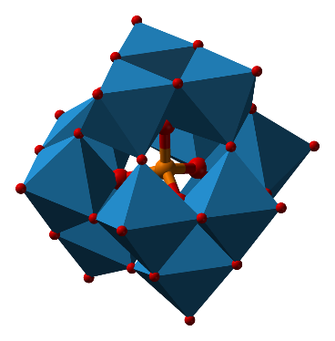
Mechanism II
The reaction is usually catalyzed by sulfuric acid, phosphoric acid, aluminum trichloride or trifluoroacetic acid. Unfortunately, many of these reactions require large quantities of the catalyst and elevated temperatures.
More recently, bismuth chloride (5 % mol, 75 ºC), iron(III) chloride in ionic liquids, montmorillonite K-10 or iron(III) fluoride under solvent-free conditions have been used successfully. In addition, Keggin-type heteropolycompounds (i.e., H₃PW₁₂O₄₀) have been used under solvent-free conditions.
The reaction works better for donor-substituted benzene ring (i.e., polyhydroxy, amino, etc.). In some cases, a polycondensation is observed particularly if an excess of ethyl acetoacetate was used.
If amines are reacted with ethyl acetoacetate, 4-methyl-2-hydroxyl-quinolines are formed via acetoacetanilides (using p-TSA/MW) or 2-methyl-4-hydroxyquinolines via ethyl β-anilinocrotonates.

Slide 6
Experimental I
In a 50 mL Erlenmeyer flask, resorcinol, ethyl acetoacetate and Amberlyst A15 are mixed thoroughly
The flask is covered with a watch glass and is then heated in the microwave
After removing the reaction mixture, it is allowed to cool slowly for 30 minutes
A minimal amount of hot solvent (methanol:water=5:1) is added
Why is a small container used here?
Which setting is used here?
How can the cooling process slowed down?
Why is the mixture used here?
The reaction is run in micro-scale, which means that only little liquid is formed upon heating
The reaction should be run at 30 % power, which is equal to ~210 W
The flask is isolated with paper towels and aluminum foil
The compound dissolves well in hot methanol but less it the cold solvent mixture

Slide 7
Experimental II
The catalyst is removed from the hot solution
Upon cooling, the product precipitates as a white solid
The crystals are isolated by vacuum filtration in a Hirsch funnel and rinsed
After sucking air through the solid for 5-10 minutes, the compound is dried under the heating lamp (or in an open container until next lab meeting).
A sample for GC/MS analysis is submitted
How is this accomplished?
What is used to rinse the crystals?
What is the proper concentration here?
The bulk of the solution can be decanted and the rest be transferred with a pipette
First, the ice-cold solvent mixture is used and then some ice-cold methanol
2 mg/mL in ethyl acetate

Slide 8
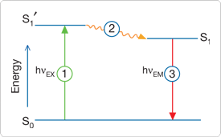
Characterization I
Fluorescence
Stage 1: Excitation
A photon of energy hν_{EX} is supplied by an external source such as an incandescent lamp or a laser and absorbed by the fluorophore, creating an excited electronic singlet state (S₁‘).
Stage 2: Excited-State Lifetime
The excited state exists for a finite time (typically 1–10 ns). During this time, the fluorophore undergoes conformational changes and is also subject to a multitude of possible interactions with its molecular environment.
The energy of S₁‘ is partially dissipated, yielding a relaxed singlet excited state (S₁) from which fluorescence emission originates.
Not all the molecules initially excited by absorption return to the ground state (S₀) by fluorescence emission. Other processes may also depopulate S₁.

Slide 9
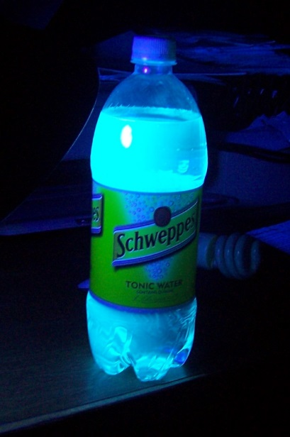
Characterization II
Stage 3: Fluorescence Emission
A photon of energy hν_{EM} is emitted, returning the fluorophore to its ground state S₀. Due to energy dissipation during the excited-state lifetime, the energy of this photon is lower, and therefore of longer wavelength, than the excitation photon hν_{EX}.
The difference in energy or wavelength represented by (hν_{EX} – hν_{EM}) is called the Stokes shift (dashed line: excitation, solid line: emission). The Stokes shift is fundamental to the sensitivity of fluorescence techniques because it allows emission photons to be detected against a low background, isolated from excitation photons.
In contrast, absorption spectrophotometry requires measurement of transmitted light relative to high incident light levels at the same wavelength.
The beverage contains quinine, which absorbs at λ=350 nm and emits at λ=460 nm (bright blue/cyan hue)

Slide 10
Characterization III
Fluorescence Test
Some of the product is dissolved in 95 % ethanol
Tube A: 1 mL of 1 M sodium hydroxide solution is added
Tube B: 1 mL of 2 M HCl is added
Tube C: add nothing to this test tube
How do the solutions look like at this point?
Place all three tubes in the UV-light (long wavelength, 365 nm). How the solutions look like now?
Warning: Do not look straight into the UV-lamp!

Slide 11
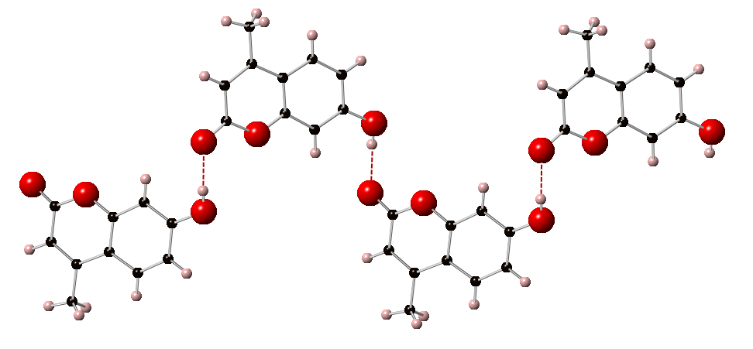
Characterization IV
Crystal Structure (7-hydroxy-4-methylcoumarin)
7-hydroxy-4-methylcoumarin is almost planar but the hydroxyl derivative displays a more than 100 ºC higher melting point than coumarin.
The higher melting point is due to the formation of hydrogen bonds between the phenolic hydroxyl group and the oxygen atom of the carbonyl group of a neighboring molecule (d(O-H…O=C=189 pm), which is similar in length compared to water.

Slide 12
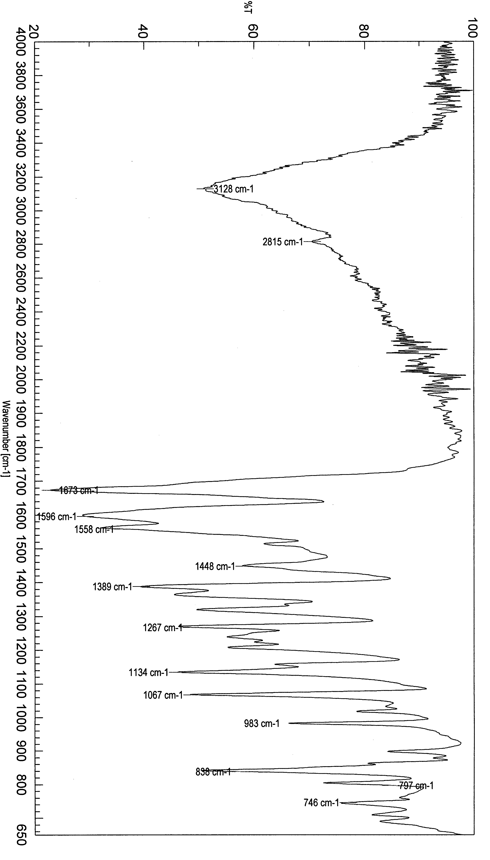
Characterization V
Infrared Spectrum (7-hydroxy-4-methylcoumarin)
ν(OH)=2400-3400 cm⁻¹
ν(C=O)=1673 cm⁻¹
ν(C=C)=1596 cm⁻¹
ν(CO)=1067, 1134 and 1267 cm⁻¹
δ(oop, tri-subst.alkene)=838 cm⁻¹
ν(OH)
δ(oop)
ν(C=O)
ν(CO)
ν(C=C)

Slide 13
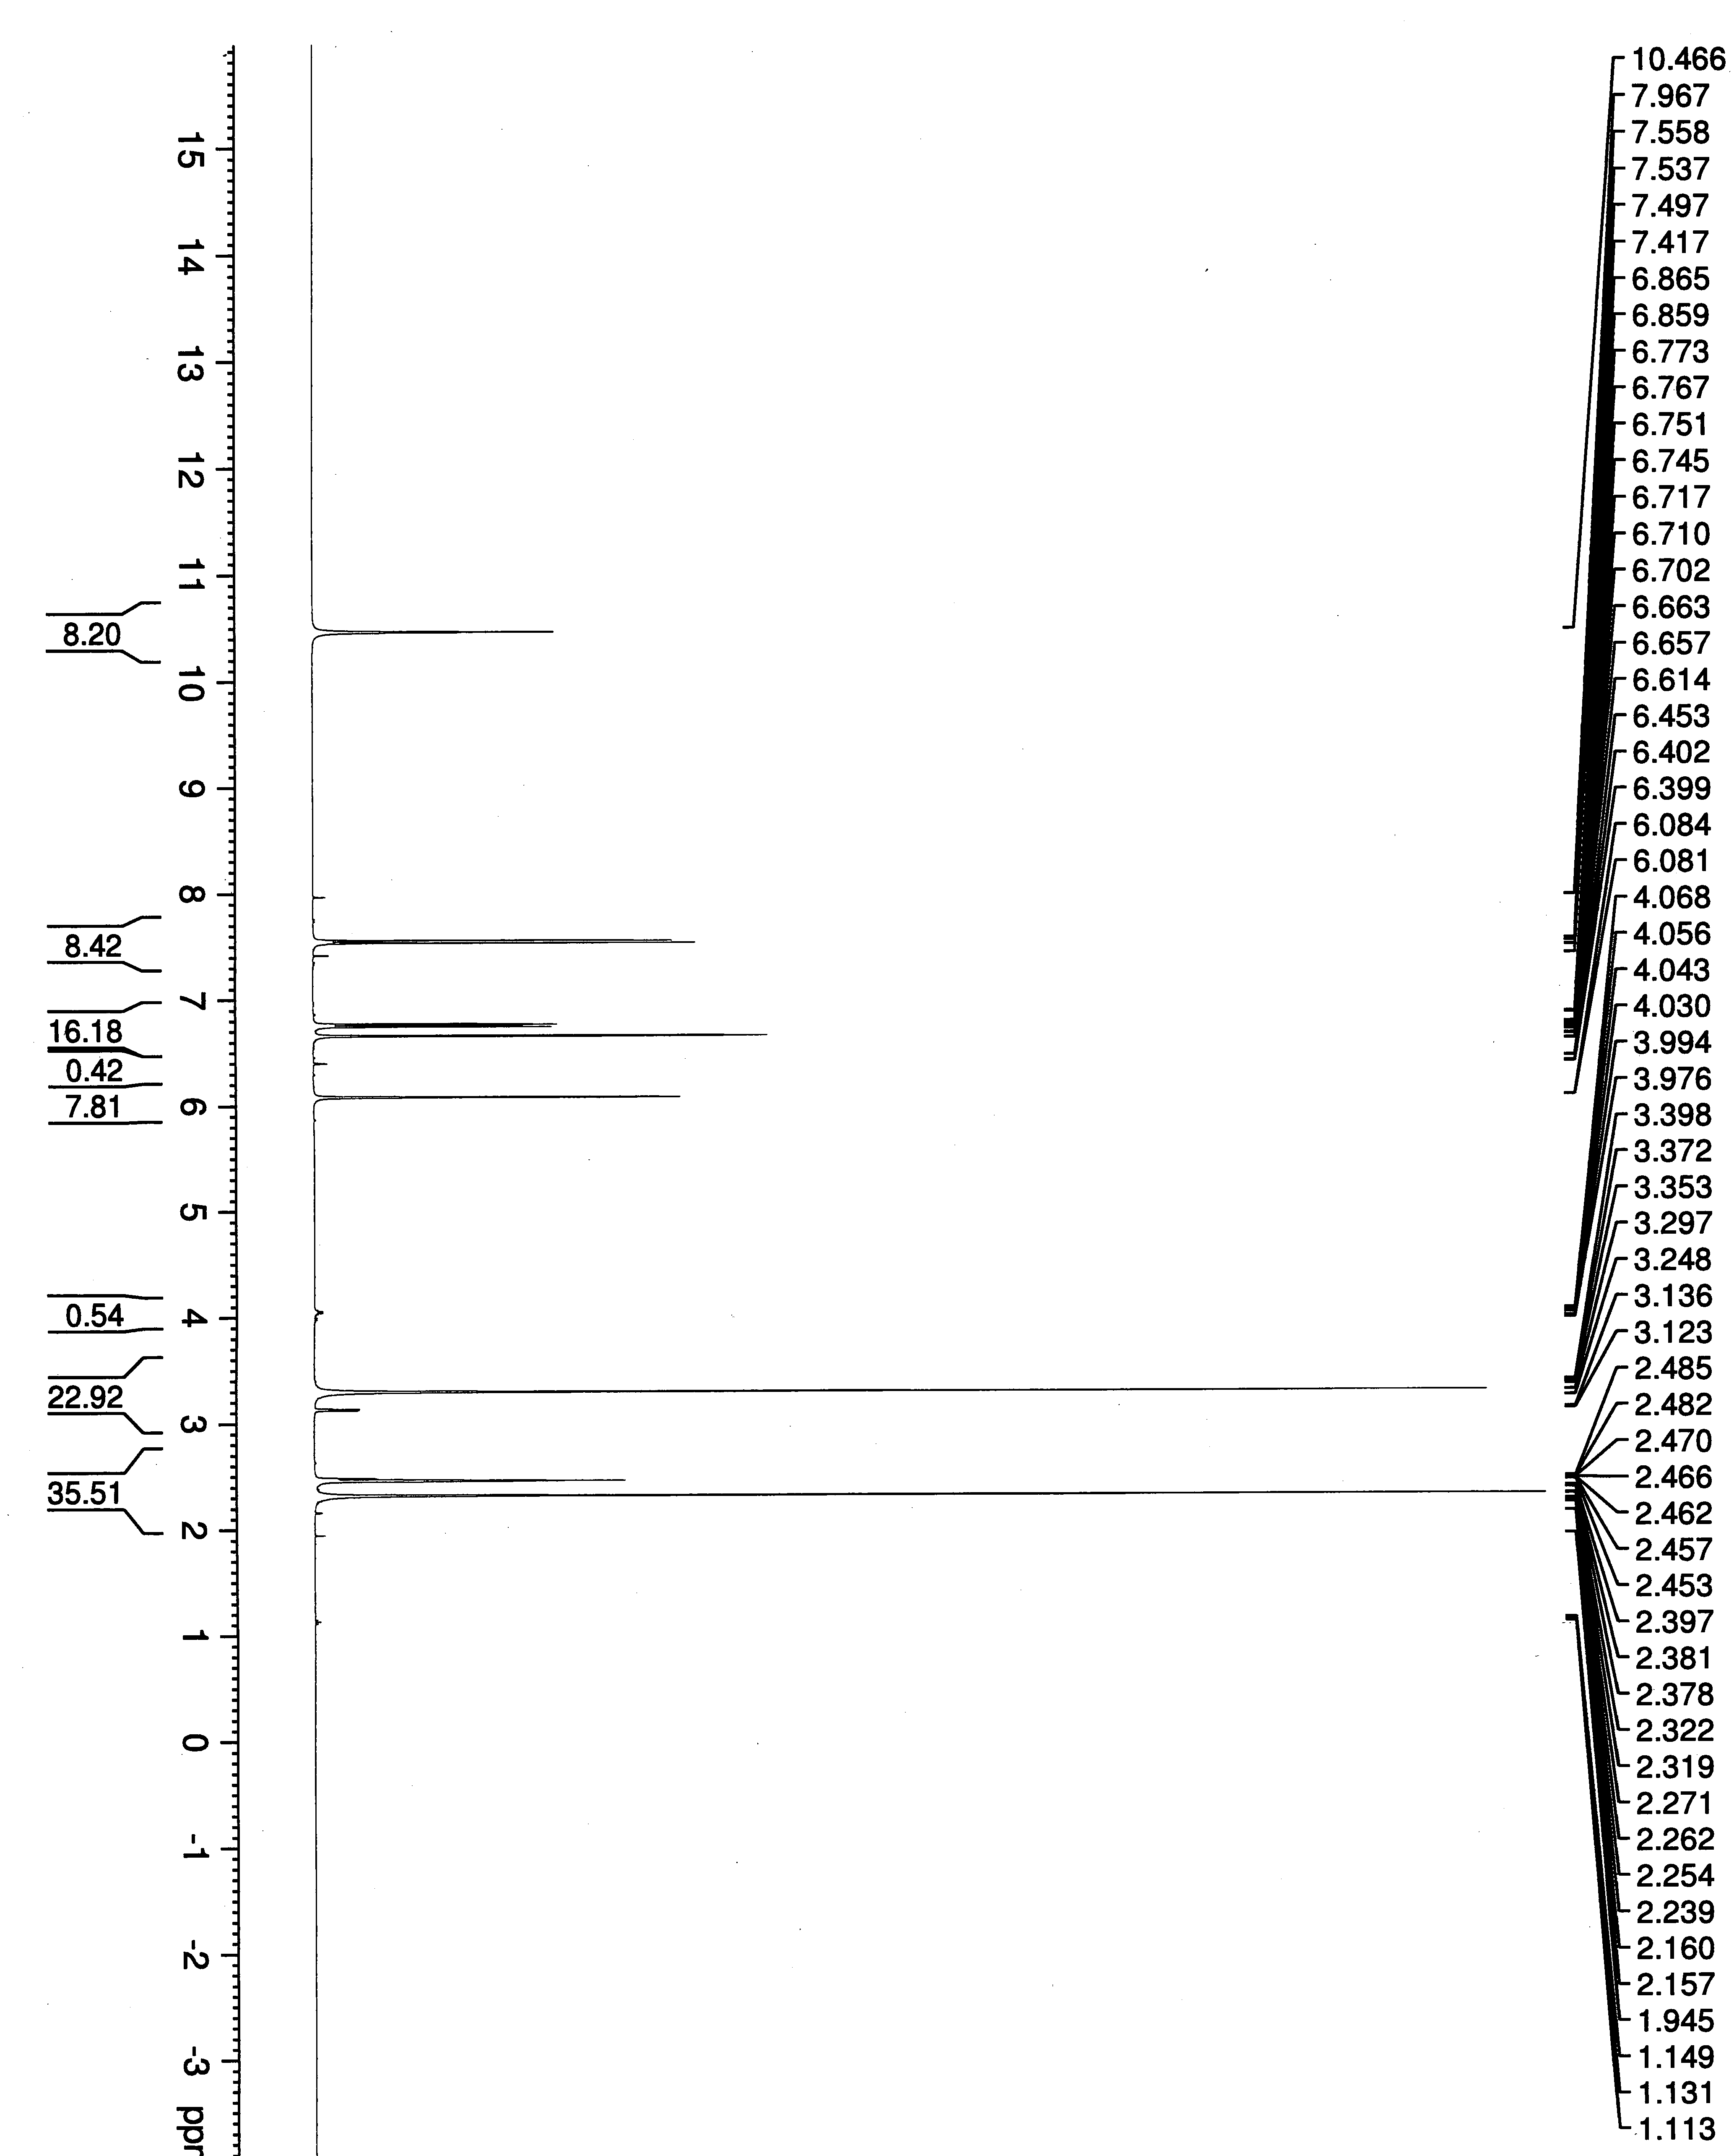
Characterization VI
¹H-NMR Spectrum (in DMSO-d₆)
δ=10.5 ppm (OH, H1)
δ=6.8 ppm (d, H2) and 7.5 ppm (d, H3) (aromatic protons)
δ=6.7 ppm (s, H6) and 6.1 ppm (s, H5) (aromatic and alkene proton)
δ=2.3 ppm (CH₃, H4)
H₂O in DMSO
H3 H2
H4
H6 H5
H1
DMSO

Slide 14
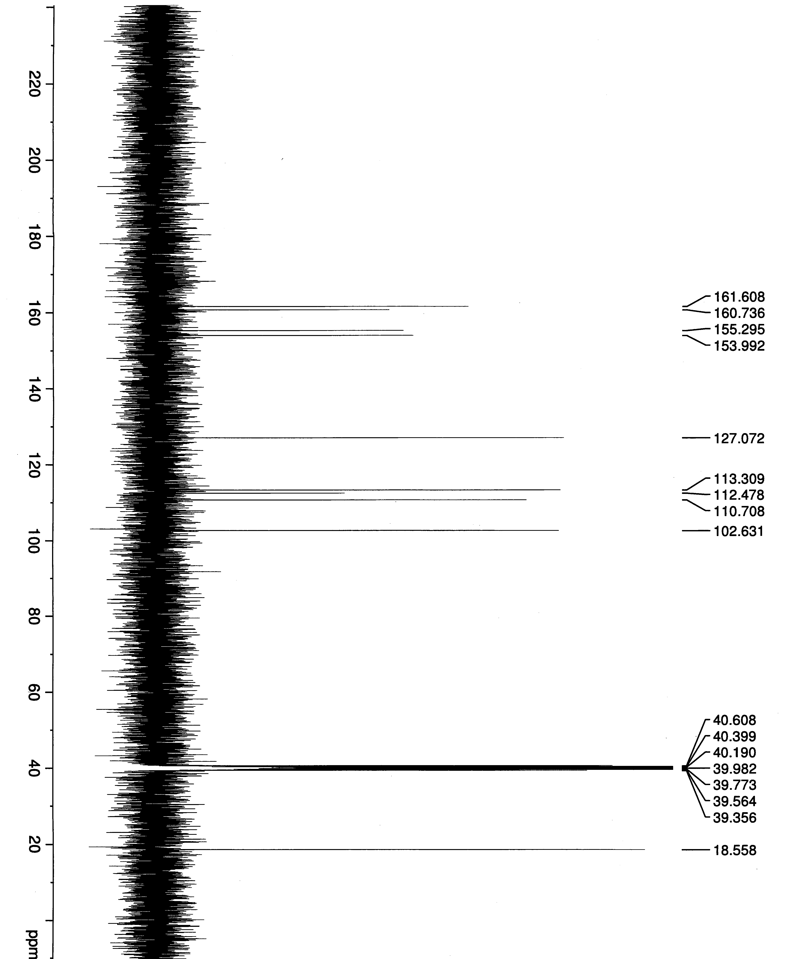
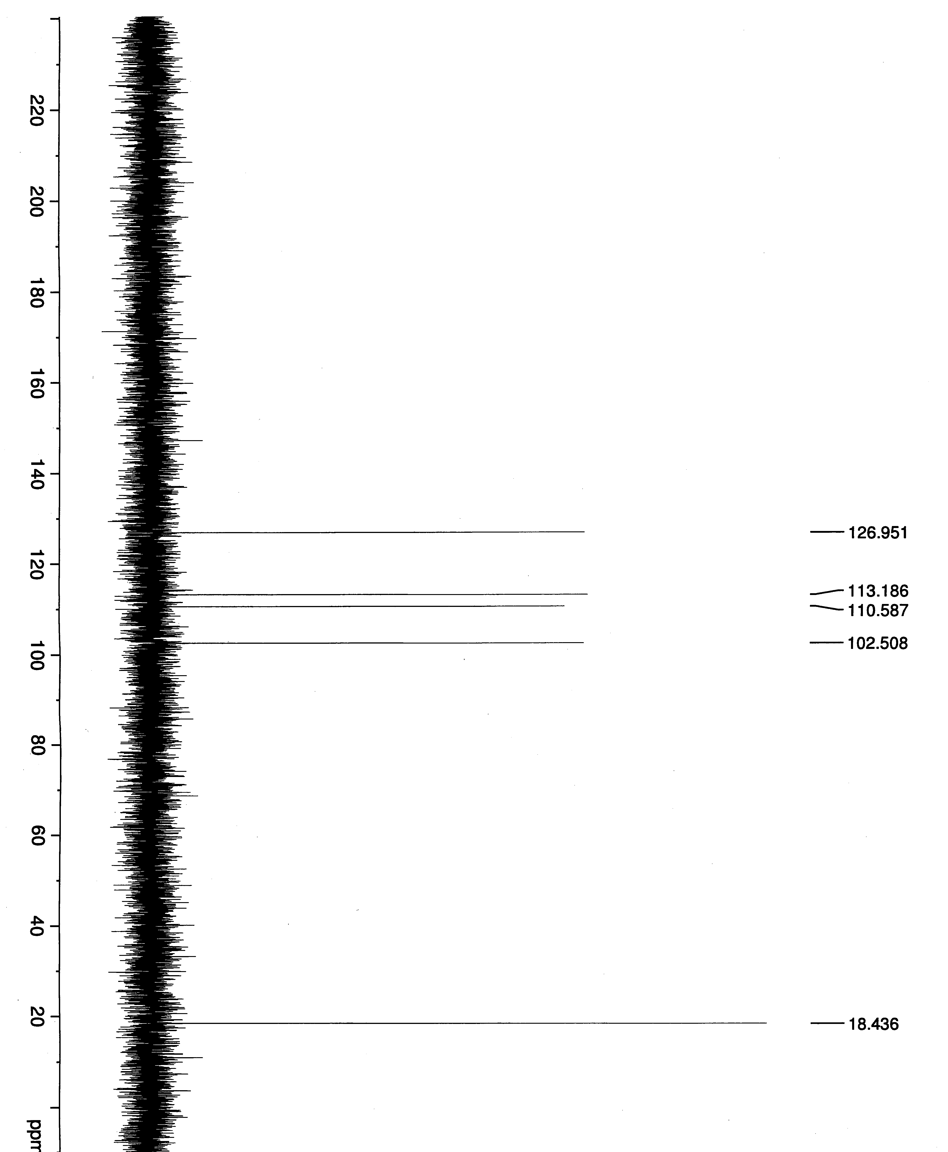
Characterization VII
¹³C{¹H}-Spectrum
Ten signals total
Five quaternary carbons
One carbonyl function (C9, 161.6)
Three ipso-carbons (C1 (160.7), C4 (112.5), C5 (154.0))
One disubstituted alkene (C7, 155.3)
Four methine carbons
Three CH (C2 (113.3), C3 (127.1), C6 (102.6))
One CH (C8, 110.7)
One methyl carbon (C10, 18.6)

Slide 15
Characterization VIII
Mass Spectrum
m/z=176 ([M]⁺)
m/z=148 ([M-28]⁺): loss of one carbon monoxide molecule leading to a benzofuran
m/z=147 ([M-28-1]⁺): loss of one carbon monoxide molecule and a proton
m/z=120 ([M-28-28]⁺): loss of two carbon monoxide molecules

