Slide 1
Lecture 5c
Aldol Condensation

Slide 2
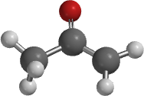
Introduction
The acidity of organic compounds is often determined
by neighboring groups because they can help stabilizing
the resulting anion (i.e., halogen, nitro, etc.) because of
their electronegative character.
For instance, the presence of a carbonyl group greatly
increases the acidity of neighboring hydrogen atoms (α-protons) because
of the resonance stabilization in the resulting enolate ion (the numbers in parentheses below are from acetone for comparison, MP2/6-311G**).
Many of the carbonyl compounds can be deprotonated with moderately strong bases i.e., hydroxide, alcoholates, etc.
Functional group | pK_{a}
Alkane | ~50
Ester | ~25
Aldehyde/ketone | ~18-20
Nitro | ~8-10
127.5 pm
(122.0 pm)
139.1 pm
(151.6 pm)

Slide 3
Aldol Condensation
Ketones and aldehydes can be reacted with each other in an Aldol or Claisen-Schmidt condensation.
Aldol
60 %
90 %

Slide 4
Theory I
In Chem 30BL, dibenzyl ketone is reacted with benzil using potassium hydroxide as catalyst.
The first step is the formation of the first enolate ion:
Note that water is one of the products in the enolate formation  water has to be excluded from the reaction mixture as much as possible (dry glassware, absolute ethanol) in order to optimize the amount of enolate formed.

Slide 5
Theory II
Mechanism
The hydroxyl group acts as a leaving group.
intermolecular
intramolecular

Slide 6
Theory III
What drives the reaction?
  The last step of the reaction is intramolecular thus favoring the cyclization.
  Enthalpy driven (ΔH_{f} < 0).
  Entropy driven (two reactant molecules go to three product molecules, ΔS >0, ΔG = ΔH - TΔS).
  The product is weakly polar because of the presence
  of four phenyl groups. Therefore, it is poorly soluble
  in absolute ethanol (and 95 % ethanol for this matter), which partially removes it from the equilibrium because it will precipitate during the reaction.

Slide 7
Experimental I
Dissolve the dibenzyl ketone and your own benzil in absolute ethanol
Add a spin vane to the conical vial
Bring the mixture to a gentle reflux (=boiling)
What should the student do
if he did not isolate enough benzil in the previous experiment?
Which way around?
Why is the mixture refluxed?
Use some of the supply
wrong orientation
correct orientation
To dissolve both ketones prior addition of the catalyst, which reduces the self-condensation of dibenzyl ketone

Slide 8
Experimental II
Add ethanolic potassium hydroxide solution drop wise
Gently reflux the mixture for about
10 minutes
Cool the reaction mixture to room temperature and then place it in an
ice-bath
Isolate the precipitate by vacuum filtration
Wash the solids with ice-cold
95 % ethanol
How can the addition be controlled?
Why should the addition be slow?
Which observation should be made here?
What does this imply?
How much solvent is used here?
By using a syringe
The reaction is exothermic and
tends to bump a lot
A color change from yellow to purple
The use of an air condenser cooled with a wet paper towel
Hint: Invert the conical vial above the funnel and inject some ice-cold ethanol to rinse out the crystals
1-2 mL

Slide 9
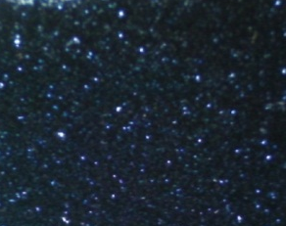
Experimental III
Dry the solid by sucking air through it
Weigh the “dry” solid
Dissolve the crude in a minimum amount of hot toluene:95% EtOH (1:1)
Allow the solution to cool down slowly
Isolate the solid by vacuum filtration
Why is the crude dried here?
How much solvents is used here?
How can this step best be accomplished?
To be able to estimate the solvent
required for recrystallization
~40 mg/mL at the b.p. of the mixture
By placing the solution in a warm water bath (~60-70 ºC)

Slide 10
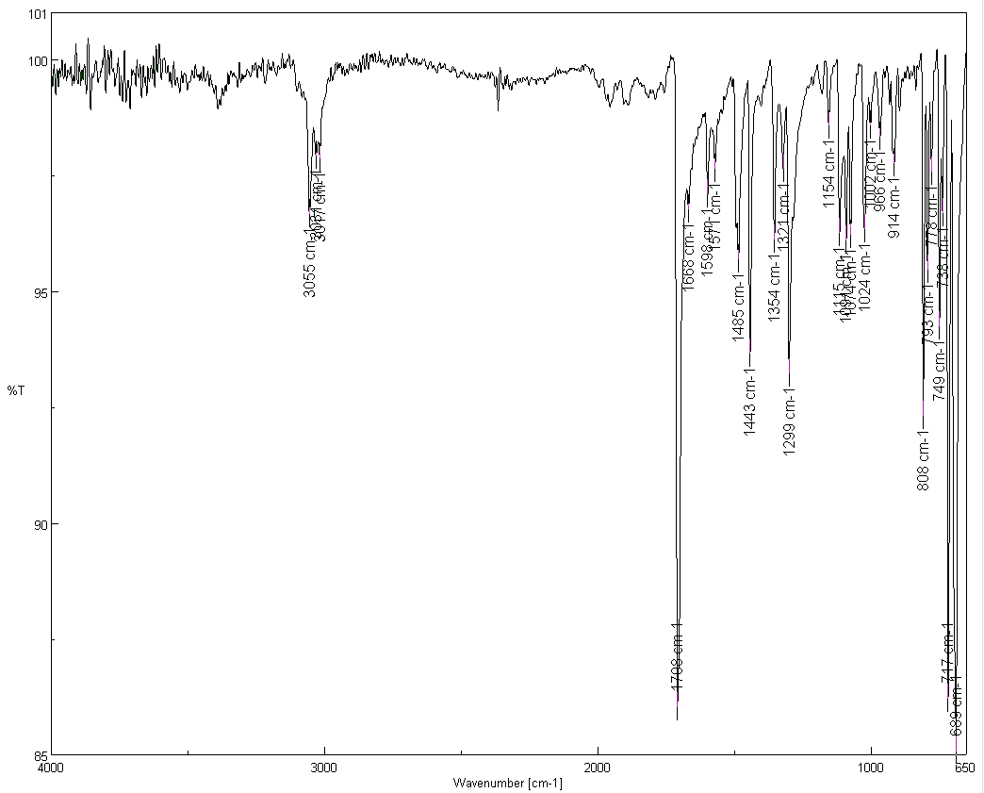
Characterization I
Melting Point
Infrared Spectrum (ATR)
  ν(C=O)=1708 cm⁻¹
  (the location is a result of the
  effect of conjugation (↓) and
  ring strain (↑))
¹³C-NMR Spectrum (see reader)
  Carbonyl carbon: δ=200.6 ppm
  β-carbon: δ=154.7 ppm
  α-carbon: δ=125.3 ppm
  The remaining peaks are assigned
  based on their size/abundance
ν(C=O)
α
β

Slide 11
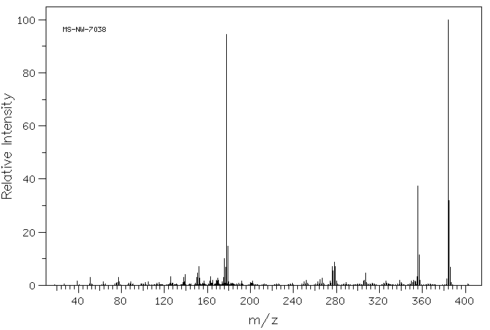
Characterization II
Mass spectrum
m/z=178
[Ph-C≡CPh]⁺
m/z=384
[M]⁺
m/z=356
[M-CO]⁺

Slide 12
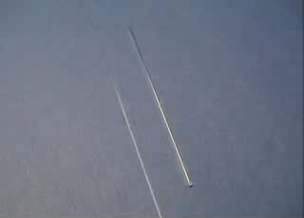
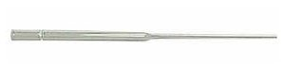
Characterization III
TLC
  Three students form a group here using different mobile phases
    Student 1: heptane
    Student 2: diethyl ether
    Student 3: propanol
    Plus: optimized mixture
  Concentration: 5 mg/mL of ethyl acetate
  Spotting has to be done with capillary
  spotters drawn from 9 inch Pasteur pipette
Melt here not here

Slide 13
Characterization IV
UV-Vis Spectroscopy
  Range: λ=300-700 nm
  Solvent: isopropanol
    The compound is weakly polar and dissolving it in isopropanol is more difficult. So be PATIENT!
  Concentration: based largest peak in the range to be measured (see SKR):
    It is important that the entire sample is dissolve prior to any dilution in order to actually know the true concentration of
    the sample being measured in the end!
  Cuvette: polyethylene
    It can only be used with low boiling alcohols.
    Toluene, hexane, the solvent mixture used for recrystallization, acetone, etc. cannot be used with this cuvette because they will etch the cuvette making it non-transparent.

