Slide 1
Lecture 5b
High-Performance Liquid Chromatography (HPLC)

Slide 2
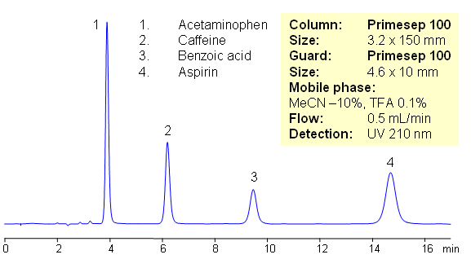
Introduction
HPLC is used to ensure the safety and nutritional quality of food i.e., chemical additives (i.e., antioxidants such as TBHQ, BHA and BHT), residues (i.e., antibiotics, steroids and flavonoids) and environmental contaminants (i.e., pesticides, insecticides).
In forensics, it is used in drug analysis, toxicology, explosives analysis, ink analysis, fibers and plastics.
HPLC is used to obtain ‘fingerprints’ of natural compounds like teas, herbs and other traditional medicines.
Excedrin

Slide 3
HPLC vs GC
HPLC does not have any volatility issues but the solute has to be somewhat soluble in the mobile phase.
HPLC can analyze samples over a wide range of polarities, even ionic compounds if the proper mobile phase is used.
The molecular size of the molecules can be larger (i.e., large proteins, peptides) than in GC as long as the compound is soluble enough.
HPLC uses significantly shorter columns and higher pressures compared to GC.

Slide 4
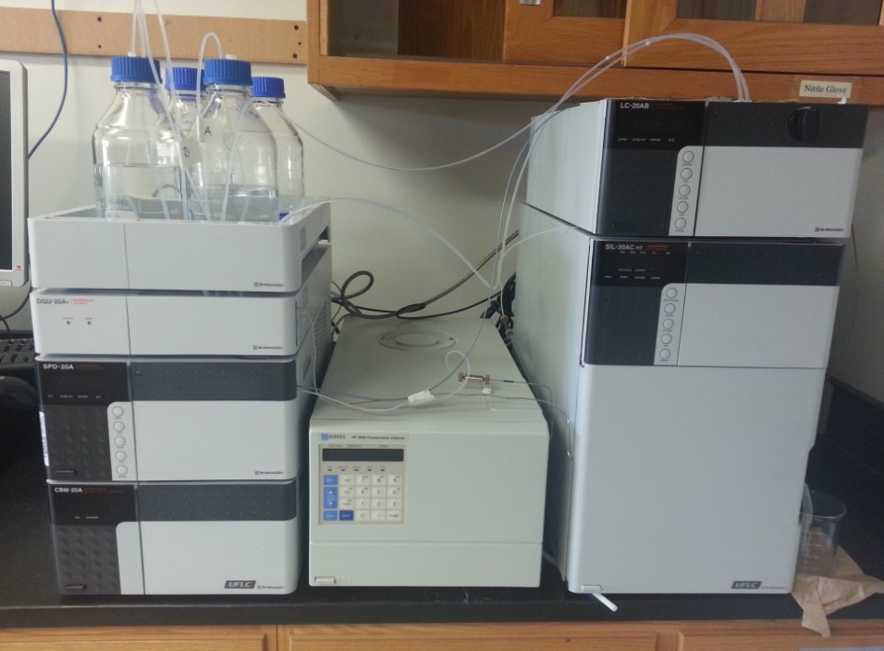
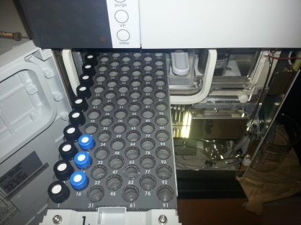
Setup
Located in YH 6076
Flow direction
Guard column
Column
Pump and mixing chamber
Solvent reservoirs with HPLC grade solvent
Autosampler
UV-Vis detector
Fluorescence detector

Slide 5
Mobile Phase I
The solvents have to be very pure to prevent contamination of the mobile phase, resulting in poorer reproducibility, a higher (and changing) background signal deterioration of the stationary phase.
The elution strength of a mobile phase is defined by the parameter e⁰
The elution strength of methanol is very high on polar stationary phases like silica (e⁰=0.73) or alumina (e⁰=0.95) but very low on reversed-phase stationary phases (i.e., C18, C8).
Polar solvents like water, methanol, ethanol or acetonitrile are often used as mobile phase when using a reversed-phase column.
Mixed solvent systems usually display an elution strength between the individual solvents (i.e., water and an organic solvent like methanol or acetonitrile, e_{system}=c₁e₁+c₂e₂+…+c_{n}e_{n}, Σc_{n}=1).
When using solvent mixtures or gradients, many parameters have to be considered.

Slide 6
Mobile Phase II
Miscibility
Acetone, absolute ethanol, isopropanol and tetrahydrofuran are fully miscible with most other solvents (water to hexane).
Acetonitrile and methanol are not miscible with hydrocarbon solvents like pentane, hexane and heptane.
If buffers were used as mobile phase, the pH-value of the buffer should be two pH-units below the pK_{a}-value of the analyte for acidic compounds or two pH-units above the pK_{a}-value of the analyte for basic compounds to reduce ionization (initial concentration: 10-25 mM).
If an aqueous salt solution is used, the experimenter has to consider the solubility of the salt in the solvent mixture to prevent the precipitation of the salt in the tubing, the injection loop, the needle, the column, etc. (The cleanup of
The solvent has to be compatible with the stationary phase as well. Some stationary phases are not chemically bonded to the support material (i.e., some chiral stationary phases).

Slide 7
Mobile Phase III
Viscosity (η)
The viscosity of the solvents is one factor that determines the back pressure of the column.
Aqueous solvent mixtures often display a higher viscosities than the individual solvents.
The viscosity of the mobile phase also changes with the temperature, often decreasing with increasing temperature. The viscosity of pure methanol decreases with increased temperature (η=0.59 cP (20 ºC), η=0.45 cP (40 ºC)).
The HPLC run can be performed isocratically or as gradient (if two or more solvents can be used). The gradient can change linearly or in complex multistep fashion. The change in solvent composition will result in a change of viscosity and the background signal.
Solvent | η²⁰ (cP)
Water | 1.00
Methanol | 0.59
Ethanol | 1.20
Acetonitrile | 0.37
Isopropanol | 2.30
Dimethyl sulfoxide | 2.24

Slide 8
Mobile Phase IV
Dipole character (π*), acidity (α) and basicity (β)
Solvent | Acidity (α) | Basicity (β) | Dipolarity (π*) | P’ | ε (silica) | UV-cutoff (nm)
Acetic acid | 0.54 | 0.15 | 0.31 | 6.0 | >0.73 | 230
Acetone | 0.06 | 0.38 | 0.56 | 5.1 | 0.47 | 330
Acetonitrile | 0.15 | 0.25 | 0.60 | 5.8 | 0.50 | 190
Alkanes | 0.00 | 0.00 | 0.00 | 0.1 | 0.00 | 200
Chloroform | 0.43 | 0.00 | 0.57 | 4.1 | 0.26 | 245
Dichloromethane | 0.27 | 0.00 | 0.73 | 3.1 | 0.32 | 235
Dimethyl formamide | 0.00 | 0.44 | 0.56 | 6.4 |  | 268
Dimethyl sulfoxide | 0.00 | 0.43 | 0.57 | 7.2 | 0.41 | 268
Ethanol | 0.39 | 0.36 | 0.25 | 4.3 | 0.65 | 210
Ethyl acetate | 0.00 | 0.45 | 0.55 | 4.4 | 0.38 | 260
Methanol | 0.43 | 0.29 | 0.28 | 5.1 | 0.73 | 210
Nitromethane | 0.17 | 0.19 | 0.64 | 6.0 | 0.54 | 380
Propanol (1- or 2-) | 0.36 | 0.40 | 0.24 | 3.9 | 0.60 | 210
Tetrahydrofuran | 0.00 | 0.49 | 0.51 | 4.0 | 0.35 | 215
Toluene | 0.17 | 0.83 | 0.00 | 2.4 | 0.23 | 284
Triethylamine | 0.00 | 0.84 | 0.16 | 1.9 |  | 235
Water | 0.43 | 0.18 | 0.45 | 10.2 | 0.82 | 200

Slide 9
Stationary Phase I
Most HPLC columns are made from stainless steel (inner diameters of 2-5 mm and lengths of 5-25 cm if the particle size is below 10 mm)
Smaller particles and a longer column improve the separation but also increase the retention time.
The separation in HPLC can be based on different principles:
Adsorption (normal phase=polar stationary phase)
Reversed-phase chromatography (non-polar stationary phase i.e., C18-column)
Ion-Pair chromatography (stationary phase contains -NR₃⁺ or -SO₃⁻ groups)
Ion chromatography
Size-exclusion chromatography (separation by size)
Affinity chromatography (based on the specific interaction of a substrate with specific groups on the stationary phase i.e., antibodies)
Chiral chromatography (i.e., cyclodextrin, Pirkle column)

Slide 10
Stationary Phase II
Silica
Free silanols are slightly acidic (pK_{a}= ~7). Metal ions near these silanols further increase the acidity causing substantial problems with basic compounds (extensive tailing).
Geminal silanols and associated silanols are not acidic but compounds with hydroxyl groups tend to interact very strongly with the latter.

Slide 11
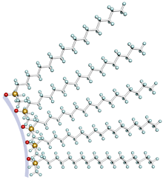
Stationary Phase III
Reversed-phase Stationary Phases
Many stationary phases are modified in their polarity. The longer the hydrocarbon chain attached to the silica surface, the less polar the stationary phase will be and the higher the retention times will be for non-polar compounds.
On reversed-phase columns, the retention decreases in the following order: aliphatics > induced dipoles (i.e., CCl₄) > weak Lewis bases (ethers, aldehydes, ketones) > strong Lewis bases (amines) > weak Lewis acids (alcohols, phenols) > strong Lewis acids (carboxylic acids)
Enantiomers can also be separated using chiral stationary phases
Amino acid derivatives (alanine, leucine, glycine), cellulose derivatives (i.e., Lux Cellulose 1 (cellulose, tris-(3,5-dimethylphenylcarbamate)) or β-cyclodextrin phases that are chemically bonded to the silica.

Slide 12
Stationary Phase IV
Other Aspects
Unretained compounds like uracil or potassium nitrate are usually used to determine dead volume (t₀) for a reversed-phase column.
A non-polar compound like 1,3,5-tri-tert.-butylbenzene (TTBB) is used for the same purpose in normal-phase chromatography (i.e., silica).
Type of Compounds | Mode | Stationary Phase | Mobile Phase
Neutrals, weak acids, weak bases | Reversed-phase | C8, C18, cyano, amino | Water, organics
Ionics, acids, bases | Ion pair | C8, C18 | Water/organic ion-pair reagent
Compounds not soluble water | Normal phase | Amino, cyano, diol, silica | Organics
Ionics, inorganic compounds | Ion exchange | Anion or Cation exchange resin | Aqueous/Buffer
High molecular weight compounds | Size exclusion | Polystyrene, silica | Gel filtration: aqueous Gel permeation: organic

Slide 13
Data Analysis I
A compound can be identified by its corrected retention time (t_{R}’), which is the difference of the retention times of the compound (t_{R}) and the unretained compound (t₀), or the retention index (k).
A solute with k=2 is twice as retained by the stationary phase as a solute with k=1.
t_{R1}
t_{R2}
t₀
t_{R}’
w₁
w₂

Slide 14
Data Analysis II
The separation factor (α) is a measure of the time or distance between the maxima of two peaks. It is calculated by the ratio of two retention indices
If α =1, then the peaks have the same retention and co-elute. Generally, α-values between one and two are sufficient for the identification.
t_{R1}
t_{R2}
t₀
t_{R}’
w₁
w₂

Slide 15
Data Analysis III
The resolution of two neighboring peaks is defined as the ratio of the distance between two peak maxima (t_{R}) and the arithmetic mean of the two peak widths (w) or half-widths (w_{1/2}).
For quantitative analysis, it is necessary to obtain baseline resolution (i.e., R=1.5). If the peaks are significantly different in size, an even higher resolution will be necessary to reduce the overlap and allow for the quantitative analysis.
t_{R1}
t_{R2}
t₀
t_{R}’
w₁
w₂

Slide 16
Data Analysis IV
The effect of different separation conditions on retention (k), selectivity (a), and plate number (N) is summarized in the table
Note: ++ (major effect); + (minor effect); - (relatively small effect); 0 (no effect); bolded quantities denote conditions that are primarily used (and recommended) to control k, α, or N, respectively (i.e., % B is varied to control k or α, column length is varied to control N). (a) For ionizable solutes (acids or bases) (b) Higher pressures allow larger values of N by a proper choice of other conditions; pressure per se, however, it has little direct effect on N
Condition | k | α | N
% modifier B | ++ | + | −
B-solvent (acetonitrile, methanol, etc.) | + | ++ | −
Temperature | + | + | +
Column type (C18, phenyl, cyano, etc.) | + | ++ | −
Mobile phase pHª | ++ | ++ | +
Buffer concentrationª | + | + | −
Ion-pair-reagent concentrationª | ++ | ++ | +
Column length | 0 | 0 | ++
Particle size | 0 | 0 | ++
Flow rate | 0 | 0 | +
Pressure | − | − | +^{b}

Slide 17
Practical Aspects
The solvent for the sample has to be very clean (HPLC grade, absolute).
The concentration of the samples should be 1-2 mg/mL in a suitable solvent that has to be compatible with the stationary phase. The sample cannot contain any solids to prevent the clogging of the syringe.
The sample vial has to be filled with 1.5 mL of sample.
In Chem 30BL and Chem 30CL, the HPLC vials have a black cap while the GC vials have a blue cap.
The sample has to be signed in.
The peak area depends on the wavelength that was used to acquire the spectrum. The calibration data has to be used to determine the concentration of the solute (in mg/mL).

