Slide 1
Lecture 3a
Reduction of D-(+)-Camphor

Slide 2
Introduction
Reduction of Ketones and Aldehydes
Transfer of either two hydrogen atoms from H_{2,} from an H⁻ and H⁺ or by disproportion
Reactant | Product | Reagent | Name
Ketone | Alkane | Zn/HCl N₂H₄/KOH | Clemmensen Wolff-Kishner
Ketone | Alcohol | H₂/Ni | Raney Nickel
Ketone | Alcohol | Al(OCH(CH₃)₂)₃ | Meerwein-Ponndorf
Ketone | Alcohol | NaBH₄, LiAlH₄
Aldehyde | Alcohol + Acid | KOH | Cannizzaro
Ketone | Diol | Mg-metal hν/(CH₃)₂CHOH | Pinacol Pinacol for aromatic ketones

Slide 3
Mechanism I
In Chem 30BL, sodium borohydride (NaBH₄) will be used
as the reducing agent
One of the main driving forces for reaction are the formation of a very strong B-O bond vs. the π-bond of the carbonyl group and the B-H bond
as well as the formation of a new σ(C-H) and a new O-H bond.
The light elements of group 3 often form compounds that possess a
partial double bond character in the E-X bond, if X has one or more
lone pairs i.e., N, O, F, etc.
Bond | D(kJ/mol)
B-H | 345
C-H | 338
B-O | 809
C-O | 1076
O-H | 430

Slide 4
Mechanism II
Ultimately, two hydrogen atoms are added to the ketone: one originates from the hydride (:H⁻), which forms the C-H function, and the other one from the protic solvent (H⁺) that leads to the formation of the hydroxyl function.

Slide 5
Mechanism (Stereochemistry I)
The reduction of 2-pentanone affords a racemic mixture of 2-pentanol because the activation energies (ΔG‡) for the two alternate pathways are identical.
The reduction of D-(+)-camphor affords a mixture of two diastereomeric alcohols. The exo product (=(-)-isoborneol) is formed in larger quantity compared to the
endo product (=(+)-borneol) because the activation energy for the formation of
the exo product is lower.

Slide 6
Mechanism (Stereochemistry II)
The stereochemistry of the reaction can be explained using HOMO-LUMO concept:
  The hydride is the nucleophile in the reaction that provides
  the electrons for the newly formed C-H bond.
  The carbonyl group is the electrophile in the reaction and therefore has to provide an empty orbital for the reaction (π*(C=O), LUMO).
100-120º

Slide 7
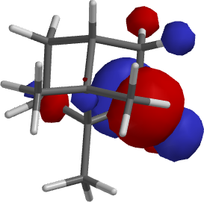
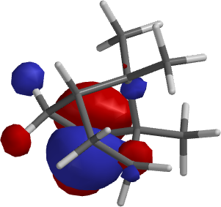
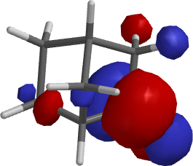
Mechanism (Stereochemistry III)
Exo approach Endo approach Exo approach
Bottom line:
  Camphor: exo approach is sterically more hindered resulting in
  a higher activation energy for this pathway and a lower quantity
  of the endo product (=borneol).
  2-Norbornanone: the exo approach is less hindered resulting in
  the endo product as major product.
camphor
camphor
2-norbornanone

Slide 8
Mechanism (Stereochemistry IV)
The stereoselectivity for the reaction would be higher
  if the R-group on the side of the carbonyl function is larger
  if the nucleophile is bulkier
  if the reaction temperature was lowered
Reducing Agent | Volume (Å³) | 2-Norbornanone (endo product) | Camphor (exo product)
NaBH₄ | 37.77 | 86 % | 86 %
LiAlH₄ | 44.24 | 89 % | 92 %
LiAlH(OMe)₃ | 126.75 | 98 % | 99 %
LiBH(n-Bu)₃ | 255.25 | 98 % | 98 %
LiBH(sec-Bu)₃ | 252.46 | 99.6 % | 99 %
LiBH(iso-Amyl)₃ | 308.86 | >99.5 % | 99.3 %

Slide 9
Experimental Design
Choice of Reducing Agent
  LiAlH₄ : leads to higher stereoselectivity, more reactive (can even be pyrophoric); requires very dry solvent (i.e., diethyl ether, tetrahydrofuran dried over sodium metal)
  NaBH₄ : displays higher chemoselectivity, lower degree of stereoselectivity but much safer and strong enough of a reducing reagent to reduce the ketone
Choice of Solvent
  NaBH₄: moderately soluble in water, insoluble in diethyl ether
  Camphor: very poorly soluble in water (0.1 g/100 mL), well soluble in diethyl ether
  The solvent choice is a compromise in terms of polarity: methanol dissolves both
  compounds reasonably well (NaBH₄: 13 g/100 mL, camphor: 63.1 g/100 mL)
  Problem: Sodium borohydride reacts with protic solvents 
  Solution
    A large excess of the reducing agent is used to ensure the complete reduction of
    the camphor✓
    Camphor is dissolved in a small amount of methanol before the NaBH₄ is added,
    which takes advantage of the fact the reduction of the camphor is faster than
    hydrolysis of NaBH₄✓

Slide 10
Experiment I
Dissolve the camphor in a small amount of methanol in a 25 mL Erlenmeyer flask
Add the sodium borohydride in three small portions
Bring the suspension to a gentle boil
After the reaction is completed, place the solution in a cold water bath
Add ice-cold water to the reaction mixture
Isolate the solid using vacuum filtration
Suck air through the solid for at least 10 minutes
What is the setup here?
Why?
Why is water added?
Why is air sucked through the solid?
Watch glass with ice
One boiling stick of
appropriate length
To have better control over the reaction
during the addition of the water
To complete the hydrolysis and
to precipitate the organic compounds
(1.2 mg/mL borneol in water at 25 ºC)
To remove the bulk of the water from
the solid

Slide 11
Experiment II
Dissolve the solid in a small amount of diethyl ether
Add a small amount of drying agent (MgSO₄)
Remove the drying agent
Extract the drying agent with a small amount of diethyl ether
Remove the solvent using the rotary evaporator
Why is the solid dissolved again?
What are you looking for here?
How is accomplished?
Why is this step necessary?
Why is the drying agent removed?
Why is the rotary evaporator used?
How this piece of equipment work?
In order to dry it
1. Some free flowing drying agent
2. A transparent solution
To recover some of the adsorbed product
1. The drying process is reversible
2. The product and the drying agents are both white solids which makes it impossible to separate them later
See video for details

Slide 12
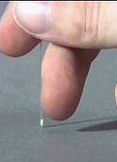
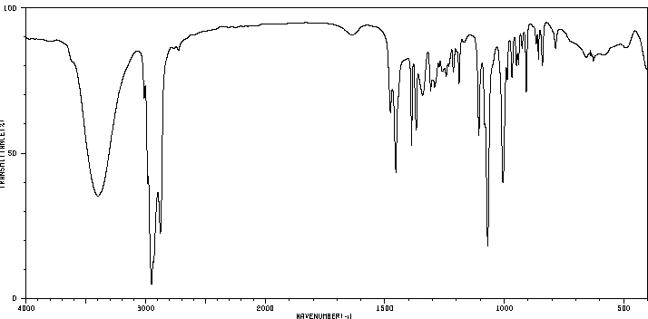
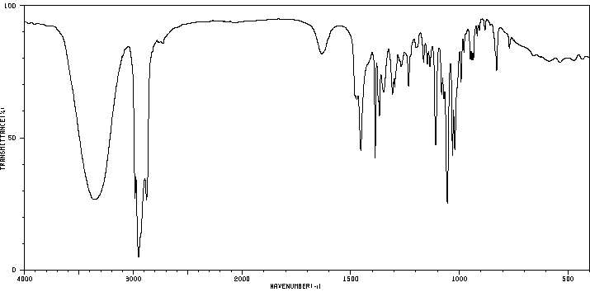
Characterization I
Melting Point (~ 1 mm in melting point capillary)
  Too much sample will result in a broader melting point range
  because the heat transfer takes too long.
Infrared Spectrum
Isoborneol (KBr):
  ν(OH)=3200-3400 cm⁻¹
  ν(C-OH)=1069 cm⁻¹
  (strong)
  ν(C=O)=1744 cm⁻¹
  is absent!
Borneol (KBr):
  ν(OH)=3200-3400 cm⁻¹
  ν(C-OH)=1055 cm⁻¹
  (strong)
ν(C=O)
ν(OH)
Isoborneol
ν(C-OH)
ν(OH)
Borneol
ν(C-OH)

Slide 13
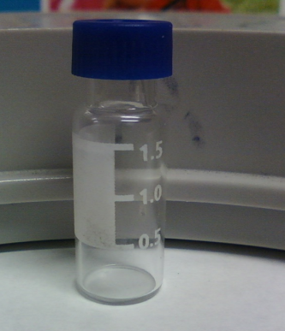
Characterization II
Gas Chromatography
  Prepare a solution of the final product in diethyl ether (conc: 1 mg/mL)
  Fill the GC vial to the 1.5 mL mark
  Close the vial with a cap and submit into tray
  The sample cannot contain any undissolved solids or
  water because they will cause significant problems
  during the data acquisition.
  Sign the sample in on the sign-in sheet: student name
  and code on the vial (make sure not to remove it). Do
  not forget to record the code in your notebook as well.
  Samples that are not signed in will not be run!
  The printout is usually available starting the office on the next day.

Slide 14
Polarimetry I
Optical activity was discovered by E.L. Malus (1808).
Chiral molecules rotate the plane of polarization of polarized light.
The specific optical rotation is a physical property like a melting point or a boiling point.
Compound | [α]_{D} (in º)
(1R)-(+)-Camphor | +44.26
Sucrose | +66.47
Cholesterol | -31.50
D-(+)-Glucose | +52.70
D-(-)-Fructose | -92.00
Morphine | -132.00
L-Proline (in water) | -84.00

Slide 15
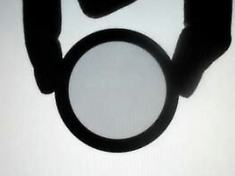


Polarimetry II
How does it work?
  Polarized lenses are used in expensive sunglasses, photo
  lenses, etc. to reduce glare and reflections from surfaces.
  Monochromatic light is polarized by a Nicol prism (polarizer).
  The plane-polarized light passes through a polarimetry cell in which
  the plane of the light will be rotated if the cells contains a chiral compound.
  The analyzer at the end of the setup rotates the plane of the light back
  to its original orientation.
Polarizer
Analyte
Analyzer

Slide 16
Polarimetry III
The value of the optical rotation (a) depends on the wavelength
(the subscript “D” refers to λ=589.3 nm), the path length (l), the concentration (c) and the specific optical rotation for the specific enantiomer and to a lesser degree on the temperature (X):
The sign of the optical rotation is independent from the absolute configuration!
The sign and absolute value can depend on the solvent because
the observer might look at different compounds i.e., cation, anion
or neutral specie for amino acids.
The specific rotation can be used to assess the optical purity of a chiral compound by comparing it with published data:

Slide 17
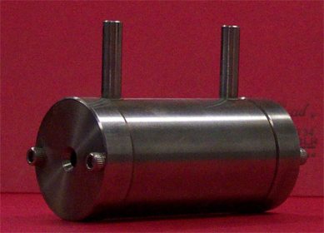
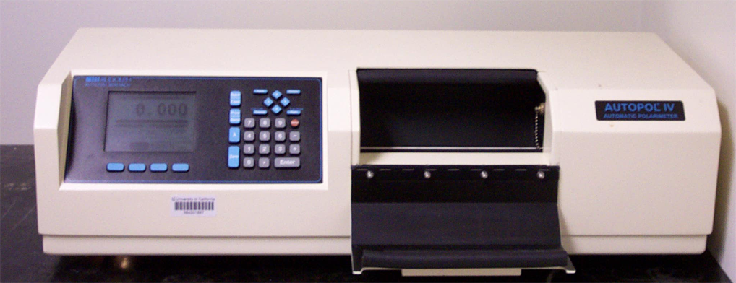
Polarimetry IV
Polarimeter (located in YH 1096 for Chem 30BL)
Concentration: ~1 % in 95 % ethanol (the exact concentration in g/mL has to be known for the correction of the observed α-value).
It is important that there are no air bubbles in the path of the light because they will cause problems in the measurement (i.e., dark sample error).
The ratio of (-)-isoborneol and (+)-borneol can be calculated by
α_{obs}=x(-34.6º)+(1-x)(+37.7º)
α_{obs}=specific optical rotation of the sample after concentration correction
x =the fraction of isoborneol in the sample
[α]_{D}= +37.7º for (+)-borneol and [α]_{D}= -34.6º for (-)-isoborneol

Slide 18
Polarimetry V
What influences the result in the polarimetry measurement?
  The concentration of the sample
  A wet sample will yield a less negative value because the concentration is less than assumed, which results in a lower reading for the sample
  The presence of unreacted camphor ([α]_{D}= +44.26º )
  The ratio of the (-)-isoborneol and (+)-borneol i.e., a 80:20 mixture should result in a value of [α]= ~ -20º after the concentration correction

