Slide 1
Lecture 2
Acid Catalyzed Dehydration of
2-Methylcyclohexanol

Slide 2
Formation of Alkenes
Dehydrohalogenation of an alkyl halide using a strong base
Catalytic reduction of an alkyne i.e., Lindlar catalyst (Pd) to form cis-alkenes, Na/NH_{3(l)} to form trans-alkenes
Wittig reaction (R’R”C=PR₃) from an aldehyde or ketone
Tebbe’s reagent ((C₅H₅)₂Ti(μ²-CH₂)(μ²-Cl)Al(CH₃)₂) from an aldehyde or ketone (the CH₂ group is transferred here to for a terminal alkene)
Catalytic cracking process (from larger an alkane using catalysts)
Hofmann elimination, Cope reaction (from amines)
Chugaev elimination (from alcohols via xanthate)

Slide 3
Alkenes as Reactants

Slide 4
Mechanistic Considerations I
Primary Alcohols (E2)
Secondary Alcohols (E1 and/or E2)
b.p.=165 °C b.p.=110 °C b.p.=104 °C b.p.=101 °C
Tertiary Alcohols (E1)
      b.p.=83 ºC b.p.= -7 ºC
Benzylic Alcohols
  Many benzylic alcohols can be dehydrated with weak acids (i.e., silica,
  oxalic acid, acetic acid/iodine), sometimes even at room temperature
l

Slide 5
Mechanistic Considerations II
E1 Mechanism
  The type of cation form in the reaction determines the overall rate of the reaction: benzylic > allylic > tertiary > secondary (>> primary >>> methyl)
Rearrangements
The product with the highest degree of substitution on the double bond is favored under thermodynamic conditions according to Zaitsev’s Rule.
ΔH_{f}= -103 kJ/mol ΔH_{f}= -95 kJ/mol

Slide 6
Mechanistic Considerations III
The regiocontrol in the elimination from α-terpineol is observed due to pre-existing double bonds:
The product distribution follows more or less the degree of stability of the product because the reaction is carried out under thermodynamic conditions (elevated temperature).
The product distribution will change significantly if a different catalyst or different conditions are used for the reaction.
Only the five most abundant products (of nine products) are shown above.
 | (2) | (3) | (4) | (5) | (6)
Yield | 15 % | 9 % | 29 % | 19 % | 15 %
ΔH_{f}(kJ/mol) | -9.4 | -2.5 | -20.5 | -17.5 | -17.8

Slide 7
Mechanistic Considerations IV
If the reaction in the lab would follow an E1 mechanism, the initially formed secondary carbocation (1) rearranges into a tertiary carbocation (2) via a hydride shift.
The elimination of a proton from cation (1) leads to the formation of 1-methylcyclohexene (4)
and 3-methylcyclohexene (3), while the elimination from cation (2) leads to the formation of
1-methylcyclohexene (4) and methylenecyclohexane (5).
Based on Zaitsev’s Rule, compound (4) is expected to be the major product. In addition, some cyclopentene derivatives are formed by a ring contraction via a alkyl shift in the carbocation (2).
The product distribution should remain constant during the progress of the reaction:
ΔH_{f}= -75.3 kJ/mol -81.2 kJ/mol -61.3 kJ/mol

Slide 8
Mechanistic Considerations V
Problem: The composition of the product mixture changes over time.
This phenomenon -sometimes referred to as Evelyn effect- contradicts the fundamental principle in organic chemistry by which reactions always go by the lowest energy pathway.
The 2-methylcyclohexanol provided is a mixture of cis and trans isomers (~47:53 by GC).
For both isomers the conformer on the left is the major conformer because it is energetically lower (ΔG‡(axial-equatorial): CH₃: 7.28 kJ/mol, OH: 3.90 kJ/mol). The leaving group has to be in axial position for the elimination to occur.
The cis isomer of the protonated alcohol reacts out its major conformer to yield primarily to 1-methylcyclohexene (4) and some 3-methylcyclohexene (3) because there are two hydrogen atoms located antiperiplanar to the leaving group.
In the minor conformer of the trans isomer, there is only one hydrogen atom antiperiplanar to the leaving group leading to only one product, 3-methylcyclohexene (3).
Thus, the two isomers display different rates of elimination (cis:trans=~8.5:1), a strong evidence for a preferential
E2 mechanism.

Slide 9
Driving Forces
Forward Reaction
  Elevated temperatures: takes advantage of the entropy increase (ΔG=ΔH-TΔS, ΔS>0) and to remove the products from the equilibrium as they are formed.
  Strong acid: it promotes the protonation of the hydroxyl group and minimizes the amount of water in the system.
Reverse Reaction
  Diluted acid: catalyst and water present.
  Moderate temperatures: to increase the rate of the reaction.
  Pressure: alkene and water turn into alcohol i.e., ethanol

Slide 10
Experimental Design
Example: Elimination from Cyclohexanol
The equilibrium constant for many elimination reactions is low because neither the enthalpy (ΔH=23.9 kJ, ) nor the entropy (ΔS=84.91 J, ) changes much and they also display opposing trends. Thus, the equilibrium constant is K_{eq}=1.8 at 25 ºC and K_{eq}=8 at 80 ºC, which are both low.
If the reaction was carried out at room temperature, the yield of the reaction
will be poor (theoretically: 73 % at 25 ºC).
The literature reports an isolated yield of 85 % for the reaction when using
concentrated phosphoric acid as catalyst. How?
The yield can be improved using the Le Châtelier Principle:
  Applying the stress from the reactant side is not possible because there is only one reactant, cyclohexanol!
  Applying the stress on the product side by removing the product(s) is an option
  because the products of the reaction (cyclohexene and water) have a lower boiling
  point than the reactant.

Slide 11
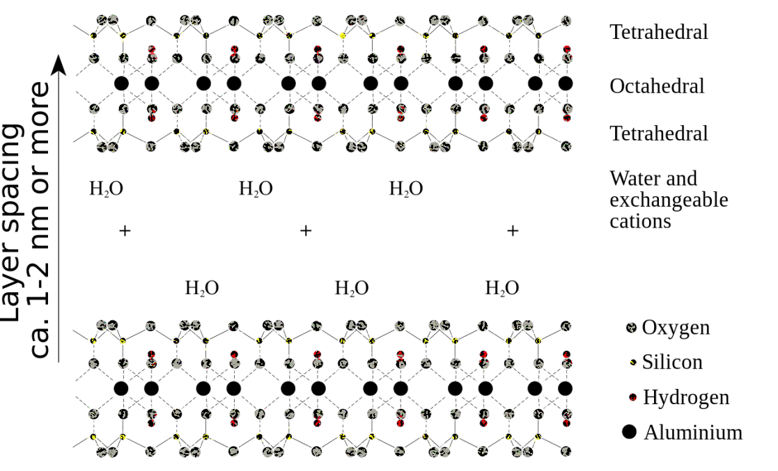
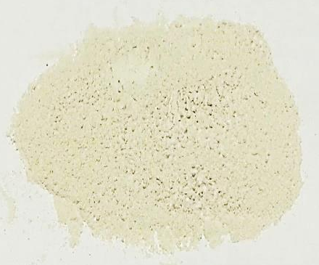
Solid-State Catalysts
The catalyst that is used in this experiment (Montmorillonite K10) is a clay catalyst that consists of aluminosilicates (Na_{0.33}((Al_{1.67}Mg_{0.33})(OH)₂(Si₄O₁₀)*n H₂O).
It is an acid-treated clay and its acidity compares with the strength of some mineral acids.
Montmorillonites are used in cosmetics, as a base in cat litter products, in cracking processes and demolition because they expand when reacted with water.

Slide 12
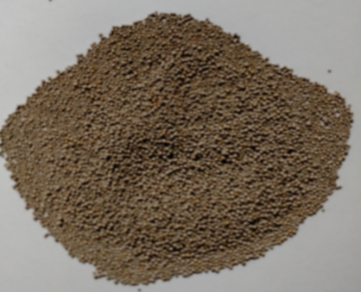
Solid-State Catalysts
Amberlyst
  Amberlyst catalysts are based on
  substituted polystyrenes:
    R= -SO₃H (A 15, strongly acidic. pK_{a}= ~-2,
    max. temp.: 120 ºC)
    R= -CH₂N(CH₃)₂ (A 21, weakly basic,
    max. temp: 100 ºC)
    R= -CH₂N(CH₃)₃⁺OH⁻ (A 26, strongly basic),
    max. temp.: 60 ºC)

Slide 13
Green Chemistry Aspects
Why is the chosen approach “greener”?
  Less decomposition of the organic material:
  no strong mineral acid (conc. H₃PO₄, conc. H₂SO₄)
  Safer chemicals are used which reduces the dangers in cases of accidents: no strong mineral acid
  (conc. H₃PO₄, conc. H₂SO₄)
  Dangerous waste prevention: no strong mineral acid, catalyst is recycled

Slide 14
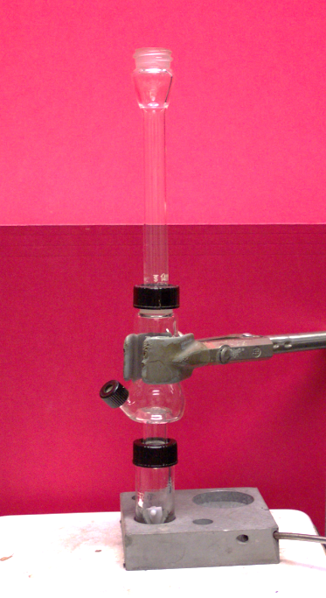

Procedure I
No cap on the top!
Assemble the setup as shown in the picture. An O-ring has to be placed below the compression cap!
Place the 2-methylcyclohexanol, the assigned catalyst and a properly placed spin vane in the conical vial.
If the conical vial and the Al-block have poor contact, use Al-foil on the sides and the bottom to improve the heat transfer.
Wrap a wet paper towel around the upper part of the Hickman head and the air condenser.
Gently boil the mixture for 30 minutes before heating the mixture to a gentle boil to slowly distill the products (~60 minutes). Once the distillation started, the temperature should not be raised.
Wet paper towel

Slide 15
Procedure II
If the lip of the Hickman head fills up, remove the product using the Pasteur pipette from the top or via the side port
if available. The group should collect
three fractions (~0.5 mL each).
Store the distillate in a closed vial.
After the distillation is completed, collect the product by rinsing the Hickman head with saturated sodium chloride solution.
Combine the rinse with the third fraction.
After closing the vial with a plastic cap, gently shake the mixture to extract the water.
Why is the distillate stored in a closed vial?
How do you know that the distillation is completed?
The methylcyclohexenes possess a low
boiling point and are very volatile
No more distillate can be collected
unless the temperature is raised
significantly

Slide 16
Procedure III
Tilt the vial and separate
the organic layer and the aqueous layer using a
Pasteur pipette.
Dry the organic layer over a small amount of anhydrous sodium sulfate.
Add some saturated sodium chloride solution to the other fractions as well.
Submit a GC sample for each fraction isolated (~1 mg/mL).
How could a given layer be identified?
How do you know that the solution is dry?
Why is it removed?
Density: Methylcyclohexenes: ~0.8 g/mL
sat. NaCl solution: ~1.2 g/mL
The solution is clear
Free flowing drying agent
The drying process is reversible
at elevated temperatures

Slide 17
Procedure IV
Clean-up (for clay and Amberlyst catalyst)
  After removing the spin vane from the conical vial, some acetone is used to rinse the clay out
  of the vial. This rinse is collected in a specially marked container
  Nothing else should be placed in this container (i.e., spin vane) because the lab support will recycle the clay for future experiment

Slide 18
Characterization I
Qualitative Tests
  These tests exploit the high reactivity of the alkene function towards bromine (or potassium permanganate, not performed in the lab anymore but the student still needs to know this test).
  The bromination affords a trans dibromide via a bromonium ion
  and the reaction with KMnO₄ the cis diol via a five-membered ring intermediate.
  When adding the bromine solution, make sure to do this drop wise
  and not a large amount at a time because the test will fail. Why?

Slide 19
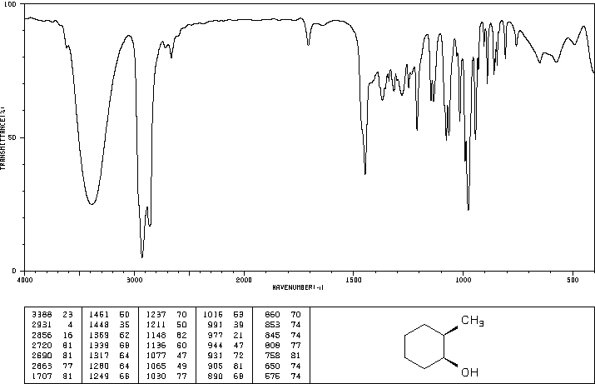
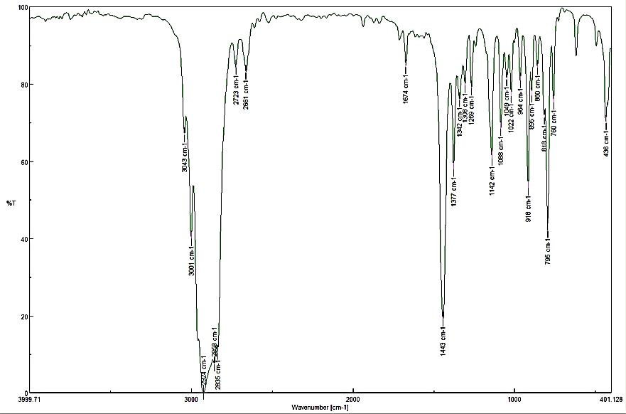
Characterization II
Infrared Spectroscopy
Reactant: cis 2-Methylcyclohexanol
  ν(OH)= ~ 3100-3500 cm⁻¹
  ν(C-OH)=977 cm⁻¹
  ν(CH, sp³)=2863-2931 cm⁻¹
Product: 1-Methylcyclohexene
  ν(CH, sp²)= 3043 cm⁻¹
  ν(CH, sp³)=2835-3001 cm⁻¹
  ν(C=C)=1674 cm⁻¹
  oop trisubstituted alkene=795 cm⁻¹
  Acquired using ATR setup (review the
  procedure in SKR, Hint: Place a cap
  on the sample to reduce its evaporation)
ν(OH)
ν(CH,sp³)
ν(C-OH)
ν(C=C)
ν(CH,sp²)
oop
ν(CH,sp³)

Slide 20
Characterization III
¹H-NMR Spectrum
  1-Methylcyclohexene
    δ=1.63 ppm (3 H, s, H7)
    δ=1.9 to 2.0 ppm (4 H, m, H3 and H6)
    δ=1.5 ppm (4 H, m, H1 and H2)
    δ=5.4 ppm (1 H, dd, H4)
  3-Methylcyclohexene
    δ=0.98 ppm (3 H, d, H7)
    δ=1.35 ppm (2 H, m, H6)
    δ=1.55 ppm (2 H, m, H1)
    δ=2.10 ppm (2 H, m, H2)
    δ=5.45 ppm (1 H, d, H4)
    δ=5.55 ppm (1 H, ddd, H3)

Slide 21
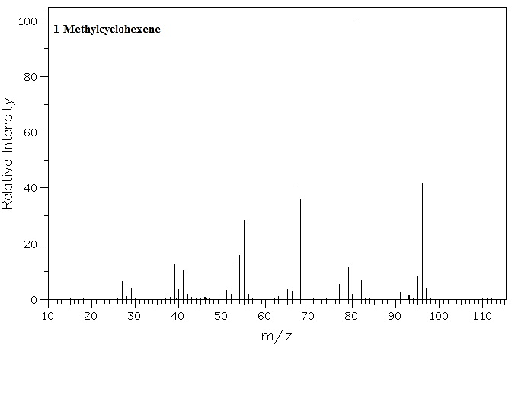
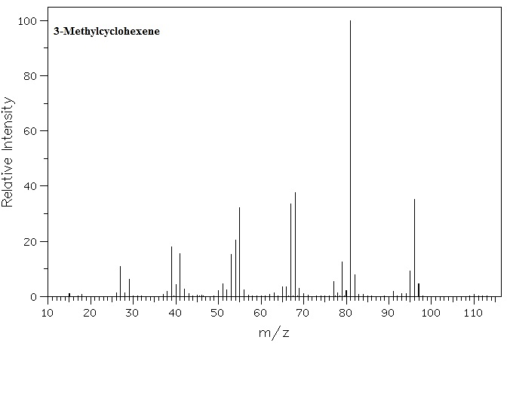
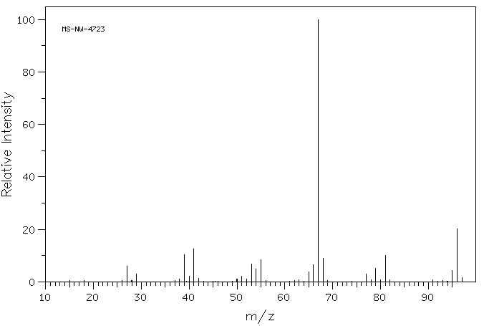
Characterization IV
Mass Spectra
  m/z=96 (M⁺)
  m/z=81 ([M-CH₃]⁺)
  m/z=68 ([C₅H₈]⁺)
  m/z=67 ([C₅H₇]⁺)
  m/z=55 ([C₄H₇]⁺)
The mass spectra for the
methylcyclohexenes display
the same base peak (m/z=81),
look very similar otherwise.
The mass spectra for the
ethylcyclopentenes display
the same base peak (m/z=67),
look very similar otherwise.
1-Ethylcyclopentene

