Slide 1
Lecture 2
Acid Catalyzed Dehydration of Cyclohexanol

Slide 2
Formation of Alkenes
Dehydrohalogenation of an alkyl halide using a strong base
Catalytic reduction of an alkyne i.e., Lindlar catalyst (Pd) to form cis-alkenes, Na/NH_{3(l)} to form trans-alkenes
Wittig reaction (R’R”C=PR₃) from an aldehyde or ketone
Tebbe’s reagent ((C₅H₅)₂Ti(μ²-CH₂)(μ²-Cl)Al(CH₃)₂) from an aldehyde or ketone
Catalytic cracking process (from larger an alkane using catalysts)
Hofmann elimination, Cope reaction (from amines)
Chugaev elimination (from alcohols via xanthate)

Slide 3
Alkenes as Reactants

Slide 4
Mechanistic Considerations I
Primary alcohol
Secondary alcohol
b.p.=161 °C b.p.=83 °C
Tertiary alcohol
      b.p.=83 ºC b.p.= -7 ºC
Benzylic alcohol
  Many benzylic alcohols can be dehydrated with weak acids (i.e., silica,
  oxalic acid, acetic acid/iodine), sometimes even at room temperature
l

Slide 5
Mechanistic Considerations II
Basic mechanism
  The type of cation form in the reaction determines the overall rate of the reaction: benzylic > allylic > tertiary > secondary > primary >> methyl
Rearrangements
The product with the highest degree of substitution on the double bond is favored under thermodynamic conditions according to Zaitsev’s Rule
ΔH_{f}= -103 kJ/mol ΔH_{f}= -95 kJ/mol

Slide 6
Mechanistic Considerations III
Regiocontrol is observed due to pre-existing double bonds
The product distribution follows more or less the degree of stability of
the product because the reaction is carried out under thermodynamic conditions (elevated temperature)
The product distribution will change significantly if a different catalyst
or different conditions are used for the reaction
Note also that only the five most abundant products (of nine products)
are shown above
 | (2) | (3) | (4) | (5) | (6)
Yield | 15 % | 9 % | 29 % | 19 % | 15 %
ΔH_{f}(kJ/mol) | -9.4 | -2.5 | -20.5 | -17.5 | -17.8

Slide 7
Experimental Design
The equilibrium constant for the elimination reaction is low because neither the enthalpy (ΔH=23.9 kJ, ) nor the entropy (ΔS=84.91 J, ) changes much in the
reaction and they also display opposing trends. Thus, the equilibrium constant is K_{eq}=1.8 at 25 ºC and K_{eq}=8 at 80 ºC, which are both low.
If the reaction was carried out at room temperature, the yield of the reaction
will be poor (theoretically: 73 % at 25 ºC)
The literature reports an isolated yield of 85 % for the reaction when using
concentrated phosphoric acid as catalyst. How?
The yield can be improved using the Le Châtelier Principle
  Applying the stress from the reactant side is not possible because there is only one reactant, cyclohexanol!
  Applying the stress on the product side by removing the product(s) is an option
  because the products of the reaction (cyclohexene and water) have a lower boiling
  point than the reactant

Slide 8
Driving Forces
Forward reaction
  Elevated temperatures: takes advantage of the entropy increase (ΔG=ΔH-TΔS, ΔS>0) and to remove the products from the equilibrium as they are formed
  Strong acid: it promotes the protonation of the hydroxyl group and minimizes the amount of water in the system
Reverse reaction
  Diluted acid: catalyst and water present
  Moderate to low temperature: to increase the rate of the reaction

Slide 9
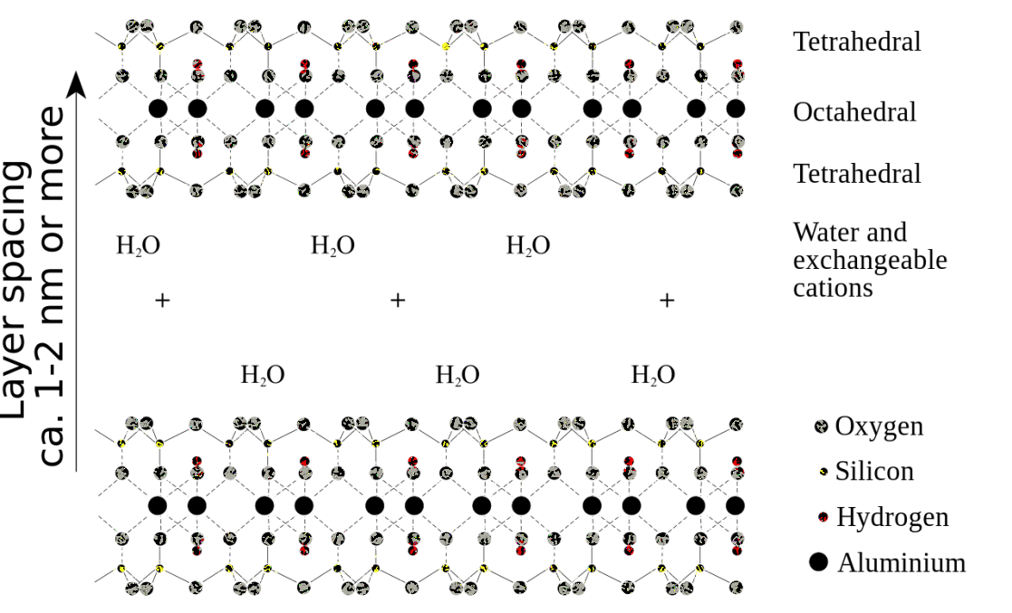
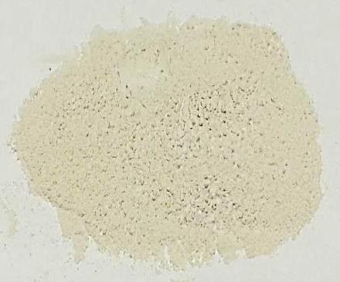
Solid-State Catalyst
The catalyst that is used in this experiment (Montmorillonite K10) is a clay catalyst that consists of aluminosilicates (Na_{0.33}((Al_{1.67}Mg_{0.33})(OH)₂(Si₄O₁₀)*n H₂O).
It is an acid-treated clay and its acidity compares with the strength of some mineral acids.
Montmorillonites are used in cosmetics, as a base in cat litter products, in cracking processes and demolition because they expand when reacted with water

Slide 10
Green Chemistry Aspects
Why is the chosen approach “greener”?
  Less decomposition of the organic material:
  no strong mineral acid (conc. H₃PO₄, conc. H₂SO₄)
  Safer chemicals are used which reduces the dangers in cases of accidents: no strong mineral acid
  (conc. H₃PO₄, conc. H₂SO₄)
  Dangerous waste prevention: no strong mineral acid, catalyst is recycled

Slide 11
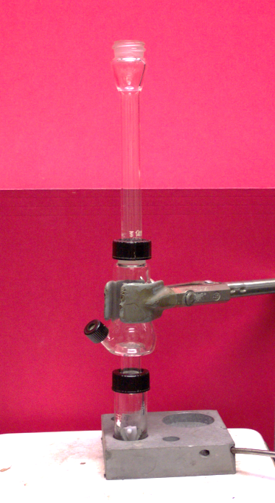

Procedure I
No cap on the top!
Assemble the setup as shown in the picture. An O-ring
has to be placed below the compression cap!
Place the cyclohexanol, the Montmorillonite K10 and
a properly placed spin vane in the conical vial
If the conical vial and the Al-block have poor contact,
use Al-foil on the sides and the bottom to improve the
heat transfer
Wrap a wet paper towel around the upper part of the Hickman head and the air condenser
Gently boil the mixture for 15-20 minutes before heating
the mixture to a gentle boil to slowly distill the products (~45-60 minutes)
If the lip of the Hickman head fills up, remove the product using the Pasteur pipette from the top or via the side port
if available.
Wet paper towel

Slide 12
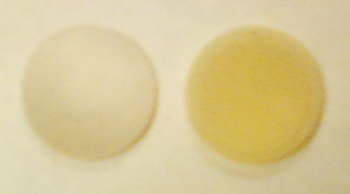
Procedure II
Store the distillate in a closed vial
After the distillation is completed, collect the product by rinsing the Hickman head with saturated sodium chloride solution
Combine the rinse with the previously collected distillate
After closing the vial using a flat septum and a compression cap, gently shake the mixture
Why is the distillate stored in a closed vial?
How do you know that the distillation is completed?
Which side of the flat septum goes down?
Cyclohexene possesses a low boiling
point and is very volatile
The distillate is clear because it
is mainly comprised of water
The flat septum has a rubbery side
(silicone, beige, left) and a plastic side
(Teflon, white, right, down)

Slide 13
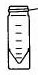
Procedure III
Separate the organic layer
and the aqueous layer
using a Pasteur pipette
Dry the organic layer over a small amount of anhydrous sodium sulfate
Remove the drying agent prior to the second distillation using the small conical vial
How could a given layer be identified?
How do you know that the solution is dry?
How is the drying agent removed?
Why is it removed?
Density: Cyclohexene: ~0.8 g/mL,
sat. NaCl solution: ~1.2 g/mL
The solution is clear
Free flowing drying agent
By pipetting the liquid out
using a Pasteur pipette
The drying process is reversible at elevated temperatures!

Slide 14
Procedure IV
Clean-up
  After removing the spin vane from the conical vial, some acetone is used to rinse the clay out
  of the vial. This rinse is collected in a specially marked container
  Nothing else should be placed in this container (i.e., spin vane) because the lab support will recycle the clay for future experiment

Slide 15
Characterization of the Product I
Qualitative Tests
  These tests exploit the high reactivity of the alkene function towards bromine (or potassium permanganate, not performed in the lab anymore but the student still needs to know this test)
  The bromination affords a trans dibromide via a bromonium ion
  and the reaction with KMnO₄ the cis diol via a five-membered ring intermediate
  When adding the bromine solution, make sure to do this drop wise
  and not a large amount at a time because the test will fail. Why?
Br₂/EtOH

Slide 16
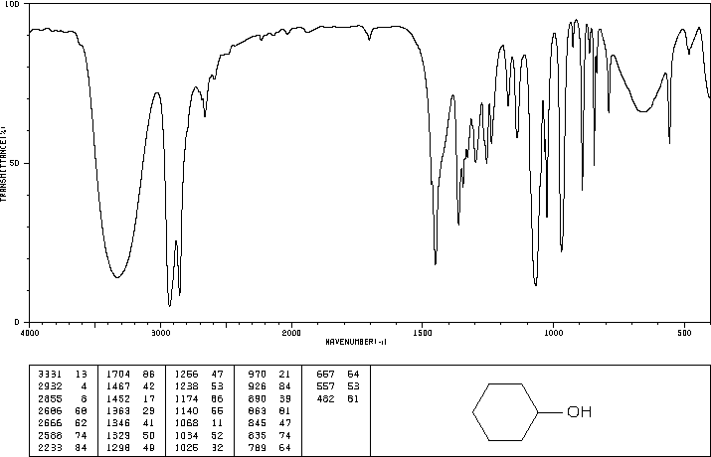
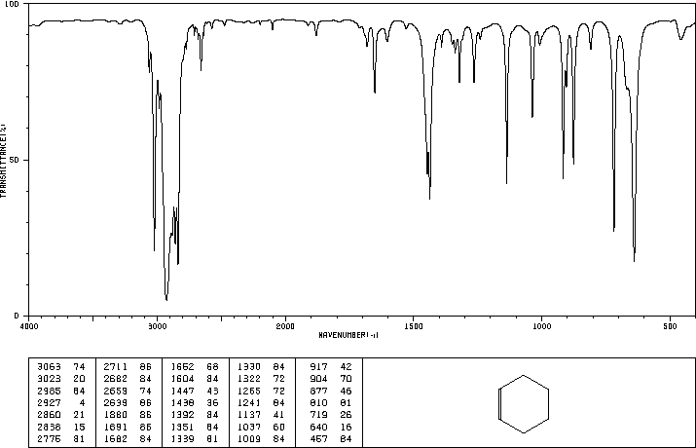
Characterization of the Product II
Infrared spectroscopy
Reactant: Cyclohexanol
  ν(OH)= ~ 3100-3500 cm⁻¹
  ν(C-OH)=1068 cm⁻¹
  ν(CH, sp³)=2855, 2932 cm⁻¹
Product: Cyclohexene
  ν(CH, sp²)=3023, 3062 cm⁻¹
  ν(CH, sp³)=2838-2965 cm⁻¹
  ν(C=C)=1652 cm⁻¹
  oop cis-alkene=719 cm⁻¹
  Acquired using ATR setup (review the
  procedure in SKR, Hint: Place a cap
  on the sample to reduce its evaporation)
ν(OH)
ν(CH,sp³)
ν(C-OH)
ν(C=C)
ν(CH,sp²)
oop
ν(CH,sp³)

