Slide 1
Lecture 10a
Polarity

Slide 2
Why this discussion?
Polarity is one of the key concepts to understand the trends observed in many techniques used in this course
  Physical properties: melting point, boiling point,
  viscosity, solubility, etc.
  Chromatography: thin-layer chromatography,
  column chromatography, HPLC, gas chromatography
  Chemical properties: nucleophile, electrophile,
  acidity, reactivity
  Spectroscopy: Infrared, NMR, UV-Vis

Slide 3
What determines Polarity?
The atoms that are involved in the bonds
  Polarity is only observed in bonds formed by two atoms exhibiting a significant difference in electronegativity (or hybridization)
The structure of the molecule
  A molecule can have polar bonds but is non-polar (i.e., CCl₄, CF₄, BF₃, CO₂) overall because the molecule is symmetric  the individual dipole moments cancel each other in a perfectly symmetric structure like a tetrahedron, trigonal planar or linear arrangement
  An asymmetric molecule with polar bonds will be polar overall (i.e., CO, H₂O, CHCl₃) particularly if it contains one or more lone pairs.
C-C C-H C-O C-F
EN 2.5 2.5 2.5 2.1 2.5 3.5 2.5 4.0
ΔEN 0 0.4 1.0 1.5
Polar no weakly medium very

Slide 4
Intermolecular Forces
Ion-dipole
Increase in bond strength
Hydrogen bonding
Dipole-dipole
London dispersion

Slide 5
London Dispersion Forces
London dispersion forces
  They are found in every molecule independent from its polarity because a small induced dipole can be formed at any time
  The magnitude is about 0-4 kJ/mol
  They grow with the size/surface area of the molecule (AM1)
    Within a homologous series, larger molecules
    have higher boiling points than small molecules
    i.e., hexane (b.p.=69 ºC, 153.3 Å²), heptane
    (b.p.=98 ºC, 173.4 Å²), octane (b.p.=126 ºC,
    193.5 Å²)
    Linear molecules have higher boiling points than
    branched molecules i.e., hexane (b.p.=69 ºC, 153.3 Å²), 2-methylpentane (b.p.=60 ºC, 151.0 Å²), 2,3-dimethylbutane (b.p.=58 ºC, 146.9 Å²),
    2,2-dimethylbutane (b.p.=50 ºC, 146.5 Å²)

Slide 6
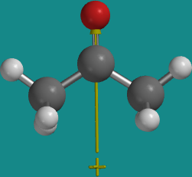
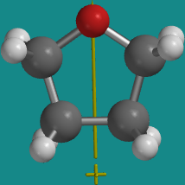
Dipole-Dipole Interaction
A dipole is defined by the product of charge being separated and the distance: the larger the charge is being separated and the larger the distance, the larger the dipole moment is for the compound (measured in Debye) i.e., different isomers of disubstituted benzene rings
Dipole-dipole interaction are only found between molecules that possess
a permanent dipole moment
The strength of this interaction depends on the individual dipoles involved and ranges typically from 2-10 kJ/mol
Compounds like acetone (m.p.= -95 ºC, b.p.=56 ºC, μ=2.88 D) or
tetrahydrofuran (m.p.= -108 ºC, b.p.=66 ºC, μ=1.74 D) possess
dipole moments because they contain an oxygen atom, which leads
to a charge separation
Compared to the corresponding hydrocarbons of similar mass
(i.e., acetone: iso-butane (m.p.= -160 ºC, b.p.= -12 ºC, μ=0.132 D),
tetrahydrofuran: cyclopentane (m.p.= -94 ºC, b.p.=49 ºC, μ=0 D),
these compounds exhibit a significantly higher boiling point
Why is the dipole moment larger for acetone than for tetrahydrofuran?

Slide 7
Hydrogen Bonding
Hydrogen bonding is found in compounds in which the hydrogen atom is directly bonded to nitrogen, oxygen or fluorine
This bond mode is comparably strong (10-40 kJ/mol)
  Many biological systems use this bond mode to stabilize a specific
  structure (i.e., DNA base pairing)
  The presence of hydrogen bonds in water explains its high melting
  and boiling point compared to its weight (H₂S: m.p.= -82 ºC,
  b.p.= -60 ºC; H₂Se: m.p.= -66 ºC, b.p.= -41 ºC; H₂Te: m.p.= -49 ºC, b.p.= -2 ºC)
  Hydrogen fluoride also displays a high boiling point (b.p.= 20 ºC) compared to hydrogen chloride (b.p.= -85 ºC) and hydrogen bromide (b.p.= -67 ºC) due to the same reason
  Hydrogen bonding is also observed in ammonia (b.p.= -33 ºC) and in amines, but
  to a lesser degree because nitrogen is less electronegative than oxygen and fluorine
  (PH₃: b.p.= -88 ºC)
  The relatively high boiling points of alcohols and carboxylic acids can also be attributed
  to this bond mode as well i.e., dimers for benzoic acid

Slide 8
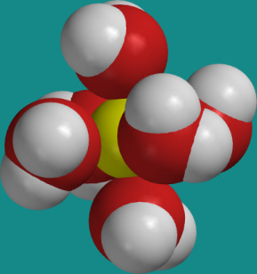
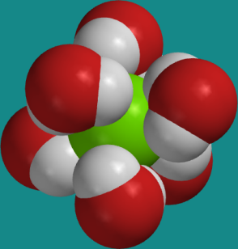
Ion-Dipole Interaction
Even though this the strongest of the non-covalent forces that are discussed here (40-80 kJ/mol), it is still much weaker than covalent bonds (i.e., C-C ~350 kJ/mol)
It is observed when an ionic compound is solvated i.e., sodium chloride in water
  The oxygen atom of water interacts with
  the Na⁺-ion while the hydrogen atoms
  interact with the Cl⁻ -ion
  This interaction is very important in the explanation why sodium chloride dissolve in water but not in hexane
  The strength of the ion-dipole interaction can also be used to
  explain why the boiling point increases when salts are dissolved
  in water (colligative properties)

Slide 9
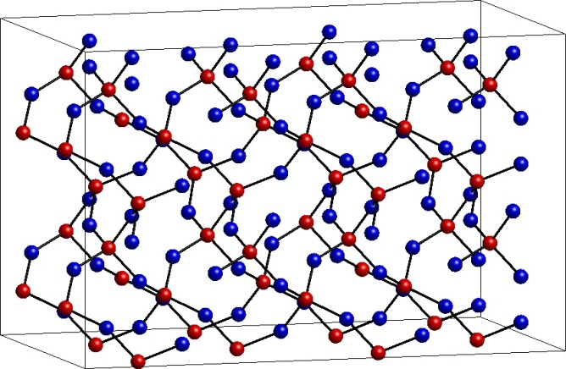
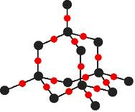
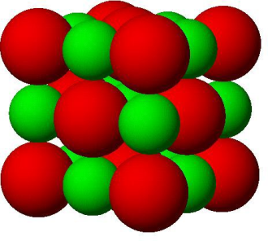
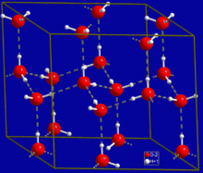
Physical Properties I
  Melting point (Effect of intermolecular forces)
  Compounds with covalent network structures have
  very high melting points i.e., silicon dioxide (~1700 ºC), aluminum oxide (2072 ºC), tungsten carbide (2870 ºC)
  Ionic compounds also exhibit very high melting points
  i.e., sodium chloride (801 ºC), sodium sulfate (884 ºC), magnesium sulfate (1124 ºC)
  Covalent compounds
    Hydrogen bonding: water (0 ºC), acetic acid (16 ºC),
    phenol (41 ºC), benzoin (137 ºC), benzopinacol (181 ºC), isoborneol (212 ºC), phenytoin (296 ºC)
    Dipole-dipole: tetrahydrofuran (-108 ºC), acetone (-93 ºC), ethyl acetate (-84 ºC), benzophenone (49 ºC), benzil (95 ºC), camphor (176 ºC), tetraphenylcyclopentadienone (218 ºC)
    London-dispersion: pentane (-130 ºC), hexane (-95 ºC), benzene (5 ºC), camphene (52 ºC), naphthalene (80 ºC), tetraphenylnaphthalene (196 ºC), anthracene (218 ºC), tetracene (357 ºC)

Slide 10
Physical Properties II
Melting point (Symmetry)
  Symmetric organic compounds exhibit a higher melting point than
  non-symmetric molecules (Carnelley Rule, 1882)
  This observation is counterintuitive because in the case of a symmetric substitution the most symmetric compound would exhibit the lowest dipole moment if X=Y!
  Symmetric molecules can be packed more efficiently, which results
  in stronger intermolecular forces in the lattice and a lower entropy
  in the solid
Compound | ortho | μ(D) | meta | μ(D) | para | μ(D)
difluorobenzene | -34.0 | 2.46 | -59.0 | 1.51 | -13.0 | 0.00
dichlorobenzene | -16.7 | 2.50 | -26.3 | 1.72 | 54.0 | 0.003
dibromobenzene | 6.7 | 2.12 | - 7.2 | 1.44 | 87.2 | 0.001
diiodobenzene | 26.7 | 1.70 | 35.4 | 1.27 | 129.2 | 0.00
dimethylbenzene | -27.9 | 0.64 | -49.4 | 0.30 | 13.3 | 0.07
dinitrobenzene | 116.0 | 6.48 | 90.0 | 3.75 | 172.0 | 0.78

Slide 11
Physical Properties III
Melting point (Intramolecular hydrogen bonds)
If intramolecular hydrogen bonds can be formed, the effect will be observed the
strongest in the ortho-isomer i.e., X= -NO₂, -CHO, -COCH₃, -COOCH₃
Compounds that can form intermolecular hydrogen bonds have higher melting
points and boiling points than compounds that cannot i.e., p-hydroxyacetophenone (147 ºC, 330 ºC) vs. p-methoxyacetophenone (37 ºC, 256 ºC), p-nitrophenol
(114 ºC, 279 ºC) vs. p-nitroanisole (53 ºC, 260 ºC), p-aminophenol (54 ºC, 242 ºC)
vs. p-methoxyaniline (29 ºC, 224 ºC)
If the boiling points of the different isomers are very similar, intra- or intermolecular hydrogen bonds are not observed i.e., methoxybenzaldehydes (ortho: 238 ºC,
meta: 235 ºC, para: 248 ºC), methoxyacetophenones (ortho: 245 ºC, meta: 240 ºC, para: 256 ºC), etc.
X-C₆H₄-Y | Ortho (m.p., b.p.) | Meta (m.p., b.p.) | Para (m.p., b.p.)
X=Cl, Y=OH | 8 ºC, 176 ºC | 34 ºC, 214 ºC | 44 ºC, 220 ºC
X=Br, Y=OH | 5 ºC, 195 ºC | 30 ºC, 236 ºC | 66 ºC, 238 ºC
X=NO₂, Y=OH | 44 ºC, 215 ºC | 97 ºC, 280 ºC | 114 ºC, 279 ºC
X=CH₃, Y=OH | 30 ºC, 191 ºC | 9 ºC, 202 ºC | 33 ºC, 202 ºC
X=Cl, Y=OCH₃ | -27 ºC, 199 ºC | XXX, 194 ºC | -18 ºC, 198 ºC
X=CHO, Y=OH | -7 ºC, 197 ºC | 101 ºC, 290 ºC | 114 ºC, 310 ºC
X=COCH₃, Y=OH | 4 ºC, 218 ºC | 94 ºC, 296 ºC | 147 ºC, 330 ºC
X=COOCH₃, Y=OH | -8.5 ºC, 222 ºC | 69 ºC, 280 ºC | 128 ºC, 280 ºC

Slide 12
Physical Properties IV
Solubility
“Like-dissolves-like”-rule
  Non-polar molecules dissolve well in non-polar solvents like hexane, toluene, petroleum ether
  Polar molecules dissolve in polar solvents like acetone, alcohols, water
Example: Nitrophenols
  The ortho isomer dissolves well in non-polar and weakly polar solvents
  but significantly less in polar solvents
    It displays the smallest dipole moment of the isomers because the distance
    between the groups inducing the dipole is small
    It forms an intramolecular hydrogen bond between the nitro group and
    the phenol function which reduces its ability to form intermolecular H-bonds
  The para and the meta isomers dissolve well in more polar solvents that are able
  to form hydrogen bonds and poorly in non-polar solvents
    The display a larger dipole moment and no intramolecular
    hydrogen bonds which allows for hydrogen bonds with
    protic solvents i.e., diethyl ether, acetone, ethanol.
Isomer | Dipole moment | Water | Ethanol | Acetone | Diethyl ether | Benzene
ortho | 3.22 | 0.32³⁸, 1.08¹⁰⁰ | 10.2⁰, 200³⁴ | 102⁰, 566³⁰ | 38¹, 916³⁷ | 46⁰, 874⁴⁰
meta | 3.90 | 3.0⁴⁰ | 117¹, 1106⁸⁵ | 169⁰, 1306⁸⁴ | 106^{0.2}, 179⁴⁰ | 0.63⁶, 571⁸⁵
para | 5.09 | 1.18²⁵, 6.0⁵⁰ | 116⁰, 1017⁹⁰ | 188⁰, 1193⁹⁷ | 110¹, 149³⁸ | 0.65⁸, 62⁸⁵

Slide 13
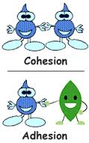
Physical Properties V
Viscosity
  Non-polar molecules have lower viscosities than polar and protic molecules
    Note that viscosity is a function of temperature: it usually decreases as the temperature is increased
    (i.e., motor oil)
    It also plays a huge role in HPLC because it determines the back pressure on the column
Properties like cohesion (intermolecular force between like molecules i.e., to form drops) and adhesion (intermolecular force between unlike molecule i.e., to adhere to a surface) are also
a result of weak intermolecular forces
Surface tension is a result of strong cohesion forces i.e., formation of spherical water droplets
Compound | Viscosity (in cp) | Surface tension (mN/m)
Pentane | 0.24 | 16
Benzene | 0.65 | 29
Ethanol | 1.20 | 22
Methanol | 0.62 | 23
Isopropanol | 2.30 | 22
Water | 1.00 | 72
Sulfuric acid | 25.4 | 55
Glycerol | 1490 | 63
Honey | 2000-10000 | -----

Slide 14
Chemical Properties I
Acidity
While a halogen atom or an electron-withdrawing group increases the acidity (pK_{a}(PhOH)=9.95), the effect greatly varies with the position
  The ortho isomers are usually less acidic than the para isomers because an intramolecular hydrogen bond makes it more difficult to remove the phenolic hydrogen (X=NO₂, CHO, COCH₃, COOCH₃)
  In these cases, the meta isomer is the least acidic one because the electron-withdrawing group does not participate in the resonance that helps to stabilize the phenolate ion
  A halogen atom in the ortho position increases the acidity more than in the
  meta or para position due to its inductive effect and poor ability to form H-bonds
X-C₆H₄-Y | Ortho | Meta | Para
X=F, Y=OH | 8.73 | 9.29 | 9.89
X=Cl, Y=OH | 8.56 | 9.12 | 9.41
X=Br, Y=OH | 8.45 | 9.03 | 9.37
X=I, Y=OH | 8.51 | 9.03 | 9.33
X=CH₃, Y=OH | 10.29 | 10.09 | 10.26
X=CHO, Y=OH | 8.37 | 8.98 | 7.61
X=COCH₃, Y=OH | 10.06 | 9.19 | 8.05
X=NO₂, Y=OH | 7.23 | 8.36 | 7.15

Slide 15
Chromatography
When using polar stationary phases (i.e., silica, alumina), polar molecules will interact more strongly with the stationary phase resulting in low R_{f}-values
This trend holds particularly true for compounds that can act as hydrogen bond donor and hydrogen bond acceptor
The size of the molecule has to be considered as well
The ability of a solvent to interact with stationary phase determine its eluting power
The ability of a solvent to form hydrogen bonds, dipole-dipole interactions as well as dispersion are quantified in the various solvent parameter tables (i.e., Hanson solubility parameters)
 | Donor | Acceptor | Dipole | Eluting power (on SiO₂) | Example (eº on SiO₂)
Alcohols, amides | strong | strong | large | very high | MeOH (0.73), DMF (0.76)
Ketone, ester, ether | none | moderate | moderate | medium to high | acetone (0.47), ethyl acetate (0.38), diethyl ether (0.38)
Chlorinated solvents | none | none | weak to moderate | weak to moderate | dichloromethane (0.32)
Hydrocarbons | none | none | low | very low | hexane (0.0), toluene (0.23)

Slide 16
Infrared Spectroscopy
The intensity of the infrared band depends on the change in dipole moment during the absorption of electromagnetic radiation (I²~ dq/dr)
The larger the dipole moment of a functional group is, the higher the intensity of the peak in the infrared spectrum (i.e., C-O, C=O, C-Cl, C-F, O-H)
Functional groups with a low dipole moment appear as medium or weak peaks in the infrared spectrum unless there are many of them present
(i.e., C-H (sp³), C-C) or they are polarized by adjacent groups (i.e., C=C)
The presence of heteroatoms also changes the exact peak locations because they either increase or decrease the bond strength of other groups due to their inductive or resonance effect
  The symmetric stretching mode of a methyl group appears at 2872 cm⁻¹
  (421 kJ/mol in C₂H₆). The stretching modes for methoxy groups are found
  at 2810-2820 cm⁻¹ (402 kJ/mol in (CH₃)₂O), while methyl amino groups
  are located from 2780-2820 cm⁻¹ (364 kJ/mol in CH₃NHCH₃) due to the weaker C-H bonds
  The symmetric stretching mode of a methyl group in CH₃X (X=halogen)
  appears at 2950-2960 cm⁻¹ because the presence of the halogen atoms
  strengthen the C-H bond (~420-430 kJ/mol)

Slide 17
NMR Spectroscopy I
The presence of heteroatoms in organic compounds leads to deshielding of nuclei
in ¹H- and ¹³C-NMR spectroscopy (shifts compared to carbon or hydrogen atoms
in benzene)
The inductive effect is pronounced for electronegative elements like fluorine, oxygen
and nitrogen while less electronegative elements like bromine, sulfur, etc. cause less
of a downfield shift of the ipso-carbon atom in a benzene ring
The effect is different for the ortho and para carbon atoms because here the resonance effect dominates for fluorine, oxygen and nitrogen
The resonance effect can also be observed in the ¹H-NMR spectrum in which the ortho and para protons are shifted upfield.
Group | Ipso carbon in Ph-X (in ppm) | Ortho/Para carbon | Ortho/Para hydrogen
F | 35.1 | -14.3, -4.4 | -0.26, -0.20
OH | 26.9 | -12.6, -7.6 | -0.56, -0.45
NH₂ | 19.2 | -12.4, -9.5 | -0.75, -0.65
Cl | 6.4 | 0.2, -2.0 | 0.03, -0.09
SH | 2.2 | 0.7, -3.1 | -0.08, -0.22
CH₃ | 9.3 | 0.6, -3.1 | -0.18, -0.20

Slide 18
NMR Spectroscopy II
If two electronegative elements are “attached” to the same hydrogen atom (i.e., hydrogen bonding), the deshielding effect will increase (i.e., carboxylic acids, δ=10-12 ppm)
Strong intramolecular hydrogen bonds also lead to a significant shift
in the ¹H-NMR spectrum as it is found in ortho substituted phenols
(i.e., o-nitrophenol: δ=10.6 ppm, m-nitrophenol: δ=6.0 ppm, p-nitrophenol: δ=6.5 ppm (all in CDCl₃))
The same downfield shift for the phenolic proton will be observed as well
if the ¹H-NMR spectrum is acquired in a more basic solvent like DMSO (i.e., p-nitrophenol: δ=11.1 ppm) or acetone (i.e., p-nitrophenol: δ=9.5 ppm) because a hydrogen bond is formed with the oxygen atom in DMSO (or acetone)

Slide 19
NMR Spectroscopy III
Similar trends are found in hydroxy-substituted benzaldehyde and acetophenones (shift of the phenolic proton in ppm)
The chemical shift in the ortho compound is similar in both solvents because in both cases a hydrogen bonding is observed.
The chemical shifts are vary with the solvent for the meta and the para isomer because in CDCl₃ no hydrogen bonding is observed with the solvent, while a strong hydrogen bonding is observed with DMSO and CD₃CN
Substitution | CDCl₃ | DMSO-d₆ | CD₃CN
ortho | 11.0 | 10.7 | 9.78
meta | 6.7 | 10.0 | ???
para | 6.2 | 10.6 | 9.82

