Slide 1
Lecture 1
Benzoin Condensation

Slide 2
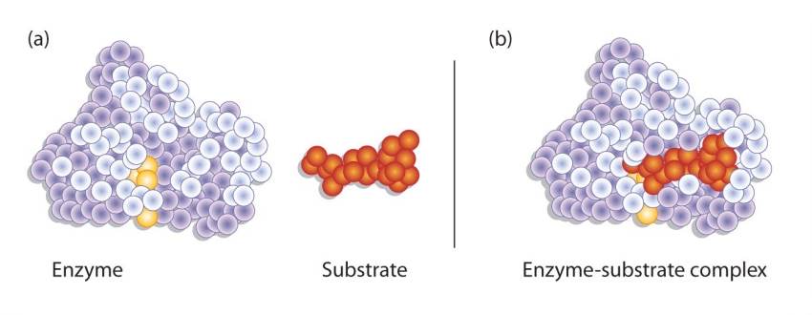
Introduction
Enzymes catalyze organic reaction in biological systems
The high stereo-, regio- and chemoselectivity of the reactions can be rationalized by the lock-and-key model
Enzymes can be classified into six classes depending on the type of reaction being catalyzed: hydrolases, isomerases, ligases, lyases, oxidoreductases and transferases
Often a coenzyme, which is a small organic molecule (i.e., many vitamins), or a cofactor like metal ions (i.e., zinc, magnesium, iron, manganese, copper, selenium) are required as well for the enzyme to function properly
The reaction conditions like the temperature, the pH-value, the salinity,
the substrate, etc. are very important in these reactions

Slide 3
Benzoin Condensation using Cyanide
The reaction can be carried out by using cyanide ions as catalyst
The cyanide ion nucleophilically attacks the carbonyl group leading to an Umpolung
of the carbonyl group.
The reaction is much faster than the coenzyme catalyzed reaction (30 min vs. 72 h),
but it requires a better hood and a much more experienced experimenter
Problems
  The possible formation of hydrogen cyanide (HCN) if the pH-value was not properly controlled (pK_{a}= 9.2) during the reaction or workup
  Hydrogen cyanide has a low boiling point (25 ºC)
  It is highly toxic (LD₅₀~500 mg/m³ for 1 minute inhalation, doses over 3000 mg/m³
  are immediately fatal).
  About 10-20 % of humans cannot smell the compound (bitter almond) due to a genetic trait

Slide 4
Benzoin Condensation using Thiamine
Thiamine consists of a pyrimidine (two nitrogen atoms in benzene ring) and a thiazole ring (nitrogen and sulfur atom in five-membered ring)
The lab uses the hydrochloride, which is ionic and dissolves well in water (~100 g/100 mL), but poorly in 95 % ethanol (~1 g/100 mL).
The highlighted proton (H) is removed from the
hydrochloride by the hydroxide ion (pK_{a}=4.8).
This hydrogen is much more acidic because of the
adjacent nitrogen atom that bears a positive charge
(without the positive charge it would be pK_{a}= ~30).
Thiamine itself is pale yellow and not very stable in its free form (heat, UV and base sensitive)
⁄

Slide 5
Green Chemistry Aspects
The thiamine-based benzoin condensation is “greener” in many ways
  Safer chemicals are used which reduces the dangers in cases of accidents: no cyanide
  Dangerous waste prevention: no cyanide
  Higher energy efficiency: no reflux required

Slide 6
Benzoin Condensation - Mechanism
Breslow intermediate

Slide 7
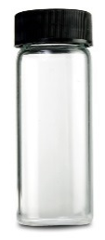

Experimental I
Dissolve the thiamine hydro-chloride in water in a large vial
Add 95 % ethanol
Add 2 N sodium hydroxide solution
Add benzaldehyde and mix well
Close and label the vial and store
it in the drawer
Come back to the lab after
2-3 days to check if crystals did form
Why is 95 % ethanol added?
Which observation you make?
What are you looking for here?
Why is this necessary?
What can be done if
no crystals formed?
To lower the polarity of the solution
Pale yellow solution
Homogeneous mixture
To reduce the oxidation of
benzaldehyde to benzoic acid
Scratching with a glass rod
on the inside of the flask

Slide 8
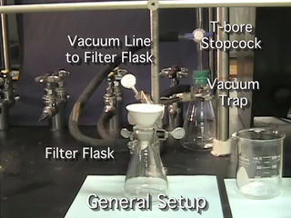
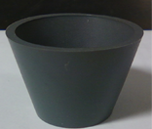
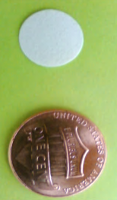
Experimental II
Place the vial with crystals in an ice-bath (=plenty of water with some ice cubes for additional cooling)
Isolate the solids using vacuum filtration (view the corresponding video on the course website and take the online quiz!)
  Do not forget to place the neoprene adapter between
  the filter flask and the Hirsch funnel
  The filter paper used for the Hirsch funnel is about
  ½ inch in diameter (Do not waste them!)
Wash the crystals with a small portions of ice-cold water and ice-cold 95 % ethanol (1-2 mL as needed to obtain a white solid!)
After sucking air through the crystals, place them on a watch glass or in an open beaker to allow them to dry until the next meeting
Characterization: yield, infrared spectrum (ATR, review procedure in SKR and online) and melting point are both acquired during meeting 3 after drying the solid very thoroughly in an open beaker
Neoprene
adapter

Slide 9
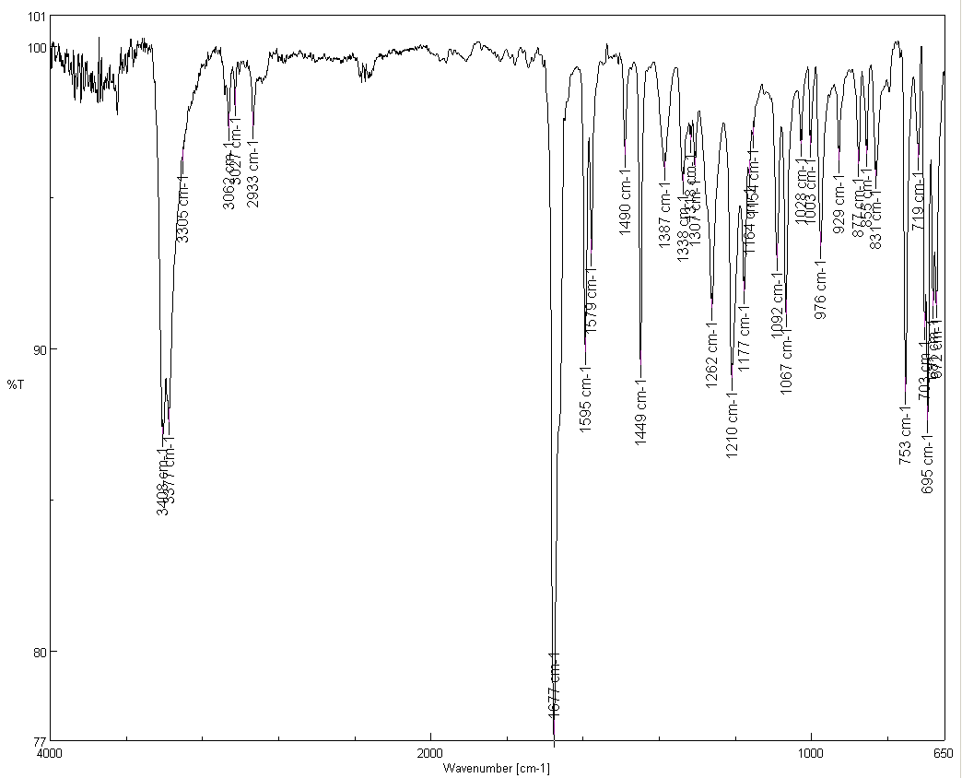
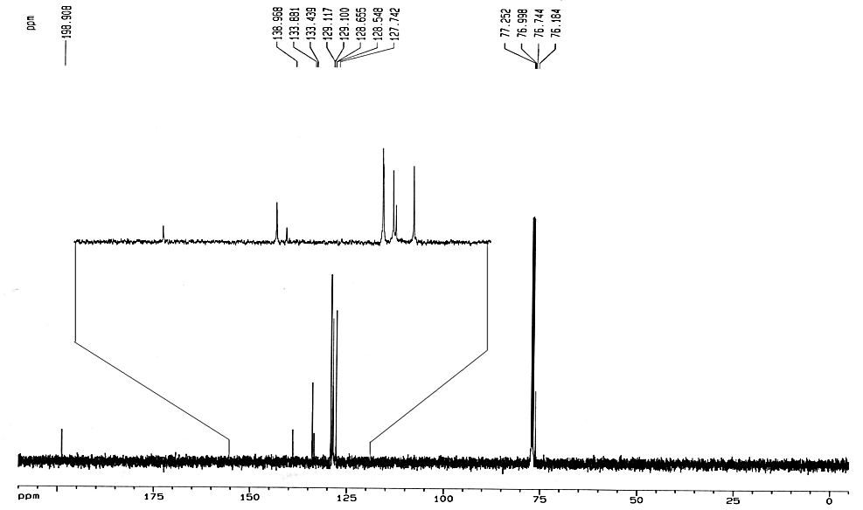
Characterization I
Melting point
Infrared spectrum (ATR)
  ν(C=O)=1677 cm⁻¹
  ν(OH)=3377, 3408 cm⁻¹
  ν(CH, sp²)=3062, 3027 cm⁻¹
  ν(CH, sp³)=2933 cm⁻¹
  ν_{as}(CCC)=1210 cm⁻¹
¹³C{¹H}-NMR (in CDCl₃)
  δ=192 ppm (C=O)
  δ=127-139 ppm (arom. carbon)
  δ=76 ppm (C-OH)
ν(CH, sp³)
ν(CH, sp²)
ν(C=O)
ν_{as}(CCC)
ν(OH)
C-OH
C=O

Slide 10
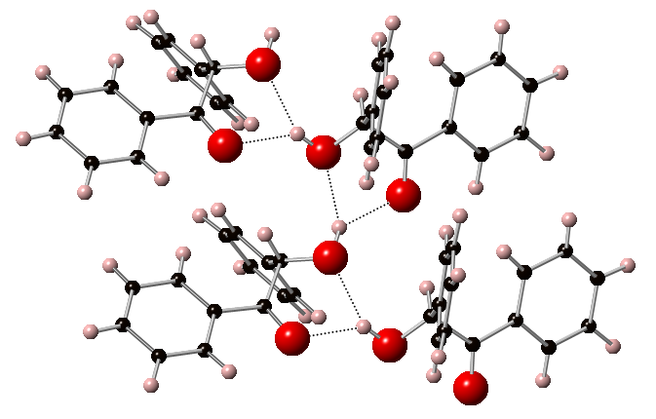
Characterization II
X-Ray Structure
  The structure of the unsubstituted benzoin does not display any intramolecular hydrogen bonds but intermolecular hydrogen bonds with the carbonyl group (~207 pm) and the oxygen atom of the alcohol function (~217 pm) of the same neighboring benzoin molecules (dotted lines)

