Slide 1
Theory of NMR
Different theoretical approaches that are consistent but use different degrees of approximation to give simple pictures that are correct within the limits of their validity
Transitions Between Stationary State Energy Levels
Find the eigenvalues of the Hamiltonian operator, then use time-dependent perturbation theory to predict transition probabilities.
Predicts frequencies and relative intensities of NMR spectra.
Because this approach is based on the time-independent Schrödinger equation, it cannot account for time-dependent phenomena due to the application of short radio frequency pulses.

Slide 2
Transitions Between Stationary State Energy Levels
Zeeman Interaction Hamiltonian:
H = -μ·B₀
μ = magnetic dipole moment; B₀ = magnetic field strength (Tesla)
μ = γħI
γ = gyromagnetic ratio; ħ = h/2π; I = nuclear spin operator
Eigenvalues:
E_{m} = -γħmB₀
m = -I,-I+1,…,I-1,I (i.e. 2I+1 allowed values)
For I = ½ (e.g., ¹H, ¹³C, ¹⁵N, ³¹P, ¹⁹F)
ΔE = hν= γħ B₀ ν = frequency in Hz; ω = 2πν = frequency in radians/sec
ω₀ = γ B₀ Larmor Precession Frequency

Slide 3
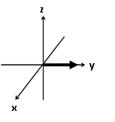
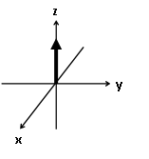
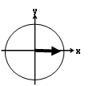

Classical Mechanical Picture
Solution of the time-dependent Schrödinger equation for a nuclear spin in an applied magnetic field produces results consistent with a simple vector description.
Summation of the nuclear moments over the entire ensemble of molecules of a real sample yields macroscopic magnetization that can be treated according to classical mechanics.
Ignores quantum effects.
immediately
after 90° pulse
At equilibrium
1) B₀ aligned along z axis by definition.
2) Net magnetization (M₀) aligned along z axis.
3) No observable NMR signal
1) M₀ precesses in xy plane.
2)Observable NMR signal.
3)Coherence in xy plane.

Slide 4
Density Matrix
Time-dependent Schrödinger equation in the density operator form is used to follow the development of quantum system with time.
For NMR, theory is easily expressed as a density matrix and simple matrix manipulations are used to follow the nuclear spin system with time.
Manipulations are very tedious and do not yield a model with good physical insight.
Product Operator Formalism
Basic ideas of density matrix are expressed in a simpler algebraic form.
General approach used to described modern multi-dimensional NMR experiments.

Slide 5
Chemical Shifts and Spin-Spin Coupling Constants
Chemical shifts depend on the magnetic field strength so they are always referenced to some sort of standard and given in ppm shifts from the reference. In this way the chemical (δ) becomes independent of the spectrometer used.
Spin-spin coupling is a through –bond interaction between neighboring nuclear dipoles. It is independent of the magnetic field strength. The coupling constant (J) is always expressed in Hz. The splitting patterns and intensity distributions can be predicted using “simple” rules.
Signal intensities (especially when integrated) can be indicative of the relative number of nuclei with the same chemical shift. Some experimental parameters must be set carefully to obtain meaningful values for the integrated intensities.
A good introductory reference for chemical shifts and spin-spin coupling is:
“Basic One- and Two-Dimensional NMR Spectroscopy”, 3rd Revised Edition, by Horst Friebolin, Wiley-VCH, New York, pages 22-41.
For a discussion in somewhat greater length, but not overwhelming continue to Chapters 2, 3, and 4 of the same book.

Slide 6
Larmor Frequency (including local magnetic environment)
For Pulse Fourier Transform spectrometers (all modern instruments)
2πν₀ = γB₀(1-σ) σ = magnetic shielding;
Chemical Shifts (δ)
δ = ν_{s} - ν_{r} x 10⁶ s = sample; r = reference
ν_{r}
To obtain δ based on the magnetic shielding, σ:
ν₀ = γB₀(1-σ)
2π
δ = (1- σ_{s}) – (1- σ_{r}) x 10⁶ = (σ_{r} – σ_{s}) x 10⁶ ≈ (σ_{r} – σ_{s}) x 10⁶
(1- σ_{r}) (1- σ_{r})

Slide 7
For continuous wave spectrometers (essentially never used today)
δ = B_{r} – B_{s} x 10⁶
B_{r}
To obtain δ based on the magnetic shielding, σ:
B₀ = 2πν₀
γ(1-σ)
1__ _ 1__
(1- σ_{r}) (1- σ_{s})
δ = ────────── x 10⁶ = (σ_{r} – σ_{s}) x 10⁶ ≈ (σ_{r} – σ_{s}) x 10⁶
1__ (1- σ_{s})
(1- σ_{r})
δ expressed as the magnetic shielding is exactly the same for pulsed Fourier transform NMR as it is for continuous wave NMR.

Slide 8
So, why do we care about all this?
I. To understand nomenclature:
A larger value for the magnetic shielding, σ, will come into resonance at a higher value of the magnetic field when the field is swept and the frequency of the applied radiation is kept constant.
B₀ = 2πν₀
γ(1-σ)
A larger value for the magnetic shielding, σ, will come into resonance at a lower value when the frequency is either swept or pulsed and the magnetic field is kept constant.
ν₀ = γB₀(1-σ)
2π
The customary presentation for NMR spectra is for the frequency (often presented as ppm rather than Hz) to increase from right to left. It is standard nomenclature for peaks on the left to be referred to as “downfield” and peaks on the right to be referred to as “upfield”. These are historical terms left over from continuous wave, field swept NMR, but are very commonly used.
II. For an awareness of the uncertainty of chemical shift values in older literature:
Early literature on ¹H chemical shifts sometimes used the τ scale. τ = (10 – δ)
Older literature, especially for nuclei other than ¹H and ¹³C, sometimes used a definition where the sign of δ is reversed. Compilations of chemical shifts for less common nuclei must be carefully checked to determine the definition of δ.

Slide 9
The Bruker Almanac
http://www.bruker.com/fileadmin/user_upload/6-AboutUs/almanac.html
http://itunes.apple.com/us/app/almanac/id367770786?mt=8

Slide 10
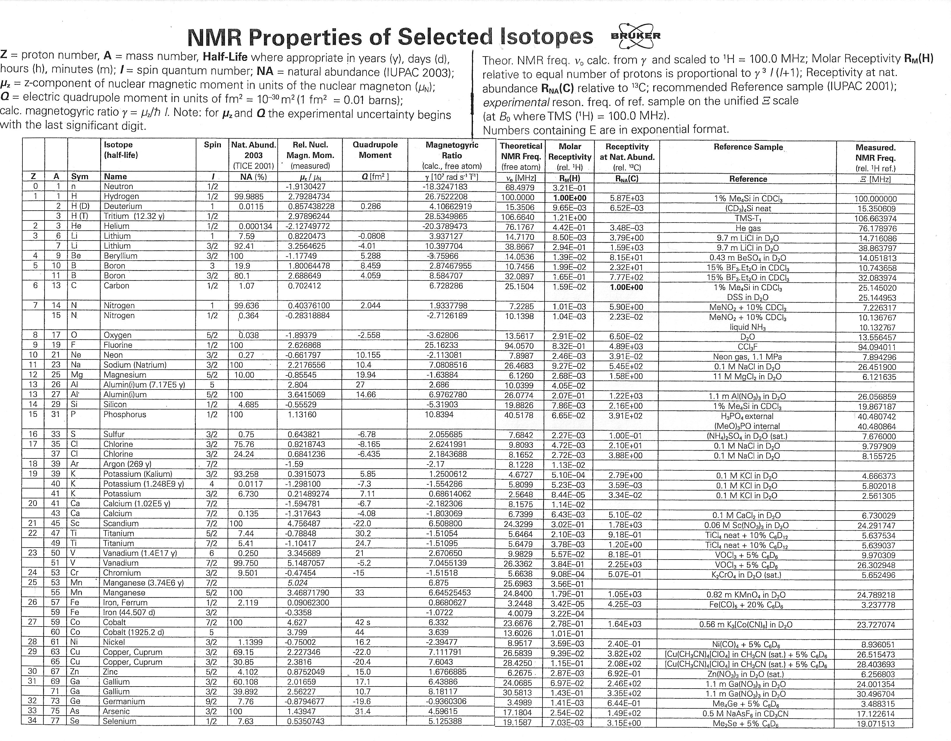

Slide 11
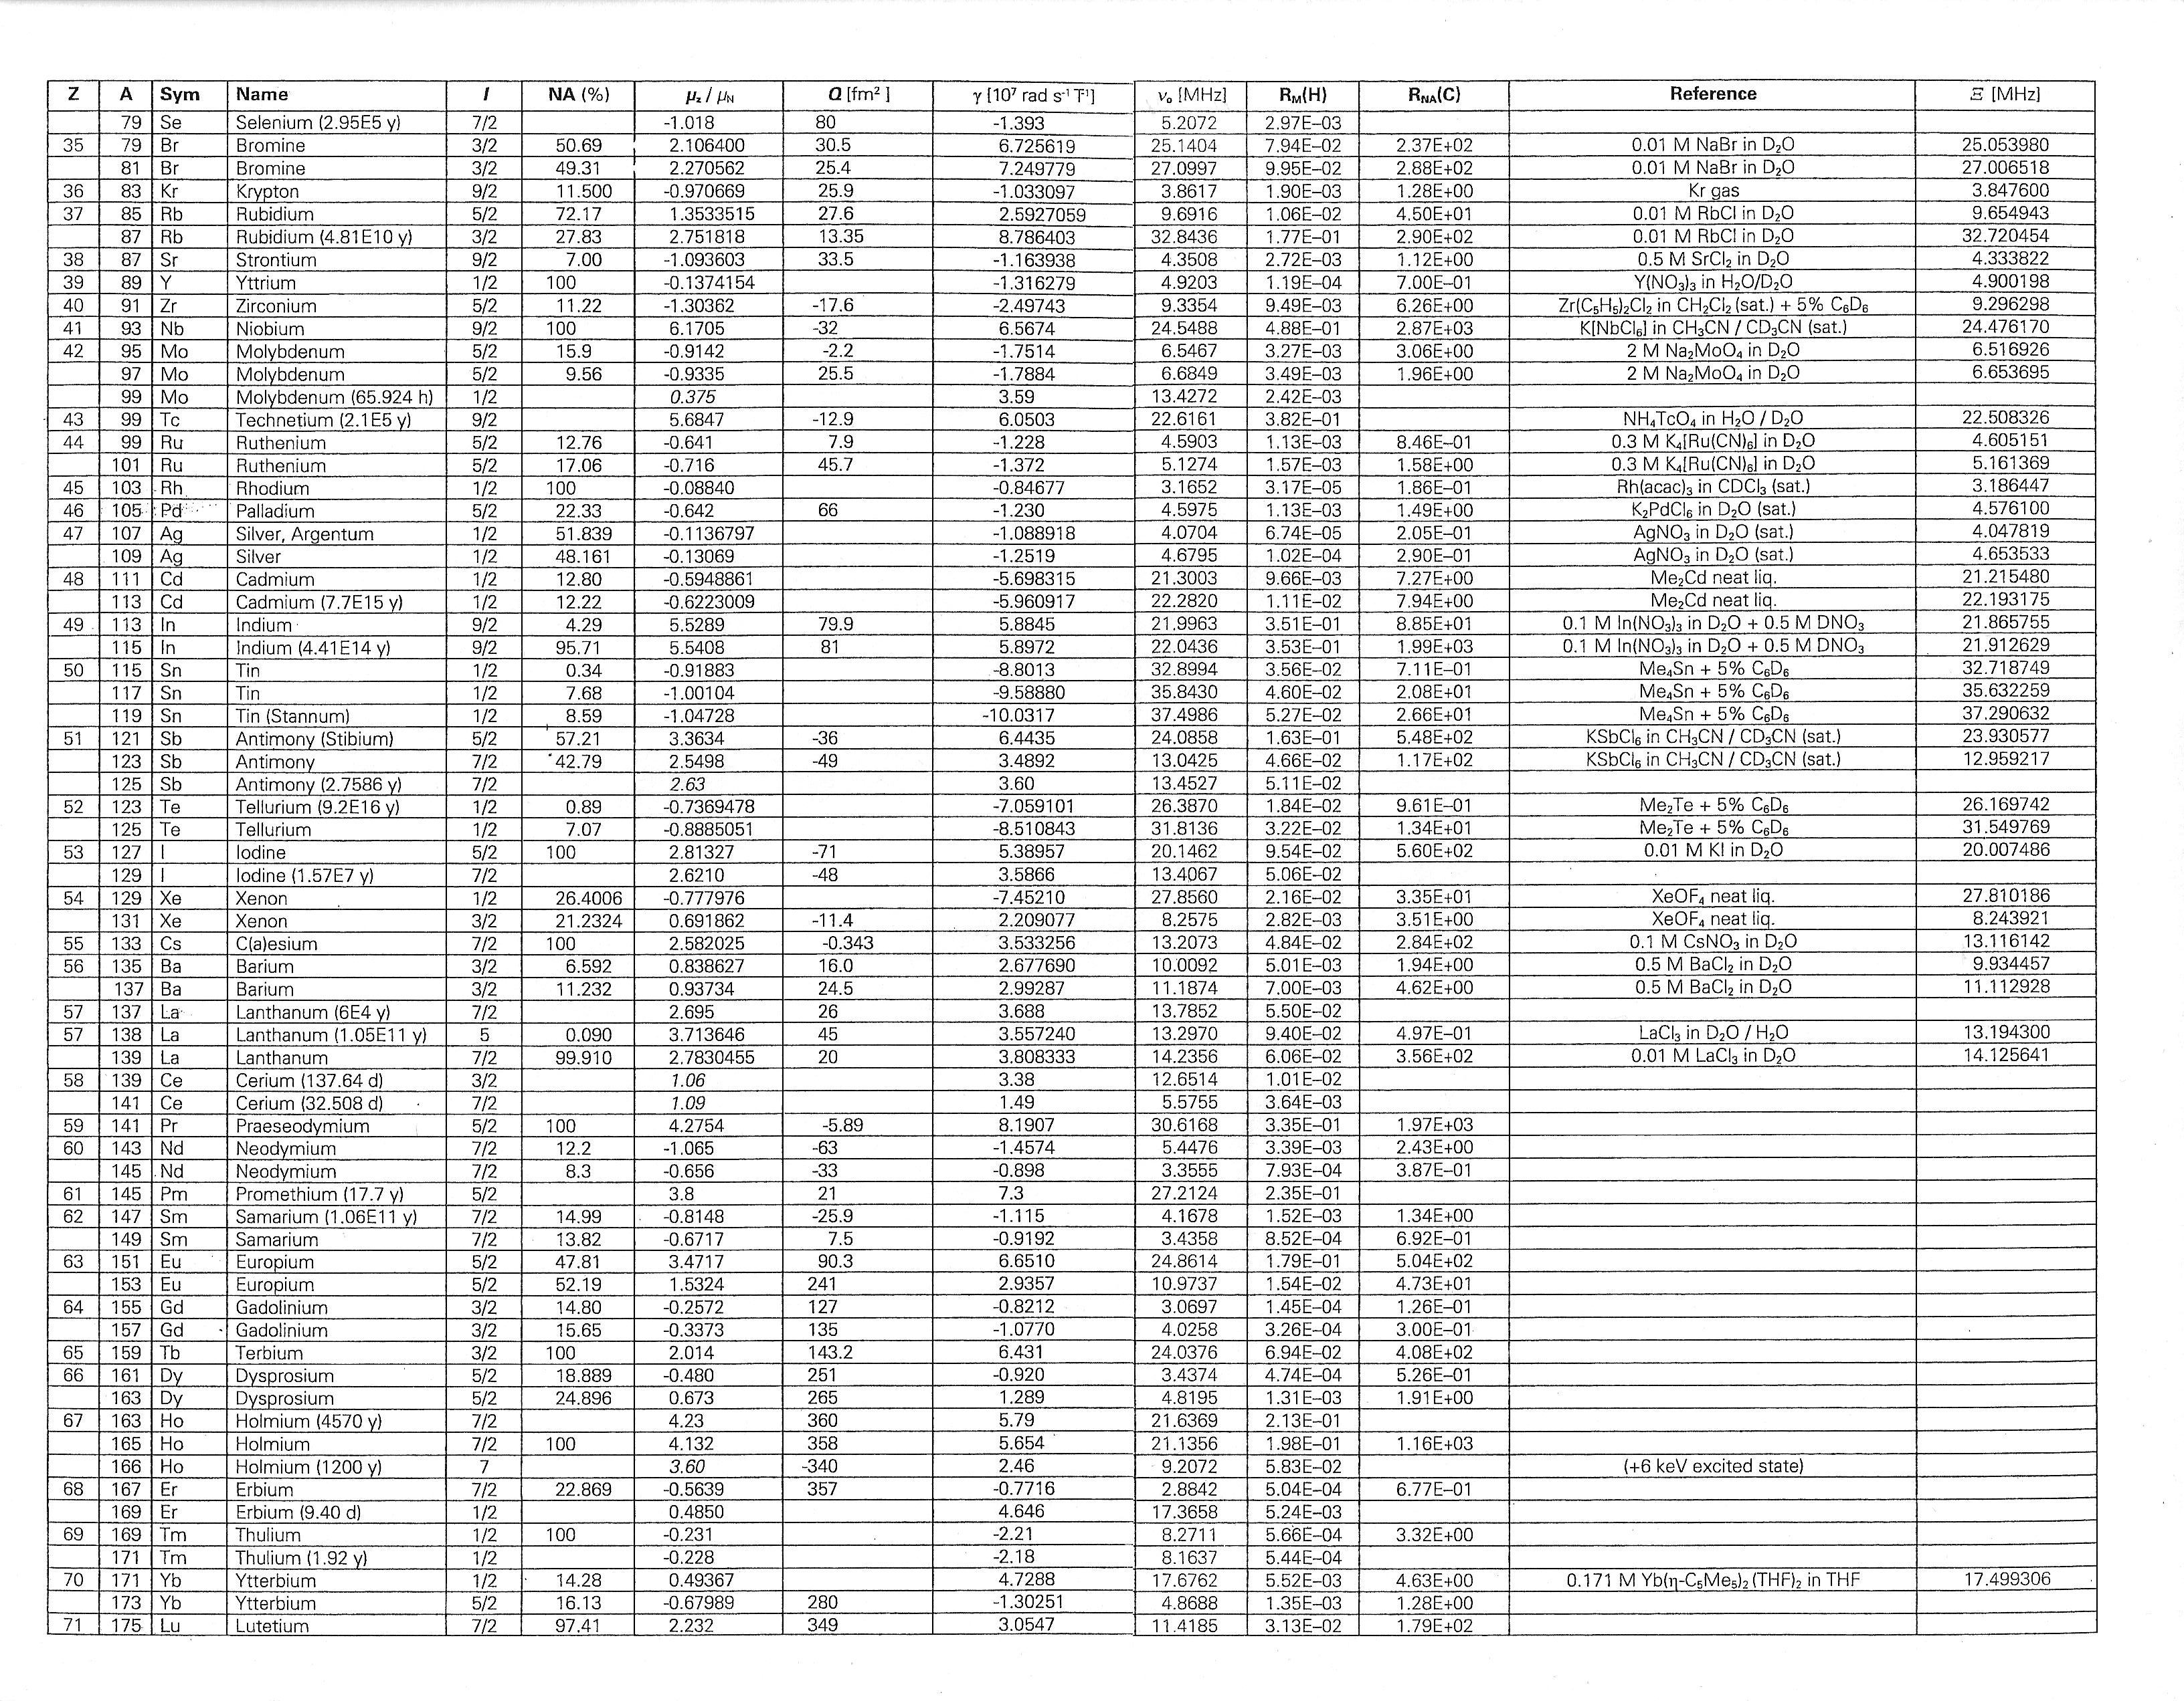

Slide 12
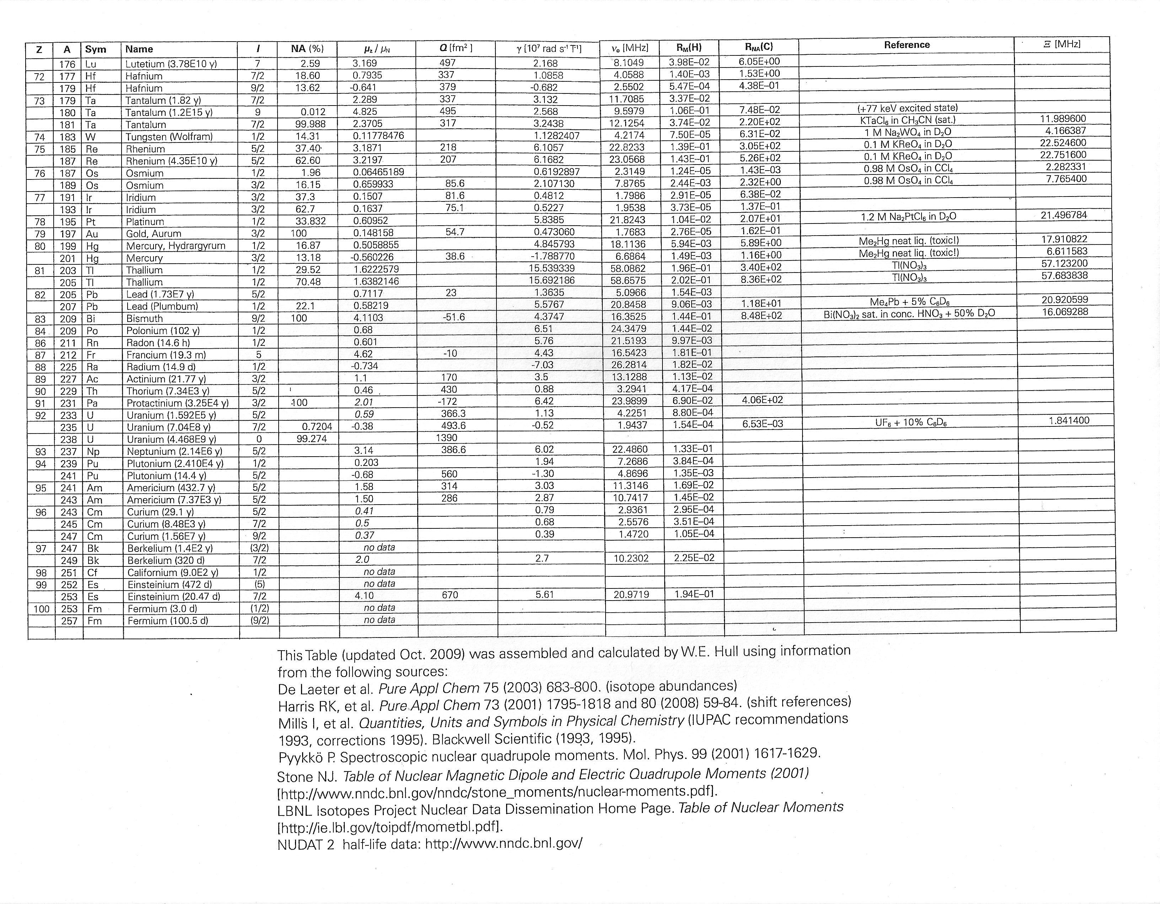

Slide 13
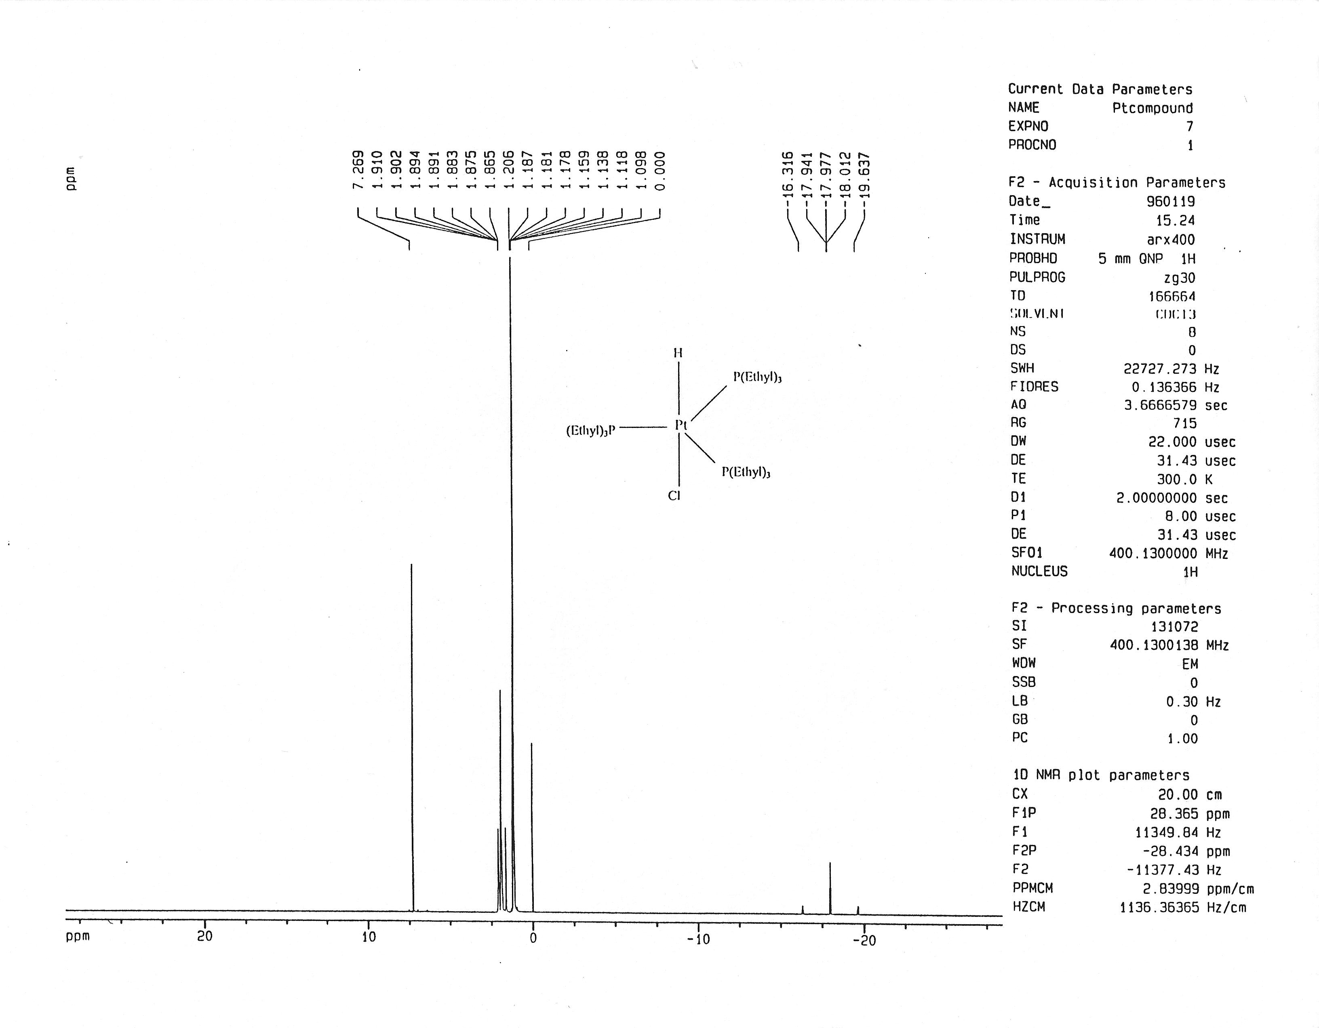

Slide 14
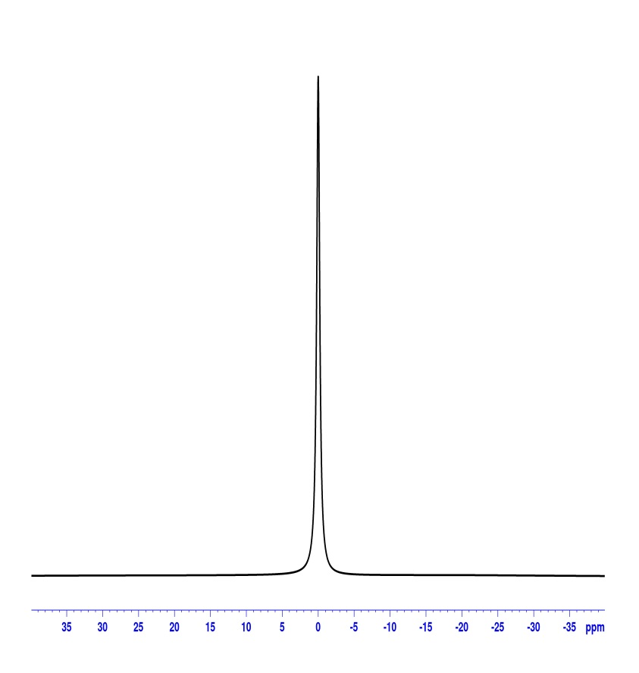
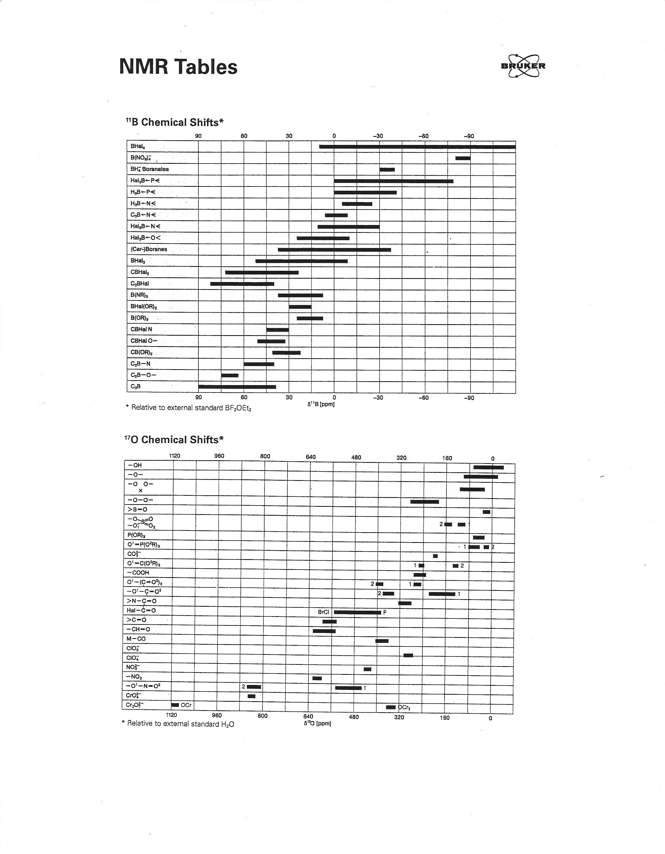
AV400
¹¹B spectrum of BF₃-etherate

Slide 15
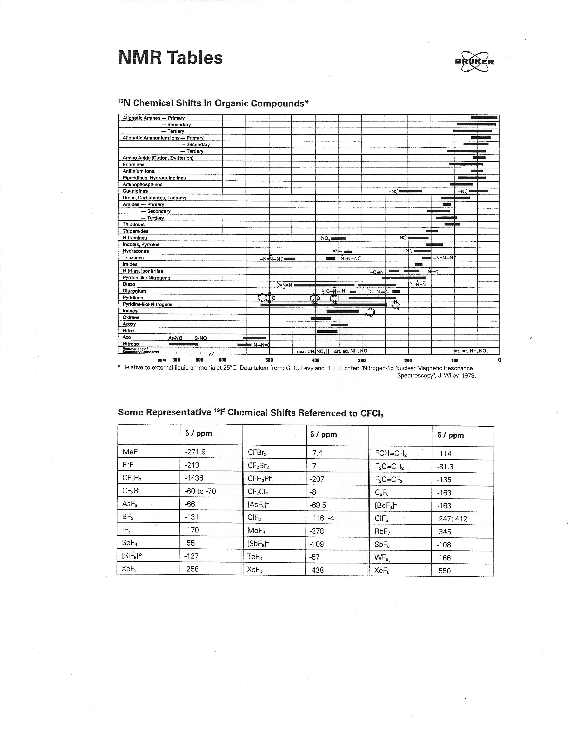
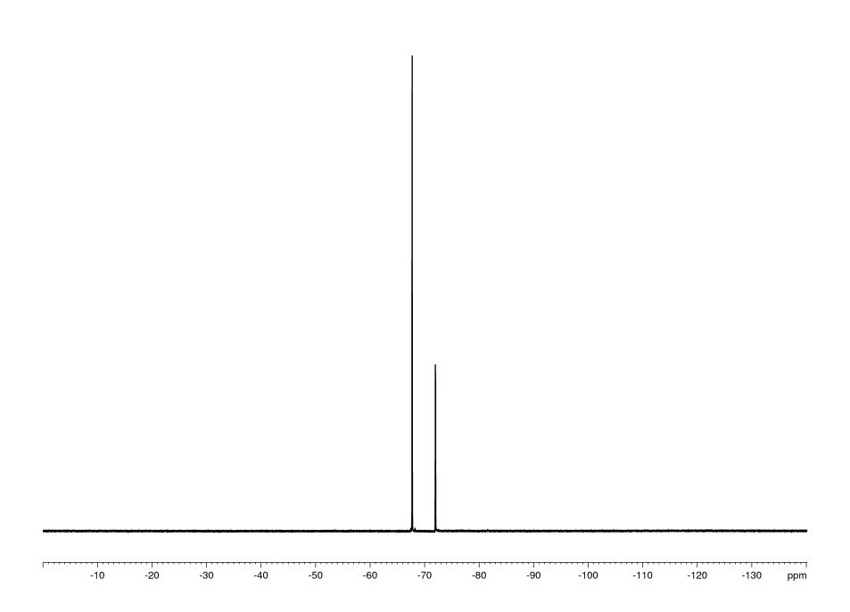
AV400
¹⁹F spectrum of CF₂Cl-CFCl₂

Slide 16
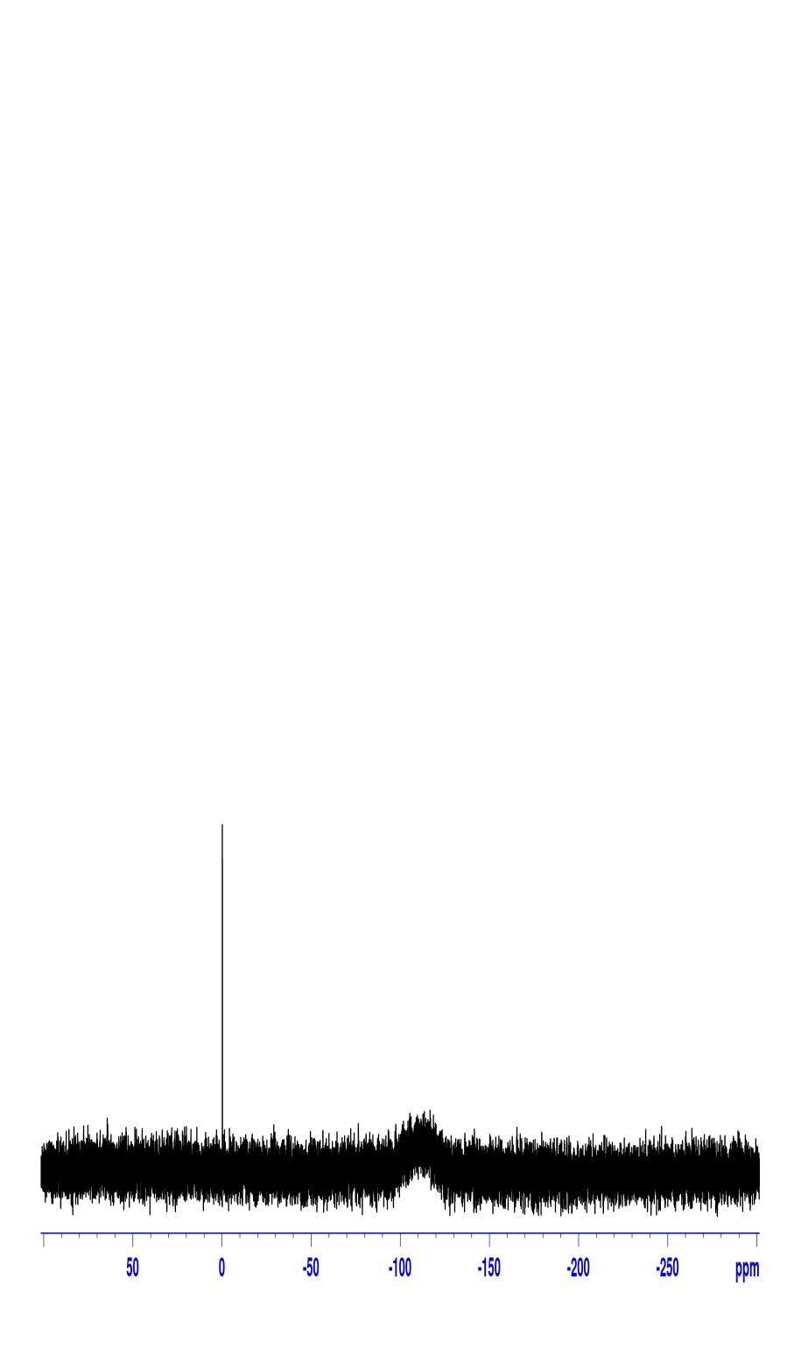
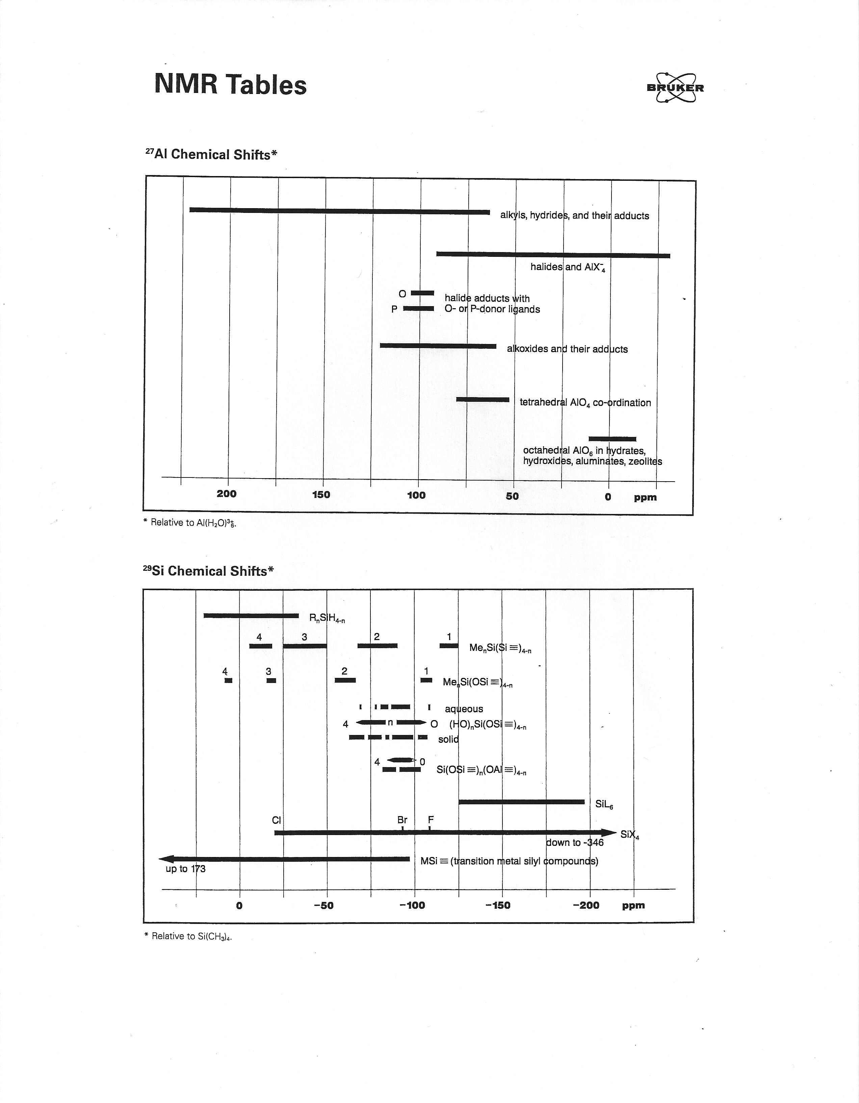
AV400
²⁹Si spectrum of TMS

Slide 17
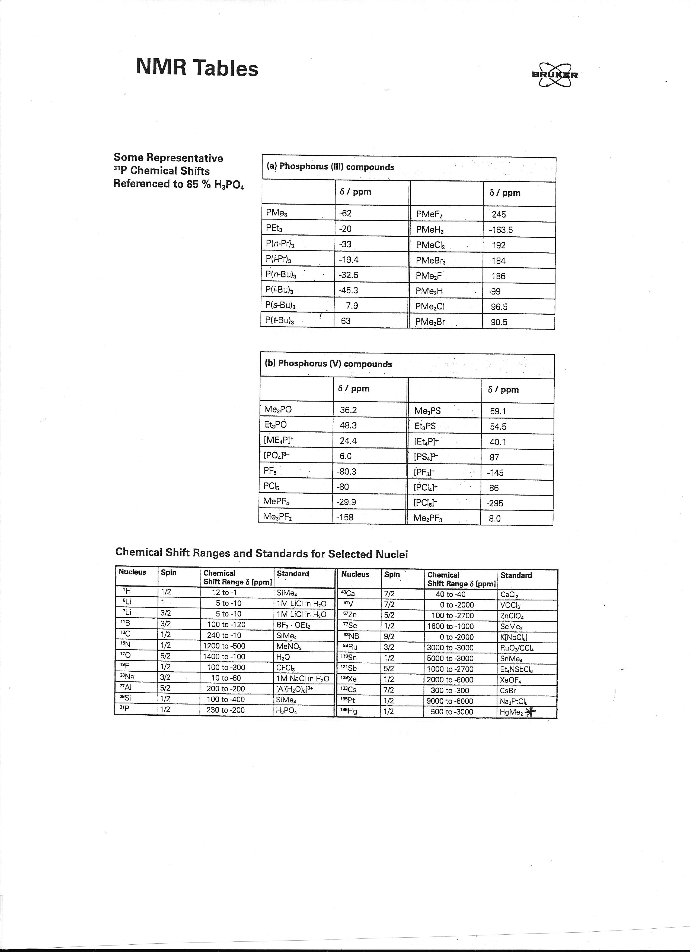
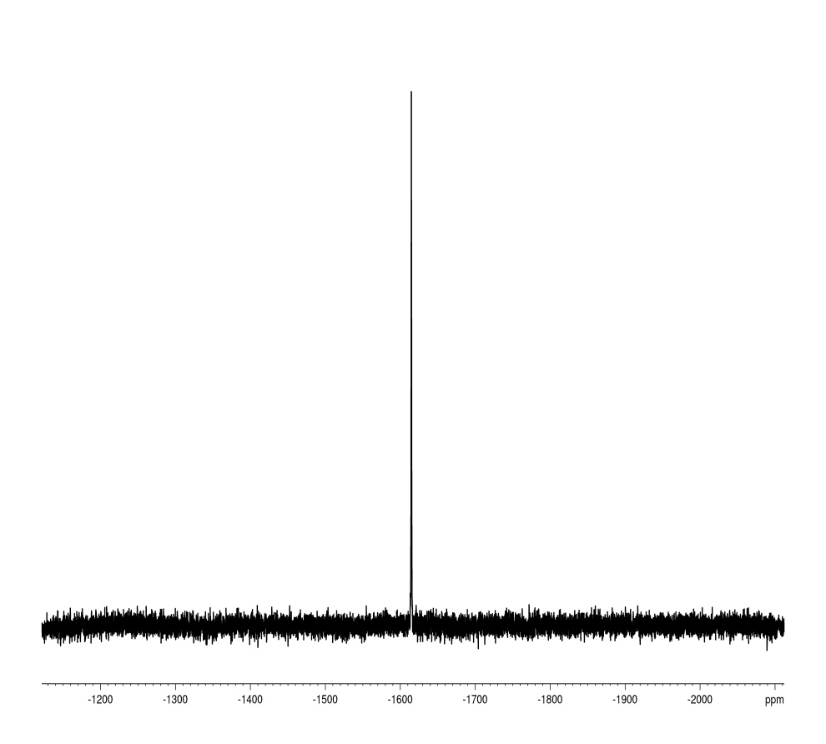
AV400
¹⁹⁵Pt Spectrum
of K₂PtCl₄

Slide 18
Heteronuclear NOE
γ_{S}
2γ_{o}
Intensity with NOE
= 1 +
Intensity without NOE
max
For X-nucleus observe with ¹H decoupling:
X γ_{S}/2γ_{o} Max. intensity vs. no NOE
¹³C 2 3
¹⁵N -5 -4*
²⁹Si -2.5 -1.5*
To the extent that relaxation mechanisms other than the dipolar mechanism contribute to the relaxation, the observed NOE will be reduced.

Slide 19
*For nuclei with a negative γ, when less than the maximum possible NOE is observed (i.e. relaxation mechanisms other than dipolar have significant contributions), the signal to noise ratio observed can be worse than with no NOE. Use "inverse gated" decoupling to avoid the NOE yet have a decoupled spectrum.
"Inverse Gated Decoupling":
¹H channel
X channel

Slide 20
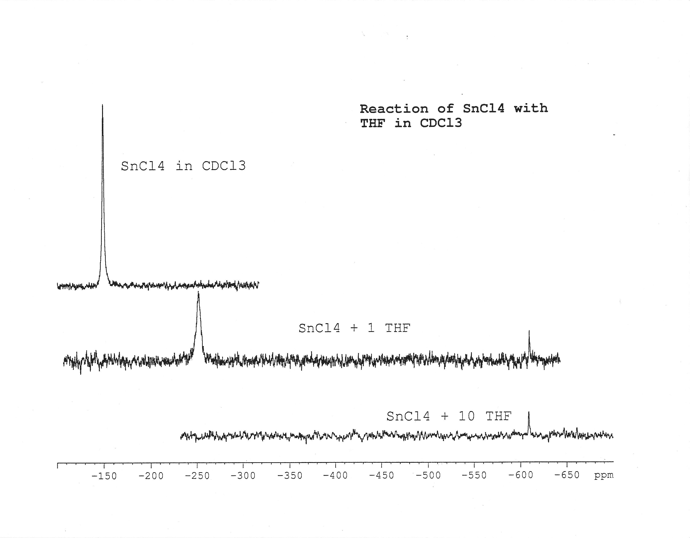

Slide 21
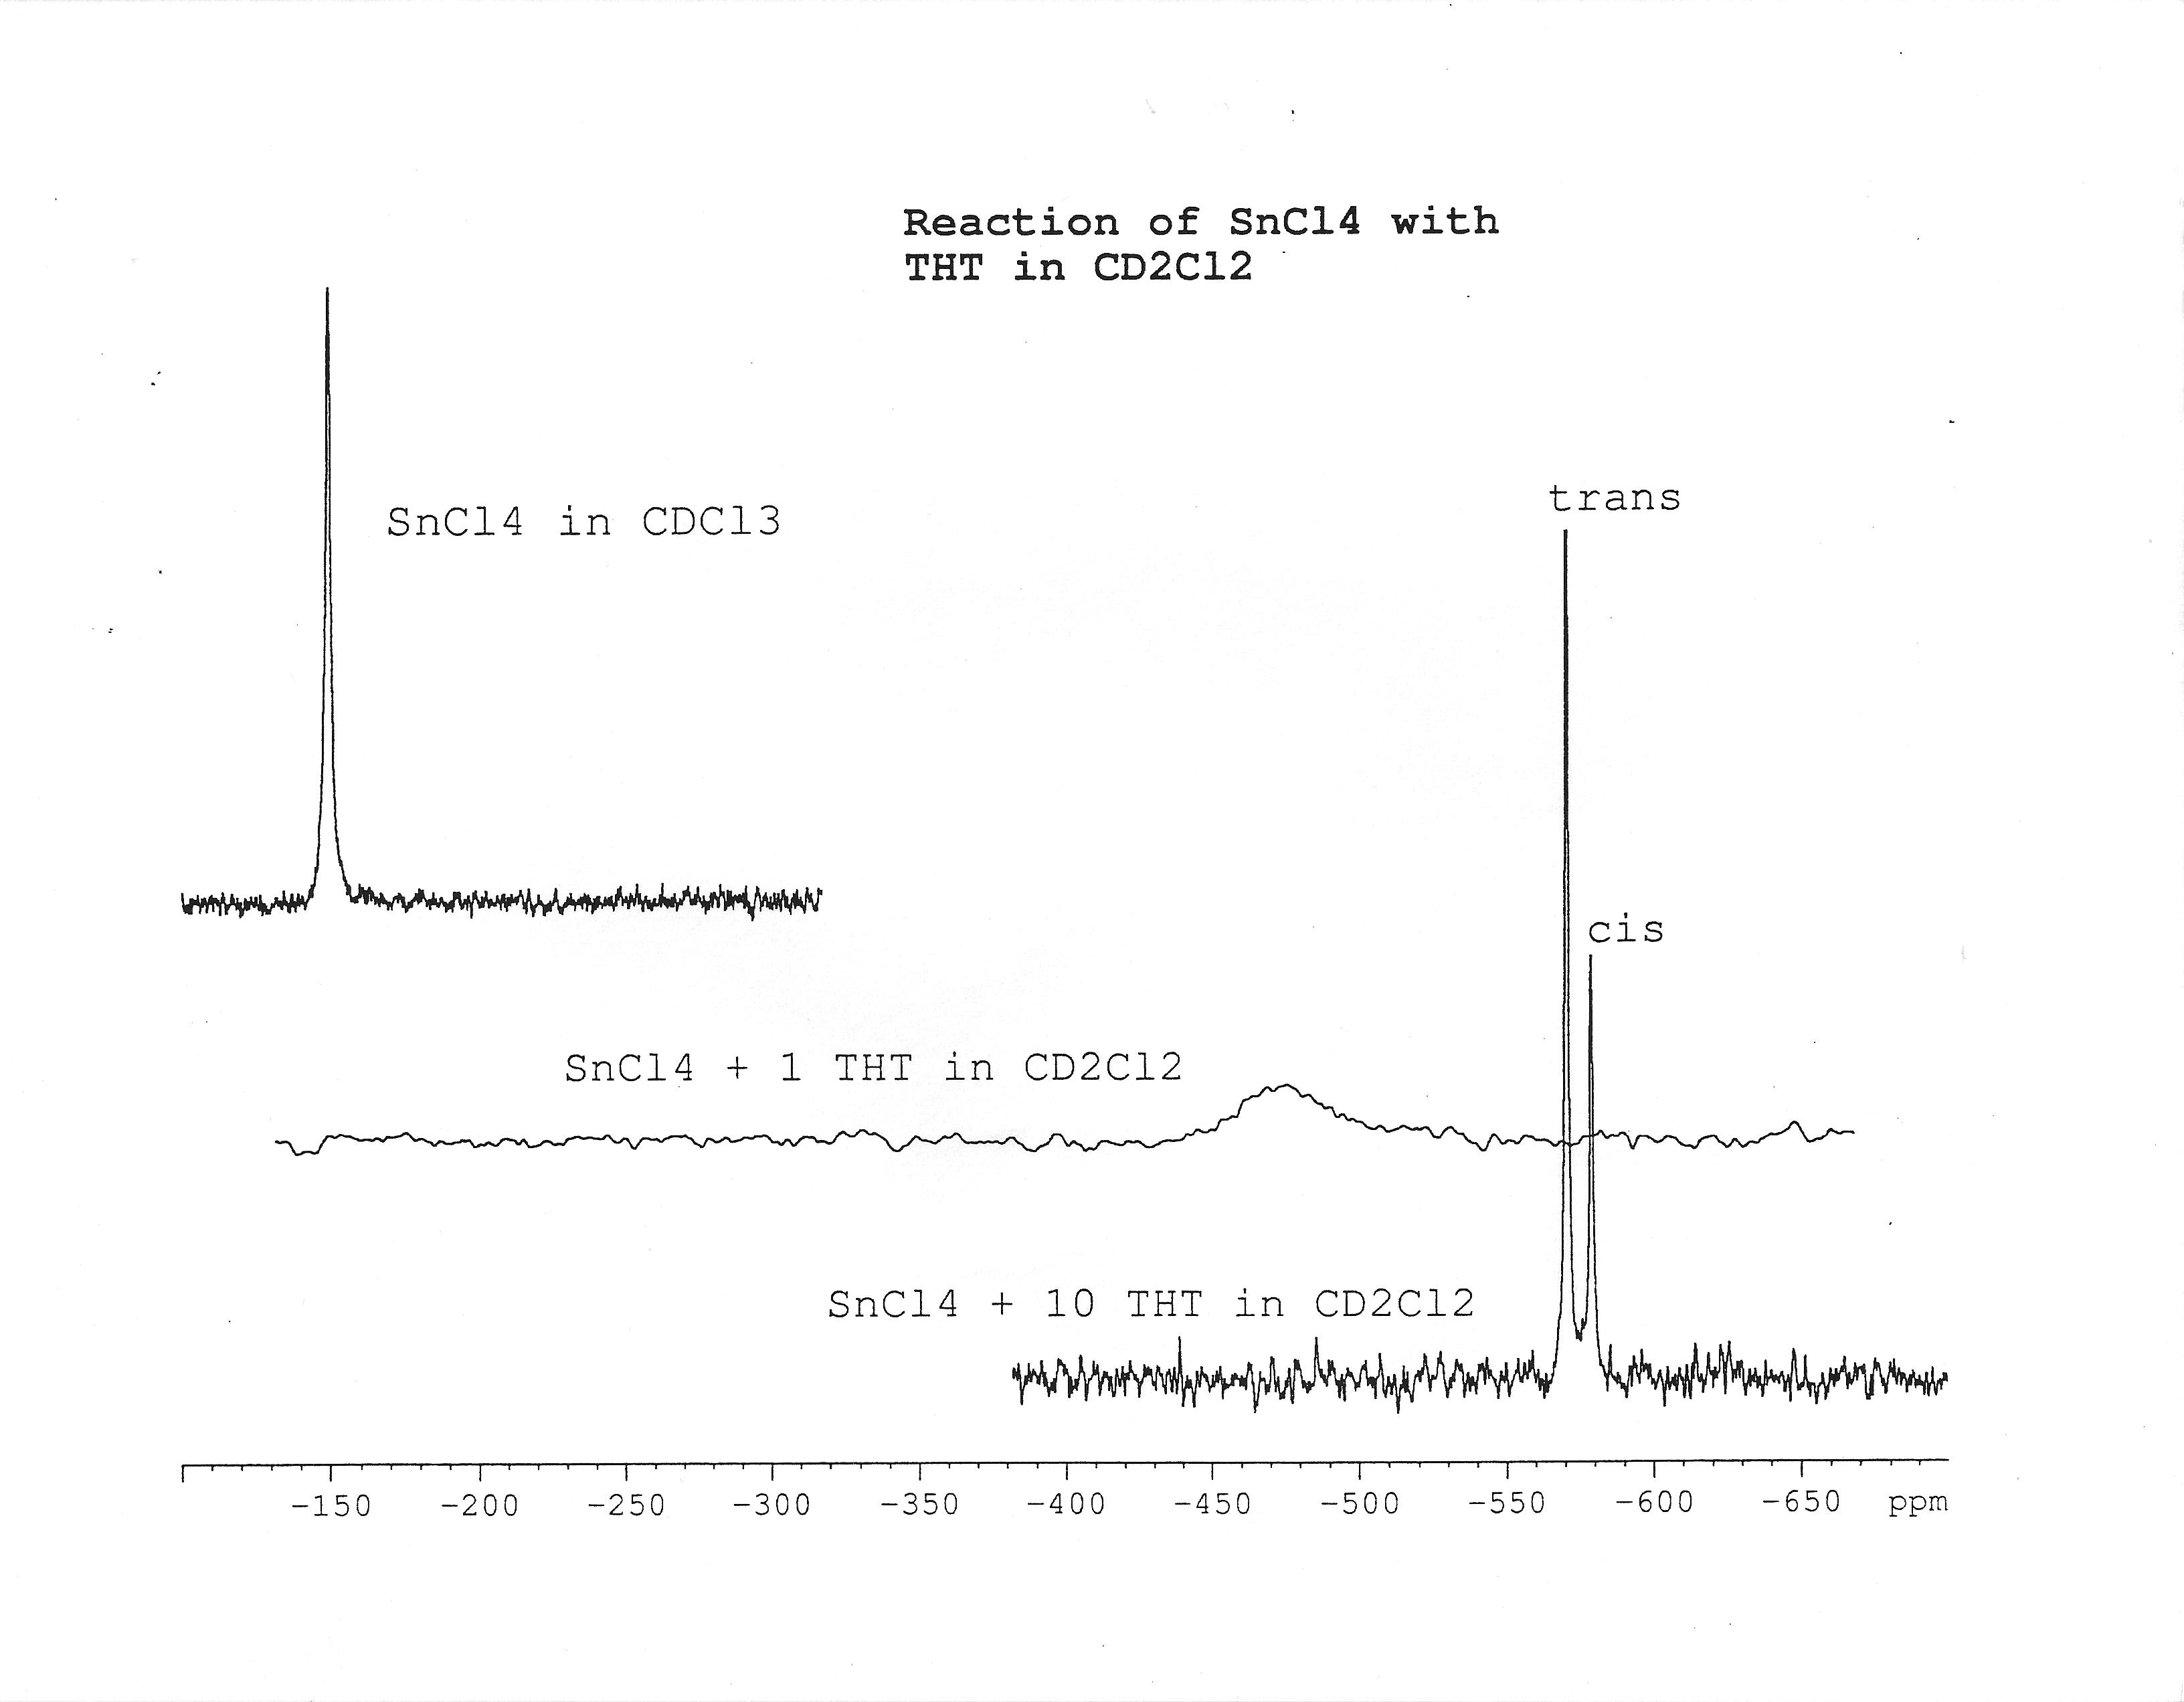

Slide 22
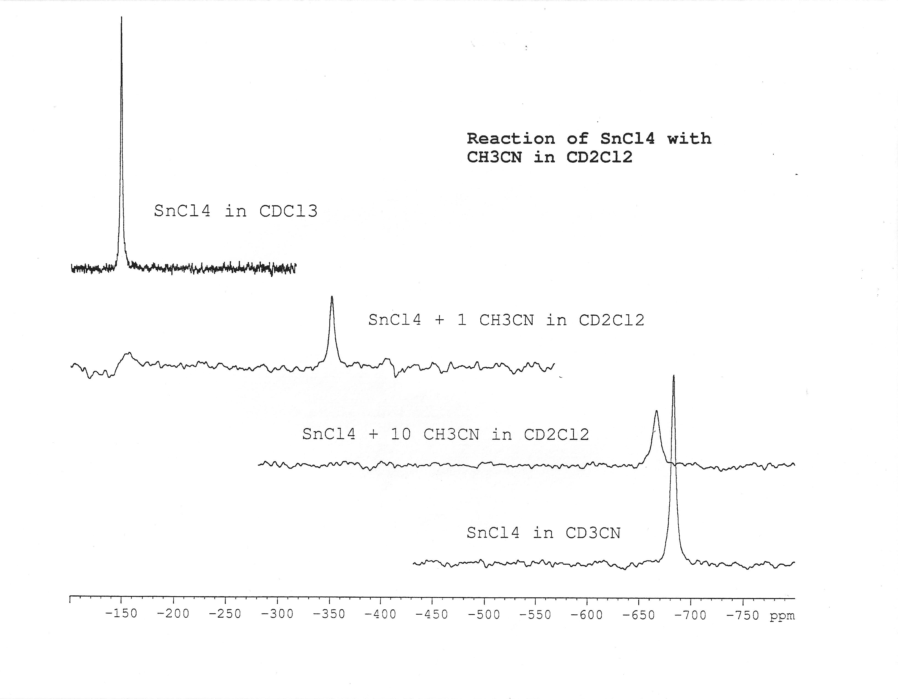

Slide 23
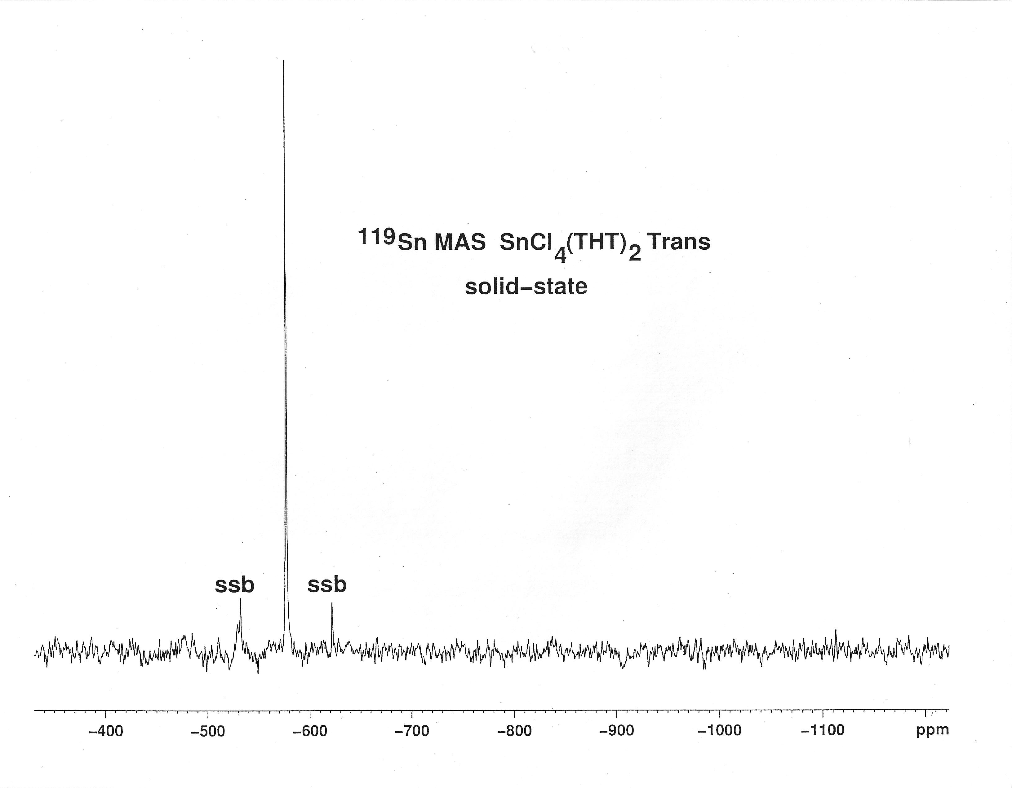

Slide 24
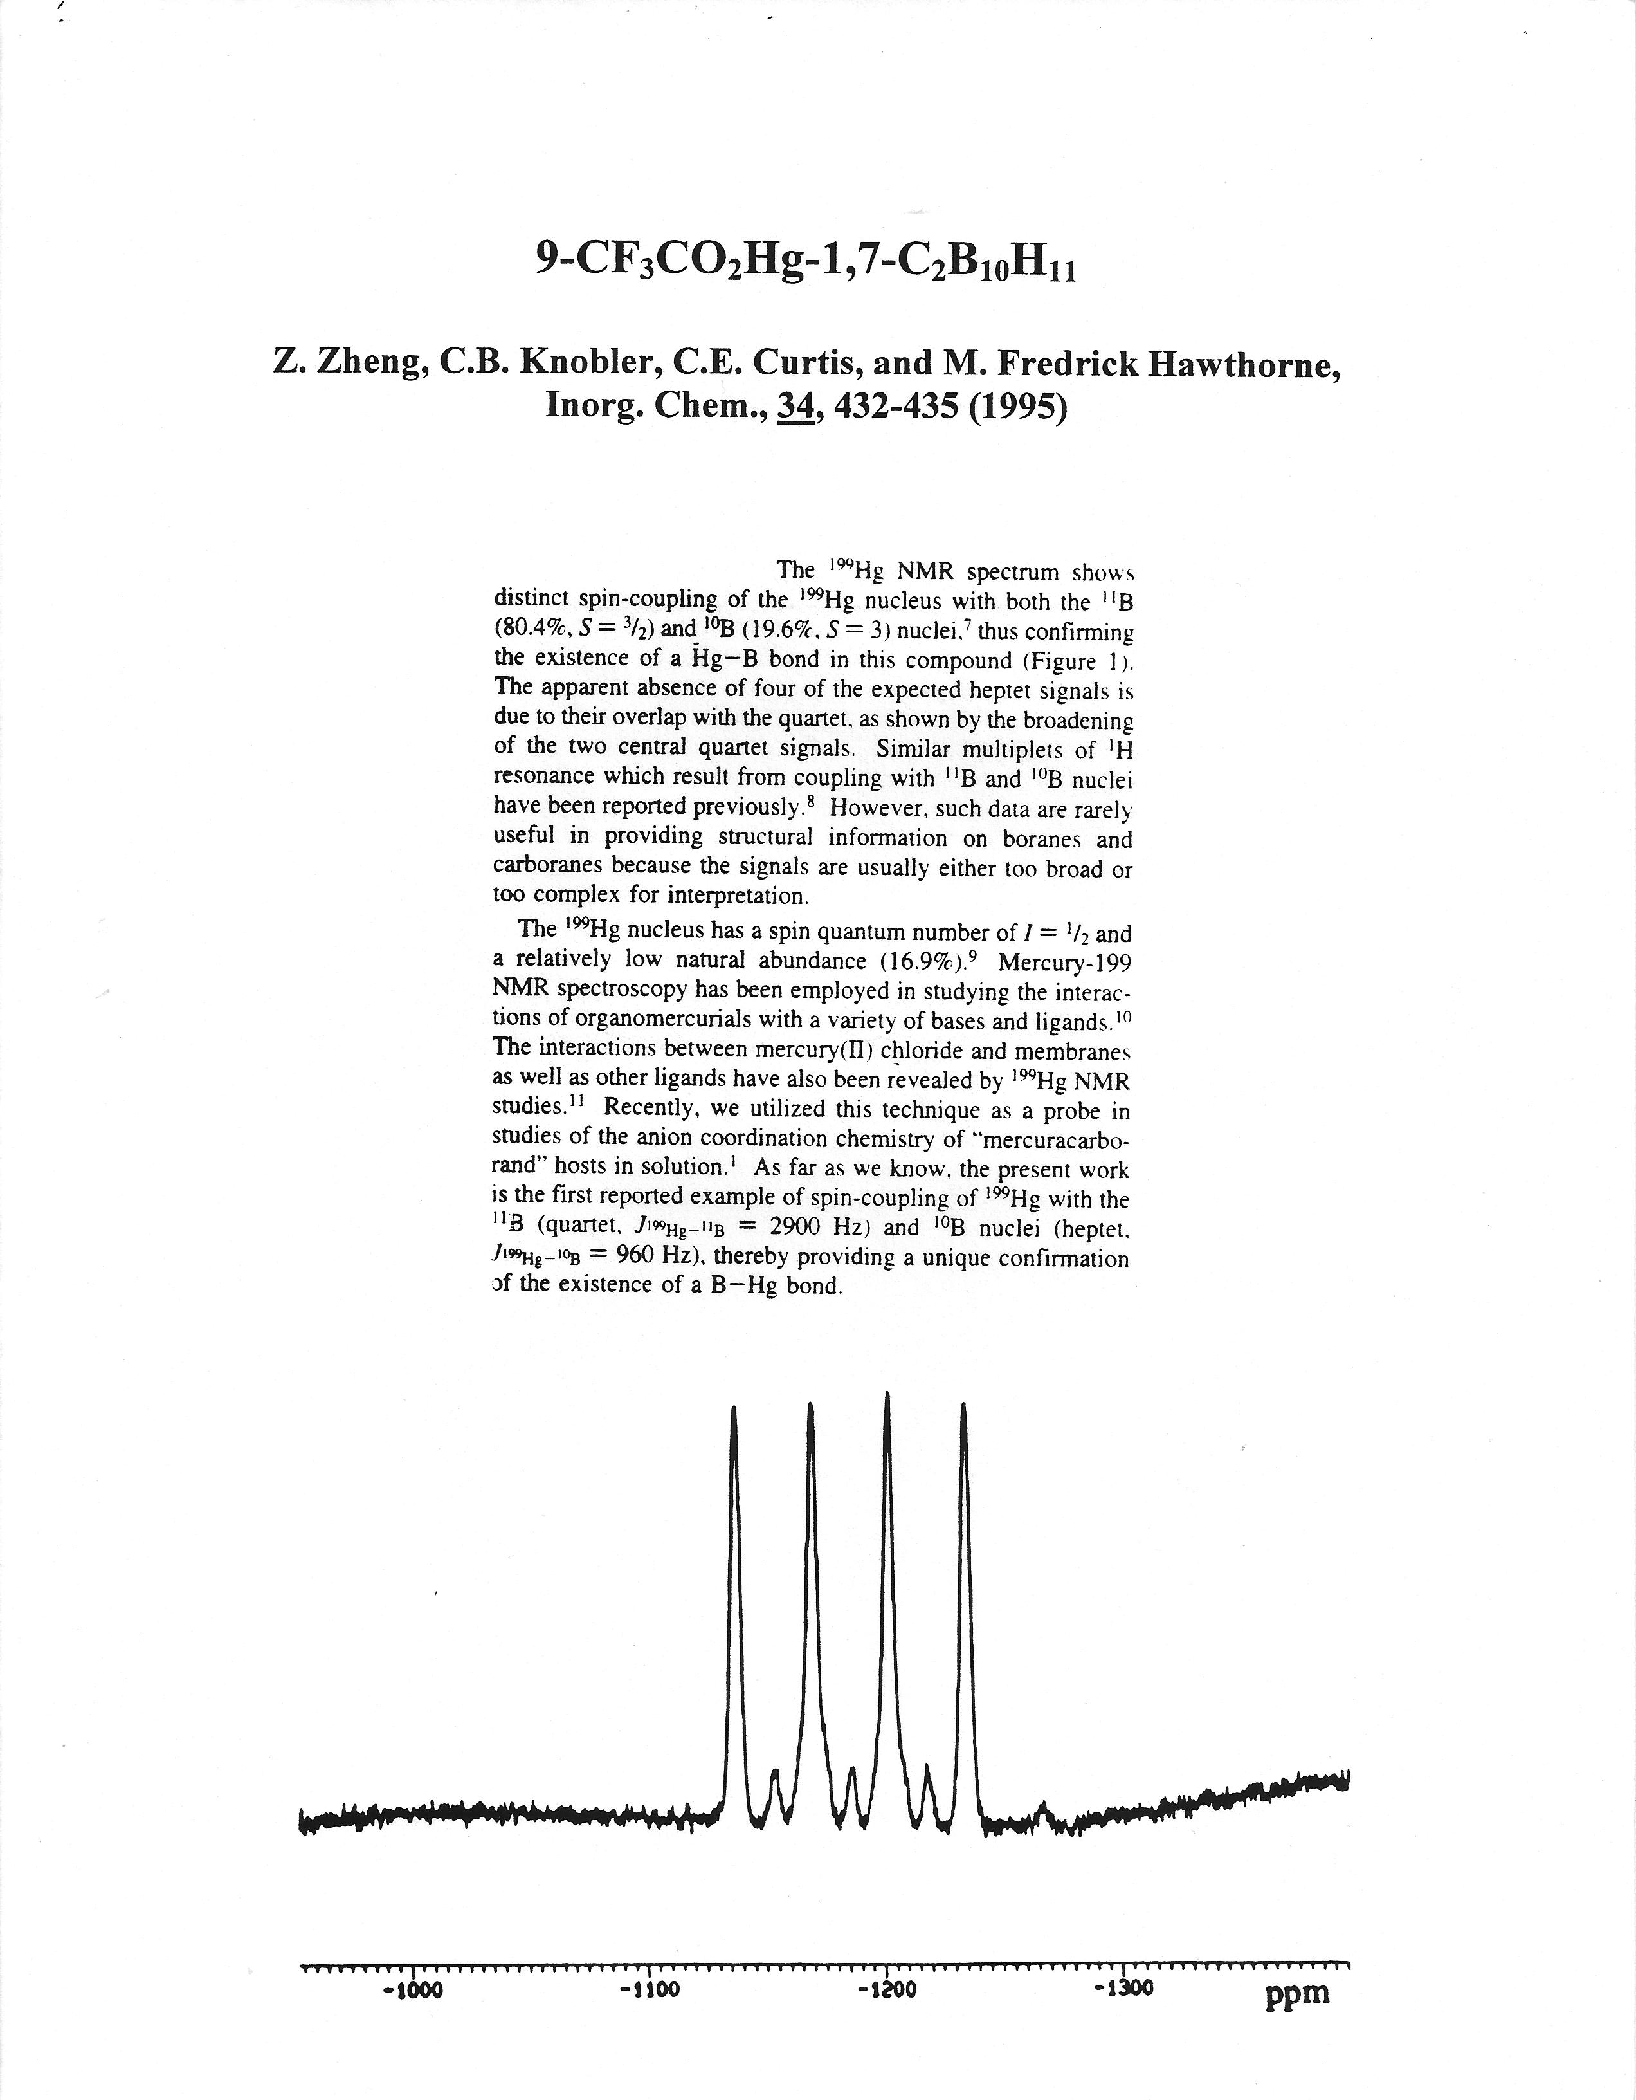
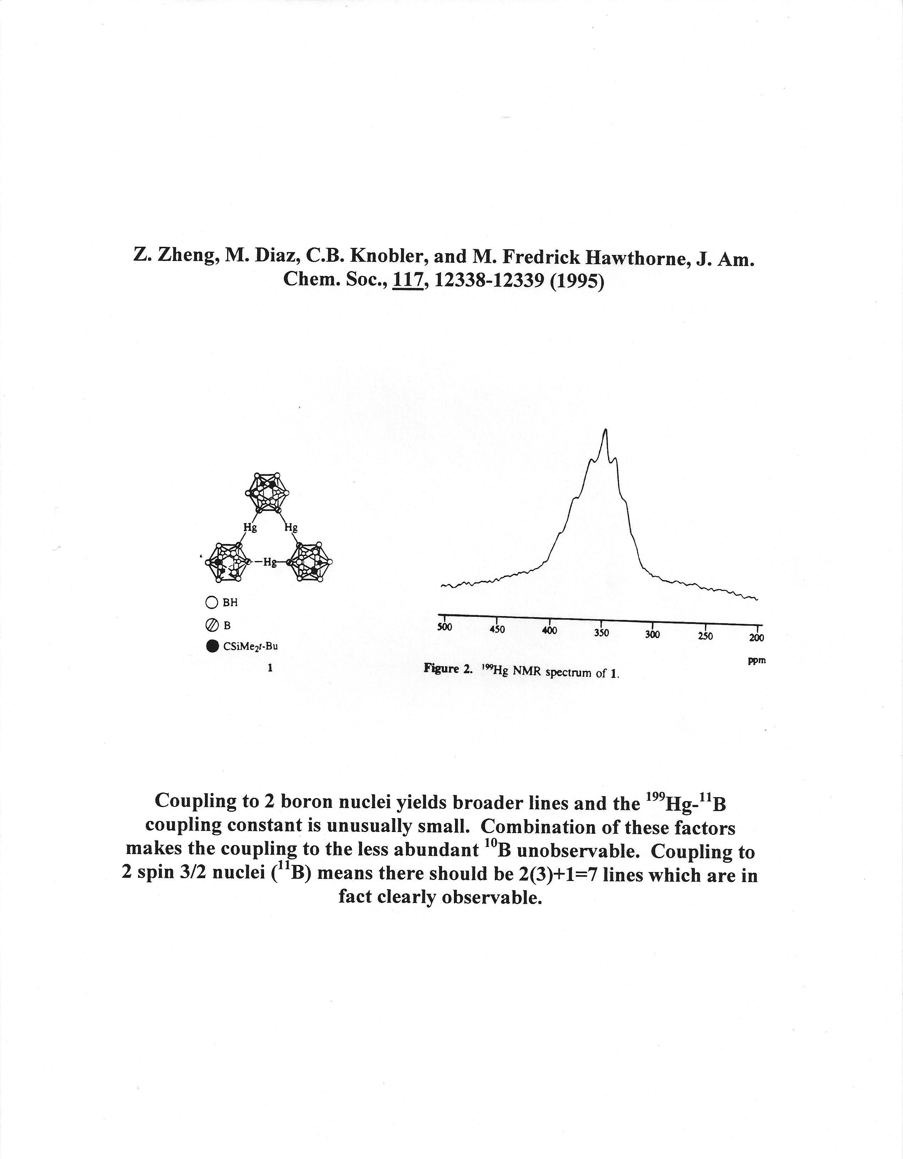

Slide 25
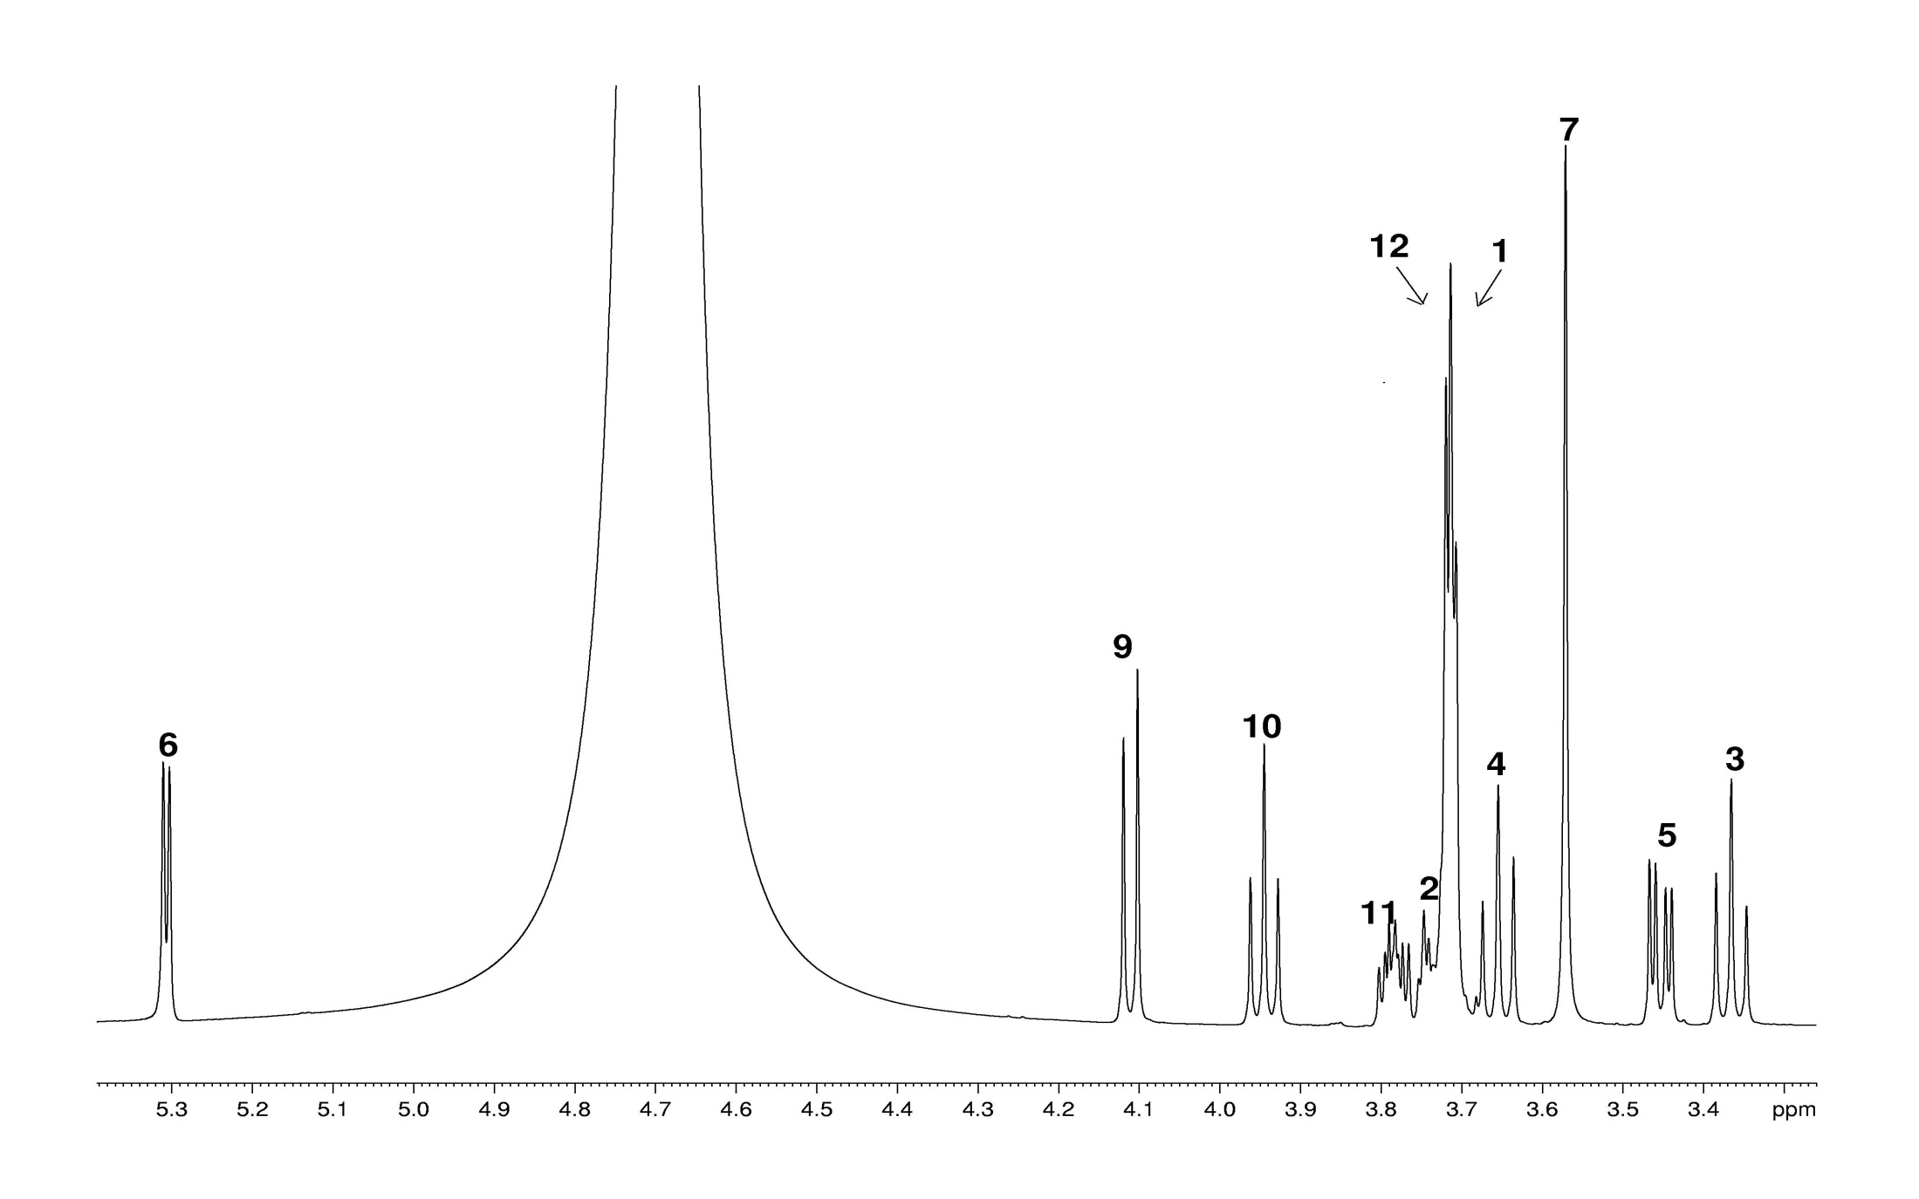
Sucrose ¹H spectrum

Slide 26
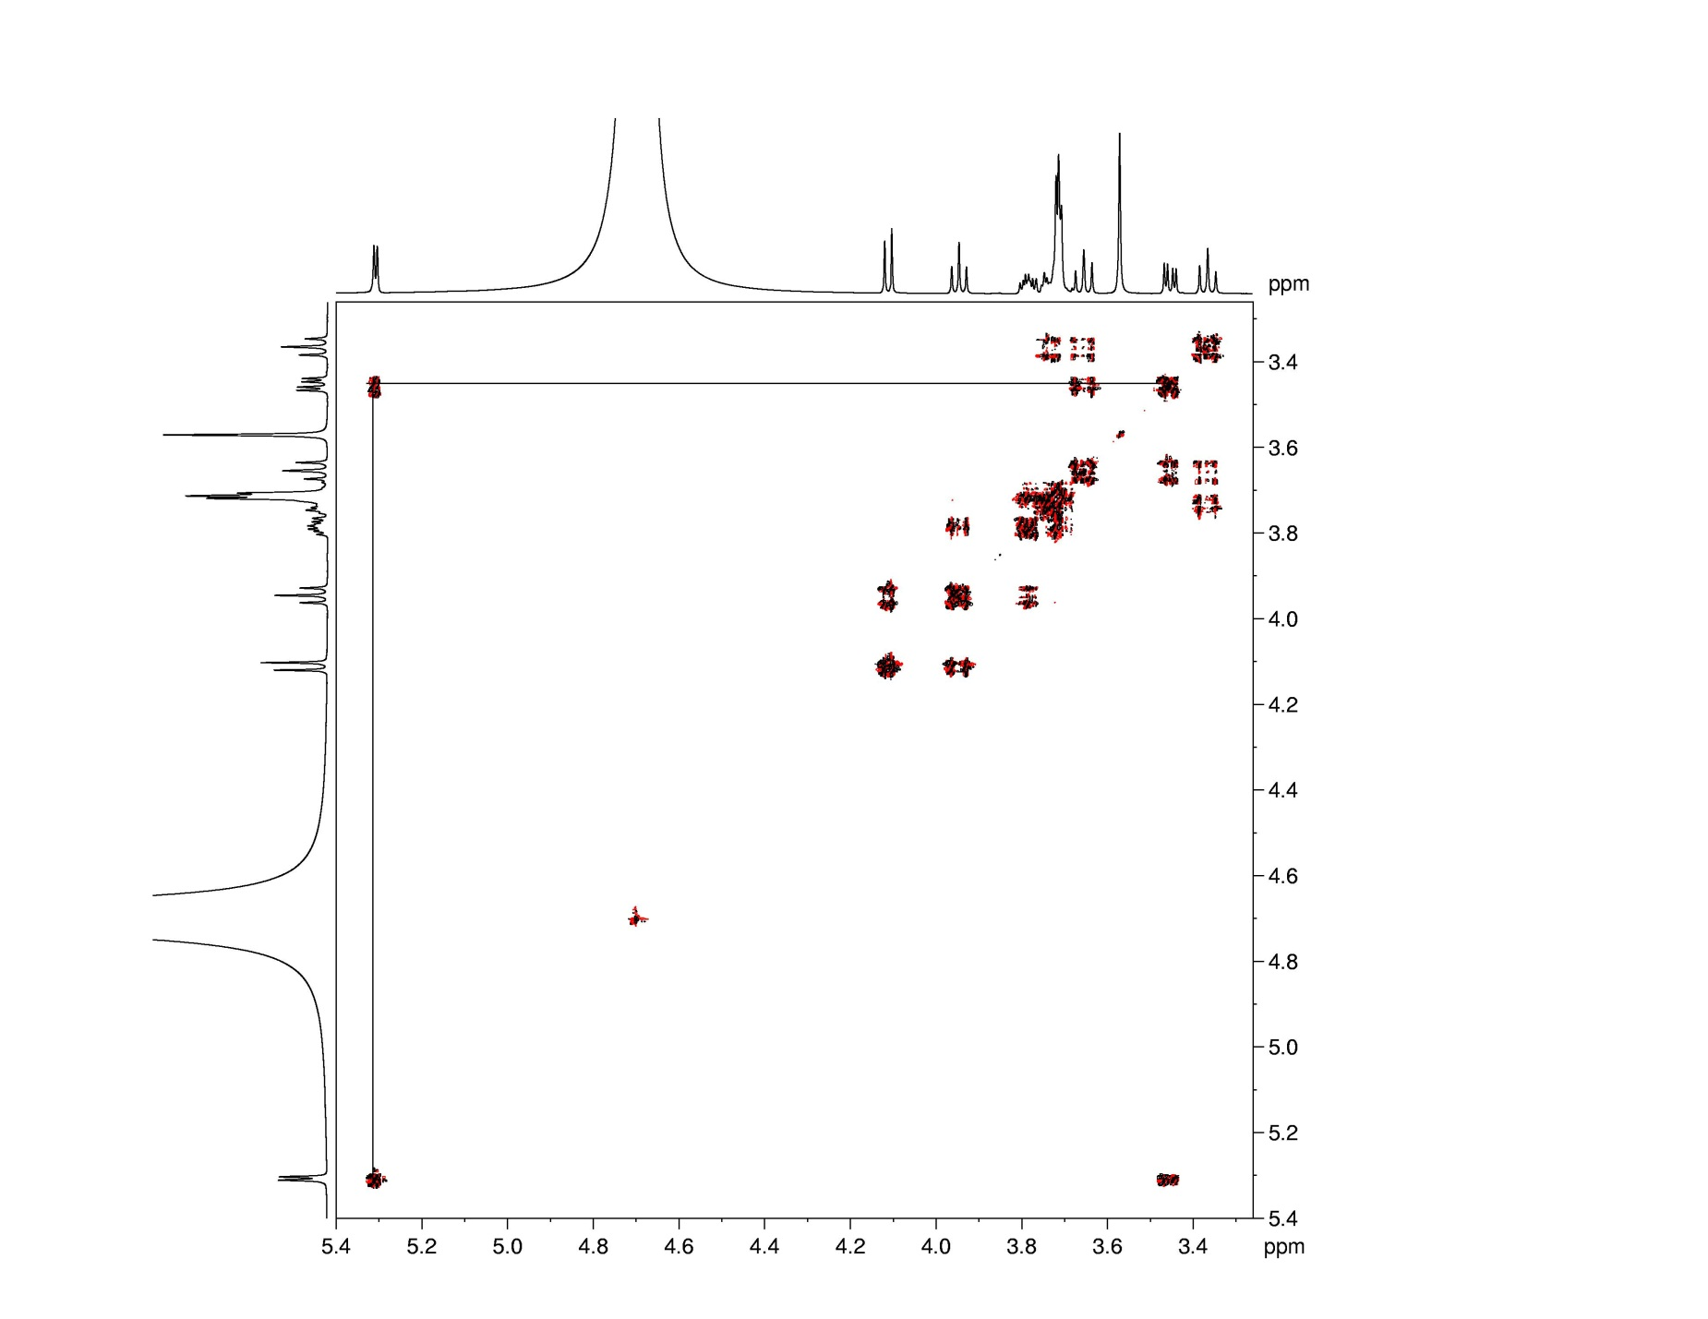

Slide 27
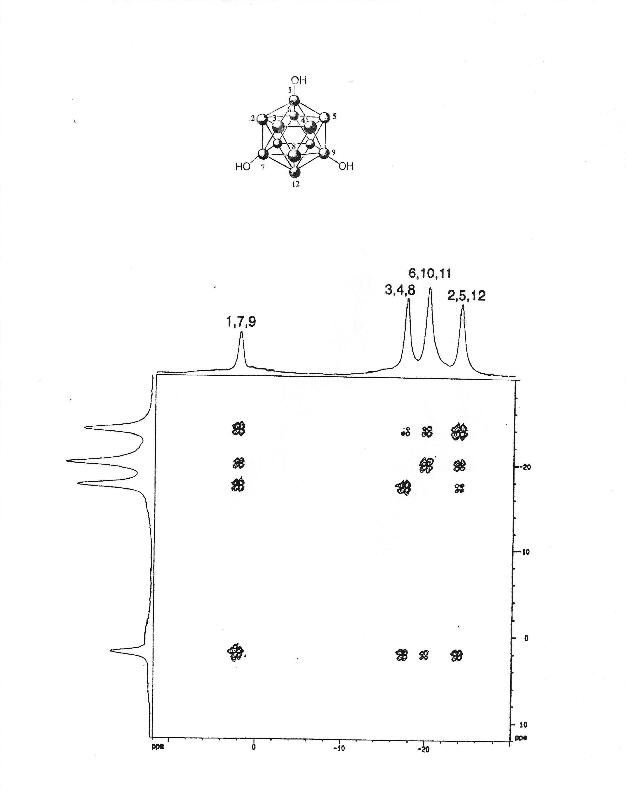
¹¹B-¹¹B COSY

Slide 28
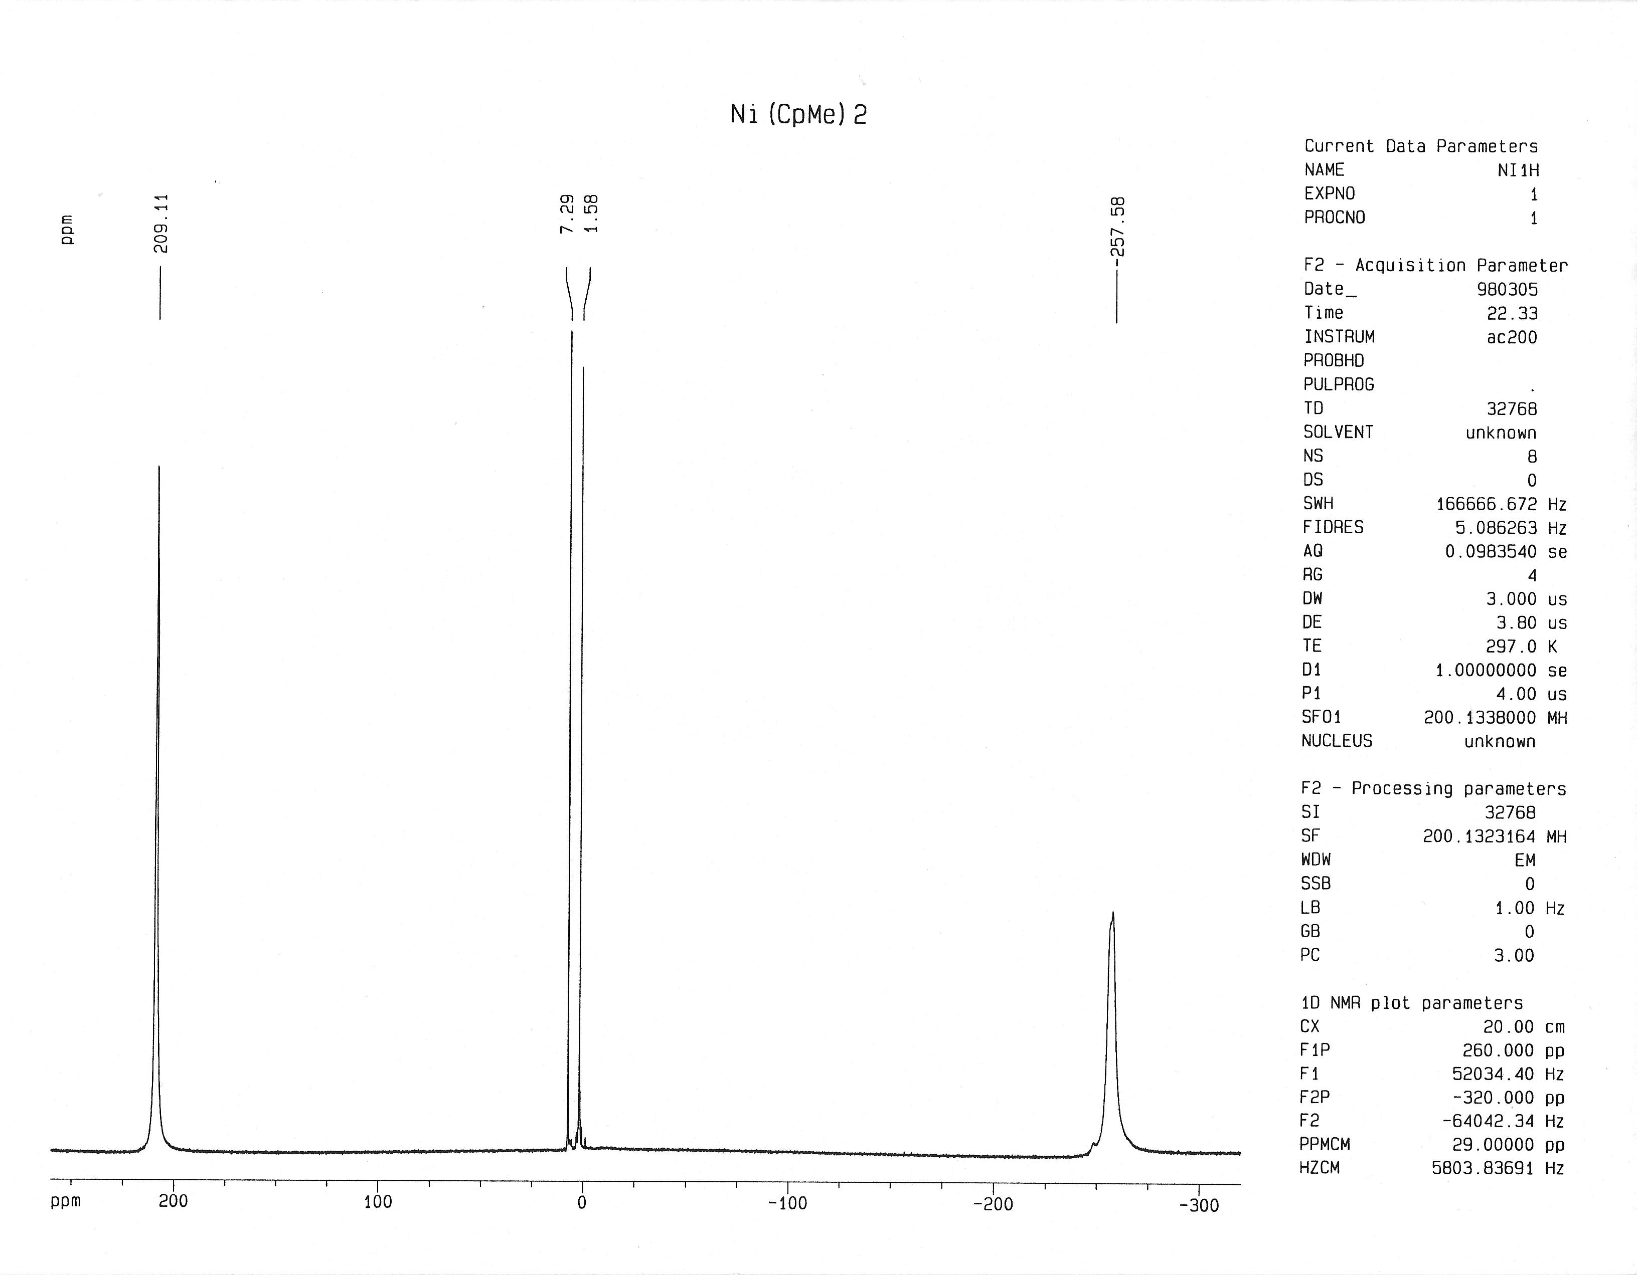

Slide 29
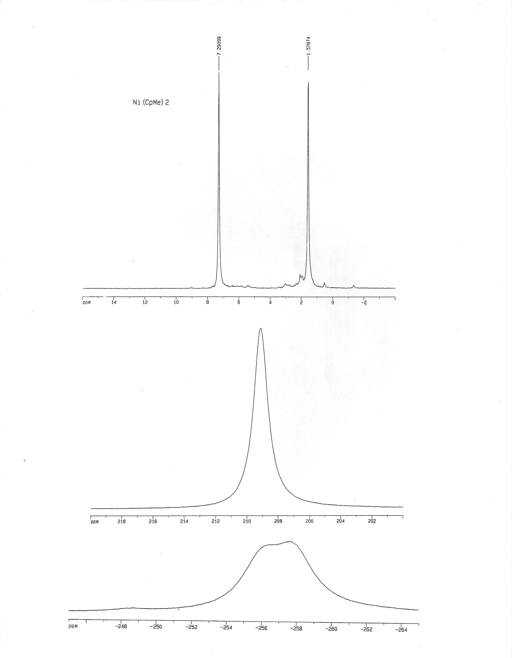
Default data acquisition region
-4 ppm to + 16 ppm
+200 ppm to +220 ppm
-245 ppm to -265 ppm

Slide 32
