Slide 1
Lecture 16a
Metal carbonyl compounds

Slide 2
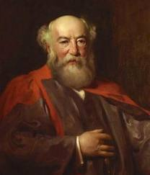
Introduction
The first metal carbonyl compound described was Ni(CO)₄ (Ludwig Mond, ~1890), which was used to refine nickel metal (Mond Process)
Metal carbonyls are used in many industrial processes aiming at carbonyl compounds i.e., Monsanto process (acetic acid), Fischer Tropsch process or Reppe carbonylation (vinyl esters)
Vaska’s complex (IrCl(CO)(PPh₃)₂) absorbs oxygen reversibly and serves as model for the oxygen absorption of myoglobin and hemoglobin

Slide 3
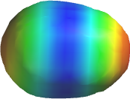
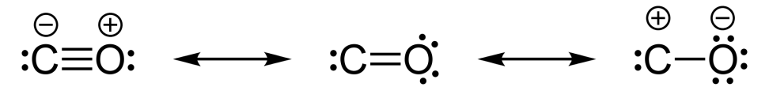
Carbon Monoxide
Carbon monoxide is a colorless, tasteless gas that is highly toxic because it strongly binds to the iron in hemoglobin
It is generally described with a triple bond because the bond distance of d= 113 pm is too short for a double bond i.e., formaldehyde (d= 121 pm)
The structure on the left is the major contributor because both atoms have an octet in this resonance structure, which means that the carbon atom is bearing the negative charge
The lone pair of the carbon atom is located in a sp-orbital

Slide 4
Bond Mode of CO to Metals
The CO ligand usually binds via the carbon atom to the metal
The lone pair on the carbon forms a σ-bond with a suitable
d-orbital of the metal
The metal can form a π-back bond via the π*-orbital of the
CO ligand
Electron-rich metals i.e., late transition metals in low oxidation states are more likely to donate electrons for the back bonding
A strong π-back bond results in a shorter the M-C bond and a longer the C-O bond due to the population of an anti-bonding orbital in the CO ligand

Slide 5

Synthesis
Some compounds can be obtained by direct carbonylation at room temperature or elevated temperatures
In other cases, the metal has to be generated in-situ by reduction
of a metal halide or metal oxide
Many polynuclear metal carbonyl compounds can be obtained
using photochemistry, which exploits the labile character of many
M-CO bonds (“bath tub chemistry”)

Slide 6
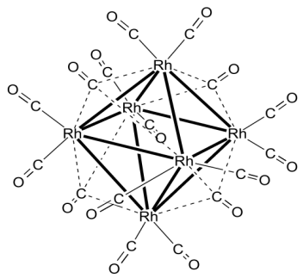
Structures I
Three bond modes found in metal carbonyl compounds
The terminal mode is the most frequently one mode found exhibiting a carbon oxygen triple bond i.e., Ni(CO)₄
The double or triply-bridged mode is found in many polynuclear metals carbonyl compounds with an electron deficiency i.e., Rh₆(CO)₁₆ (four triply bridged CO groups)
Which modes are present in a given compound can often be determined by infrared spectroscopy

Slide 7
Structures II
Mononuclear compounds
Dinuclear compounds
M(CO)₆ (O_{h}) M(CO)₅ (D_{3h}) M(CO)₄ (T_{d})
i.e., Cr(CO)₆ i.e., Fe(CO)₅ i.e., Ni(CO)₄
M₂(CO)₁₀ (D_{4d}) Fe₂(CO)₉ (D_{3h})
i.e., Re₂(CO)₁₀
Co₂(CO)₈ Co₂(CO)₈
(solid state, C_{2v}) (solution, D_{3d})

Slide 8
Infrared Spectroscopy
Free CO: 2143 cm⁻¹
Terminal CO groups: 1850-2120 cm⁻¹
μ₂-brigding CO groups: 1750-1850 cm⁻¹
μ₃-bridging CO groups: 1620-1730 cm⁻¹
Non-classical metal carbonyl compounds can have ν(CO) greater than the one observed in free CO
Compound | ν(CO) (cm⁻¹)
Ni(CO)₄ | 2057
Fe(CO)₅ | 2013, 2034
Cr(CO)₆ | 2000
Re₂(CO)₁₀ | 1976, 2014, 2070
Fe₂(CO)₉ | 1829, 2019, 2082
Rh₆(CO)₁₆ | 1800, 2026, 2073
Ag(CO)⁺ | 2185

Slide 9
Application I
Fischer Tropsch Reaction/Process
  The reaction was discovered in 1923
  The reaction employs hydrogen, carbon monoxide and
  a “metal carbonyl catalyst” to form alkanes, alcohols, etc.
  Ruhrchemie A.G. (1936)
    Used this process to convert synthesis gas into gasoline using
    a catalyst Co/ThO₂/MgO/Silica gel at 170-200 ºC at 1 atm
    The yield of gasoline was only ~50% while about 25% diesel
    oil and 25% waxes were formed
  An improved process (Sasol) using iron oxides as catalyst,
  320-340 ºC and 25 atm pressure affords 70% gasoline

Slide 10
Application II
Second generation catalyst are homogeneous i.e. [Rh₆(CO)₃₄]²⁻
Union Carbide: ethylene glycol (antifreeze) is obtain at high pressures (3000 atm, 250 ºC)
Production of long-chain alkanes is favored at a temperature around 220 ºC and pressures of 1-30 atm

Slide 11
Application III
Monsanto Process (Acetic Acid)
  This process uses cis-[(CO)₂RhI₂]⁻ as catalyst to convert methanol and carbon dioxide to acetic acid
  The reaction is carried out at 180 ºC and 30 atm pressure
  Two separate cycles that are combined with each other
Oxidative
Addition
CO Insertion
Reductive
Elimination
CO Addition

Slide 12
Application IV
Hydroformylation
  It uses cobalt catalyst to convert an alkene, carbon monoxide and hydrogen has into an aldehyde
  The reaction is carried at moderate temperatures (90-150 ºC) and high pressures (100-400 atm)

Slide 13
Application V
Reppe-Carbonylation
  Acetylene, carbon monoxide and alcohols are reacted in the presence of a catalyst like Ni(CO)₄, HCo(CO)₄ or Fe(CO)₅ to yield acrylic acid esters
  The synthesis of ibuprofen uses a palladium catalyst on the last step to convert the secondary alcohol into a carboxylic acid

Slide 14
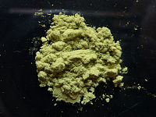
Application VI
Vaska’s Complex (1961)
  Originally synthesized from IrCl₃, triphenylphosphine
  and various alcohols i.e., 2-methoxyethanol.
  Triphenylphosphine as a ligand and reductant in the reaction
  A more convenient synthesis uses N,N-dimethylformamide as the CO source
  Aniline is frequently used as an accelerant
  The resulting bright yellow complex is
  square planar (IrCl(CO)(PPh₃)₂) because
  Ir(I) exhibits d⁸-configuration
  The two triphenylphosphine ligands are
  in trans configuration.

Slide 15
Application VII
Vaska’s Complex (cont.)
  The carbonyl stretching mode in the complex is consistent with a strong
  π-backbonding ability (d(CO)=116.1 pm (free CO=113 pm))
  The complex is a 16 VE system that reactants with broad variety of compounds under oxidative addition usually via a cis addition in which
  the Cl and the CO ligand fold back
  Note that a molecule like oxygen is bonded
  side-on in the light orange complex:
    d(O-O)=147 pm (free oxygen: 121 pm, peroxide (O₂²⁻:149 pm))
    ν(O-O)=856 cm⁻¹ (free oxygen: 1556, peroxide (O₂²⁻: 880))
    Note that the older literature reports a d(O-O)=130 pm, which
    is more consistent with a superoxide (O₂⁻)!
    The addition of oxygen to Vaska’s complex is reversible

Slide 16
Application VIII
Vaska’s Complex (cont.)
  The resulting products exhibit increased carbonyl stretching frequencies because the metal does less π-backbonding due to its higher oxidation state (Ir(III))
  A similar trend is also found for the Ir-P bond length, which increases in length compared to the initial complex
X-Y | ν(CO) in cm⁻¹
none | 1967
H₂ | 1983
O₂ | 2015
HCl | 2046
MeI | 2047
I₂ | 2067
Cl₂ | 2075

