Slide 1
Lecture 8a
Synthesis of MoS₂

Slide 2
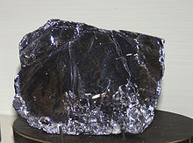
Introduction I
In nature, molybdenum occurs primarily as molybdenite (MoS₂)
Molybdenum disulfide has gained interest as lubricant, battery cathode material and catalyst for hydrogenation reactions
Like graphite, MoS₂ forms a layered structure consisting of closed packed of sulfur atoms with Mo atoms occupying the trigonal prismatic interstices. The individual layers can slip easily towards each other, which make it a good lubricant.
Like graphite, MoS₂ is able to form intercalation compounds with alkali metals

Slide 3
Introduction II
MoS₂ can also be prepared by direct combination of the elements at elevated temperatures (T>900 ºC)
The solid-state metathesis reaction of molybdenum(V) chloride and anhydrous sodium sulfide leads to the product more conveniently.
The formation of MoS₂ is highly exothermic (ΔH_{f} = -210 kcal/mol).
The same method can be applied for other dichalcogenides (WS₂, MoSe₂, WSe₂) as well.

Slide 4
Introduction III
The synthesis of MoS₂ works best with high-quality MoCl₅ (b.p.=268 ºC), which can be obtained by direct combination of the elements at elevated temperatures.
2 Mo + 5 Cl₂ 2 MoCl₅
The pure product is a dark-blue solid, which is very air-sensitive.
The crude product from the chlorination usually contains some oxychlorides i.e., MoOCl₄ (green, b.p.=159 ºC), MoOCl₃ (black, d>215 ºC), MoO₂Cl₂ (yellow, b.p.=250 ºC)
Thus, thee crude has to be purified by a “fractionated distillation/sublimation ” prior to the use in the synthesis of MoS₂.

Slide 5
Introduction IV
Alkali metal sulfides can be obtained by reaction of ethanolic alkali hydrogensulfide (NaHS) solutions with sulfur.
2 NaHS + S Na₂S + H₂S
In the lab it will be synthesized by direct synthesis of the elements in liquid ammonia.
2 Na + S Na₂S
The obtained white powder (Na₂S) exhibits a large surface area that makes it too reactive towards strong oxidizers.
The crude product has to be annealed prior the reaction to reduce its reactivity.
If this annealing step is skipped, the Na₂S and the MoCl₅ will most likely react already when mixed in the mortar (initiated by the heat from the grinding!).

Slide 6
Experimental I (MoS₂)
Handling quartz equipment
The quartz tube and the quartz boat are very expensive.
Always use gloves when you touch the tube or the boat. Skin desorbs alkali that cause the quartz to crystallize (cracking upon heating!).
Make sure that you clean the tube and the boat right after you are done.
Safety considerations (gas cylinders)
Ensure that everything is well secured with clamps and wires when you work with gas cylinders (See appendix F in the course reader to obtain information how to operate gas cylinders properly).
Make sure to use the proper regulators with the gas tank (needles valves for Cl₂ and NH₃, two-stage regulators for H₂ and CO₂). It is advisable to check the availability of the gases and regulators beforehand.
Scheduling
The reaction takes about 4-6 hours to complete depending on efficiency. Therefore, it is advisable to start a little earlier and prepare the setup already during the previous lab section. Talk to the TA supervising this experiment ahead of time.
The compounds are very air sensitive and any leak will deteriorate the quality for further reactions. This means that you cannot stop the reaction halfway.
As of today, we do not have the chlorine and the ammonia cylinder. They were supposed to arrive on Tuesday, then on Thursday and as of last Friday, on Friday of this week.

Slide 7
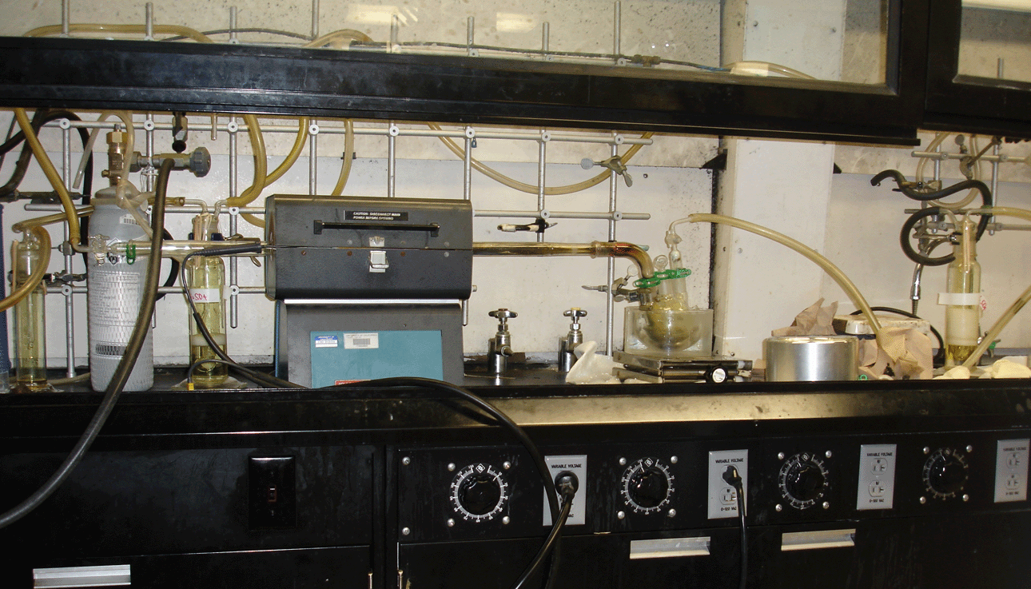
Experimental II (MoS₂)
Setup
The setup consists of: 3-4 foot quartz tube, quartz boot with molybdenum powder, three gas wash bottles, a bend adapter, a large three-necked flask, a furnace, two gas adapters, Tygon tubing, gas cylinders (chlorine, hydrogen, carbon dioxide)

Slide 8
Experimental III (MoS₂)
Place the quartz boat filled with Mo-powder inside the quartz tube, which is clamped at each end.
Attach a gas adapter on the side, which will be connected to the tanks
Attach a bent adapter on the other side that connects a large three-necked flask (pre-weight the flask) to the quartz tube
The middle hole is closed with a glass plug (no rubber septum here!!!)
Another gas adapter with glass wool on the inside to prevent that the hole in the plug gets clog up
This entire setup in flame-dried twice

Slide 9
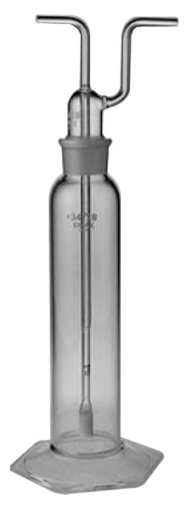
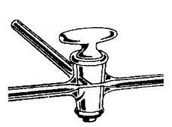
Experimental IV (MoS₂)
Inlet
Outlet
Two gas wash bottles (with frit here) are connected to each other via a Tygon tubing.
The first bottle is ¼ filled with concentrated sulfuric acid (careful: very corrosive!)
The outlet of the second bottle is later connected to the gas adapter
A three-way adapter is connected to the first gas wash bottle and two gas tanks, initially carbon dioxide and hydrogen gas, later carbon dioxide and chlorine gas.
This entire part of the setup has to be purged with carbon dioxide for 10 minutes before being attached to the quartz tube.

Slide 10
Experimental V (MoS₂)
Next, the quartz tube is then purged with carbon dioxide to remove the nitrogen (10 minutes).
Afterwards the system is filled with hydrogen gas and the furnace slowly heated to about 900-1000 ºC while maintaining a slow hydrogen stream.
This temperature is maintained for about 30-60 minutes (depending on how much water is observed on the other end of the quartz tube).
The system is cooled to about 200-300 ºC under hydrogen flow
The formed water is removed from the tube and the Schlenk flask with a heat gun (If the water cannot be removed entirely from the flask, it has to be exchanged under a stream of nitrogen).

Slide 11
Experimental VI (MoS₂)
Next, the chlorine tank then replaces the hydrogen tank. The tube is purged for at least ten minutes with chlorine gas.
If the reaction does not occur spontaneously, the tube has to be heated gently with a heat gun or the furnace. The reaction started if dull-red vapors appear. (Careful: the reaction is exothermic!)
The product should condense in the three-necked flask. If necessary, the quartz tube has to be heated at the end and the flask cooled with ice water.
Make sure to check on the gas adapter on the three-necked flask on a regular basis. Despite the glass wool, it tends to clog up often times, particularly if the flow rate of the chlorine is too high.

Slide 12
Experimental VI (MoS₂)
After cooling, the Schlenk flask is disconnected, is evacuated and is transferred into the glove box. The crude yield is determined.
About 2 g of the crude product is transferred into a long Pyrex tube. The tube is evacuated and is then placed horizontally in a furnace with a temperature of about 250 ºC.
The volatile oxychlorides condense at the outside the furnace, MoCl₅ in the colder areas inside the furnace.
The blue-black crystals are extremely air sensitive and should only be handled in the glove box.

Slide 13
Experimental I (Na₂S)
Safety consideration
Ammonia gas is toxic and flammable (b.p.= -33 ºC).
Liquified gases have a very high potential of accidents. One mol of ammonia occupies about ~20 mL as a liquid, but ~22400 mL as a gas (at 0ºC)! Thus, the temperature has to be controlled carefully throughout the reaction.
The reaction vessel has to be connected to a bubbler filled with paraffin oil.
Alkali metals are very reactive. They usually react violently with water, low boiling alcohols, etc.
The solution of alkali metals in liquid ammonia is extremely reactive, often times pyrophoric.
Metal fires are generally very difficult to extinguish.

Slide 14
Experimental II (Na₂S)
4 mmol of sodium metal (remove the outer oxide layer by cutting it under petroleum ether or hexane) and 2 mmol of sulfur are placed in a 100 mL Schlenk flask with a long neck
2 Na + S Na₂S
Na₂S + xS Na₂S_{2+x}
The flask is cooled to T= –78 ºC in an isopropanol/dry ice mixture.
Gaseous ammonia is introduced to the flask that is previously equipped with a bubbler (filled with paraffin oil).
The ammonia condenses and dissolves the sodium metal slowly. The dark blue solution reacts with the sulfur to form a white precipitate.
A total of about 30 mL of ammonia is condensed. The mixture stirred for an additional 30 minutes to ensure the complete reaction of the sodium.

Slide 15
Experimental III (Na₂S)
Note: If the solution remains blue, a little bit more sulfur has to be added. If it turns yellow, a very small amount of sodium metal is added to the suspension. The final product has to be almost white/grayish!
The cooling bath is removed and the ammonia is allowed to evaporate. Towards the end, the flask is evacuated in a dynamic vacuum and a warmed with a water bath to remove the trace amounts of absorbed ammonia .
The cooling trap has to be removed immediately upon venting the setup to avoid explosions and the contamination of the pump oil.
The white, moisture sensitive powder is transferred into a thick-walled Pyrex tube (in the glove box). The tube is evacuated and placed in a furnace at 350 ºC (maximum temperature!) over night.

Slide 16
Experimental I (MoS₂)
Safety considerations
Despite the fact that the Na₂S is less reactive after the annealing process, caution should be exercised when mixing it with MoCl₅.
The reaction is highly exothermic. In addition, leftover MoCl₅ can react violently with methanol and water releasing hydrogen chloride and other toxic gases.
Carbon disulfide is very flammable and not very healthy. Avoid breathing its vapors. It also has to be collected in a separate waste bottle.

Slide 17
Experimental II (MoS₂)
In the glove box, a mixture of 2 mmol of MoCl₅ and 5 mmol of annealed Na₂S are placed in a small crucible.
2 MoCl₅ + 5 Na₂S 2 MoS₂ + 5 NaCl + S
The reactants are lightly stirred and then transferred into the bomb (shown on the right). The bomb cover is placed on top (The ignition wire has to be long enough to be in contact with the mixture!).
The bomb is closed and then the contacts are attached to a variable power control (Variac). Setting ‘10’ (not higher initially!) will usually be sufficient to initiate the reaction, which will usually be completed in a few seconds.
The container is allowed to cool down before taken out of the glove box (without opening it if possible). It is opened under the hood.
Since several students usually run the reaction at the same time, it will be necessary to transfer the mixture to a small beaker in the glove box.

Slide 18
Experimental III (MoS₂)
The reaction mixture is transferred to a mortar and ground with a pestle. The mixture is washed with methanol, water, methanol and carbon disulfide (in this exact sequence) in the fume hood before being dried in vacuo.
The product is characterized using X-ray powder diffraction. For this, a piece of double stick tape is placed on a microscope slide in the marked area. A thin layer of MoS₂ placed on top of the tape (even coating works the best). The powder should stick well to the tape. Otherwise, it will fall off the slide during the data acquisition.
Depending on the conditions during the reaction, two different polymorphs of MoS₂ can be formed. The crystallinity of the sample determines the peak shape and height.

