Slide 1
Lecture 2a
Triphenylphosphine

Slide 2
Introduction I
Phosphines are frequently used as ligands in metalorganic and organometallic compounds because they can be tuned in terms of their steric and their electronic properties (see later lecture)
Examples containing PPh₃ as ligand:
Vaska’s complex: Ir(CO)Cl(PPh₃)₂
Wilkinson’s catalyst: RhCl(PPh₃)₃
Tetrakis(triphenylphosphine)palladium(0): Pd(PPh₃)₄
Stryker’s reagent: [(PPh₃)CuH]₆
Wittig reagents: PPh₃CHR⁺X⁻

Slide 3
Introduction II
Triphenylphosphine can be synthesize by reaction of
Phosphorus trichloride with chlorobenzene and sodium metal (industrial process)
Phosphorus trichloride with organometallic compound like phenyllithium or phenylmagnesium bromide (Grignard reagent)

Slide 4
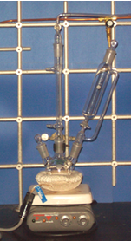
Experimental I
Assemble the setup as shown on the right side and previously discussed
Hints:
If the flask still contains a white solid, it has to be treated with diluted sulfuric acid, water and acetone
The addition funnel has to be checked for leaks at the stopcock before assembling the setup
The water-jacketed condenser should not be connected to the water outlet
The apparatus should be clamped at the center neck using a clamp that is appropriate for the neck size of the flask
Make sure that there is no dirt or Mg-turnings stuck inside the joints when charging the flask
The setup is then flame-dried twice before the additional funnel is charged with the ethereal bromobenzene solution

Slide 5
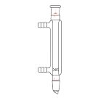
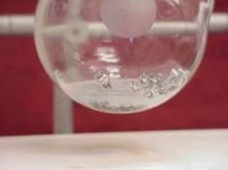
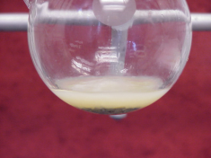
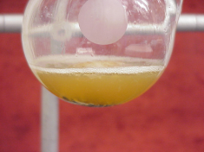
Experimental II
Place the dry diethyl ether in the addition funnel
Add the bromobenzene and mix well
Attach the water hoses to the Liebig condenser and turn the water flow on to cool the condenser
Add about 5 mL of the solution to the Mg-turnings
After the addition is completed, gently reflux the mixture
Where does the dry diethyl ether come from?
Where does the water enter the condenser?
Why is so little added only?
What should be observed here?
How can the reaction be initiated?
How fast should the solution be added?
out
From the solvent still
The water enters the condenser on the lower end of the Liebig condenser
in
By heating
Addition of a few iodine crystals
The mixture has to maintain a gentle boil

Slide 6
Experimental III
Assay of the resulting Grignard solution
Remove a 2 mL aliquot of the solution with a pipette and add it to water
Add 2-3 drops of phenolphthalein
Titrate the solution with dilute hydrochloric acid until a permanent color change is observed
Assuming that the flask contains 60 mL of solution, calculate the amount of PCl₃ needed for the reaction
What happens here?
What should the student observe here?
How is dilute hydrochloric acid obtained?
Which ratio is the student aiming for?
The Grignard is hydrolyzed and hydroxide ions are formed
The color should change from pink (or red depending on how much indicator was added)
Conc. HCl: ~12.5 M
Dilute HCl (1:99): ~0.125 M
In order to have an excess of Grignard reagent, a ratio of PCl₃:PhMgBr = 1:3.5 is used in the experiment

Slide 7
Experimental IV
Dissolve PCl₃ in diethyl ether in the addition funnel
Add the solution slowly to a chilled solution of the Grignard reagent while stirring rapidly
After stirring for about 30 minutes, water and conc. hydrochloric acid are added (in this sequence)
What is the protocol here?
Why is the slow addition necessary?
What does the addition of water and hydrochloric acid do?
Add the diethyl ether before the PCl₃ (ρ=1.574 g/cm³)
The reaction is exothermic due to the formation of the Mg-salts that are insoluble in ether
Water quenches the left-over Grignard reagent
Hydrochloric acid dissolves the magnesium salts

Slide 8
Experimental V
Separate the layers
Extract the aqueous layer with diethyl ether
Dry the combined organic layers over anhydrous sodium sulfate
Remove the diethyl ether by distillation under nitrogen
Remove other byproducts (i.e., biphenyl, chlorophosphines) by distillation under nitrogen
Recrystallize the remaining oil/solid from hot ethanol
How is this accomplish here?
What is the protocol here?
What is the final temperature here?
Which compound is removed here?
Separatory funnel
Start with a small amount of drying agent
About T_{b}~280 ºC to remove PhPCl₂ (b.p.=240 ºC) and biphenyl (b.p.=256 ºC)
Diphenylchlorophosphine (b.p.=326 ºC)

Slide 9
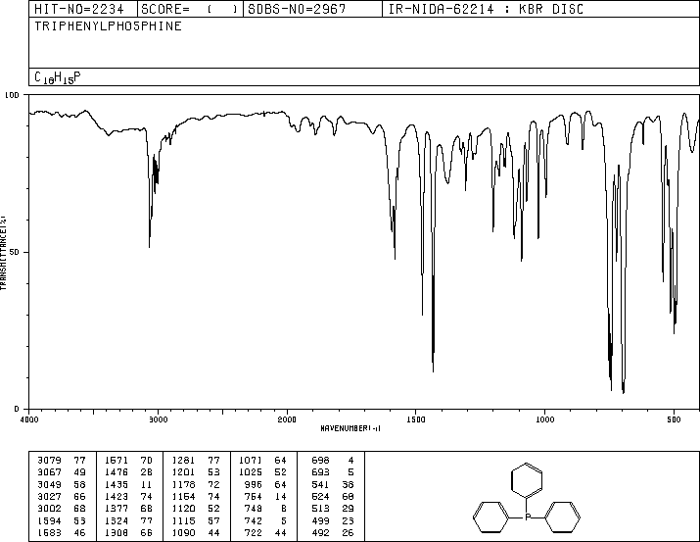
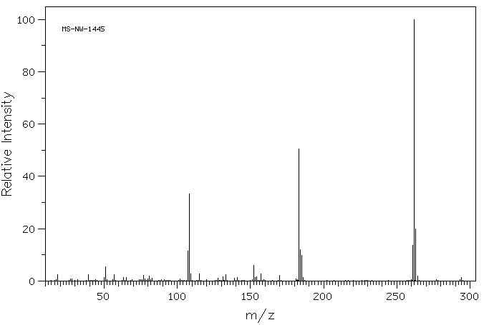
Characterization I
Melting point
Infrared spectrum
¹H-NMR spectrum
³¹P-NMR spectrum
δ= ~-5 ppm
Mass spectrum
m/z= 262 (C₁₈H₁₅P)
m/z= 183 (C₁₂H₈P)
m/z= 108 (C₆H₅P)

Slide 10
Characterization II
¹³C-NMR spectrum (162 MHz)
Need to consider the ³¹P-¹³C coupling: J₁=12.1 Hz, J₂=19.6 Hz, J₃=5.6 Hz, J₄= ~0 Hz

