Slide 1
Lecture 2a
Equipment

Slide 2
Introduction I
In the lower division organic laboratory courses, often times microscale or semi-macroscale equipment is used:
  to reduce the amount of chemicals handled ($)
  to reduce waste ($)
  to make the experiment safer as well
This is possible because most of the chemistry conducted in these courses does not require special precautions other than the occasional exclusion of water to a certain degree

Slide 3
Introduction II
Many of the compounds used in research labs are very moisture i.e., TiCl₄, SnCl₄, LDA, etc., or air-sensitive
i.e., organometallic compounds, metal compounds in
low oxidation states, cyclopentadienides, etc.
This makes it necessary to eliminate water and oxygen (and in some cases even nitrogen) from the reaction in order for the reaction to proceed and afford decent yields

Slide 4
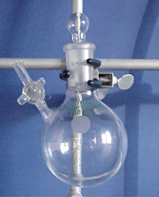
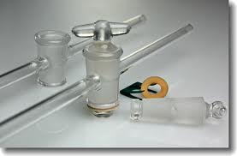
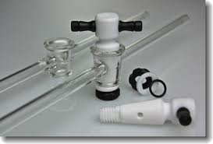
Schlenkware I
A round-bottomed flask with a side port is
referred as Schlenk flask, which commonly
serves as reaction vessel
  The side port has to have a fitting stopcock plug
    There are Teflon and glass stopcocks available in the lab, which
    are not interchangeable because of their different slopes
    The glass stopcocks are generally larger, the plugs need to be lightly lubricated to seal properly and also be secured by a clip
    The Teflon stopcock is clear and does not have to be lubricated, but they shrink upon cooling i.e., freezer

Slide 5
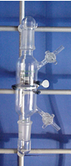
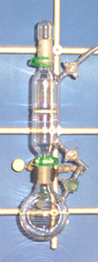
Schlenkware II
Another important piece of equipment is a Schlenk frit, which
allows for filtrations under inert gas
A frit is a glass tube with one or two stopcocks, a male joint
on each end and contains a porous plate in the middle, which
comes in different porosities
Some frits are also labeled by pencil marks on the side: the more
marks, the finer the frit is
The particle size of the precipitate determines the porosity of the
frit that should be used for the filtration
In some cases a filter aid i.e., Celite, can be used as well
Aceglass/Robu | Corning/Kimble | TGP/Duran
A (145-174) | EC (170-220) | 0 (150-200)
B (70-100) |  | 1 (90-150)
C (25-50) | C (40-60) | 2 (40-90)
D (10-20) | M (10-15) | 3 (15-40)
E (4-8) | F (4-4.5) | 4 (4-15)
VF (2-2.5)

Slide 6
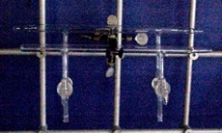
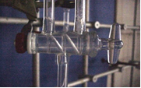
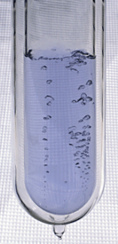
Schlenkware III
Another very important piece of equipment is the Schlenk line itself
  Glass manifold that can be connected to the
  vacuum or the inert gas line via double oblique
  bore stopcocks
  It is very important to make yourself familiar
  with the operation of the line asap
  It is very important to coordinate the work on the
  line among the students using it
The vacuum is produced by a mechanical rotary pump,
that can provide a vacuum of 10⁻²-10⁻³ torr.
It is protected by a trap that is immersed in a Dewar
containing liquid nitrogen (T_{b}=-196 ºC), which means that
pretty much everything will condense in the trap including
oxygen (T_{b}=-183 ºC, light blue liquid), which poses a
significant problem because it can cause an explosion!
The inert gas used on the Schlenk lines is nitrogen,
which is less dense than air.
Vacuum
Nitrogen
Outlet

Slide 7
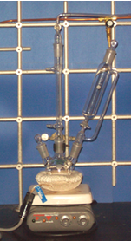
Basic Setup I
A basic reaction setup as used in the Grignard experiment is shown on the right consisting of:
  Three-necked flask with stir bar
  Liebig condenser with an adapter that connects the setup to the Schlenk line (cold water enters on the lower end)
  Addition funnel (make sure to use the proper plug here!)
  Hot plate (as stirrer or heat source)
  Heating mantle (preferential), water or oil bath as a heat source
The glassware has to be prepared by flame-drying under vacuum:
  Check glassware for cracks
  Assemble setup (don’t forget to lubricate the ground glass joints!)
  Evacuate for ten minutes
  Heat the glassware with the heat gun
  Allow the glassware to cool under vacuum
  Refill with inert gas
  Repeat the process at least once

Slide 8
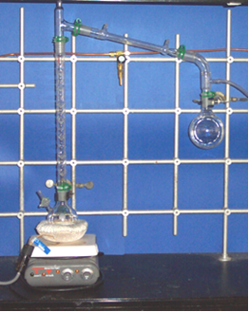

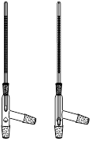
Basic Setup II
Another common task is a distillation under inert gas. The setup consists of
  Schlenk flask or three-necked flask
  Vigreux column (1)
  Three way distilling head with a thermometer of proper length
  Liebig condenser
  Vacuum adapter, which serves as connection to the Schlenk line (2)
  A Schenk flask to collect the distillate
2
1

Slide 9
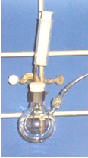
Basic Setup III
Another basic task in the lab is the transfer of solvents from one Schlenk flask to another
Under a positive pressure, the glass stopper is replaced by a rubber septum, which has to be folded over to seal properly
A syringe with a proper sized needle is assembled. The needle is inserted in the septum above the liquid and the inert gas is drawn into the syringe. The needle is removed from the flask and the inert gas is expelled. The process is repeated twice before the liquid is drawn into the syringe.

Slide 10
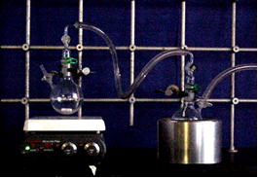
Basic Setup IV
If a larger amount of solvent has to be removed under inert gas, a trap-to-trap distillation has to be used
  The setup consists of two Schlenk flasks connected by a thick-wall tubing or a glass adapter
  The flask (flask A) containing the solvent originally has to have a stir bar and is placed in a water bath
  The receiving flask (flask B) is placed in a shallow Dewar filled with liquid nitrogen and connected to the Schlenk line (indicated by arrow)
  After carefully establishing a sufficient vacuum as can be seen be the boiling of the liquid in flask A, the vacuum is disconnected to ensure that the solvent condenses in flask B and does not get collected in the trap of the Schlenk line
Flask A
Flask B

Slide 11
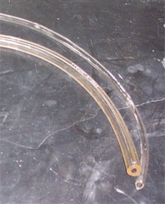
Basic Setup V
Whenever possible, glass plugs should be used instead
of rubber septa because they seal better if they are
lubricated properly
There are two kind of tubing in the lab:
thick-walled and thin-walled tubing
  Thick-walled tubing is used for vacuum and pressure setups
  Thin-walled tubing is used as water hoses and gas lines
Lubrication be used lightly on ground glass joints only
The glassware that is used in the course is very expensive (Schlenk flask: $60-$100, Schlenk frit: $200). If you break it due to carelessness, you will be held financially responsible.

