Slide 1
Lecture 7b
EPR spectroscopy

Slide 2
Introduction I
Electron Paramagnetic Resonance (EPR), also commonly called Electron Spin Resonance (ESR), was reported by Zavoisky in 1945
EPR is a versatile and non-destructive spectroscopic method of analysis, which can be applied to inorganic, organic, and biological materials containing one or more unpaired electrons
The technique depends on the resonant absorption of electromagnetic radiation in a magnetic field by magnetic dipoles arising from electrons with net spin (i.e., an unpaired electron)

Slide 3
Introduction II
Application
  Kinetics of radical reactions
  Spin trapping
  Catalysis
  Oxidation and reduction processes
  Defects in crystals
  Defects in optical fibers
  Alanine radiation dosimetry
  Archaeological dating
  Radiation effects of biological compounds

Slide 4
Physics I
EPR is in many ways similar to NMR spectroscopy
  The electronic Zeeman effect arises from an unpaired electron, which possesses a magnetic moment that assumes one of two orientations in an external magnetic field
  The energy separation between these two states, is given as
  ΔE = hν = gβH where h, g, and β are Planck's constant, the
  Lande spectroscopic splitting factor, and the Bohr magneton
  The Bohr magneton is eh/4πmc with e and m as the charge and mass of the electron and c as the speed of light
  The g-factor is a proportionality constant approximately equal to a value of two for most organic radicals but may vary as high as six for some transition metals such as iron
  in heme proteins

Slide 5
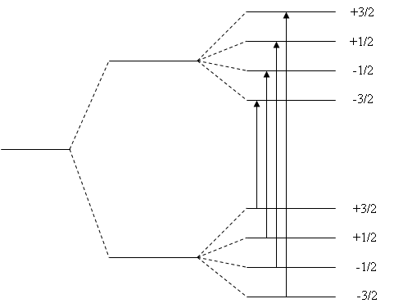
Physics II
Example: Energy levels of an unpaired electron in the presence of a magnetic field and then interaction with a nucleus of spin I=3/2
E₁=E₀ - ½gβH
E₀, H=0
E₁=E₀ + ½gβH

Slide 6
Physics III
A nuclear spin of I, when interacting with the electronic spin, perturbs the energy of the system in such a way that each electronic state is further split into 2I+1 sublevels, as further shown above
For n nuclei, there can be 2nI+1 resonances (lines)
Since the magneton is inversely related to the mass of the particle, the nuclear magneton is about 1000 times smaller than the Bohr magneton for the electron
Therefore, the energy separations between these sublevels are small. The required energies fall in the radiofrequency range

Slide 7
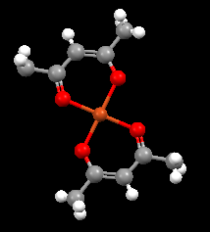
Example I
Copper(II) acetylacetonate (Cu(acac)₂)
  Copper has two nuclear magnetically active isotopes. Both isotopes have a nuclear spin of I=3/2, but they vary in their natural abundance.
  The ⁶³Cu isotope has a natural abundance of 69% while the ⁶⁵Cu isotope has a natural abundance of 31%.
  Since the nuclear magnetogyric ratios are quite similar with 7.09 for ⁶³Cu and 7.60 for ⁶⁵Cu, the hyperfine coupling to each isotope is nearly identical.
  As a result, the ESR spectrum shows four resonances as it couples to the one nuclear spin I=3/2 in each molecule.

Slide 8
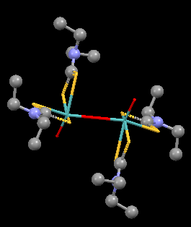
Example II
Mo₂O₃dtc₄
  The complex is dinuclear and contains molybdenum(V)
  The strong centerline is due to the molecules with the ⁹⁶Mo isotope. This isotope has a nuclear abundance of 75% with a nuclear spin I=0. Because of the spin of zero, only a single resonance is observed.
  The ⁹⁵Mo isotope is 15.72% and the ⁹⁷Mo isotope is 9.46% abundant, both with a spin of I=5/2 with similar magnitudes of the magnetogyric ratio (but opposite signs). As a result, about 25% of the EPR signal is split into a sextet of lines.

Slide 9
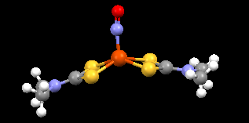
Example III
Fe(NO)dtc₂
  The nitrosyl group has an unpaired electron
  The electron is located at the nitrogen atom and therefore couples with the nucleus
  (¹⁴N: 99.638% abundance, I=1)
  A three line spectrum is observed for this compound (=2*1+1)

Slide 10
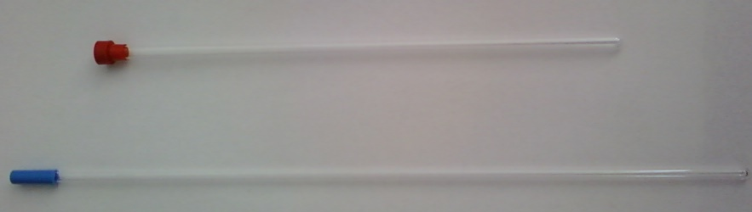
Practical aspects
EPR spectra are measured in special tubes made from quartz. These tubes are usually longer and smaller in diameter compared to NMR tubes. These tubes are very fragile.
The measurement should be conducted by the teaching assistant while the students are present
When using the EPR spectrometer, one has to be careful not to contaminate the EPR cavity because this will mess up everybody else’s measurement
Any broken glassware and spillage has to be cleaned up immediately. Failure to follow these rules will result in a significant penalty (point deduction and additional assignment)

