Slide 1
Lecture 4c
Geometric Isomers of Mo(CO)₄(PPh₃)₂

Slide 2
Introduction I
As discussed previously, metal carbonyl compounds are good starting materials for many low oxidation state compounds
They are reactive and lose one or several CO ligand upon heating, photolysis, exposure towards other radiation, partial oxidation, etc.
The resulting species are very reactive because they usually exhibit an open valence shell
  They react with Lewis bases (i.e., acetonitrile, THF, phosphines, amines, etc.) to form closed shell compounds i.e., Cr(CO)₅THF, Mo(CO)₄(bipy), fac-Cr(CO)₃(CH₃CN)₃, etc.
  The also react with each other to form clusters i.e., Fe₂(CO)₉, Co₄(CO)₁₂, etc.
  Oxidation with iodine i.e., Fe(CO)₄I₂, Mn(CO)₅I, etc.

Slide 3
Introduction II
As mentioned before, phosphine complexes are used in many catalytic applications
In the experiment, Mo(CO)₄L₂ compounds are formed starting from Mo(CO)₆
  Step 1: Formation of cis-Mo(CO)₄(pip)₂
  Step 2: Formation of cis-Mo(CO)₄(PPh₃)₂ from PPh₃
  and cis-Mo(CO)₄(pip)₂ at low temperature (40 ºC)
  Step 3: Formation of trans-Mo(CO)₄(PPh₃)₂ from
  cis-Mo(CO)₄(PPh₃)₂ at elevated temperature (110 ºC)

Slide 4
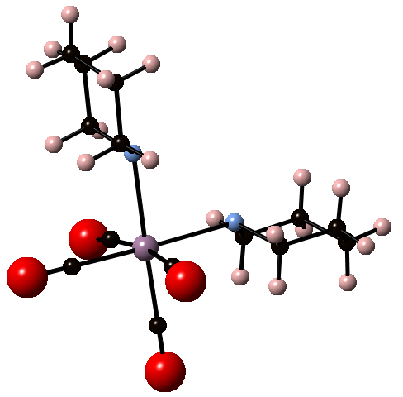
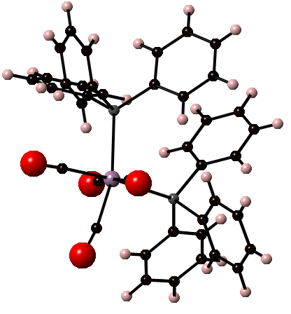
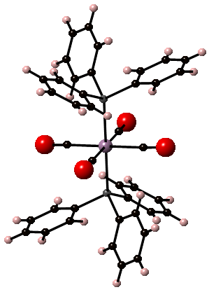
Introduction III
The formation of the cis piperidine adduct requires elevated temperatures because two of the Mo-C bonds have to be broken
The subsequent low-temperature reaction with two equivalents of triphenylphosphine yields the cis isomer, which can be considered as the kinetic product
The cis product is converted into the trans isomer at elevated temperature, which makes it the thermodynamic product
The piperidine adduct can be used as reactant with other phosphine and phosphonite ligands as well (i.e., P(n-Bu)₃, P(OMe)₃, etc.)

Slide 5
Introduction IV
For many Mo(CO)₄L₂ compounds, both geometric
isomers are known i.e., AsPh₃, SbPh₃, PPh₂Et, PPh₂Me, PCy₃, PEt₃, P(n-Bu)₃, NEt₃, etc.
Which compound is isolated in a reaction depends on various parameters
  Solvent polarity: determines the solubility of the compound
  Temperature: higher temperature increases the solubility and also favors the thermodynamic product
  The nature of the ligand i.e., its Lewis basicity, back-bonding ability, etc.
  Mechanism of formation
  Nature of the reactant

Slide 6
Experiment I
Safety
  All molybdenum carbonyl compounds in this project have to be considered highly toxic
  Piperidine is toxic and a flammable liquid
  Triphenylphosphine is an irritant
  Dichloromethane and chloroform are a regulated carcinogen (handle only in the hood!)
  Toluene is a reproductive toxin (handle only in the hood!)
Schlenk techniques
  Even though the literature does not emphasize this point, it might be advisable to carry the reactions out under inert gas to reduce oxidation and hydrolysis

Slide 7
Experiment II
Cis-Mo(CO)₄(pip)₂
  Piperidine is refluxed over potassium hydroxide pellets before being distilled under
  inert gas
  Mo(CO)₆ and piperidine are dissolved in deoxygenated or
  dry toluene
  The mixture is refluxed for the three hours under nitrogen
  The mixture is filtered hot
  The crude is washed with cold toluene and cold pentane
What does this mean for the setup?
What does this mean practically?
What should the student observe during this time?
Why is the solution filtered while hot?
The formation of a bright
yellow precipitate
This will keep the toluene soluble
Mo(CO)₅(pip) in solution

Slide 8
Experiment III
Cis-Mo(CO)₄(PPh₃)₂
  Cis-Mo(CO)₄(pip)₂ and
  2.2. eq. of PPh₃ are dissolved
  in dry dichloromethane
  The mixture is refluxed for
  30 minutes
  The volume of the solution is reduced and dry methanol is added
  The isolated product can be purified by recrystallization from CHCl₃/MeOH if needed
How is this accomplished?
Why is methanol added to the solution?
Trap-to-trap distillation
To increase the polarity of the
solution which causes the cis product
to precipitate

Slide 9
Experiment IV
Trans-Mo(CO)₄(PPh₃)₂
  Cis-Mo(CO)₄(PPh₃)₂ is dissolved in toluene
  The mixture is refluxed for 30 minutes
  After cooling, chloroform is added to the mixture
  The mixture is filtered and methanol is added
  The mixture is chilled in an ice-bath
  The off-white solid is isolated
Why is chloroform added?
Why is methanol added?
To keep the more polar cis isomer
in solution
To increase the polarity of the
solution which causes the trans
product to precipitate

Slide 10
Characterization I
Infrared spectroscopy
  The cis and the trans isomer exhibit different point groups:
    This results in a different number of infrared active bands
    Cis (C_{2v}): four CO or M-CO peaks (2 A₁, B₁, B₂) and two Mo-P peaks (A₁, B₂)
    Trans (D_{4h}): One CO or M-CO peak (E_{u}) and one Mo-P peak (A_{2u})
    The carbonyl peaks fall in the range from 1850-2050 cm⁻¹ while the Mo-P peaks are located around 150-200 cm⁻¹ (cannot be measured
    with the equipment available)
    Note that the exclusion rule (peaks are infrared or Raman active) applies to the trans isomer because
    it possesses a center of inversion
    The infrared spectra are acquire in solid form using the ATR setup

Slide 11
Characterization III
¹³C-NMR spectroscopy
  The two phosphine compounds exhibit different chemical shifts for the carbon atoms and also different number of signals (cis: δ= ~210, 215 ppm)
³¹P-NMR spectroscopy
  The two phosphine complexes exhibit different chemical shifts in the ³¹P-NMR spectrum (δ= ~38 (cis), 52 ppm (trans))
  In both cases, the shift is to more positive values
  (PPh₃: δ= ~ -5ppm) because the phosphorus atom acts
  as a good σ-donor and a weak σ*-acceptor, which results in a net loss of electron-density on the P-atom

Slide 12
Characterization III
⁹⁵Mo-NMR spectroscopy
  ⁹⁵Mo possesses a nuclear spin of I=5/2 with a large range of chemical shifts (δ= -2400 ppm to 4300 ppm)
  The reference is 2 M Na₂MoO₄ in water (δ=0 ppm)
  All three compounds exhibit different chemical shifts in the ⁹⁵Mo-NMR spectrum
  In all cases, the signals are shifted to more positive values
  (δ= -1100 ppm, -1556 ppm, ?) compared to Mo(CO)₆ itself
  (δ=-1857 ppm, CH₂Cl₂) because the ligands are better σ-donors than σ*-acceptors resulting in a net gain of electron density on the Mo-atom
  The phosphine complexes exhibit doublets because of the coupling observed with the ³¹P-nucleus

Slide 13
Characterization IV
⁹⁵Mo-NMR spectroscopy
  The effect of the ligands changes with their ability to act as σ-donor and a weak σ*-acceptor
  The trans complexes usually exhibit a more negative value compared to
  the cis complexes because they display a larger HOMO-LUMO gap, which means that they are considered more shielded.
  How could one determine the HUMO-LOMO gap?
L= | Basicity (pk_{a}) | Cone Angle (Θ) | Mo(CO)₅L | Cis-Mo(CO)₄L₂ | Trans-Mo(CO)₄L₂ | Fac- Mo(CO)₃L₃
PPh₂Me | 4.57 | 136 | -1772ª | -1637ª | -1655ª | -1427ª
PPh₂Et | 4.69 | 140 | -1789ª | -1657ª | -1720ª | -1414ª
P(OPh)₃ | -2.0 | 128 | -1819ª | -1754ª | -1792ª | -1673ª
PEt₃ | 8.69 | 132 | -1854ª | -1756ª | -1810ª | -1558ª
P(n-Bu)₃ | 8.43 | 132 | -1843ª | -1742ª | -1741^{b} | -1521ª
PPh₃ | 2.73 | 145 | -1747ª | -1556ª
AsPh₃ |  | 147 | -1757ª | -1577ª | -1757^{b}
SbPh₃ |  | 139 | -1864ª | -1807ª | -1867^{b}

Slide 14
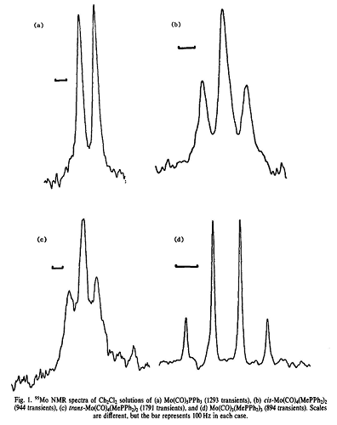
Characterization V
⁹⁵Mo-NMR spectroscopy
  The phosphine complexes (Mo(CO)₅(PR₃): doublets; Mo(CO)₄(PR₃)₂: triplets, Mo(CO)₃(PR₃)₃: quartets) display multiplets in the ⁹⁵Mo-NMR spectrum due to the coupling with the ³¹P-nucleus (I=½).
  The coupling constants are higher for phosphite ligands compared to phosphine ligands indicating a stronger and shorter Mo-P bond.
L | Mo(CO)₅L | Cis-Mo(CO)₄L₂ | Trans-Mo(CO)₄L₂ | d(Mo-P) [pm]
PPh₂Me | 135 Hz, 30 Hz | 133 Hz, 60 Hz | 125 Hz, 170 Hz | 255.5 pm (cis)
PPh₂Et | 137 Hz, 30 Hz | 130 Hz, 80 Hz | 128 Hz, 50 Hz
P(OPh)₃ | 234 Hz, 40 Hz | 250 Hz, 40 Hz | 231 Hz, 30 Hz | 243.4 pm (cis)
PEt₃ | 131 Hz, 10 Hz | 129 Hz, 30 Hz | 151 Hz, 110 Hz | 254.3 pm (cis)
P(n-Bu)₃ | 129 Hz, 20 Hz | 123 Hz, 90 Hz | 159 Hz, 70 Hz | 255.2 pm (cis)
PPh₃ | 139 Hz, 54 Hz | 140 Hz, 46 Hz |  | 257.7 pm (cis)
AsPh₃ | ---- , 110 Hz | ---- , 190 Hz | ---- , 5 Hz
SbPh₃ | ---- , 120 Hz | ---- , 250 Hz | ---- , 150 Hz

