Slide 1
Lecture 3a
Electrochemical Study of Mdtc₃

Slide 2
Introduction I
Metal dithiocarbamates (M(S₂CNR₂)_{n}) are known for more than 100 years.
  Disinfectants due to their fungistatic activity (i.e., Zn(S₂CNMe₂)₂ (Ziram), Fe(S₂CNMe₂)₃ (Ferbam), As(S₂CNMe₂)₃ (Asomate))
  Vulcanization accelerators (i.e., Te(S₂CNEt₂)_{4,} Zn(S₂CNMe₂)₂)
  Precursor for the formation of metal sulfide thin films and nanoarticles (CdS, ZnS, PbS, Bi₂S₃, LnS (Ln=Eu, etc.))
  Iron dithiocarbamates are used in the spin trapping of NO in biological systems
  Antidote for metal poisoning during chemotherapy
  Extraction of heavy metals from aqueous solution and subsequent quantitation via photometry
  Antabuse (thiuram disulfide) is used in treatment of alcoholism

Slide 3
Introduction II
The dithiocarbamate ligand exhibits several resonance structures, which allows for it to act as a mono- or bidentate ligand depending on the metal and its oxidation state
The ligand has a low formal charge (-1) and a small bite
angle, which makes it ideal for high-coordination number
(i.e., eight in Mdtc₄ (M=Ti, Nb, Ta, Mo, W, Tc, Re, Sn)
The ligand is known with a broad variety of R-groups
(i.e., Me, Et, iso-Pr, n-Pr, n-Bu, cyclohexyl, phenyl,
C₄H₈, etc.), which alter the properties of the compounds (i.e., redox properties, solubility, catalytic properties, etc.)

Slide 4
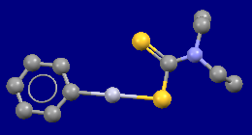
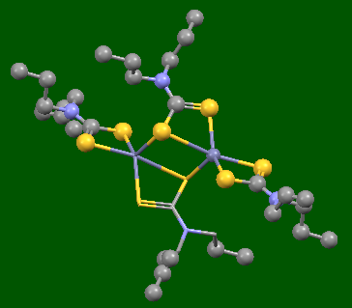
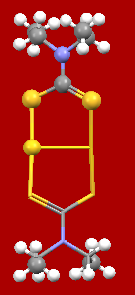
Introduction III
There are various bond modes known in metal complexes
  Monodentate
    C-N bond has single bond character
    i.e., PhHgdtc (R=Et)
  Bidentate (one metal center)
    C-N bond has double bond
    character (i.e., Mdtc₃, Zndtc₂ (R=n-Pr))
  Bidentate (two metal centers)
    Mo-Fe-S clusters (Fe₃MoS₄)
    [Au(dtc)]₂ (R=Et)

Slide 5
Introduction IV
Synthesis
  Secondary amine and carbon disulfide
    If a second base like sodium hydroxide was present,
    compound (1) would be converted into its sodium salt
  Metathesis
    The reaction of a metal halide with an alkali metal salt
    If a low polarity solvent (i.e., toluene, dichloromethane, etc.)
    is used, the alkali metal halide will precipitate while the dtc compound (i.e., TiCl₂dtc₂) remains in solution
    Generally, a mixture of several products will be formed
    (i.e., MCl_{4-x}dtc_{x})

Slide 6
Introduction V
Synthesis (continued)
  Insertion
    The reaction of an metal amide (obtained by a metathesis reaction, (3)) with carbon disulfide can lead to the formation of dtc complexes via an insertion reaction (4)
  Oxidative addition
    The reaction of thiuram disulfides with low oxidation metal compounds (i.e., carbonyl compounds of group VI metals) affords dtc complexes

Slide 7
Experiment I
Iron (Fedtc₃)
  The compound is obtained as a black precipitate by the reaction of an aqueous solution of iron(III) chloride with sodium diethyldithiocarbamate
  FeCl₃ + 3 Nadtc Fedtc₃ ↓ + 3 NaCl
  The crude product contains FeCl_{3-x}dtc_{x}, Fe(OH)₃, FeS and thiuram disulfide (Et₂NCS₂)₂
  The product is non-polar and dissolves well in solvents with low
  polarity (i.e., toluene, dichloromethane), but poorly in
  solvents with high polarity (i.e., ethanol, water)
  The compound undergoes spin crossover:
    The high-spin complex (μ_{eff}= 4.3 B.M.) is mainly observed
    at room temperature
    The low-spin complex (μ_{eff}= 2.2 B.M.) is preferred at 79 K
↑ ↑
↑ ↑ ↑
High spin
↑↓↑↓↑
Low spin

Slide 8
Experiment II
Manganese (Mndtc₃) and Cobalt (Codtc₃)
  Problem: Mn(III) and Co(III) are much stronger oxidants than Fe(III) in aqueous solution (E⁰=1.51 V (Mn(III)), E⁰=1.82 V (Co(III)) vs. E⁰=0.77 V (Fe(III))) and favoring the oxidation of the dtc ligand over its coordination
  The reaction starts with MnCl₂ and CoCl₂ instead
    Step 1: Mdtc₂ is formed
    MCl₂ + 2 Nadtc Mdtc₂ + 2 NaCl
    Step 2: Oxidation with oxygen in air affords Mdtc₃
    2 Mdtc₂ + 2 Nadtc + H₂O 2 Mdtc₃ + 2 Na⁺ + 2 OH⁻
    Color change: Mn: pale yellow to dark purple, Co: light green to dark-green
[O]

Slide 9
Experiment III
Chromium (Crdtc₃)
  Problem: The dithiocarbamate ligand is a strong base
  as well because it is the conjugate base of a weak acid (Et₂NCS₂H: pK_{a}= 4). Thus, the hydrolysis has to be considered in aqueous solution!
  dtc⁻ + H₂O dtc-H + OH⁻
  Fe(III), Mn(II) and Co(II) are considered soft cations
  (=low charge and high number of d-electrons (d⁵ or d⁷)), which react preferentially with the softer dtc⁻ anion
  Cr(III) is a hard cation (=high charge and low number
  of d-electrons (d³)), which reacts preferentially with the harder hydroxide ion (-> Cr(OH)₃, dark green solid)

Slide 10
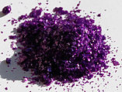
Experiment IV
Chromium (Crdtc₃) (cont.)
  The reaction has to be carried out in the absence of water:
    Synthesis has to be carried out under strict Schlenk techniques
    Anhydrous CrCl₃ is used as the chromium(III) source
    Anhydrous sodium N,N-diethyldithiocarbamate
    Anhydrous tetrahydrofuran
  If the CrCl₃ is very pure, it does not dissolve well in THF
    A small amount of Zn-powder can be added to catalyze the dissolution
    Partial reduction to the kinetically more labile Cr(II)
  Hint: After the reaction, the unreacted CrCl₃, Cr(OH)₃ and NaCl have to be removed by Schlenk filtration. The best way of doing this is to decant the supernatant solution before transferring the precipitate onto the frit.
  The final product is dark blue and air-stable

Slide 11
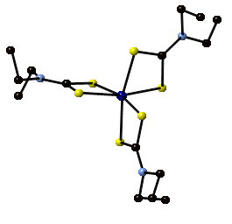
Characterization I
Infrared spectroscopy
  The infrared spectra are acquire using the FTIR spectrometer (ATR) in YH 6076 and the spectrometer in
  YH 1033 (Nujol/CsI)
  The infrared spectra are very similar for all four compounds
  (i.e., Mndtc₃ and Codtc₃) because the compounds are isostructural
    ν(C-N)= ~1475-1490 cm⁻¹
    ν(C-S) = ~960-1000 cm⁻¹
    ν(M-S)= ~300-400 cm⁻¹
      High-spin complexes display one band in this range, low-spin complexes two bands
Co(S₂CNEt₂)₃

Slide 12
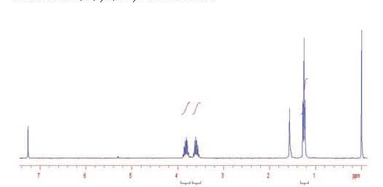
Characterization II
NMR spectroscopy
  Three of the four compounds are paramagnetic (Cr, Mn and Fe)
    Large chemical shift ranges
    Broad peaks for most parts
    Difficult to observe splitting patterns
  Requires different parameters for the NMR data acquisition
    Different spectral window
    Shorter T1-time
    Most scans to get a better signal-to-noise ratio
  The compounds are also chiral, which means that the spectra exhibit additional splitting, ABX₃ system (i.e., Codtc₃)
  Note that all NMR spectra are temperature dependent as well, particularly the Fe-compound that is an intermediate between a high-spin and low-spin complex
10 ppm

Slide 13
Characterization III
Cyclic voltammetry
  Used to determine redox potentials of the different compounds
  The measurement uses a three-electrode system: working electrode (glassy carbon), auxiliary electrode (platinum wire) and reference electrode (Ag/AgCl/1 M LiCl in dry acetone)
  The current between the auxiliary and the reference electrode is recorded as the potential between the reference and the working electrode is swept
  In the lab, a full scan is done first before focusing on the individual steps using a small window (less of a potential range) and lower sweep rate (=V/s)
  Often times, a peak at E=+0.15 V is observed due to the oxidation of free dtc ligand leading to thiuram disulfide.
[Mndtc₃]⁻ Mndtc₃
[Mndtc₃]⁺
  Left side: reduction of Mndtc₃
  Right side: oxidation of Mndtc₃

