Slide 1
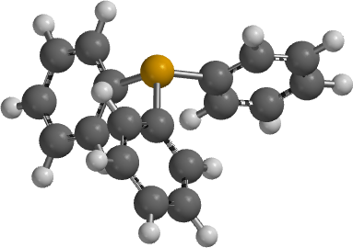
Lecture 2b
Triphenylphosphine

Slide 2
Introduction I
Phosphines are frequently used as ligands in metalorganic and organometallic compounds because they can be tuned in terms of their steric and their electronic properties (see later lecture)
Asymmetric phosphines are chiral because of their high barrier of inversion (ΔG‡> 130 kJ/mol) compared to amines
  DIPAMP: Synthesis of L-DOPA
  BINAP: Rhodium or ruthenium complexes are used in asymmetric hydrogenation
  Grubbs Catalyst (RuCl₂(=CHPh)(PCy₃)₂): Olefin metathesis
  Crabtree Catalyst ([(COD)Ir(py)(PCy₃)]⁺PF₆⁻ ) homogeneous hydrogenation
Examples containing PPh₃ as ligand:
  Vaska’s Complex: Ir(CO)Cl(PPh₃)₂
  Wilkinson’s Catalyst: RhCl(PPh₃)₃
  Tetrakis(triphenylphosphine) palladium(0): Pd(PPh₃)₄
  Stryker’s Reagent: [(PPh₃)CuH]₆
  Wittig Reagents: Ph₃P=CHR⁺X⁻

Slide 3
Introduction II
Triphenylphosphine can be synthesize by reaction of
  Phosphorus trichloride with chlorobenzene and sodium metal
  (industrial process but not feasible for this course)
  Phosphorus trichloride with organometallic compound like phenyl lithium or phenylmagnesium bromide (Grignard reagent)
Triphenylphosphine is a white solid (m.p.: 80 ºC, b.p.: 377 ºC)
Triphenylphosphine is slowly oxidized in air at room temperature to form triphenylphosphine oxide (Ph₃P=O), which can be removed by recrystallization from isopropanol or ethanol
The molecule displays a trigonal pyramidal structure
with a high (ΔG‡(inversion)= >130 kJ/mol)

Slide 4
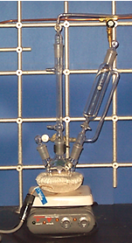
Experimental I
Assemble the setup as shown on the right side and previously discussed
Hints:
  If the flask still contains a white solid, it has to be treated with diluted sulfuric acid, water and acetone
  The addition funnel has to be checked for leaks at the stopcock before assembling the setup
  The water-jacketed condenser should not be connected to the water outlet
  The apparatus should be clamped at the center neck using a clamp that is appropriate for the neck size
  of the flask
  Make sure that there is no dirt or Mg-turnings stuck inside the joints when charging the flask
After adding the crushed Mg-turnings to the three-necked flask, the setup is then flame-dried twice before the addition funnel is charged with the ethereal bromobenzene solution

Slide 5
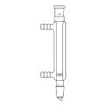
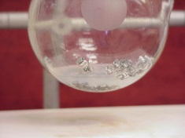
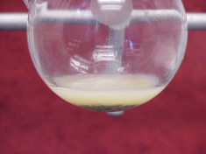
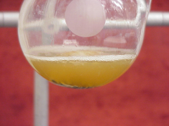
Experimental II
Place the dry diethyl ether in the addition funnel
Add the bromobenzene and mix well
Attach the water hoses to the Liebig condenser and turn the water flow on to cool the condenser
Add about 5 mL of the solution to the Mg-turnings
After the addition is completed, gently reflux the mixture
Where does the dry diethyl ether
come from?
Where does the water enter the condenser?
Why is so little added only?
What should be observed here?
How can the reaction be initiated?
How fast should the solution be added?
out
From the solvent still
The water enters the condenser on
the lower end of the Liebig condenser
in
To reduce for the formation of biphenyl
By heating
Addition of a few iodine crystals
The mixture has to maintain a gentle boil

Slide 6

Experimental III
Assay of the Grignard solution
Remove a 2 mL aliquot of the solution with a pipette and add it to water
Add 2-3 drops of phenolphthalein
Titrate the solution with dilute hydrochloric acid until a permanent color change is observed
Assuming that the flask contains
60 mL of solution, calculate the amount of PCl₃ needed for the reaction
What happens here?
What should the student observe here?
How is dilute hydrochloric acid obtained?
Which ratio is the student aiming for?
The Grignard is hydrolyzed and hydroxide ions are formed
The color should change from pink (or red depending on how much indicator was added)
Conc. HCl: ~12.5 M
Dilute HCl (1:99): ~0.125 M
In order to have an excess of Grignard reagent, a ratio of PCl₃:PhMgBr= 1:3.5 is used in the experiment to reduce the formation of Ph_{3-x}PCl_{x}

Slide 7
Experimental IV
Dissolve PCl₃ in diethyl ether in the addition funnel
Add the solution slowly to a chilled solution of the Grignard reagent while stirring rapidly
After stirring for about
30 minutes, water and
conc. hydrochloric acid are added (in this sequence)
What is the protocol here?
Why is the slow addition necessary?
What does the addition of water and hydrochloric acid do?
Add the diethyl ether before the PCl₃ (ρ=1.574 g/cm³)
The reaction is exothermic due to the formation of the Mg-salts that are insoluble in ether
Water quenches the excess of the Grignard reagent
Hydrochloric acid dissolves the magnesium salts

Slide 8
Experimental V
Separate the layers
Extract the aqueous layer with diethyl ether
Dry the combined organic layers over anhydrous sodium sulfate
Remove the diethyl ether by distillation under nitrogen
Remove other byproducts (i.e., biphenyl, chlorophosphines) by distillation under nitrogen (Do not use a column here!)
Recrystallize the remaining oil/solid from hot ethanol
How is this accomplish here?
What is the protocol here?
Why is the distillation performed under nitrogen?
What is the final temperature here?
Which compound is removed here?
Separatory funnel
Start with a small amount of drying agent
To suppress the oxidation of PPh₃
T_{max}: ~280 ºC to remove
PhPCl₂ (b.p.: 240 ºC) and
biphenyl (b.p.: 256 ºC)
Diphenylchlorophosphine (b.p.: 326 ºC)
Triphenylphosphine oxide (b.p.: 360 ºC)

Slide 9
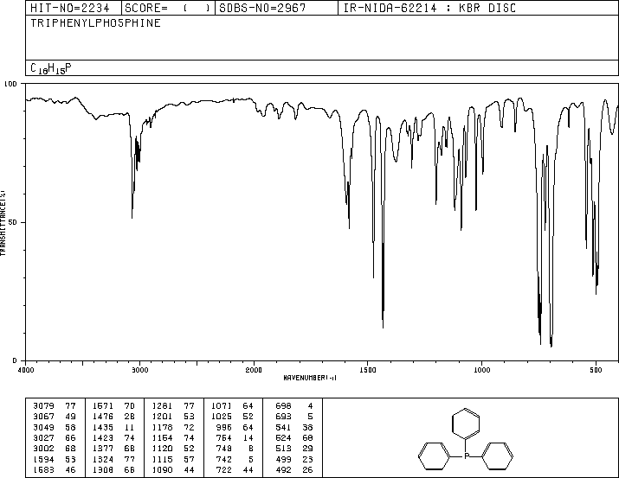
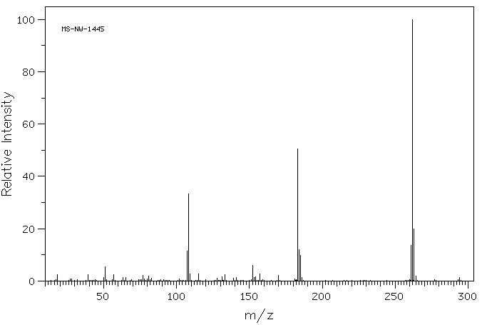
Characterization I
Melting point
Infrared spectrum
  ν_{as}(PC)=499, 513 cm⁻¹
  ν_{s}(PC)=422, 432 cm⁻¹
Mass spectrum
  m/z=262 (C₁₈H₁₅P)
  m/z=183 (C₁₂H₈P)
  m/z=108 (C₆H₅P)

Slide 10
Characterization II
¹³C-NMR spectrum (162 MHz)
    Need to consider the ³¹P-¹³C coupling: J₁=12.1 Hz, J₂=19.6 Hz,
    J₃=5.6 Hz, J₄= ~0 Hz
C2
C3
C4
C1

Slide 11
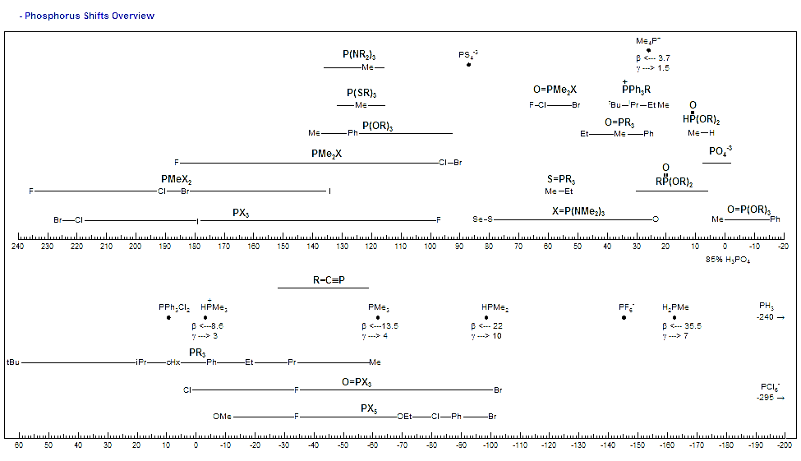
Characterization III
³¹P-NMR (I=½, Abundance= ~100 %)

Slide 12
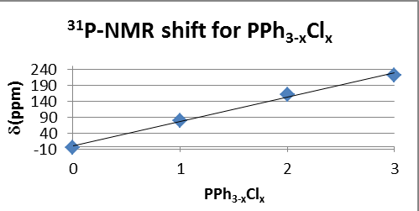
Characterization IV
³¹P-NMR (part II)
  The reactant (PCl₃) and the product (PPh₃) display significantly different chemical shifts in the ³¹P-NMR spectrum, and so do the possible intermediates
  The phosphorus atom is very deshielded in PCl₃ because of the electronegativity of the chlorine atoms
  The ligand exchange (Cl to Ph) causes a shift by ~80 ppm upfield for each
Compound | δ(ppm)
PCl₃ | 220
PPhCl₂ | 162
PPh₂Cl | 81
PPh₃ | ~ -5
POPh₃ | 26
PPh₄Br | 23.3
85 % H₃PO₄ | 0

