Slide 1
Lecture 2a
Equipment

Slide 2
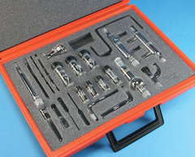
Introduction I
In the lower division organic laboratory courses, often times microscale or semi-macroscale equipment is used:
  to reduce the amount of chemicals handled ($)
  to reduce the amount of waste ($)
  to make the experiment overall safer as well
This is possible because most of the chemistry conducted in these courses does not require special precautions other than the occasional exclusion of water to a certain degree

Slide 3
Introduction II
Many of the compounds used in research labs are very moisture i.e., TiCl₄, SnCl₄, LDA, etc., or air-sensitive i.e., organometallic compounds, metal compounds in low oxidation states, cyclopentadienides, etc.
This makes it necessary to eliminate water and oxygen (and in some cases even nitrogen) from the reaction in order for the reaction to proceed and afford decent yields

Slide 4
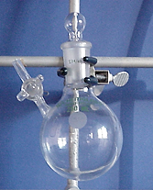
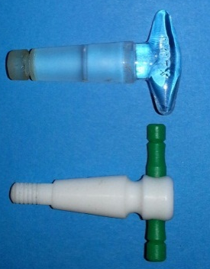
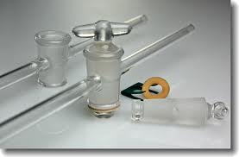
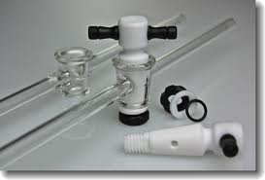
Schlenkware I
A round-bottomed flask with a side port is
referred as Schlenk flask, which commonly
serves as reaction vessel (~$100)
  The side port has to have a fitting stopcock plug
    There are Teflon and glass stopcocks available in the lab, which
    are not interchangeable because of their different dimensions
    The glass stopcocks are generally larger, the plugs need to be
    lightly lubricated to seal properly and also be secured by a clip
    The Teflon stopcock is clear and does not have to be lubricated, but they shrink upon cooling i.e., freezer

Slide 5
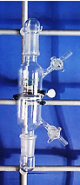
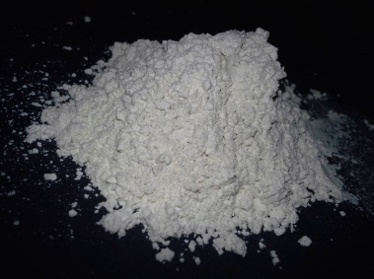
Schlenkware II
Another important piece of equipment is a Schlenk frit, which allows for filtrations under inert gas
A frit is a glass tube with one or two stopcocks, a male joint on each end and contains a porous plate in the middle, which comes in different porosities (value are in μm)
Some frits are also labeled by pencil marks on the side: the more marks, the smaller the holes in the frit usually are
The particle size of the precipitate determines the porosity of the frit that
should be used for the filtration
In some cases a filter aid i.e., Celite, can be used as well to prevent clogging
It is very important that the frit are properly cleaned and dried prior to its use
Aceglass/Robu | Corning/Kimble | TGP/Duran
A (145-174) | EC (170-220) | 0 (150-200)
B (70-100) |  | 1 (90-150)
C (25-50) | C (40-60) | 2 (40-90)
D (10-20) | M (10-15) | 3 (15-40)
E (4-8) | F (4-4.5) | 4 (4-15)
VF (2-2.5)

Slide 6
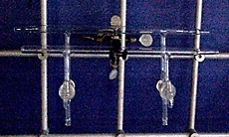
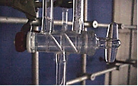
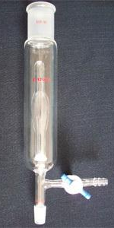
Schlenkline I
Another very important piece of equipment is the Schlenk line itself
  Glass manifold that can be connected to the vacuum or the inert gas line via double oblique bore stopcocks
  It is very important to make yourself familiar with the operation of the line as soon as possible
  It is very important to coordinate the work on the line among the students using it to prevent accidents to occur (i.e., contamination of the line with air, sudden pressure drops that cause violent boiling
  of a boiling mixture)
The inert gas used on the Schlenk lines is nitrogen, which is less dense than air.
Ideally, a bubbler with a small ball joint filled with mineral oil is placed at the end of the inert gas portion of the Schlenk line
If a bubbler with without a ball joint was used, more care has to be exercised when refilling evacuated glassware
Vacuum
Nitrogen
Outlet

Slide 7
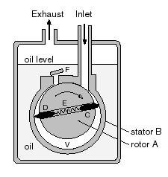
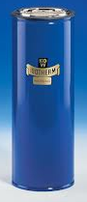
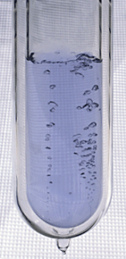
Schlenkline II
The vacuum is produced by a mechanical rotary pump that can provide a vacuum of 10⁻¹-10⁻² torr if properly set up
They employ a rotor that revolves inside a cylindrical stator.
A thin film of oil maintains a seal between fixed and moving parts. It is imperative that other materials i.e., organic solvents that can cause explosions or corrosive gases do not contaminate the oil
It is protected by a trap that is immersed in a Dewar containing liquid nitrogen (T_{b}=-196 ºC), which means that pretty much everything will condense in the trap including oxygen (T_{b}=-183 ºC, light blue liquid) and argon
(T_{b}=-186 ºC, colorless liquid) , which poses a significant problem because it can cause an explosion!
After the pump is turned off, the vacuum part has to be vented immediately while the Dewar with liquid nitrogen is removed at the same time to prevent the pressurization of the Schlenk line.
Contact with liquid nitrogen causes severe burns on the skin! ☹

Slide 8
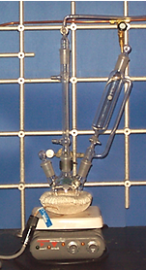
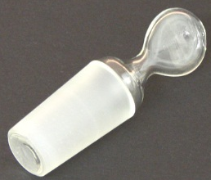
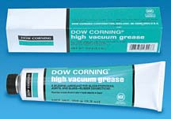
Basic Setup I
To vacuum line
A basic reaction setup as used in the Grignard experiment is shown on the right consisting of:
  Three-necked flask with stir bar
  Liebig condenser with an adapter that connects the setup to the Schlenk line (cold water enters on the lower end)
  Addition funnel (make sure to use the proper plug here!)
  Hot plate (as stirrer or heat source)
  Heating mantle (preferential, has to be plugged into a Variac to control the temperature), water or oil bath as a heat source
  Additional joints are closed with a glass stopper and not with rubber septa
The glassware has to be prepared by flame-drying under vacuum:
  Check glassware for cracks
  Assemble setup (do not forget to lubricate the ground glass joints lightly (only the upper third of male joint)!)
  Evacuate for ten minutes
  Heat the glassware with the heat gun
  Allow the glassware to cool under vacuum
  Refill slowly with inert gas
  Repeat the process at least once
out
in

Slide 9
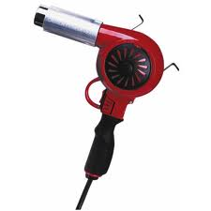
Basic Setup II
Heat gun
  The heat guns in the laboratory are industrial strength heat guns. They allow for temperatures up to 500 ºC. The temperature can be controlled by opening or closing the intake shuffle.
  The heating commences at the point the farthest away from the vacuum connection to drive the water out of the glassware.
  After the student completed the heating of the glassware, the switch has to be set to cooling in order to cool down the filament in the front part of the nozzle. Failure to do so will cause the filament to burn out
  During the step, all flammable materials
  (i.e., flammable solvents, paper towels, etc.) have to be removed from the area to prevent fires.

Slide 10
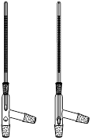


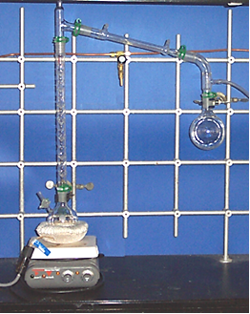

Basic Setup III
Another common task is a distillation under inert gas. The setup consists of
  Schlenk flask or three-necked flask
  Vigreux column (1)
  Three way distilling head with a thermometer of proper length (as shown on the right)
  Liebig condenser (water enters on the lower end)
  Vacuum adapter, which serves as connection to the Schlenk line (2)
  A Schenk flask to collect the distillate
  Clamping should be done on the neck
  of the two flasks. If the setup is not stable enough, the Vigreux column can be lightly clamped as well.
2
1

Slide 11
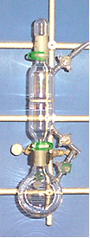
Basic Setup IV
Schlenk filtration (part I)
  The setup for the Schlenk filtration has to be flame-dried in vacuo prior to its use because the frit (red arrow) usually contains a lot of water. The connection to the vacuum line should be at the top part of the Schlenk frit to remove the contaminants (blue arrow)
  After the drying process and cooling, a plastic clip is attached at the connection between the flask and frit. The setup is subsequently inverted and the cap removed (under a positive inert-gas pressure in the filtration setup and the inert gas line).
  The other flask has to be vented prior to this step. The stopper is removed from the flask and the two pieces are joined quickly. The assembly is then slowly inverted, while making sure that the solution does not enter the inert gas line. Often times, it is better to close this stopcock to prevent this from happening. Warning: A significant pressure can build up if low boiling solvents were used!

Slide 12
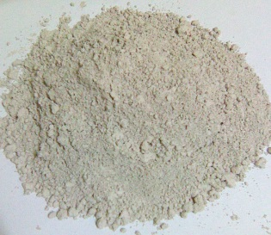
Basic Setup V
Schlenk filtration (part II)
  After a short time, the stopcock of the receiving flask is opened briefly to perform a pressure exchange.
  In some cases, a slight vacuum has to be applied to increase the speed of the filtration. Warning: Low boiling solvents or hot solvents evaporate under those conditions at the frit leaving behind a solid material, which can make it even harder to filter the mixture.
  If a solution containing a very fine precipitate (i.e., NaCl, LiCl) was filtered, the precipitate should be allowed to settle first. The supernatant solution is then carefully decanted onto the frit before the solid is transferred onto the frit together with the remaining small amount of solution. This way, the frit will not clog immediately and the filtration process will be much faster.
  An alternative method would employ the use of Celite® or
  Diatomaceous Earth as a filter aid. However, one has to make
  sure that the target compound is not absorbed or reacts with
  the Celite®, which is often the case for polar compounds.

Slide 13
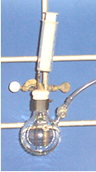
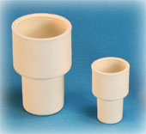
Basic Setup VI
Another basic task in the lab is the transfer of solvents from one Schlenk flask to another
Under a positive pressure, the glass stopper is replaced by a rubber septum, which has to be folded over to seal properly
A syringe with a proper sized needle is assembled. The needle is inserted in the septum above the liquid and the inert gas is drawn into the syringe. The needle is removed from the flask and the inert gas is expelled. The process is repeated twice before the liquid is drawn into the syringe
The storage flask has to be connected to the inert gas line while withdrawing any gas or liquid to provide a proper pressure exchange
Larger amount of liquid can be transferred with a cannula

Slide 14
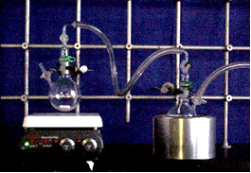
Basic Setup VII
If a larger amount of solvent has to be removed under inert gas, a trap-to-trap distillation has to be used
  The setup consists of two Schlenk flasks connected by a thick-wall tubing or a glass adapter
  The flask (flask A) containing the solvent originally has to have a stir bar and is placed
  in a water bath
  The receiving flask (flask B) is placed in a shallow Dewar filled with liquid nitrogen and connected to the Schlenk line (indicated by arrow)
  After carefully establishing a sufficient vacuum as can be seen be the boiling of the liquid in flask A, the vacuum is disconnected to ensure that the solvent condenses in flask B and does not get collected in the trap of the Schlenk line
Flask A
Flask B

Slide 15
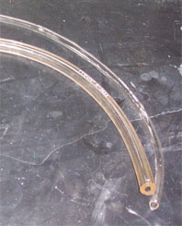
Basic Setup VIII
Whenever possible, glass plugs should be used instead
of rubber septa because they seal better if they are
lubricated properly
There are two kind of tubing in the lab:
thick-walled and thin-walled tubing
  Thick-walled tubing is used for vacuum and pressure setups
  Thin-walled tubing is used as water hoses and gas lines
Lubrication be used lightly on ground glass joints only
The glassware that is used in the course is very expensive (Schlenk flask: >$100, Schlenk frit: $200). If you break it due to carelessness, you will be held financially responsible.

Slide 16
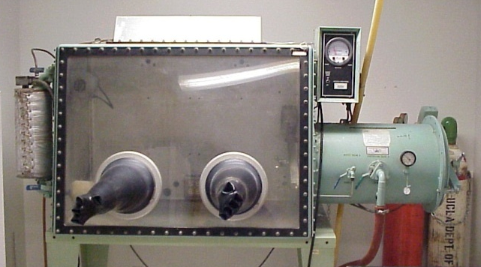
Glove Box I
Glove box (part I)
  The entire setup consists of several parts: the main chamber (A) in which the work with the chemicals is carried out, the anti-chamber
  (B, outer part on the right side), the catalyst (C, outer part on the left side) and the vacuum pump (not shown)
  All containers that will have to be transferred into the glove box have to be evacuated. Stoppers and stopcock plugs have to be secured with clips, plastic clamps and rubber bands to prevent that they are being dislodged during the evacuation of the anti-chamber.
A
C
B

Slide 17
Glove Box II
Glove box (part II)
  The anti-chamber has to be evacuated twice (25-30 units) before anything is transferred into the main chamber. This takes at least
  30 minutes.
  All equipment like spatulas, flasks, containers, etc. should be in the anti-chamber.
  Sharp objects cannot be used in the glove box because they can damage the rubber gloves. They are not exactly cheap (~$400-500/pair!)
  Thorough planning is extremely important here. The work in the glove box takes significantly more time than working outside, especially for beginners.
  All valves have to be closed completely before any door is opened to the inside or outside.

Slide 18
Glove Box III
Glove box (part II)
  If solids are transferred into containers, the containers will have to be labeled and wrapped with parafilm around the lid for extra protection.
  The balance and the glove box have to be kept clean. Any waste has to be taken out immediately. The main chamber has to be cleaned before transferring materials out of the glove box.
  The catalyst consists of a copper metal on a silica support. It reacts with oxygen in the inert gas and other sources. Molecular sieves absorb the byproducts (water, organic solvents). From time to time, the catalyst has to be recycled by treating it with a mixture of hydrogen and nitrogen (5/95).

Slide 19
Glasses
Most beakers and flasks are manufactured from Pyrex, a borosilicate glass
  Soften point around T=800 ºC
  These glasses are not compatible with hydrofluoric acid, hot concentrated phosphoric acid and alkalis at elevated temperature.
  Relative large coefficient of expansion of 30-50*10⁻⁷ cm/cm/ ºC,
  which is ten times more than quartz
Quartz
  Soften point of T=1680 ºC, which makes it very useful for high-temperature applications i.e., reduction of metals at high temperatures
  Its coefficient of expansion of 5.5*10⁻⁷ cm/cm/ ºC is the lowest of all glasses. This is important because this makes it more resistant towards thermal shocks.
  Quartz is not compatible with alkali at high temperatures. Alkali traces (i.e., skin) cause quartz to crystallize and to become brittle.

