Slide 1
Lecture 1a
Safety

Slide 2
Safety - Issues
Several accidents in the past couple of years (one of them deadly and others, which required treatment in the hospital) have triggered a very strict enforcement of existing and the institution of many new safety rules
For instance, the use of chlorinated solvents i.e., chloroform and dichloromethane, which used to be a very popular due to their low flammability, were banned from lower division organic labs like Chem 30BL and Chem 30CL because they are considered potential carcinogens, which should only be handled by properly trained personnel and other a well-ventilated hood
UCLA has also established a very strict policy regarding PPE (personal protective equipment, UCLA policy 905, for details see link on the homework for meeting 2, make sure to read it thoroughly because you will be held to these standards as well)
There are many internal inspections from EHS (Environmental Health and Safety), whose results will cause a lot of trouble for the teaching assistant and the instructor.
The chemistry department will be under a lot of scrutiny for the next four years by CAL OSHA, which means that everything has to be done by the book. Any violation will be very costly and bring a lot of bad publicity with it as well (newspaper and TV).

Slide 3
Safety – Dress code
The dress code for the course applies from the first day of class because the student will handle chemicals starting from meeting 1 to meeting 20 in the lab (check-in, glass cleaning, disposal of waste, clean-up, etc.)
Long pants (or a long skirt that covers the ankles if required due to religious reasons, but this needs to be approved by the instructor)
Long-sleeve shirt or sweeter preferred
Clothing should be made from natural fibers (cotton, wool)
Shorts or short skirts are NOT allowed
Closed-toes shoes i.e., sneakers (the feet have to be entirely covered of necessary with socks!)
Clogs, sandals or narrow base heels are NOT allowed
Long hair has to be tied back

Slide 4
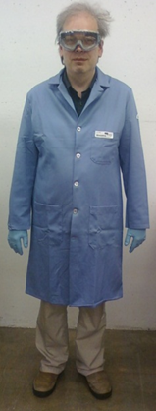
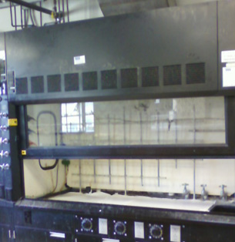
Safety – Personal Protective Equipment
Knee-length, flame-resistant lab coat (the blue ones that are available from AXS) with proper length sleeves, has to be closed at all times in the lab! No aprons!
Goggles that cover the front and the sides of the eyes have to be worn at all times in the lab. Regular prescription glasses are not sufficient, neither are sunglasses!
Nitrile gloves come in different colors and different thicknesses (Latex gloves dissolve more or less quickly even in acetone).
Note that the lab coat and the gloves are only to be worn in the lab and not outside.
Providing the proper personal protective equipment is the student’s responsibility and not the instructor’s or the department’s responsibility. All of these items can be purchased from AXS (Young Hall 1275), the ASCULA bookstore, a store like Scrubbs Unlimited (Westwood) or the internet.
All parts of the experiments have to be carried out in the hoods provided in the lab. The bench workspace should be used as little as possible to minimize the exposure to volatile, hazardous chemicals.
The sash has to be lowered when working in the hood
Do not stick your head into the hood
Keep the hood free of clutter
Finally, make sure to review UCLA policy 905

Slide 5
Safety – Other Issues I
No eating, drinking or chewing gum
Cell phones and beepers have to be turned off in the lab
No hats, no headsets
Backpacks have to be properly stored
Inform the instructor immediately if you have any health conditions that could cause problems or need special consideration i.e., diabetes, pregnancy, use of strong drugs, etc. It is advisable to consult with your physician about this issue as well.

Slide 6
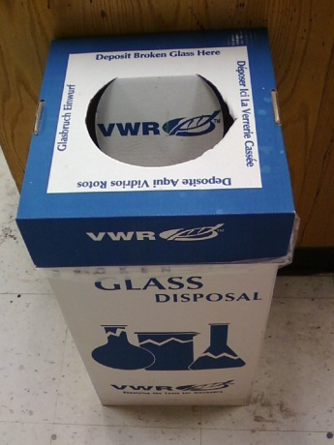
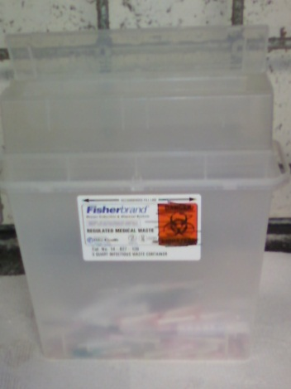
Safety – Waste Management
Glass waste (and only glass waste!) has to be placed in the appropriate boxes (white-blue). The container will be considered full if it is 75% filled.
Sharps i.e., razor blades, syringe needles without the caps, etc. have to be placed in the sharps container (plastic boxes in the hood). The container will be considered full if it is 75% filled.
Solid waste and liquid waste have to be placed in the container provided by lab support. Acetone has to be collected and disposed as organic liquid waste!
The waste containers have to have a waste manifest attached to them and have to kept closed when not in use
If the containers are full (90%), inform the teaching assistant immediately so that s/he can obtain a new container from lab support immediately

Slide 7
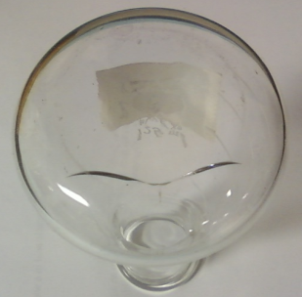
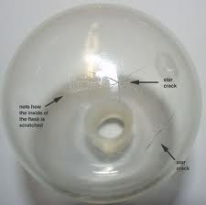
Safety – Other Issues II
Glassware
Glass is fragile and can break easily during usage and cleaning
Glassware has to be inspected for cracks prior use or cleaning particularly glassware that is going to be evacuated and heated because star cracks can cause a sudden collapse (implosion)
The student has to be cautious when touching it since it can be hot i.e., heated beaker or Pasteur pipette after pulling capillaries
Broken glassware of any kind has to be properly disposed off immediately
Hotplate
Aluminum blocks have to be handled carefully as well because the student cannot see if it is hot or not

Slide 8
Safety – Bottom line
Goal: Creation of a safe work environment
The experiments will be safe if the procedures are followed properly. Understanding what you are doing in the lab helps a lot here. This is also the reason for the mandatory oral examination with the instructor prior to the start of the project.
Failure to observe the basic rules above (and others that arise from the hazards of specific chemicals as indicated in the reader and/or the MSDS) will endanger everybody present in the lab.
No tolerance policy: dismissal from in-lab meeting and point deduction, dismissal from class for safety grounds and a report to the Dean of Students

