Slide 1
Lecture 10
X-Ray Diffraction

Slide 2
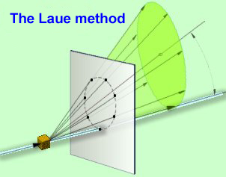
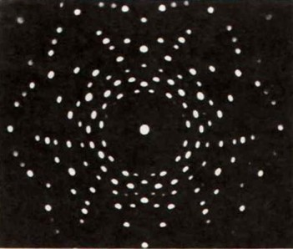
Introduction I
History
  1895 Wilhelm Conrad Rӧntgen discovered
  X-rays
  1905 Albert Einstein introduces the concept of photons (concept not accepted until 1922)
  1913 Max von Laue, Walter Friedrich and Paul Knipping passed X-rays through crystal of copper sulfate and concluded that
    Crystals are composed of periodic arrays of atoms
    Crystals cause distinct X-ray diffraction patterns due to atoms
  1914 Bragg and Lawrence showed that diffraction pattern can be used to determine relative positions of atoms within a single
  crystal (i.e., molecular structure)

Slide 3
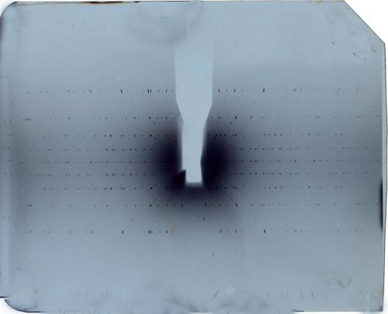
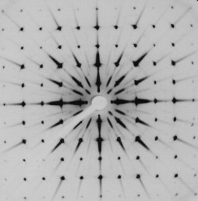
Introduction II
Several decades ago, it took 0.5-2 years to obtain a crystal structure, starting from the data collection using camera pictures (Weissenberg method (top) and Precession method (bottom) by Buerger) or diffraction patterns over the mathematical modeling of the data.
In 2013, an array detector is used and structures for simple molecules can be acquired in 6-8 hours time (data collection and data analysis).
In general, one has to distinguish between single crystal X-ray diffraction and X-ray powder diffraction.

Slide 4
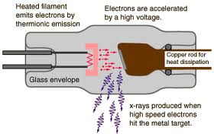
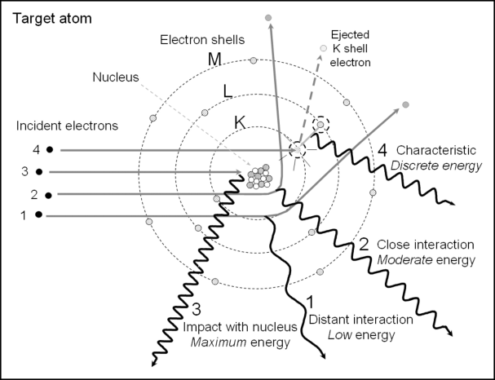
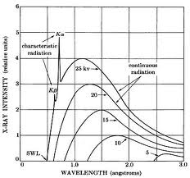
X-rays I
X-rays are produced by energy conversion in an evacuated tube where accelerated electrons from a filament hit a metal target (anode)
Events 1, 2, and 3 depict incident electrons interacting in the vicinity of the target nucleus, resulting in Bremsstrahlung production caused by the deceleration and change of momentum, with the emission of a continuous energy spectrum of X-ray photons. This process is predominant as long as the applied voltage (10-100 kV) is insufficient to remove electrons near the nucleus.
Event 4 demonstrates characteristic radiation emission, where an incident electron with energy greater than the K-shell binding energy collides with and ejects the inner electron creating an unstable vacancy. An outer shell electron transitions to the inner shell and emits an X-ray with energy equal to the difference in binding energies of the outer electron shell and K-shell that are characteristic of copper (or molybdenum if it was used as the anode material)

Slide 5
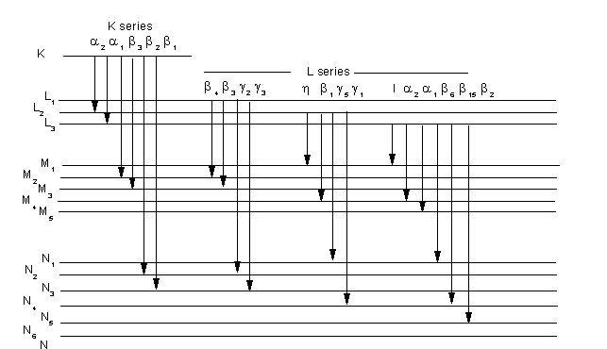
X-rays II
Every element emits electrons with characteristic wavelengths that can be used to identify the element
i.e., X-ray fluorescence.
Atomic Number | Element | K_{α} | K_{α1} | K_{α2} | K_{β}
24 | Chromium | 2.29092 | 2.28962 | 2.29351 | 2.08480
26 | Iron | 1.93728 | 1.93597 | 1.93991 | 1.75653
27 | Cobalt | 1.79021 | 1.78892 | 1.79278 | 1.62075
28 | Nickel | 1.65912 | 1.65784 | 1,66169 | 1.50010
29 | Copper | 1.54178 | 1.54051 | 1.54433 | 1.39217
42 | Molybdenum | 0.71069 | 0.70926 | 0.71354 | 0.63225
47 | Silver | 0.56083 | 0.55936 | 0.56738 | 0.49701
74 | Tungsten | 0.21060 | 0.20899 | 0.21381 | 0.18436

Slide 6
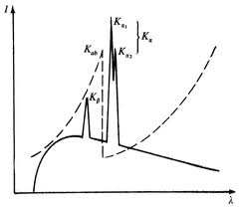
X-rays III
Because many different electronic transitions possible in an atom, specific filters are used to obtain monochromatic X-rays. For instance, a thin foil of zirconium metal is used to filter out the K_{β}-lines of molybdenum, because it possesses an absorption edge, which is located between the K_{α}- and the K_{β}-line of molybdenum
Anode | λ(K_{a}) in Å | Filter 1 | Thickness(mm) | Density(g/cm²) | Filter 2 | Not suitable for
Chromium | 2.29092 | Vanadium | 0.016 | 0.009 | Titanium | Ti, Sc, Ca
Iron | 1.93728 | Manganese | 0.016 | 0.012 | Chromium | Cr, V, Ti
Cobalt | 1.79021 | Iron | 0.018 | 0.014 | Manganese | Mn, Cr, V
Nickel | 1.65912 | Cobalt | 0.013 | 0.019 | Iron | Fe, Mn, Cr
Copper | 1.54178 | Nickel | 0.021 | 0.069 | Cobalt | Co, Fe, Mn
Molybdenum | 0.71069 | Zirconium | 0.108 | 0.069 | Yttrium | Y, Sr, Rb
Silver | 0.56083 | Palladium | 0.030 | 0.030 | Ruthenium | Ru, Mo, Nb

Slide 7
X-rays IV
The instrument used in the department uses an X-ray array detector (CCD) to obtain accurate counts of the X-rays reflected from the sample.
Both the sample and the counter are tilted throughout the process of data collection in a way that the reflection angle is always twice as much as the angle of the incident beam about the sample.
Therefore, the recorded values are 2θ-values. The X-ray source contains a copper anode.
A nickel foil is used as monochromator, which filters out the K_{β}-line of Cu.

Slide 8
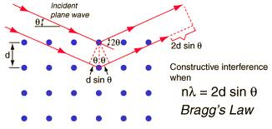
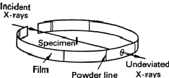

Diffraction pattern
Why is a diffraction pattern observed?
  Electromagnetic radiation possesses both a wave and a corpuscular nature. The wave interpretation of diffraction is based on constructive and destructive interference when different waves are superimposed. This aspect is summarized in Bragg’s law
n λ = 2d sin(θ)
  For the interpretation of diffraction patterns, the locations of the atoms in a crystal have to be known.
  The diffraction pattern of a powder can be determined in different way. The Straumanis technique and the Debye-Scherrer-method used X-ray sensitive films that were attached on the inside of a cylindrical arrangement. After development, the film exhibits lines at angles that showed constructive interference. The intensity (or darkness) of the lines is used to quantify the strength of the reflection.

Slide 9
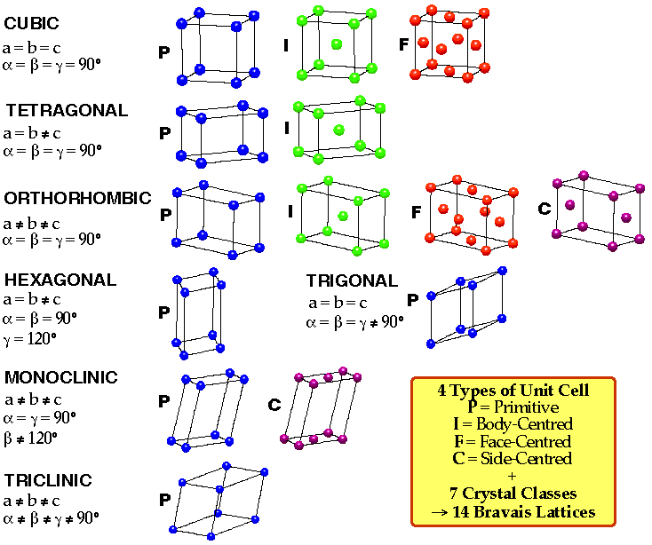
Bravais lattices
Based on translation symmetry and local symmetry the 14 Bravais lattices
can be derived.
The combination of these translation symmetries (simple translation, screw axis and glide planes) with the 32 classes of point groups leads to 230 space groups.
Every space group shows a specific pattern of diffraction

Slide 10
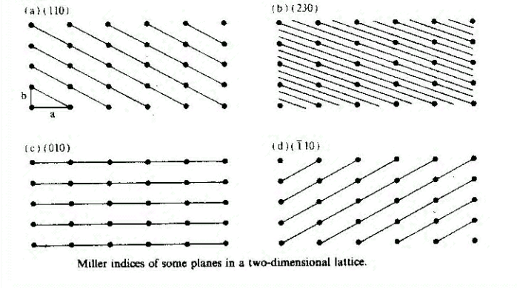
Miller Indices I
For crystalline materials, the atoms, ions or molecules of a unit cell are packed in an ordered way to form a lattice. The atoms form crystal planes that cause the diffraction of X-rays.
The intercepts of these planes on three suitably chosen axes set in the crystal can be expressed as integral multiples of three basic dimensions.
The Miller indices (h k l) are the reciprocals of the distances along the unit cell axes.
  If the plane is parallel to an axis, the value of the Miller index is zero (i.e., l=0 in case of the
  two-dimensional case) because the system does not extend in z-direction.
  A Miller index of (110) means that the plane intercepts the x-axis at x=a, and the y-axis at y=b.
  A Miller index of (230) on the other side means that the plane intercepts at x=a/2 and y=b/3.
  In case (c), the Miller index for the x-direction is zero, which means that the plane is parallel to the x-axis. If the index is negative (indicated by the bar above the number), the plane has a negative slope in this direction.
z
y
x

Slide 11
Miller Indices II
The interplanar spacing (d) changes as the orientation of the plane changes. For orthorhombic lattices (all angles are 90 º,
all side different in length), they can be determined by the following general equation:
This equation can be simplified for a tetragonal lattice, where two axes have the same length (a=b).
For cubic lattices, where all axes have the same length (a=b=c), it reduces to

Slide 12
Miller Indices III
Based on this knowledge, the space group and the lattice constants (a, b and c) of an unknown compound can be determined from X-ray diffraction pattern.
The following example illustrates the indexing of copper metal. Cu-K_{α}-radiation (λ=154.178 pm) was used to obtain the powder pattern.
Copper possesses a cubic structure with a lattice constant of a=361.5 pm. The use of Bragg’s law permits the connection between the observed angle (2θ) and the lattice constant.

Slide 13
Miller Indices IV
For a hypothetical plane (100) the value of sin²(θ) can be determined by
All sin²(θ)-values are divided by this value to obtain the sum of the squares of the Miller indices (Σ). In other words, all other reflections have to be multiple of this (100) index.
The second reflex in the table could also be indexed as (0 2 0) or (0 0 2), which are equivalent to (2 0 0) in this case. Note that the angles when comparing the reflections (2 0 0) and (4 0 0) or (1 1 1) and (2 2 2)
2Θ | I/I₀ | Θ | sin(Θ) | sin²(Θ) | Sum (Σ) | h k l
43.35 | 10 | 21.675 | 0.36934 | 0.13641 | 3 | 1 1 1
50.50 | 4 | 25.25 | 0.42657 | 0.18196 | 4 | 2 0 0
74.20 | 2 | 37.10 | 0.60321 | 0.36386 | 8 | 2 2 0
90.00 | 3 | 45.00 | 0.70711 | 0.50000 | 11 | 3 1 1
95.25 | 1 | 47.625 | 0.73875 | 0.54575 | 12 | 2 2 2
117.05 | 1 | 58.525 | 0.85287 | 0.72738 | 16 | 4 0 0
136.50 | 2 | 68.25 | 0.92881 | 0.86269 | 19 | 3 3 1
137.20 | 1 | 68.60 | 0.93106 | 0.86686 | 19 | 3 3 1
144.70 | 2 | 72.35 | 0.95293 | 0.90807 | 20 | 4 2 0
145.60 | 1 | 72.80 | 0.95528 | 0.91256 | 20 | 4 2 0

Slide 14
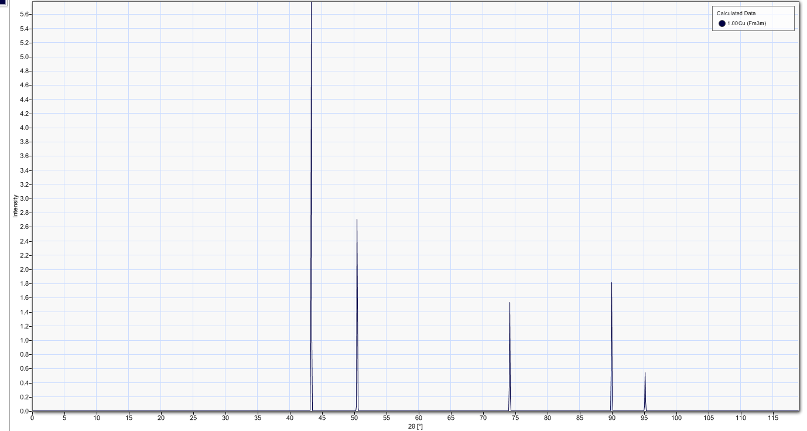
X-ray powder diffraction of Cu (Fm3m)

Slide 15
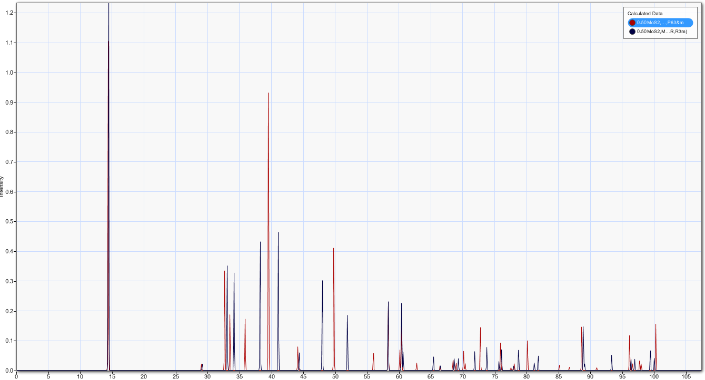
X-ray powder diffraction of MoS₂
Red (MoS₂, 2H, P6₃/mmc, hexagonal)
Blue (MoS₂, 3R, R3m,rhombohedral)

