Slide 1
Lecture 6a
Cyclic Voltammetry

Slide 2
Introduction I
Electrochemical methods are used
  To investigate electron transfer processes and kinetics
  To study redox processes in organic and organometallic chemistry
  To investigate multi-electron transfer processes in biochemistry and macromolecular chemistry
  To determine adsorption processes on surfaces
  To determine electron transfer and reaction mechanisms
  To determine of thermodynamic properties of solvated species

Slide 3
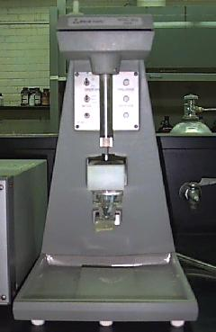
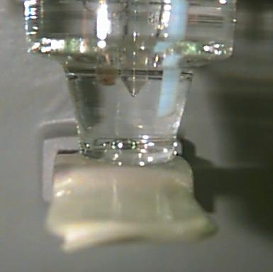
Introduction II
Methods
  Polarography: Often used mercury dropping electrodes because the drop is only used for one measurement and then discarded
  Linear sweep voltammetry (LSV): the current at a working electrode is measured while the potential between the working electrode and
  a reference is swept linearly in time
  Cyclic voltammetry: the same as LSV but the potential is swept in a way that the experiment ends where it started

Slide 4
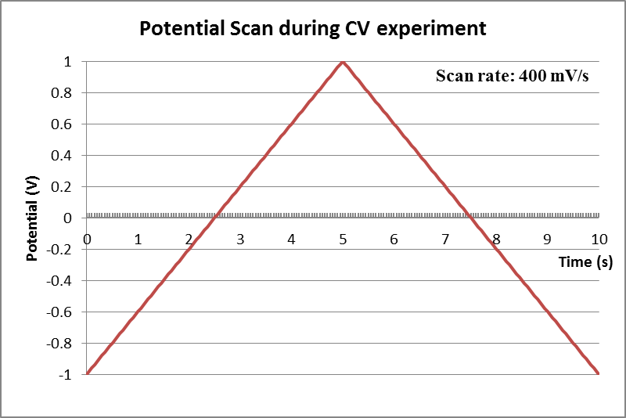
Cyclic Voltammetry I
This technique is based on varying the applied potential at a working electrode (compared to the reference electrode) in both forward and reverse directions while monitoring the current between the auxiliary electrode and reference electrode
Peaks will be observed at potentials that initiate a chemical reaction in the solution (reduction or oxidation) because they involve a flow of electrons

Slide 5
Cyclic Voltammetry II
For a reversible reaction, the peak current for the forward sweep of the first cycle is proportional to the concentration of the analyte and the square root of the sweep rate (Randles–Sevcik expression):
  n is the number of electrons in the half-reaction
  A is the area of the electrode (cm²)
  C is the concentration of the analyte (mol/L)
  D is the diffusion coefficient of the analyte (cm²/s)
  ν is the sweep rate (V/s)
From this equation, it can be concluded that the peak current increases with the sweep rate, with the concentration and the area
of the electrode as long as the reaction is reversible

Slide 6
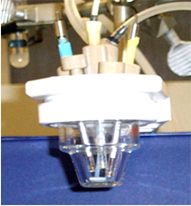
Cyclic Voltammetry III
What is needed to run the experiment?
  Glass cell with the three electrodes
    Working electrode (left, glassy carbon in this course)
    Reference electrode (middle, Ag/AgCl/0.1 M LiCl in dry acetone)
    Auxiliary electrode (right, Pt-disk electrode)
  Three electrodes are needed because the measurement of the potential and the current have to be performed
  in different cycles because they interfere with each other
A gas line for ebulliating the solution with nitrogen is also evident on the upper right hand
A potentiostat that allows for the control of the potential and the measurement of a current
Computer system for control and recording

Slide 7
Cyclic Voltammetry IV
Dry solvent
  To prevent or reduce side reactions
  Dry dichloromethane from solvent still (Be careful!)
Electrolyte
  Organic solvents exhibit a very low electrical conductivity
  Tetraalkylammonium salt with an inert anion i.e., BF₄⁻, ClO₄⁻, PF₆⁻, etc. (NEt₄BF₄)
  Typically about 0.1 M solution
Analytes
  Ferrocene: to check setup and figure out appropriate adjustment in redox potentials as needed
  Mdtc₃: analytes, 0.005-0.01 M

Slide 8
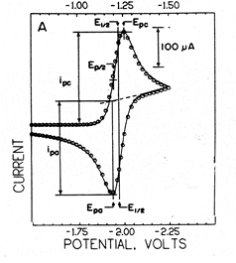

Cyclic Voltammetry V
Data analysis
  The cathodic E_{pc} and anodic E_{pa} peak potentials
  The cathodic half peak potential E_{p/2} and the half way potential E_{½}
  The cathodic (i_{pc}) and anodic (i_{pa}) peak currents
The formal reduction potential is obtained by
  E⁰= (E_{pa}+E_{pc})/2
The half peak potential E_{1/2} can be described
by the Nernst Equation
E_{1/2}=Eº +
D_{O}, D_{R} = diffusion coefficient of oxidized or reduced species (D_{O}~D_{R})

Slide 9
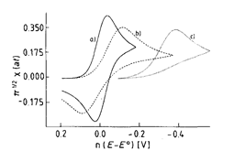
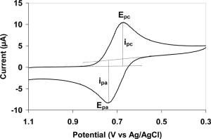
Cyclic Voltammetry VI
Reversible process
  Condition 1:
  ΔE_{p} = │E_{pa} – E_{pc}│= 57/n (mV) (theoretically)
  n=number of electrons transferred in
  the process
  Usually more like 70 mV/n because
  of cell resistance
  Condition 2:
  The ratio of the anodic and cationic
  peak (i_{pa}/i_{pc}) should be close to one
  and independent from the scan rate

Slide 10
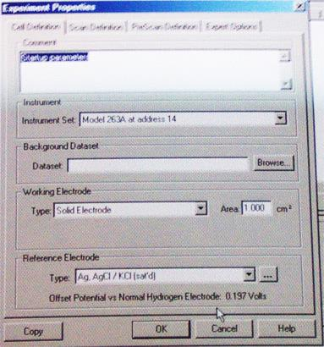
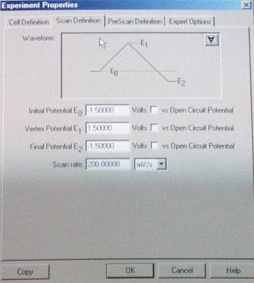
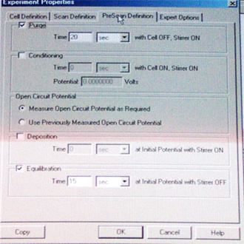
Experiment I
After placing a given amount of the solvent with the electrolyte on the cell, a certain amount of the analyte is dissolved (~0.005 M -0.01 M)
The electrodes are placed in the solution and connected
to their respective cables
  Make sure that the alligator clamps do not touch
  Make sure to check if the reference electrode contains sufficient liquid that the silver wire is not just hanging in
  the glass tube
Make sure that the instrument and the electrode are set properly (Experiment Properties/Cell Definitions)
Initially, the potentials are set to initial and final potential V=-1.5 V while the vertex potential is V=1.5 V with a scan rate of 200 mV (Experiment Properties/Scan Definitions) and a purge and equilibration time of
30 seconds each

Slide 11
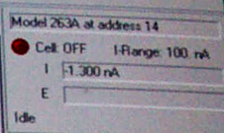
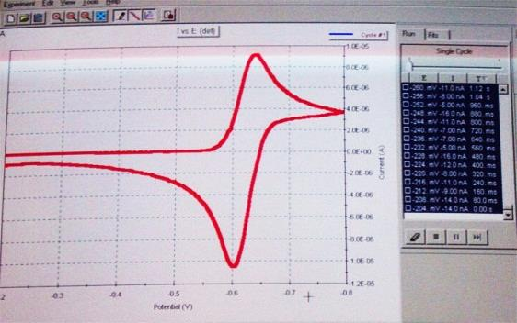
Experiment II
Next, the run is started
  The nitrogen flow is started at a rate that the nitrogen bubbles slowly through the solution while the solution is stirred
  Once the purge time is completed, the stirred and the nitrogen flow are discontinued
  After the equilibrium time, the actual sweep starts as indicated in the status window
    An overflow error usually indicates a short circuit or poor contact somewhere
  The graph that appears should look like the one to the right, but with two peaks because the oxidation step and the reduction step are recorded in the same scan
After the run is completed, the data is printed, saved and then erased on the screen (Edit-Select all and Delete points)
  Next, the window for the sweep is narrowed (focus on each
  peak separately (±0.3 V from maximum, (Experiment Properties/Scan Definitions)) and the sweep rate reduced
  (20-30 mV/s)
  It is highly advisable to bring a flash drive with you to store the data (as ASC file)

