Slide 1
Lecture 13a
Solid State Structures

Slide 2
Introduction I
Physical properties of solids are largely influenced by the structures.The larger the degree of association is, the less volatile is the compound:
WCl₆ (b.p.: 286 ºC) and MoCl₅ (b.p: 268 ºC) exhibit low boiling points and are also soluble in solvents with low polarity (i.e., dichloromethane, carbon tetrachloride).
Solids in which strong interactions are observed between the particles are virtually insoluble, possess very high melting points and non-volatile (i.e., SiO_{2,} Al₂O₃, NaCl).
Small distortions from an ideal structure can result in special properties i.e., BaTiO₃ is piezoelectric and ferroelectric because the Ti-atoms are not centered in the TiO₆-octahedrons.

Slide 3
Metal structures I
Two-dimensional picture
In the figure 1, the red atom has contact with four next neighbors, while in the figure 2 each atom touches six next neighbors.
The box in figure 1 contains 25 atoms and still has a lot of free space in between them. The box in figure 2 has only 23 full atoms in the same area, but in addition fits eight atoms at least half way into the cell, which adds up to an overall atom count of ~27 atoms.
While the arrangement in figure 2 appears to be less organized, the packing on the right accommodates almost 10% more (84.8% vs. 78.5%) because it leaves less space between the individual atoms resulting in a stronger interaction between atoms.
Figure 1
Figure 2

Slide 4
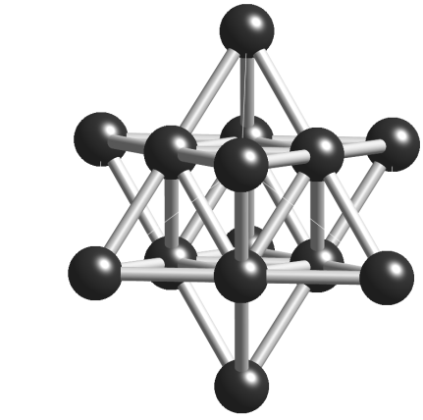
Metal structures II
Three-dimensional picture
Assuming that the first layer has the arrangement of atoms like in the figure 2, the second layer is placed on top of the holes as indicated in figure 2, where the dark blue atom is surrounded by six neighbors (dashed line circles), which are placed in the indentations of the first layer.
The third layer can either be eclipsed with the first layer of atoms leading to a packing ABA, also called hexagonal closed-packed (hcp, Mg-type), or staggered, which respect to the first two layers and therefore results in a ABC packing, which is also referred to cubic closed-packed (ccp, Cu-type).
Among metals, the hexagonal closed-packed structure is found in Be, Sc, Y, La, Ti, Zr, Hf, Co and many lanthanoids. The cubic closed-packed motif is common in metals like Ni, Pd, Pt, Cu, Ag, Au Al, Ca and Sr.
Alkali metals and metals like V, Nb, Ta, Cr, Mo, W and Fe prefer the body-centered cubic structure (bcc, W-type), which is a three-dimensional equivalent to the structure shown in figure 1. Here the atoms of the second layer are placed eclipsed with the one of the first layer and one atom is placed in the center of these eight atoms. This packing is not particularly efficient compared to the other structures (68% for bcc vc. 74% for ccp and hcp).
HCP
A
B
A
CCP
A
B
C
A
BCC

Slide 5
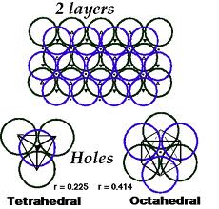
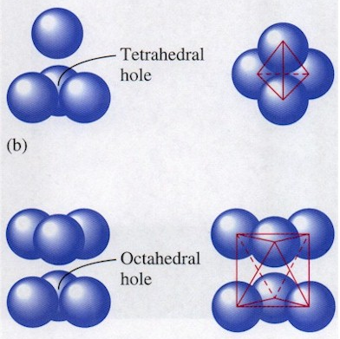
Metal structures III
Despite the hcp and ccp structures being the closest-packed structures, they still exhibit gaps in the structure that are referred to as octahedral holes (because there are six nearest sphere neighbors) and tetrahedral holes (because there are four nearest sphere neighbors).
The lower limits of the radii of these holes are r=0.225a for tetrahedral holes (or sites) and r=0.414a for the tetrahedral holes (a=atomic radius of the metal).
Smaller atoms can be placed in the tetrahedral holes while larger atoms are preferentially going to be placed in the octahedral holes.
The size of these holes in a bcc structure is r=0.732a, which allows much larger atoms to be placed inside this structure.
Many “simple solids” can be described as derivatives of basic structures of metals (or anions), in which the anion (or metal ion) has been placed in interstitial sites (“holes”).
Many basic structures can be derived from closest-packed or body-centered cells. One way to look at these structures is that the new structure incorporates atoms into interstitial sites in the lattice.

Slide 6
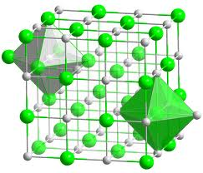
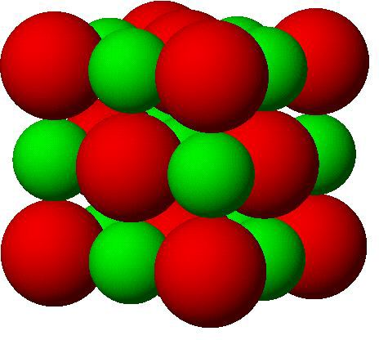
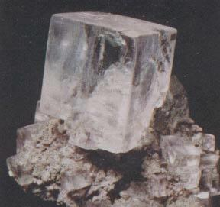
AB Structures I
NaCl Structure (Rock salt, Halite, r=0.695)
If all of the octahedral holes in the ccp structure of chlorine atoms were filled with sodium atoms, one would arrive at the NaCl-structure.
There are a total of four formula units of NaCl per unit cell (Na: 12 edges (12/4) + 1 center (1/1), Cl: 8 corners (8/8) + 6 faces (6/2)). (Note that an atom that are located on a face only counts ½ toward this cell, while an atom on an edge counts ¼ towards this cell and an atom at a corner only ⅛ towards a given cell.)
A different way to look at the NaCl structure is that a face-centered cubic lattice of chlorine atoms is inter-penetrated by a face-centered cubic lattice of sodium atoms offset by a vector of (½, 0, 0).

Slide 7
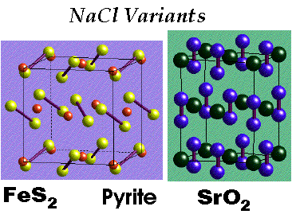
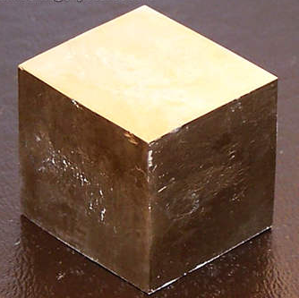
AB Structures II
NaCl Structure variations
The structures of Pyrite (FeS₂= Fe²⁺ and S₂²⁻) and SrO₂ (=Sr²⁺ and O₂²⁻) are variations of the NaCl structure in which the anion consists of a diatomic specie. They vary from each other in the way the anion is arranged along the z-axis.
Compounds like NaN₃, CaCO₃ and CsCN are also variations of the NaCl-type containing a polyatomic anion
NbO, which is a superconductor at 1.38 K, also crystallizes in the NaCl-type, but there are atoms missing in both sub-lattices. As a result, the niobium atom and the oxygen atom possess a square planar coordination instead of an octahedral environment.
Most alkali halides (except CsX), most oxides and chalcogenides of alkaline earth metals and many nitrides, carbides and hydrides (i.e., ZrN, TiN, TiC, NaH) assume this structure type.
O
Nb

Slide 8
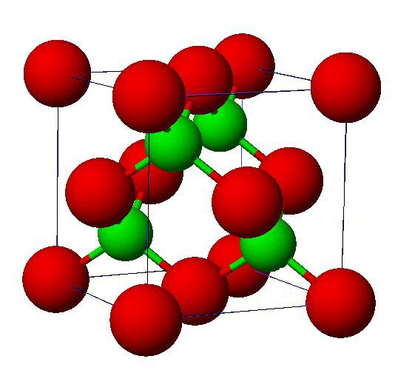
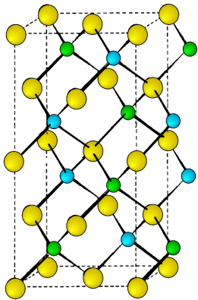
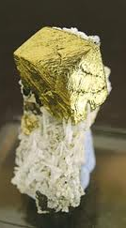
AB Structures III
ZnS Structure (Sphalerite, r=0.518)
If half of the tetrahedral holes in the ccp structure of sulfide ions were filled with zinc ions, one would obtain the ZnS structure. Both, zinc and sulfur have tetrahedral coordination. There are four formula units of ZnS per unit cell (S: 8 corners (8/8) + 6 faces (6/2), Zn: 4 tetrahedral holes (4/1)).
This structure type is formed from many polarizing cations (i.e., Cu⁺, Ag⁺, Cd²⁺, Al³⁺, Ga³⁺, In³⁺) and polarizable Anions (i.e., I⁻, S²⁻, P³⁻, As³⁻, Sb³⁻) leading to Cu(Cl,Br,I), AgI, Zn(S,Se,Te), Ga(P,As), Hg(S,Se,Te), etc.
The structure of GaAs is identical with the ZnS structure.
Nearly all MEX₂ compounds (M=Cu⁺, Ag⁺, E=Al³⁺, Ga³⁺, In³⁺; X=S²⁻, Se^{2-,} Te²⁻; i.e., AgInS₂) adopt the chalcopyrite structure (CuFeS₂), which is a superlattice of the zinc blende structure, at room temperature.
S
Zn
As
Ga
Fe
Cu
S

Slide 9
AB Structures IV
NiAs Structure (Nickel Arsenide, r=0.532)
In this structure, the arsenide ions form an hcp structure, in which the Ni-ions are occupying all octahedral holes. The nickel ions have an octahedral coordination and the arsenide ions a trigonal prismatic environment.
There are two formula units of NiAs per unit cell (Ni: 8 corners (8/8) + 4 edges (4/4), As: 2 atoms in the interior or unit cell)).
This structure is found among transition metals with chalcogens, arsenides, antimonides and bismuthides i.e., Ti(S,Se,Te), Cr(S,Se,Te,Sb), Ni(S,Se,Te,Sb,Sn), etc.
FeS (Troilite)
It is hexagonal (with distortions), with alternating layers of Fe²⁺ and S²⁻ ions.
The c‐axis of hexagonal symmetry is the axis of very hard magnetization and is perpendicular to the basal planes.
The alternating Fe²⁺ layers define the two magnetic sublattices with oppositely directed magnetic moments.
In nonstoichiometric monoclinic pyrrhotite Fe₇S₈, the cation vacancies are preferentially located on one of the two magnetic sublattices, giving rise to ferrimagnetism.
Ni
As

Slide 10
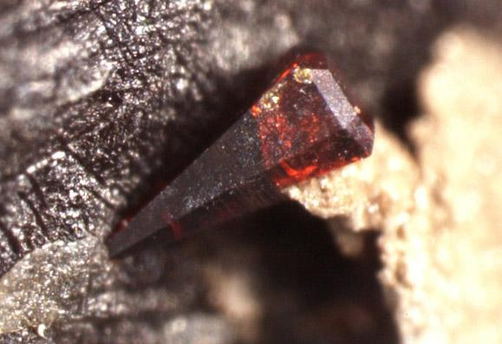
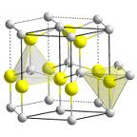
AB Structures V
ZnS (Wurtzite, r=0.518)
In this structure, the sulfide ions (large atoms) form an hcp structure in which the Zn-ions (small atoms) are occupying half of the tetrahedral holes. As a result, both ions have a tetrahedral coordination. There are two only formula units of ZnS in each unit cell.
Compounds such as AgI, AlN, BeO, CdS, CdSe, GaN and ZnO also crystallize in this type.
Zn
S

Slide 11
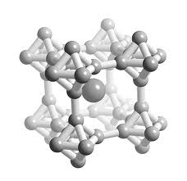
AB Structures VI
CsCl Structure (r=0.922)
This structure is based on a body centered cubic cell. Both, the cesium and the chloride ion, have a cubic environment (=eight neighbors). Many chlorides, bromides and iodides of larger cations (i.e., Cs⁺, Tl⁺ and NH₄⁺) adopt this structure. There is only one formula unit of CsCl in each unit cell (Cs: center (1/1), Cl: 8 corners (8/8)).
A compound like CaB₆ and many lanthanide borides also adopts the CsCl type. The calcium ions are arranged in a simple cubic packing, in which the B₆-octahedrons occupy the vertices of a cube around the calcium atom.
The CsCl structure is also found in intermetallic compounds like LiHg, CuZn (β-brass), MgSr, NiAl (shown on the right), etc.
Cs
Cl
Ca

Slide 12
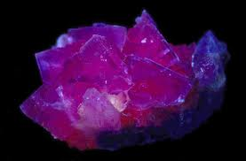
AB₂ Structures I
CaF₂ Structure (Fluorite)
The calcium ions are arranged in a cubic-closed packed lattice, in which the fluoride ions are occupying all tetrahedral holes. Therefore, the calcium ions exhibit a cubic coordination while the fluoride ions experience a tetrahedral coordination. Overall, there are four formula units of CaF₂ in each unit cell (Ca: 8 corners (8/8) + 6 faces (6/2), F: 8 tetrahedral holes (8/1)).
The pink or purple color of many fluorite crystals is due to a defect in the lattice, in which an electron has replaced a fluoride ion. This trapped electron is referred to as color center.
The fluorite structure is commonly found in fluorides of large divalent cations, chlorides of Sr and Ba, and dioxides of large quadrivalent cations i.e., Zr, Hf, Ce, Th, U, etc.
Lead(II) oxide and platinum(II) sulfide are variation of the fluorite structure in which half of the tetrahedral holes are not filled. In PbO, the tetrahedral positions at z=¾ are not filled. In PtS, half of the sulfide ions are removed in a way that Pt(II)-ions exhibits a square-planar coordination afterwards.
Ca
F

Slide 13
AB₂ Structures II
Antifluorite
If the cation and anion are switched, one arrives at the antifluorite structure that is found in Na₂O and Li₂O. This structure is found in many oxides and chalcogenides of alkali metals.
The structure of K₂PtCl₆ is a variation of this structure, in which the potassium ion assumes the role of the sodium filling all tetrahedral holes, and the PtCl₆-octahedron the function of the oxide ion occupying the corners and the center of the faces.
Li
O

Slide 14
AB₂ Structures III
CdI₂ structure
This structure can be described as an hcp structure of iodide ions that have cadmium ions places in half of the octahedral holes in alternate layers. As a result, the structure consists of layers that have cadmium atoms that have an octahedral environment while the iodide ions sit on top of a triangle of cadmium ions. Overall, one formula unit of CdI₂ (CdI_{6/3}) is found in each unit cell.
This structure type is very common among iodides of moderately polarizing cations, bromides and chlorides of strongly polarizing cations i.e., PbI₂, FeBr₂, VCl₂. It is also found in hydroxides of many divalent cations i.e., (Mg, Ca, Ni)(OH)₂ and dichalcogenides of many quadrivalent cations i.e., TiS₂, ZrSe₂, CoTe_{2.}
The CdCl₂ type is cubic-closed packed equivalent of the CdI₂ structure with the small Cd-ion occupying 50% of the octahedral sites and the chloride ions assume a ccp structure.
This type is found in chlorides of moderately polarizing cations i.e., MgCl₂, MnCl₂, etc. and in disulfides of quadrivalent cations i.e., TaS₂, NbS₂, and Cs₂O, which has the anti-CdCl₂ structure.
Cd
I

Slide 15
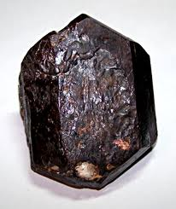
AB₂ Structures IV
TiO₂ (Rutile)
In this structure, the oxide ions form a hexagonal closest-packed structure.
The titanium(IV) ions are smaller than the oxide ions, and therefore are placed into the octahedral holes. The structure expands so that the oxide ions are not in contact with each other anymore.
Only half of the octahedral holes are occupied by titanium(IV) ions. The titanium atoms have a slightly distorted octahedral coordination, while the oxygen atoms have a trigonal planar coordination.
There are two formula units of TiO₂ in the unit cell (Ti: center (1/1) + 8 corners (8/8), O: 4 faces (4/2) + 2 interior of cell (2/1)).
Ti
O

Slide 16
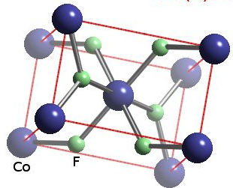
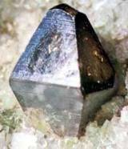
AB₂ Structures V
TiO₂ (Rutile)
A different way to look at the structure is that TiO₆ octahedra share edges in chains along c-axis. Vertices link the edge-sharing chains.
This structure is found in many metal(IV) oxides (MO₂) (i.e., Ti, Nb, Cr, Mo, Ge, Pb, Sn) and metal(II) fluorides (MF₂) (i.e., Mn, Fe, Co, Ni, Cu, Zn, Pd).
Anatase is the cubic closed-packed equivalent of TiO₂. One of the main differences is that the octahedrons share four edges instead of two like in the Rutile structure.

Slide 17
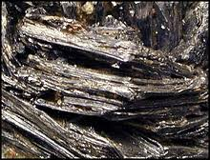
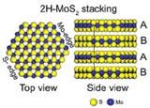
AB₂ Structures VI
MoS₂ (Molybdenite)
The structure consists of hexagonal layers of S-atoms are that are not close-packed.
The Mo-atoms have a trigonal prismatic coordination, while the sulfur atoms are located on top of a triangle. There are two formula units of MoS₂ per unit cell.
This layer structure makes MoS₂ interesting as lubricant in various applications.
Based on this layer structure, compounds like MoS₂ are also able to intercalate various amounts of alkali metals. This intercalation causes the lattice to expand more or less in the c-direction.
S
Mo

Slide 18
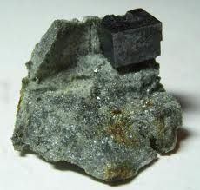
AB₃ Structures I
Rhenium trioxide (ReO₃)
ReO₃ forms a primitive cubic cell with one formula unit per unit cell. The structure can be seen as a cubic-closed packed structure of oxygen atoms with a quarter of ccp sites being vacant (in the center of the cell).
The rhenium atoms have an octahedral coordination, while the oxygen atoms have a strictly linear coordination. Each ReO₆-octahedron shares its vertices with each neighboring ReO₆-octahedron (Re: 8 corners (8/8), O: 12 edges (12/4)).
The structure of Perovskite, CaTiO₃, is a variation of the ReO₃-structure, in which the calcium ion occupies the center of the cube, which is vacant site in the ccp structure of ReO₃. This results in a cuboctahedral environment of calcium in terms of the oxygen atoms, an octahedral coordination of titanium and a distorted octahedral coordination (4 Ca and 2 Ti-atoms) around the oxygen atom.
This structure is also found in compounds such as NaNbO₃, BaTiO₃, CaZrO₃, YAlO₃, KMgF₃.
O
O
Ti
Ca

Slide 19
AB₃ Structures II
Li₃Bi structure
The bismuth atoms form a cubic-closed packed lattice, in which all octahedral (=edges) and all tetrahedral sites (interior positions) are filled with.
The structure is also found in Na₃OsO₅, which consists of isolated OsO₅ trigonal bipyramids, which adopt a distorted ccp structure. The sodium ions occupying all tetrahedral and all octahedral holes in the structure (anion part shown on the right).
Bi
Li

Slide 20
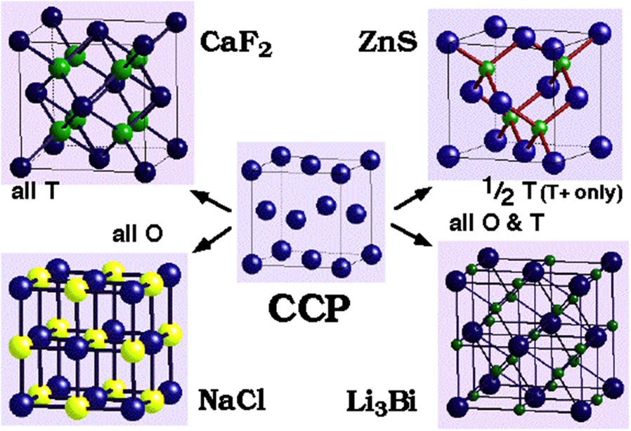
Summary CCP structures
The diagram below illustrates the relationship of different salt structures with the CCP packing

Slide 21
Polyhedra I
Polyhedra can be linked via a vertex, an edge or a face. The distance between the center atoms decreases in this sequence as shown below.
Which type of linking is observed depends on various factors:
While the stoichiometry of the compound defines a narrow window for the type of linking, the type bridging atoms involved are very important as well.
Bridging sulfur, chlorine, bromine and iodine atoms favor bond angles around 100º.
Oxygen and fluorine atoms prefer a more electrostatic interaction up to 180º, but frequently exhibit angles from 130-150º.
More polar bonds disfavor edge and face sharing because of the increased electrostatic repulsion of the central atoms.
If the interaction of center atoms is favorable i.e., to form M-M bonds, edge or face shared are predominant.
Polyhedron | Vertices | Edge | Face
Tetrahedron | 0.95-1.22 | 0.66-0.71 | 0.41
Octahedron | 1.29-1.41 | 1.00 | 0.82

Slide 22
Polyhedra II
Unshared octahedra
Molecules like WCl₆, WF₆ or SF₆ (shown below) form a three-dimensional array of isolated MX₆ octahedra in the solid state.
Due to the weak interactions between the octahedra, these compounds exhibit low boiling points. Both, SF₆ (b.p.= -64 ºC) and WF₆ (b.p.= 17 ºC) are gases at room temperature. MoF₆ exhibits a boiling point of 34 ºC, while UF₆ sublimes at 56 ºC.

Slide 23
Polyhedra III
Octahedra with shared vertices
Many pentafluorides, pentafluoro anions and oxofluorides exhibit vertex-sharing octahedra.
Molecules like NbF₅ and MoF₅ form tetramers in which the octahedra are connected in cis-configuration, forming linear F-M-F units.
OsF₅, RuF₅ and RhF₅ also form tetramers, but the F-M-F angle is 132º, because the octahedral are tilted.
NbF₅
OsF₅

Slide 24
Polyhedra IV
Octahedra with shared vertices
Molecules like BiF₅ and UF₅ form linear chains in which the octahedra are connected in trans-configuration. The M-F-M unit is strictly linear in these cases.
In Ca[MF₅] (M=Cr, Mn), the MF₅²⁻-anion forms a zigzag chain via trans linking, where the M-F-M angle is 150º.
In VF₅, CrF₅ and ReOF₄, zigzag chains are observed with a bond angle of 152º via cis linkage.
(BiF₅)∞
CaCrF₅
(VF₅) ∞

Slide 25
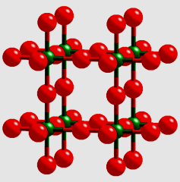
Polyhedra V
Octahedra with shared vertices
If four vertices are shared like in MF₄ (M=Pb, Sn), a layered structure is formed in which the four M-F-M bridges are almost linear and two fluoride atoms are not shared.
The K₂NiF₄ type, which is based on the same motif, is found in many fluorides with K₂MF₄ (M=Mg, Zn, Co, Ni) and oxides Sr₂MO₄ (M=Sn, Ti, Mo, Ru, Rh, Ir). The potassium and strontium ions are coordinated to the four axial fluorine or oxygen atoms.
If the MX₄ layers are stacked on top of each other, one arrives at the ReO₃ structure. A^{I}MF₃ and A^{II}MO₃ derive from this structure by filling the center position. The RhF₃ is a more efficiently packed version of the ReO₃ structure where the central octahedron is rotated, which causes a shrinking of the cell. The M-F-M moiety is not linear anymore like in ReO₃.
Many trifluorides (M=Ga, Cr, V, Fe, Co) form structures in between the ReO₃ and the RhF₃ type. ScF₃ is very close ReO₃ (due to the high charge), while MoF₃ is more like RhF₃.

Slide 26
Polyhedra VI
Edge sharing octahedra
This motif is found in many pentachlorides (M=Nb, Ta, Mo, W, Re, Os, U), pentabromides (M=Nb, Ta, Mo, U), pentaiodides (M=Nb, Ta, Pa) and pentachloro anions (M₂Cl₁₀²⁻, M=Ti, Zr, Mo) of transition metals, where dimeric (MX₅)₂ units are found in the structure.
However, SbCl₅ (monomer, b.p.: 140 ºC) and PX₅ is ionic (PX₄⁺X⁻, X=Cl, Br) do not follow this motif or dimerization.
For instance, MoCl₅ exhibits a magnetic momentum of μ=1.64 B.M., which is indicative of two unpaired electrons. The Mo-atoms are moved away from each other (384 pm). The terminal Mo-Cl bonds are about 10% shorter than the bridging Mo-Cl bonds (225 pm vs. 253 pm). In addition, the axial Cl-atoms are bent towards the Mo₂Cl₂-bridge (167.2º).

Slide 27
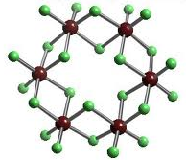
Polyhedra VII
Edge sharing octahedra
Among tetrahalides (X=Cl, Br, I), the edge sharing via two edges is commonly observed. In NbCl₄, α-NbI₄, α-MoCl₄ and WCl₄, the trans edges are shared, which leads to a linear chain. The metals form a M-M bond in these compounds, which results in alternating M-M distances i.e., Nb-Nb distances of d=303 and 379 pm are found in NbCl₄, while the shorter distance in α-NbI₄ is d=331 pm. In NbCl₄, the axial chlorine atoms are bent towards the longer bridge.
ZrCl₄, PtCl₄, PtI₄ and UI₄, the octahedra are connected via cis-edges, which lead to zigzag chains.
An extreme form of this sharing is the formation of a cyclic hexamer in β-MoCl₄ (shown below on the left). In β-ReCl₄, face-sharing octahedra with strong Re-Re bonds (d=273pm) are connected via corners to form a regular chain.

Slide 28
Polyhedra VIII
Edge sharing octahedra
The BiI₃ type (hexagonal closed-packed,) and the AlCl₃ type (cubic closed-packed) can be regarded as a three-dimensional version of edge sharing.
Both of the structures are layer structures, which explains the volatility of AlCl₃.
DyCl₃, ErCl₃, HoCl₃, InCl₃, LuCl₃, TlCl₃, TmCl₃, YbCl₃ also crystallize in the AlCl₃ structure.

Slide 29
Polyhedra IX
Face sharing
This structural motif is often found in species of M₂X₉ composition i.e., Fe₂(CO)₉ and M₂Cl₉³⁻ (M=Cr, Mo, M).
In W₂Cl₉³⁻, a strong W-W triple bond is found (d=241 pm). The M-M bond in Mo₂Cl₉³⁻ (d=267 pm), Cr₂Cl₉³⁻ (d=312 pm) and V₂Cl₉³⁻ (d=328 pm) and Ti₂Cl₉³⁻ (d=322 pm) are significant longer because of weak or no M-M interactions.
In ZrI₃, MoBr₃ and RuBr₃, a chain of face-sharing octahedra are found. In many cases, face sharing allows the metal atoms to form M-M bonds of various degrees. This results in alternating Zr-Zr distances in the chain structure of ZrI₃ due to Zr-Zr pair formation.
Anionic chains are also observed in compounds like Cs[NiCl₃] and Ba[NiO₃].
M
Cl

Slide 30
Polyhedra X
Octahedra with Shared Vertices and Edges
This type of linkage is also very common. For instance, NbOCl₃ consists of a bioctahedra, in which the chlorine atoms are located in the equatorial position and the oxygen atoms are in axial position. This way, the oxygen atoms serve as linkage within the chain.
In WOCl₄, the oxygen atom occupies the vertex of a square pyramid and serves as linkage between the WOCl₄ units leading to a linear chain, which can also be seen in its fiber-like structure.
O
Cl
Nb
O
W
Cl

Slide 31
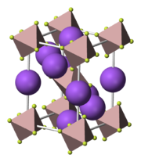
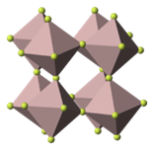
Polyhedra XI
Special cases
The lack of “ligand atoms” generally leads to an increase networking. For instance, the structure of Na₃AlF₆ (=Cryolite) exhibits isolated octahedra of AlF₆.
If one fluoride is removed (leading to AlF₅²⁻), the structure still contains AlF₆ octahedra, which are now linked via fluoride in trans positions (like in BiF₅).
In Tl(AlF₄), the Al-atoms share four fluoride ions with neighboring aluminum atoms, forming a layer structure.
The degree of association increases even further for AlF₃, which exhibits the ReO₃ motif with distorted AlF₆ octahedra.

Slide 32
Polyhedra XII
Metal hydrides
Metal hydrides can be understood as interstitial compounds, in which hydrogen atoms fill in the octahedral or/and tetrahedral holes of a metal.
Many of these hydrides are non-stoichiometric and possess varying amounts of hydrogen atoms in the lattice.
A very important metal in this context is palladium, which can absorb up to 900 times its volume in hydrogen.
Alkali metal hydrides possess NaCl structure in which the hydrogen atoms occupy all of the octahedral holes.
MH₂ have a cubic closed packed metal structure in which all of the tetrahedral holes are occupied (CaF₂ motif).
If additional hydrogen atoms are included (up to MH₃), the octahedral holes are filled as well by H-atoms.

Slide 33
Polyhedra XIII
TiN
Carbides and Nitrides
The carbides and nitrides of group 4, group 5, Th and U can be understood as interstitial compounds as well. In MC or MN, the metal forms a cubic closed-packed structure, in which the carbon or nitrogen atoms occupy all octahedral holes. These compounds exhibit very high melting points (i.e., HfC 3890 ºC, HfN 3300 ºC).
In M₂C or M₂N, the metals form a hexagonal closed-packed structure, in which these atoms occupy half of the octahedral holes.
The carbides and nitrides of molybdenum and tungsten crystallize in WC-type. The metal exhibits a trigonal prismatic packing. The carbon atom occupies the center of this prism. Most of these carbides are chemically quite inert, very hard (8-10 on Mohs Scale), have metallic properties and are refractory.
For transition metals that have a smaller radius (r<130 pm), a distortion of the structure is observed resulting in stronger C-C interactions. Some of these compounds contain C₂²⁻ or C₃⁴⁻ anions that afford acetylene or higher hydrocarbons upon hydrolysis with dilute acids i.e., Al₄C₃, CaC₂.
WC

