Slide 1
Lecture 12a
Metal-organic Frameworks

Slide 2
Introduction I
The size of the interstitial spaces in structures depends largely on the size of the atoms that make up the basic structure
Larger subunits allow for the inclusion of larger molecules i.e., solvent molecules
Many structures release these solvent molecules but tend to collapse without them

Slide 3
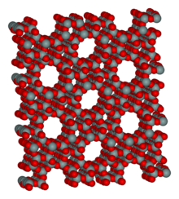
Introduction II
Porous materials like zeolites have been used for a long time in industrial application as catalysts or support of catalysts in the petroleum industry, in water purification, in gas separation, or
as a drying agent (molecular sieves).
They display porous structures that are based on a Si/Al-oxide structures that contain additional cations i.e., Na⁺, K⁺, Mg²⁺, Ca²⁺, etc. that modify their properties like their Lewis acidity or the size of their pores/channels significantly.
Due to the large channels in the structures, they usually display very low densities compared to other minerals (SiO₂: 2.65 g/cm³, Al₂O₃: 4.00 g/cm³, CaO: 3.34 g/cm³). Some zeolites like clinoptilolite ((Na,K,Ca)₂₋₃Al₃(Al,Si)₂Si₁₃O₃₆·12 H₂O, 2.15 g/cm³), stilbite (NaCa₄(Si₂₇Al₉)O₇₂·28 H₂O, 2.15 g/cm³) and natrolite (Na₂Al₂Si₃O₁₀·2 H₂O, 2.25 g/cm³) occur in nature.
ZSM-5 (named after Zeolite Sconoy Mobile, Na_{n}Al_{n}Si_{96–n}O₁₉₂·16 H₂O (0<n<27), 0.72 g/cm^{3,}) is an artificial zeolite that is used for the isomerization of meta-xylene or ortho-xylene to para-xylene
and as support for the copper-based oxidation of ethanol to acetaldehyde.

Slide 4
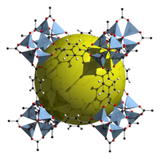
Introduction III
Recently, metal-organic frameworks (MOF) have garnered a lot of attention because of their unique properties.
  They consist of a metal ion and an organic ligand that links the metal ions together into larger arrays.
  Many dicarboxylic acids (i.e., oxalic acid, malonic acid, succinic acid, glutaric acid, terephthalic acid), tricarboxylic acid (i.e., citric acid, trimesic acid) or azoles (i.e., 1,2,3-triazole, pyrrodiazole) are used as linker.
  MOF-5 (Zn₄O(1,4-benzenedicarboxylate)₃, 0.13-0.20 g/cm³) consists of tetrahedral [Zn₄O]⁶⁺ units that are linked together with 1,4-benzene-dicarboxylate units. The opening in the structure is 9.3-13.8 Å depending on the orientation of the ring.
    MOF-5 can store a significant amount of hydrogen at low temperature (77 K: 7.1 wt % (40 bar), 10 wt % (100 bar)).
    While the hydrogen storage capacity in decent at 77 K (66 g/L), its ability to store hydrogen at room temperature is significantly lower (9.1 g/L), which limits its use as hydrogen storage medium

Slide 5
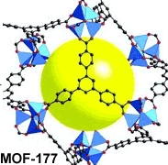
Introduction IV
MOF-177 (Zn₄O(1,3,5-benzenetribenzoate)₂) also consists of tetrahedral [Zn₄O]⁶⁺ units are linked by large, triangular tricarboxylate ligands.
Its hydrogen storage capacity is similar to the one of MOF-5 (77 K: 7.1 wt % (40 bar), 11.4 wt % (78 bar)).
MOF-200 and MOF-210 display a little bit higher uptake of hydrogen at low temperature and are able to deliver 3 % at 100 bar at room temperature.

Slide 6
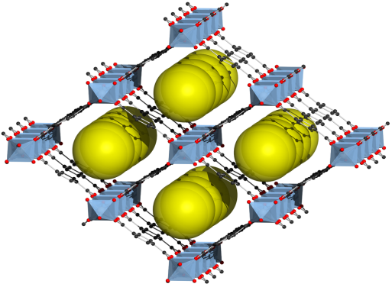
Introduction V
MIL-53 ([Al(OH)] (1,4-benzenedicarboxylate)
(1,4-benzenedicarboxylic acid)_{0.7,} 0.4 g/cm³) consists linear chains of [AlO₄(OH)₂] octahedra that are linked together with 1,4-benzene-dicarboxylate units.
Like many other MOFs, it is obtained by the reaction of the metal nitrate with the dicarboxylic acid under hydrothermal conditions (synthesis of single crystals that depends on the solubility of minerals in hot water under high pressure, important in geochemistry).
Recently, the iron, chromium and scandium analog of MIL-53 have been prepared as well.
MIL-101 (Cr₃O(F/OH)(H₂O)₂(1,4-benzenedicarboxylate)₃) and MIL-100(Fe) (Fe₃OF(H₂O)₂ ((1,3,5-benzenetribenzoate)₂) are variations of MIL-53 using iron or chromium as metal center and fluoride or hydroxide ligands in addition to the organic linkers.

Slide 7
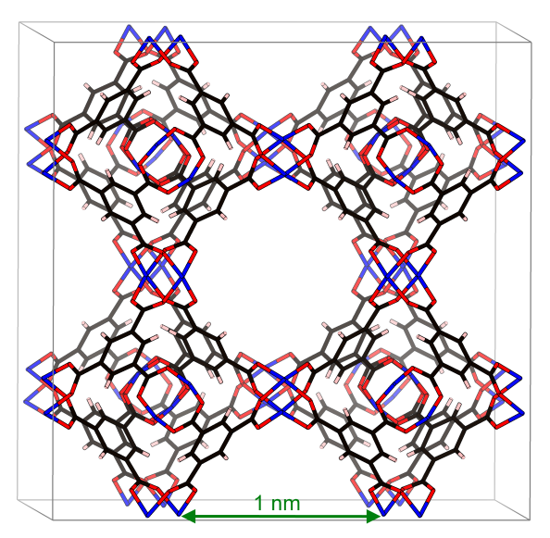
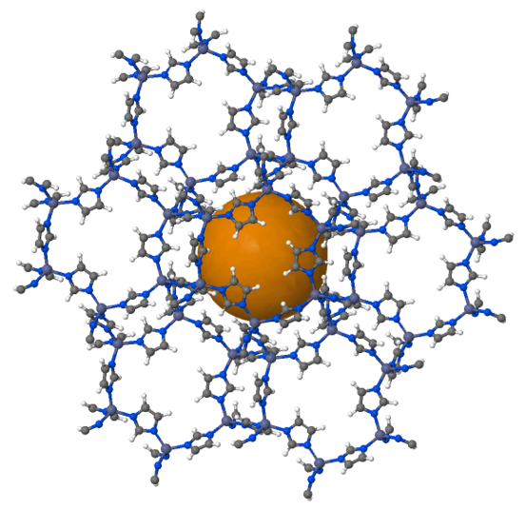
Introduction VI
HKUST-1 (Cu₃(1,3,5-benzenetribenzoate)₂, 0.35 g/cm³, Basolite C300) is a copper-based MOF whose thin films could be used in applications including photovoltaics, sensors
and electronic materials while.
ZIF-8 (Zn(C₄H₅N₂)₂, 0.35 g/cm³, Basolite Z1200) is a is a zinc 2-methylimidazoline compound.

Slide 8
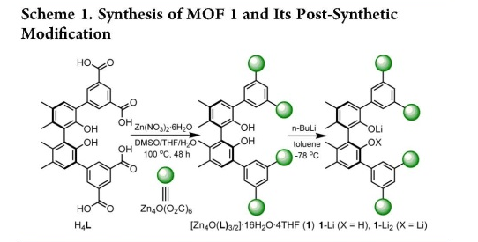
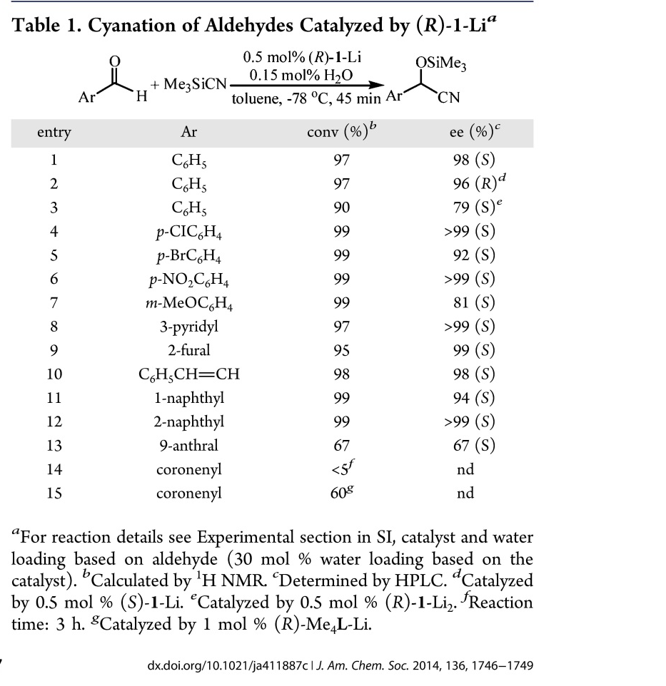

Introduction VII
Asymmetric Synthesis

Slide 9
Experiment I
The students will synthesize α-magnesium formate, which also displays MOF–type properties as well, in solvothermal fashion
Since the synthesis of α-Mg₃(O₂CH)₆ is carried out in N,N-dimethylformamide, the solvent will be included into the porous structure
Upon heating under reduced pressure, the guest can be removed without disrupting the framework as the crystal structure of the two compounds demonstrates.
Other molecules (i.e., THF, Et₂O, MeOH, EtOH, C₆H₆, C₇H₈, C₆H₁₂, etc.) may or may not be used to fill the voids of the guest-free structure depending on their size.

Slide 10
Experiment II
Synthesis of α-Mg₃(O₂CH)₆ ⊃DMF
  Magnesium nitrate (Mg(NO₃)₂*6 H₂O) and formic acid are suspended in dry DMF in a 20 mL drum vial.
  The vial is closed with a flat septum (Teflon side down, pushed inwards) and a compression cap.
  The vial is place in an oven at 110 ºC for at least 40 hours.
  During this time, a crystalline precipitate is formed.

Slide 11
Experiment III
Synthesis of α-Mg₃(O₂CH)₆
  α-Mg₃(O₂CH)₆⊃DMF are placed is a small Schlenk flask. The sample is heated to 130 ºC (silicon oil bath) for 36 hours in a dynamic vacuum.
Synthesis of the guest inclusion complexes
  α-Mg₃(O₂CH)₆ (100 mg) is placed in the assigned solvents (10 mL, dry) for at least 48 hours. The obtained solids are isolated by filtration and dried in air.
Characterization
  Infrared spectrum (ATR), ¹H-NMR and ¹³C-NMR spectrum (D₂O)

Slide 12
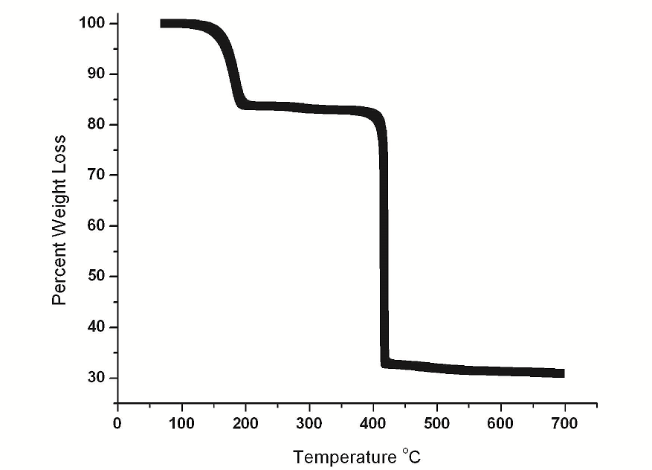
Thermogravimetric Analysis (TGA)
The weight sample is
heated under nitrogen
gas and the decrease in
weight is observed
  The loss of solvent starts
  at 130 ºC leading to the
  solvent free compound,
  which has a mass of 82.4 % of the original compound
  At 400 ºC, α-magnesium formate thermally decomposes to form MgO (29.0 %)

