Slide 1
Lecture 9a
Introduction to Infrared Spectroscopy II

Slide 2
Introduction I
Why do some objects appear more symmetrical than others?
A symmetric molecule appears to look the same from all sides, even if it is rotated.
How do symmetry and spectroscopy relate to each other?
In order to understand this, chemists use symmetry operations and symmetry elements.
  Operations that leave the appearance of the molecule the same are symmetry operations.
  The tools that are used for those operations are called symmetry elements.

Slide 3
Symmetry operations I
What types of symmetry operations are there?
Translation
Going along the translation vector in α-PdCl₂, does not change the molecule.
This type of transformation has high significance in
solid-state structures (X-ray crystallography), but does
not play a role in infrared and Raman spectroscopy because the observer usually looks at isolated molecules or ions.

Slide 4
Symmetry operations II
Rotation
A rotation is performed around an axis of symmetry through an angle of 360/n (n-fold axis)
These axes are generally labeled by symbols like C_{n} or n.
In most cases, regular polygons with n corners have a
(n-2)-axis as principle axis, which is the axis with highest priority i.e., IF₇ exhibits a pentagonal bipyramidal structure with a C₅-axis as the principle axis

Slide 5
Symmetry operations III
Reflection
If a reflection in a plane passing through a molecule leaves it indistinguishable from its initial form, it possesses a plane of symmetry, which is also called a mirror plane (σ, m).
Indices:
  v= vertical, principle axis is part of the mirror plane
  h= horizontal, perpendicular to principal axis
  d= diagonal or dihedral i.e., ethane
For instance, the water molecule possesses two mirror planes passing through the oxygen atom, one that contains all three atoms, the other one perpendicular to it.
Example:
Pt(NH₃)₂Cl₂ forms two geometrical isomers, trans and cis.

Slide 6
Symmetry operations IV
Center of symmetry
If a molecule is symmetric about a point in the molecule, it has a center of symmetry (also called inversion center, i, 1 or º).
Atoms are in equal distance and in opposite directions about this point in space.
Water and cis-Pt(NH₃)₂Cl₂ do not possess an inversion center.
Trans-Pt(NH₃)₂Cl₂ on the other hand has a center of symmetry located in the platinum atom.
If a molecule possesses an inversion center, the exclusion rule will apply.
If a molecule exhibits an inversion center, a vibration is either infrared or Raman active, but not both.

Slide 7
Symmetry operations V
Rotary reflection
The rotary reflection is a combination of n-fold rotation and a horizontal reflection (S_{N}, N).
The methane molecule forms an ideal tetrahedron and therefore possesses T_{d}-symmetry.
Assuming a horizontal plane passing through the central atom, the C-H bonds can be projected onto this plane revealing a 90º angle between them.
This molecule possesses a S₄ axis.
Hint: The projection onto a horizontal plane makes it generally easier to identify such an axis.

Slide 8
The 32 Point groups I
The orientation of symmetry elements is always relative to a Cartesian system with the z-axis being vertical. This axis is
defined as the principal axis.
If a mirror plane is the only symmetry element, the point group
is C_{s} (m).
If an inversion center is the only symmetry element, the point
group is C_{i} otherwise C_{n}.
Symmetry elements are only referred to once, even if they occur several times due to multiplication of other symmetry elements
i.e., IF₇ (=pentagonal bipyramidal) has one C₅-axis and five
C₂-axis perpendicular to the C₅-axis.
If a twofold axis is perpendicular to the principal axis, the point
group is characterized with D_{n}.

Slide 9
The 32 Point groups II
The orientation of the mirror planes are relative to the principal axis:
v: if a mirror plane includes the principal axis
h: if a mirror plane is perpendicular to the principal axis
d: for vertical mirror planes, if also a two-fold axis in the horizontal orientation is present, which is not on the mirror plane
The use of rotary reflection axes is usually avoided. In most cases they can be substituted i.e., S_{4v} = D_{2d} except for S₄, S₈, S₁₂.
Cubic point groups like O (octahedral) or T (tetrahedral) possess four three-fold axes in space, which form an angle of 109.5º.
Icosahedral point groups (I) have ten three-fold axes and six
five-fold axes in space.

Slide 10
Examples
Trans-[Co(NH₃)₄Br₂]⁻ B(OH)₃ trans-C₂H₂Cl₂ PCl₅
Symmetry elements:
E, C₄, 4C₂’, 4σ_{v}, σ_{h}, i, S₄
Point group:
D_{4h} C_{3h} C_{2h} D_{3h}

Slide 11
Point group flowchart
C₄, 4C₂’, 4σ_{v}, σ_{h}, i, S₄

Slide 12
Why do we bother with these things?
If the vibration leads to a periodic change in dipole moment, the vibration will be infrared active.
If the polarization changes throughout the process, the vibration will be Raman active.
Group theory allows us to classify certain vibrations into symmetry species.
Nomenclature:
A the symmetry of the principal axis remains at all times during the
vibration
B the symmetry in regard to the principal axis is destroyed
E,F,.. degeneration of vibration (2, 3, ...)
g, u only if inversion center is present, g=gerade (symmetry remains),
u=ungerade (symmetry destroyed)
‘, “ symmetrical or asymmetrical vibration perpendicular to principal
axis
1,2,3 indices if there are more than one symmetry element

Slide 13



Example 1: trans-N₂F₂
Point group: C_{2h} (inversion center, C₂)
Number of modes: 6 (=3*4-6), non-linear
The exclusion rule applies because of the inversion center!
Sym. to p.a. asym. to p.a. sym. to p.a.
Sym. to i.c. asym. to i.c. asym. to i.c.
A_{g}, ν_{s}(NF) B_{u}, ν_{as}(NF) A_{u}, γ(FNNF)
Raman active Infrared active Infrared active
1018 cm⁻¹ 990 cm⁻¹ 364 cm⁻¹

Slide 14



Example 1: trans-N₂F₂
Sym. to p.a sym. to p.a. asym. to p.a.
Sym. to i.c. sym. to i.c. asym. to i.c.
A_{g}, ν(N=N) A_{g}, δ(NNF) B_{u}, δ(NNF)
Infrared active Infrared active Infrared active
1523 cm⁻¹ 603 cm⁻¹ 423 cm⁻¹

Slide 15



Example 2: CHCl₃
Point group: C_{3v} (C_{3,} vertical mirror plane)
Number of modes: 6 (=3*4-6), non-linear
The exclusion rule does not apply here because there is no inversion center in the molecule.
Sym. to p.a. asym. to p.a. sym. to p.a.
A₁, ν(CH) A₁, ν_{s}(CCl₃) A_{u}, δ_{s}(CCl₃)
Raman and IR active Raman and IR active Raman and IR active 3019 cm⁻¹ 668 cm⁻¹ 366 cm⁻¹

Slide 16



Example 2: CHCl₃
Sym. to p.a sym. to p.a. asym. to p.a.
E, δ(HCCl), ρ(CCl₃) E, ν_{as}(CCl₃) E, δ_{as}(CCl₃)
Raman and IR active Raman and IR active Raman and IR active
1216 cm⁻¹ 761 cm⁻¹ 262 cm⁻¹

Slide 17
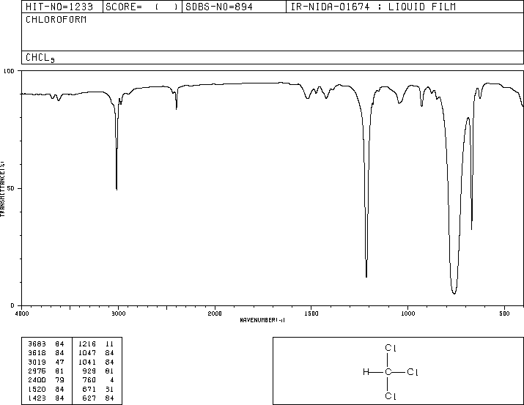
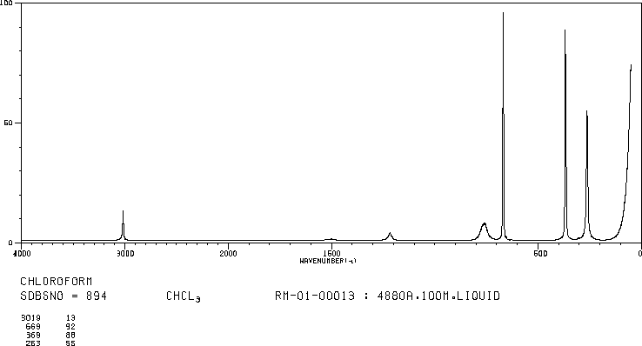
Example 2: CHCl₃
ν(CH)
ν_{as}(CCl₃)
ν_{s}(CCl₃)
Infrared spectrum
δ(HCCl), ρ(CCl₃)
Raman spectrum
ν_{s}(CCl₃)
δ_{s}(CCl₃)
δ_{as}(CCl₃)
ν(CH)
ν_{as}(CCl₃)
δ(HCCl), ρ(CCl₃)

Slide 18
THE END???

