Slide 1
Lecture 7b
¹³C-NMR Spectroscopy

Slide 2
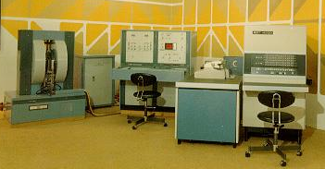
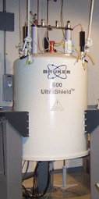
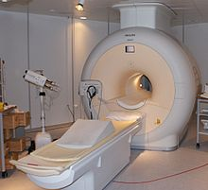
Introduction
Nuclear Magnetic Resonance (NMR) Spectroscopy is a technique used to determine the type, number and relative positions of certain atoms in a molecule.
Originally discovered by Felix Bloch and Edward Purcell
in 1946 (both shared the Nobel Prize in Physics in 1952 for their pioneering work), it has seen a significant increase in popularity with the development of FT-NMR spectrometers
(in the beginning continuous spectrometers were used)
NMR spectroscopy is the chemical version of MRI

Slide 3
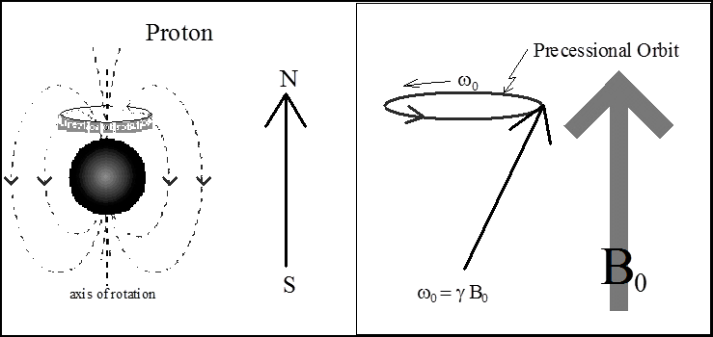
Physical Background of NMR Spectroscopy I
Nuclei, which are moving and are charged particles, generate a magnetic field
The precession of a nucleus with a nonzero magnetic momentum can be described using a vector model
The precession itself is a quantized phenomenon
  The magnetic moment m is either aligned with (m_{I}= +½) or opposed (m_{I}= -½)
  (for a nucleus with I=½) to the applied magnetic field, resulting into two energy states
  The nucleus with the magnetic moment m assumes (2*I+1) states for a nucleus in an applied field i.e., deuterium (I=1): m_{I}= -1, 0, 1 (three states)
Energy
m_{I}= -½
ΔE= f(γB_{o})= hν
m_{I}= +½
Increased magnetic field B_{o}

Slide 4
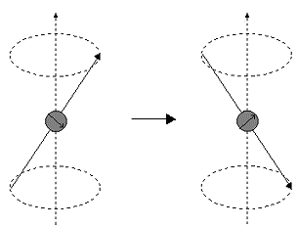
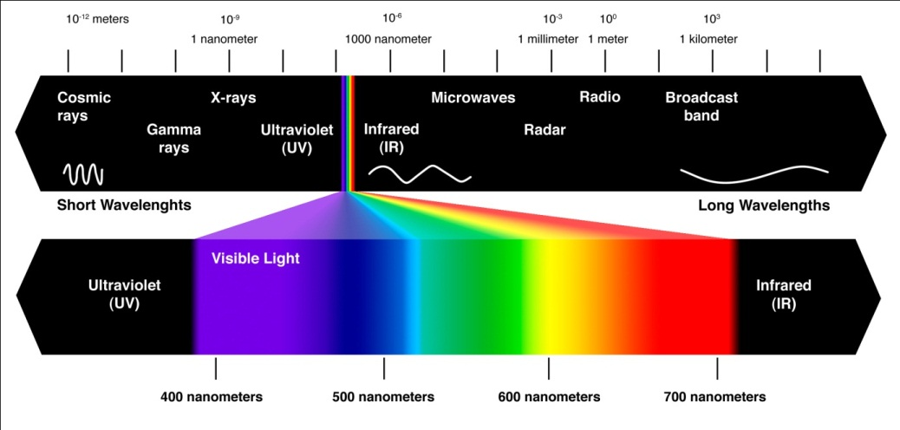
Physical Background of NMR Spectroscopy II
A resonance phenomenon occurs when the aligned nuclei interact with the applied field and are forced to change their spin orientation
The energy, which is absorbed, is equal to energy difference ΔE between the two
spin states. This resonance energy is about 10⁻⁶ kJ/mol, which corresponds to energy in the radio-frequency region.
The stronger the applied field, the greater ΔE becomes, which allows distinguishing even between very similar atoms.
  The NMR spectrometers with stronger magnetic fields provide better resolution revealing
  more details about the structure of a molecule because they separate the signals more
  The NMR experiment itself becomes more sensitive as well because saturation is less of
  a problem
hν

Slide 5
Physical Background of NMR Spectroscopy III
The exact resonance frequency of a certain nucleus depends on the environment of the nucleus. The effective magnetic field is a result
of the applied magnetic field and the changes that are induced by the environment.
The changes are often summarized into a shielding constant, σ. The larger the shielding constant and the smaller the effective field, the higher the applied field has to be in order for the nucleus to resonate as constant frequency. If a constant magnetic field is applied, the resonance frequency will decrease with increasing shielding.
In ¹H-NMR spectroscopy, the diamagnetic and neighboring effects are the most important contributions because only s-orbitals are important here.
In ¹³C-NMR, the paramagnetic term becomes more significant because of the involvement of p-electrons.

Slide 6
NMR active Nuclei
Although hydrogen atoms and carbon atoms are typically of most interest to
organic chemist, there are many other nuclei that are of common interest
In order for an atom to be NMR active, the spin quantum number (I) must be
non-zero.
If the proton and neutron number are even and equal, the spin quantum number
will be zero. Both ¹²C and ¹⁶O will not be observable, but ¹³C and ¹⁷O are active.
There is a significant difference in abundance in these NMR active nuclei and
the sensitivity of these experiments differs quite a bit as well.
Nucleus | Spin Quantum Number, I | Natural Abundance | Magnetogyric ratio, g (10⁷ rad T⁻¹s⁻¹) | Receptivity compared to ¹H-nucleus | NMR Active
¹H | ½ | 99.985 % | 26.7519 | 1.00 | YES
²H | 1 | 0.015 % | 4.1066 | 1.50*10⁻⁶ | YES
³H | ½ | trace | 28.535 | 4.00*10⁻¹⁸ | YES
¹²C | 0 | 98.89 % |  |  | NO ☹
¹³C | ½ | 1.11 % | 6.7283 | 1.70*10⁻⁴ | YES
¹⁴N | 1 | 99.6 % | 1.934 | 1.01*10⁻³ | YES
¹⁵N | ½ | 0.37 % | -2.712 | 3.85*10⁻⁶ | YES
¹⁶O | 0 | 99.76 % |  |  | NO ☹
¹⁷O | ⁵∕₂ | 0.04 % | -3.62808 | 1.11*10⁻⁵ | YES
¹⁹F | ½ | 100 % | 25.181 | 8.30*10⁻¹ | YES
³¹P | ½ | 100 % | 10.841 | 6.63*10⁻³ | YES

Slide 7
¹³C-NMR Spectroscopy - Introduction
The ¹³C-atom possesses like protons a nuclear spin of I=½.
Unfortunately, the signals are much weaker because of the lower natural abundance of the ¹³C-isotope (~1 %). Overall, the ¹³C-nucleus is about 6000 times less receptive than ¹H-nucleus (see previous table).
Most spectra are acquired as proton decoupled spectra, which means that signal is not split by any attached protons (only singlets will be observed in the spectrum).
A methylene group shows as a triplet in a proton coupled spectrum,
but displays a singlet in a proton decoupled spectrum.
The sensitivity of the experiment increases because the already weak
signal is not further split up, but some important information is lost
i.e., how many hydrogen atoms are attached to the carbon.
Note that couplings between carbon and deuterium atoms (and other
NMR active nuclei i.e., P, F) are still observed i.e., CDCl₃, which shows three lines (2*n*I+1, I=1, n=1) at δ=77 ppm.

Slide 8
¹³C-NMR Spectroscopy - Chemical Shift
The smaller magnetogyric ratio compared to hydrogen causes a lower resonance frequency in addition (about a quarter of the one used for hydrogen nuclei i.e., ¹H-NMR: 400 MHz, ¹³C-NMR: 100 MHz).
The effect of shielding and deshielding is much stronger for the carbon nucleus because the heteroatom, which causes this chemical shift, is directly attached to the carbon atom.
While proton NMR spectra are mainly limited in a range between 0-15 ppm, the chemical shifts in ¹³C-NMR spectroscopy range from 0-220 ppm.
Functional Type | Hybridization | Chemical Shift (ppm)
Carbonyl compounds (C=O) Aldehyde and ketone Carboxylic acid, ester, anhydrides Amide | sp² | 185-220 160-185 150-180
Imine (C=N) | sp² | 140-170
Aromatic and alkene | sp² | 100-170
Nitrile | sp | 120-130
Alkyne | sp | 60-100
O-C, Ether | sp³ | 60-90
C-X, Alkyl halide | sp³ | 10-65
RCH₂R, Alkyl | sp³ | 0-50

Slide 9
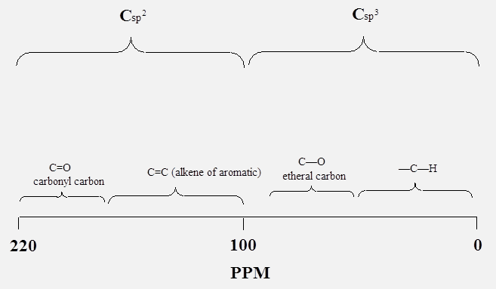
¹³C-NMR Spectroscopy - Chemical Shift
In addition, the chemical shift also reveals some information about the chemical environment.
Like in ¹H-NMR spectra, there is a characteristic range for carbons with sp³ hybridization (δ=0-100 ppm) and sp² (δ=100-220 ppm). The sp-hybridized carbon atoms can be found in the range between δ=60-130 ppm.
Electronegative atoms like oxygen, nitrogen, chlorine and fluorine cause a downfield shift of the carbon signal.
Carbon atoms in carbonyl and imine functions are shifted downfield due to the effect of hybridization
and electronegativity. This effect will be less pronounced if these functions are conjugated because
the polarization is less.
Carbocations display significantly higher chemicals i.e., tert.-butyl: 335.7 ppm, iso-propyl: 317.8 ppm, tropylium: 156.2 ppm (sp³-C), etc. because of the higher positive charge on the carbon atom
C_{sp}

Slide 10
¹³C-NMR Spectroscopy - Symmetry
Symmetry
  If there are fewer signals than atoms of a particular kind, there has to be symmetry in the molecule because atoms with the same chemical (or more accurately magnetic) environment show up at the same location in the spectrum, which usually results in a larger signal.
  Even for simple groups this assumes that there is free rotation around σ-bonds which will strictly speaking only be true when the temperature is high enough to provide enough energy for
  this process and if there is no preferentially arrangement of
  the molecule that generates an asymmetric environment
  (i.e., intramolecular hydrogen bonds, resonance, etc.).

Slide 11
DEPT-Introduction
Recall that most ¹³C-NMR are acquired as proton decoupled spectra because of the ¹³C nucleus is significantly less abundant than the ¹H nucleus
Distortionless Enhancement by Polarization Transfer, or also called DEPT, is a technique that is used to compensate for some shortcomings of ¹³C-NMR spectroscopy
The technique utilizes the fact that different CH functions behave differently in an experiment, where the polarization
is transferred from the proton to the carbon atom
  Some spin states are changed, which causes a greater imbalance between different energy states and an enhanced sensitivity.
# of attached hydrogens | 0 (-C-) | 1 (CH) | 2 (CH₂) | 3 (CH₃)
DEPT 135 | 0 | up | down | up
DEPT 90 | 0 | up | 0 | 0
DEPT 45 | 0 | up | up | up

Slide 12
DEPT-Example
The original spectrum of isoamyl acetate displays only six signals due to the symmetry in the side chain
The carbonyl carbon atom at δ=172 ppm does not show up in either DEPT spectrum because it is quaternary
The methylene functions
at δ=38 ppm and δ=61 ppm point down in the DEPT 135 spectrum
The methine function at δ=25 ppm shows up in all three DEPT spectra
The DEPT spectrum can not determine which of the signals at δ=21 ppm and δ=24 ppm belongs to C1 and C6 (only one signal due to symmetry!)
Full Spectrum
1/6
3
4
5
2
DEPT 135
DEPT 90
DEPT 45

Slide 13
DEPT-Examples
The full spectrum
of camphor displays ten signals
The signal at δ=215 ppm is due to the carbonyl group
The signals at δ=47 ppm and δ=57 ppm are due to the other two quaternary carbon atoms
Thus, these three carbon atoms do not appear in any of the DEPT spectra
2
3
1

Slide 14
DEPT-Examples
The range of the DEPT spectra show here is from δ=0-50 ppm (the three quaternary peaks are removed)
The signal at δ=43.6 ppm (furthest to the left) is due to the methine function (C4)
The signals at δ=43.4 ppm, δ=30 ppm and δ=27 ppm are due to methylene groups (C5, C6, C7)
The signals at δ=19.8 ppm, δ=19.2 ppm and δ=9 ppm are due to the methyl groups (C8, C9, C10)
For the methylene and the methyl groups, it is very difficult to determine which signal is due to which carbon atom without additional information
4
6
7
5
8 9
10

Slide 15
DEPT-Examples
The reaction of 1,2-Diphenylpropanediol with acids leads to
the formation of an aldehyde (I) or ketone (II) (or a mixture
of them) depending on the conditions during the reaction
(i.e., temperature, amount and type of catalyst, etc.).
How could the ¹³C-NMR spectrum and the DEPT spectra be used to determine the nature of the product?

Slide 16
DEPT-Examples
The aldehyde displays seven signals due to the symmetry of the two phenyl groups.
  Aldehyde carbon: 201 ppm
  Four carbon atoms: 126-145 ppm (small (ipso), medium (para), two tall (ortho, meta))
  Quaternary carbon atom: 62 ppm
  Methyl group:
  21 ppm
Full Spectrum
DEPT 135
DEPT 90
DEPT 45

Slide 17
DEPT-Examples
The ketone displays eleven signals due to the lack of symmetry
  Ketone carbon:
  200 ppm
  Eight carbon atoms: 128-141 ppm (two small (ipso), two medium (para), four tall (ortho, meta))
  Methine carbon atom: 48 ppm
  Methyl group:
  20 ppm
Full Spectrum
DEPT 135
DEPT 90
DEPT 45

Slide 18
Problem Solving Strategy
Strategy for solving structure problems with ¹³C-NMR spectra
Step 1: Determine degrees of unsaturation from molecular formula.
Degree of unsaturation =
Step 2: Determine if there is symmetry in the molecule
Step 3: Determine the hybridization of carbon atoms giving rise
to observed signals
Step 4: Determine the number of hydrogen atoms on each
carbon atom
Step 5: Put the pieces together. Make sure that all atoms have
proper valences (i.e., carbon: 4, hydrogen: 1, oxygen: 2)
Step 6: Make sure that the structure is consistent with the formula
(and other information provided)

Slide 19
In-lab Assignment
Make sure to bring the handout/worksheet with you that was sent to you last week
During the ¹³C-NMR lab, your TA will assign one molecular formula/group (=2 students).
Each group will try to draw five isomers and predict the ¹³C-NMR spectra for that molecule in the work sheets.
Each group will go to SLC lab (the TA will tell you which room to use) and use computer to generate the spectra for each of your isomers (use the ACD/NMR program, which can be found in Start--Programs ACD Labs.
Inside ACD Labs is C-NMR and H-NMR
Each group MUST answer all the questions in the FIRST page on the “work sheets” before turning in the sheets immediately after the meeting
Make sure to write the names of the group members on the work sheets. If the your name is not on the worksheet, you will not receive credit.

