Slide 1
Lecture 4a
Infrared Spectroscopy

Slide 2
Administrative Issues
The Infrared lab will be dry lab and it is a group work & group report. The work sheet for this meeting was sent to you via email last Tuesday and is also posted online. You should finish all the molecules before you leave the SLC labs.
You will turn in your Infrared worksheets with your caffeine post-lab April 28 & April 29, 2016 with your caffeine post lab depending on when your section meets.
You should come to your regular lab and your TA will walk with you to the SLC labs (YH 4341 (A, C, E, G, I) or YH 4345 (B, D, F, H, J)).
All the infrared molecules are saved on the Network drives. Following are the instructions on how to open files in Spartan 2014:
Go to Start, then Run and type the following command:
\\dellsvr2\Common Shared Files\ChemIR
The “ \ “ key is located above the Enter key.
The command must be typed exactly as shown, or the file will not open.
The Spartan documents will not open directly from that folder, you need
to highlight and drag the files to the desktop.

Slide 3
The Spectroscopy Tool Shed
Which methods are used in the organic chemistry lab?
Technique | Wavelength range | Observation | Information | Matrix
Infrared spectroscopy (Raman spectroscopy) | 10⁻⁶…10⁻³ m (200 - 4000 cm⁻¹) | Rotation and vibration in molecules | Presence of functional groups Symmetry | Solid (KBr), Liquid, Gas
NMR spectroscopy | 1 m …. 10 m | Nuclear spins in magnetic field | Structural information about molecules based on splitting pattern | Liquid, Solid, (Gas)
UV-Vis spectroscopy | 10⁻⁸ …. 10⁻⁶ m (200 - 800 nm) | Excitation of electrons from bonding/non-bonding to anti-bonding orbitals | Conjugation Quantitative description of color | Liquid, Solid
Mass spectrometry | 1 …. 1000 amu | Fragmentation of molecules | Molecular weight Structural information from fragmentation pattern | “Gas”
EPR spectroscopy | 0.01 …. 0.1 m | Electron spins in the magnetic field | Location of unpaired electrons in paramagnetic compounds | Solid, Liquid
X-Ray diffraction | 10⁻¹¹ …. 10⁻⁸ m | Diffraction of X-rays on nuclei in a solid | Crystal structure | Solid

Slide 4
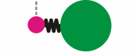

The Basic Equation
Vibrational modes within a molecule can be
described using the (an)harmonic oscillator model.
This model assumes that the two masses (with known weight) are connected with a spring (with known strength).
Using this model and the help of quantum mechanical calculations (Schrödinger equation), the frequencies of basic stretching and bending modes are obtained by
μ₁, μ₂ = masses of involved atoms, F=force constant
In chemistry, the modes are measured in wavenumber in units of “cm⁻¹” while engineers often use “μm” (4000 cm⁻¹ = 2.5 μm).
The range of interest for organic chemists is ν= 650-4000 cm⁻¹.

Slide 5
Number of Peaks
The number of fundamental stretching and bending modes (n=0 to n=1) expected for a molecule increases with the number of atoms
in the molecule (N=number of atoms):
  Non-linear molecules 3N-6 (2N-5 bending, N-1 stretching) vibrations are observed.
  Linear molecules, one expects to observe 3N-5 modes (2N-4 bending, N-1 stretching) because the rotation about the molecular axis cannot
  be observed.
  In addition, overtones (n=0 to n=2) (i.e., carbonyl overtones between 3300 and 3600 cm⁻¹) and combination overtones are observed in many spectra as well i.e., aromatic overtones between 1660 and 2000 cm⁻¹.
Thus, infrared spectroscopy is only used for small molecules because large, asymmetric molecules will display too many
peaks unless they are symmetric.

Slide 6
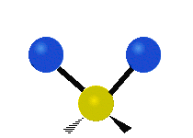
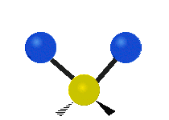
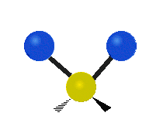


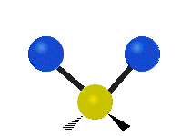


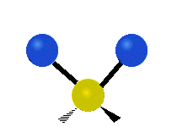

Fundamental Modes
Stretching mode
  The movement of the atoms is along the bond axis while bond angles remain (almost) constant.
Bending mode
  The movement of the atoms is perpendicular to the bond axis while bond distance remains constant.
Since bending modes require less energy than stretching modes, they are located in the middle and on the right hand side of the spectrum.
For the methylene group, there are two stretching and four bending modes observed.
symmetric asymmetric scissoring rocking twisting wagging
stretching stretching bending bending bending bending

Slide 7
Peak Intensity
A vibration will only be infrared active, if the dipole moment changes during the vibration because only then electromagnetic radiation can
be absorbed or emitted. The intensity of a peak is proportional to the
change of dipole moment (I² ~ dμ/dr).
  Thus, groups that already possess a significant dipole moment i.e., C-O, C=O, C=N, N=O, S=O, P=O, C-F, C-Cl, O-H, etc., usually show strong peaks in the infrared spectrum.
  Functional groups in which the atoms have a small difference in electronegativity i.e., C-H, C-C, C=C and C≡C, will usually show as
  weak or medium sized peaks in the infrared spectrum unless there are
  many groups of this type present which can overlap resulting in a higher peak intensity i.e., longer alkyl chain.
  The intensity of these weakly polar groups will also increase if a dipole moment is induced due to an asymmetric substitution (donor-C=C-acceptor, donor-C≡C-acceptor) i.e., RO-C≡C-COOR’

Slide 8
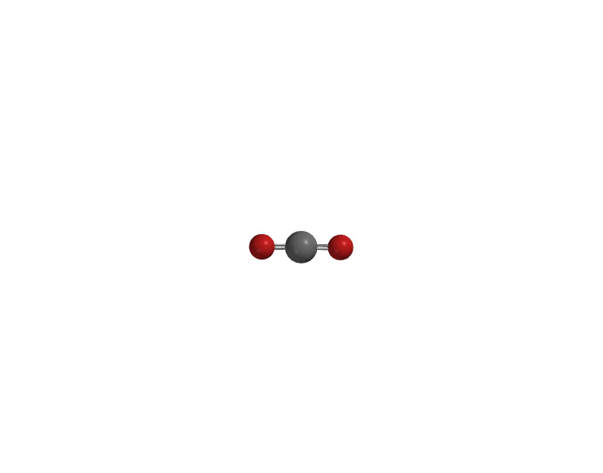
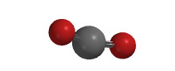
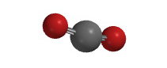
Carbon dioxide
Carbon dioxide (4 modes=3*N-5,N=3)
Most infrared spectra exhibit the “doublet” at ν~2350 cm⁻¹.
Nitrogen and oxygen do not appear in the infrared spectrum
because they do not have infrared active modes due to the
lack of a dipole moment.
Water does appear in the infrared spectrum because it possesses infrared active modes (ν_{s}=3657 cm⁻¹, ν_{as}=3756 cm⁻¹, δ=1595 cm⁻¹).
ν_{s}
Mode | Symbol | Infrared/Raman | ν(cm⁻¹)
Symmetric stretching | ν_{s} | Infrared inactive/Raman active | 1388, 1286
Asymmetric stretching | ν_{as} | Infrared active/Raman inactive | 2349
Deformation | δ | Infrared active/Raman inactive | 667
Deformation | δ | Infrared active/Raman inactive | 667
ν_{as}
δ
δ

Slide 9
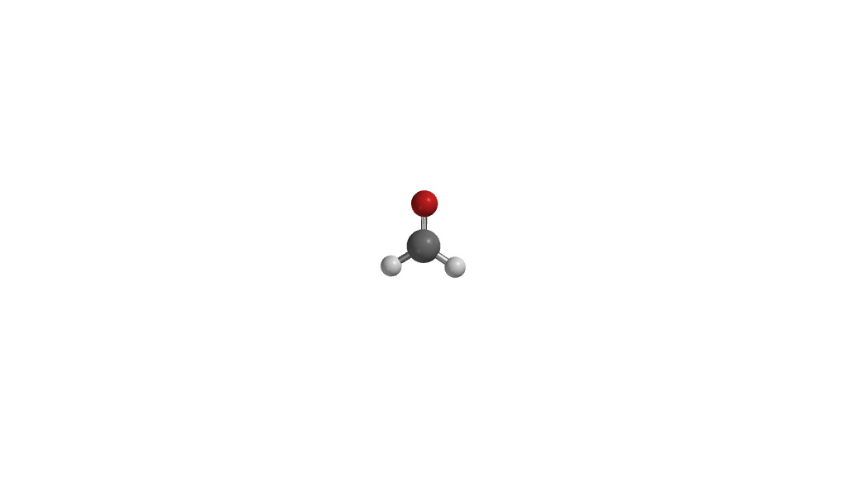
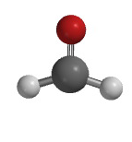
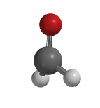
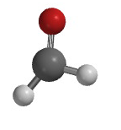
Formaldehyde
Formaldehyde has six fundamental modes since it is not linear (=3*N-6, N=4):
Note that all of these peaks are going to be infrared active!
Symmetric Asymmetric Carbonyl In-plane Out-of-plane Rocking
Stretching Stretching Stretching Bending Bending Bending
ν_{s}(CH₂) ν_{as}(CH₂) ν(CO) δ(CH₂) γ ρ(CH₂)
2766 cm⁻¹ 2843 cm⁻¹ 1746 cm⁻¹ 1501 cm⁻¹ 1167 cm⁻¹ 1247 cm⁻¹

Slide 10
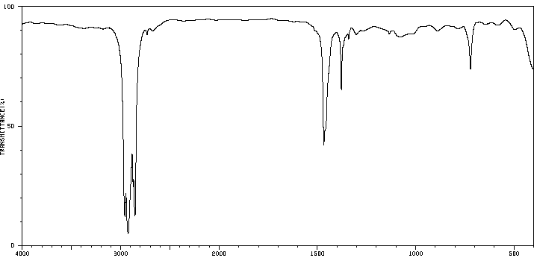
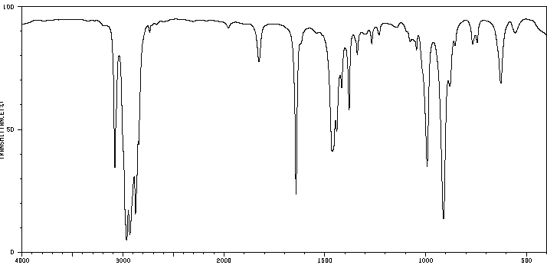
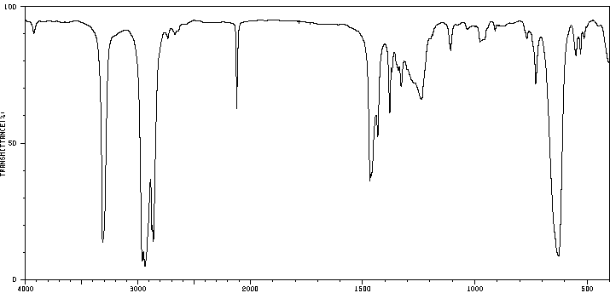
Zone I (C-H stretching)
3000 cm⁻¹
The C-H stretching modes can be found between 2780 and 3300 cm⁻¹, depending
on the type of hybridization:
  Alkanes (sp³(C-H)) : 2810-3000 cm⁻¹
  Alkenes or aromatic ring (sp²(C-H)): 3000-3150 cm⁻¹
  Terminal alkynes (sp(C-H)): 3300 cm⁻¹
The C-H bond distance decrease from
110 pm (sp³(C-H), 422 kJ/mol) over
108 pm (sp²(C-H), 464 kJ/mol) to
106 pm (sp(C-H), 556 kJ/mol) indicating an increase in bond strength.
The higher the s-character in the bond is, the stronger the bond is, because the electrons are closer to the nucleus.
sp³(C-H)
sp²(C-H)
sp³(C-H)
ν(C≡C)
sp(C-H)
sp³(C-H)

Slide 11
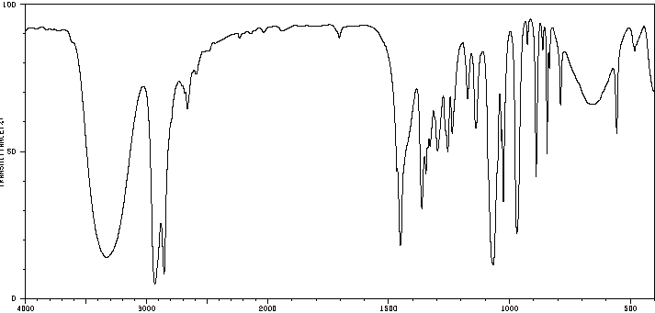
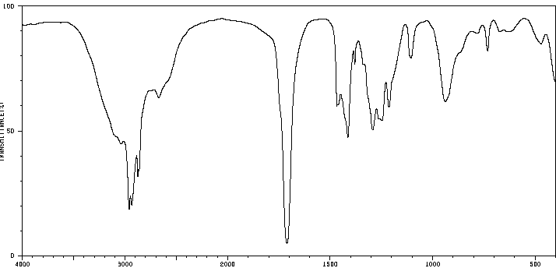
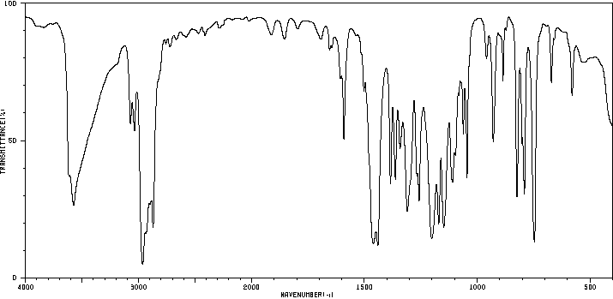
Zone I (O-H stretching)
3500 cm⁻¹
The O-H stretching modes of alcohols and phenols are mostly broad and very strong (3200-3650 cm⁻¹).
The O-H peaks that are due to carboxylic acid are usually much broader (between 2500 and 3500 cm⁻¹)
and also less intense.
The change in peak shape is a result of the different degree and nature of hydrogen bonds in alcohols, phenols and carboxylic acids, which often form
dimeric species.
Intramolecular hydrogen bonds to nitro or carbonyl functions shift the peak maximum to lower wavenumbers and lead to broadening i.e., nitrophenols: ortho: 3249 (m, broad), meta: 3393 (s) and para: 3331 (s) cm⁻¹
Phenols that possess two large (branched) alkyl groups in the ortho positions to the OH-function exhibit a sharp peak for the OH stretching mode that are located at very high wavenumbers (i.e., R=iso-C₃H₇: 3575 cm⁻¹) because of their reduced ability to form hydrogen bonds.

Slide 12
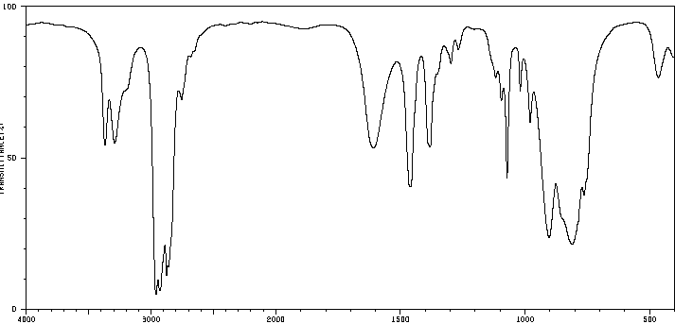
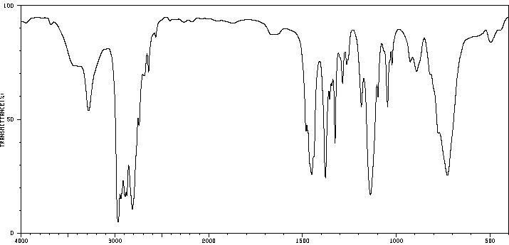
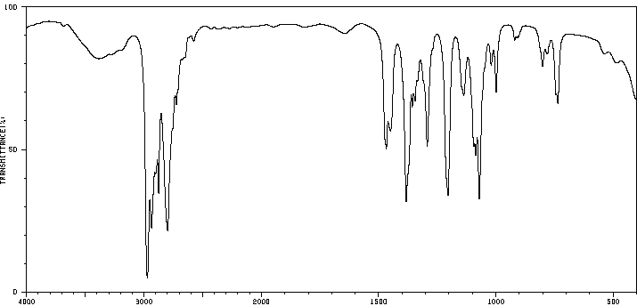
Zone I (N-H stretching)
Peaks that are due to N-H stretching modes fall in the same range (3300-3500 cm⁻¹) but are usually a little sharper than O-H peaks.
Because N-H functions are lower in polarity than O-H functions, less intense peaks are observed.
The bands due to N-H groups are less broad due to the lower tendency to form hydrogen bonding, which can also been seen in their lower boiling points compared to alcohols:
  Primary amines exhibit two peaks due
  to the presence of a symmetric and an asymmetric vibration mode in this range.
  Secondary amines show only one peak in this range.
  There are no peaks observed in this area for tertiary amines. Why?
ν(NH₂)
δ(NH₂)
ν(NH)
no ν(ΝΗ)

Slide 13
Zone III (C=O stretching)
This is considered the most important range of the entire infrared spectrum for organic chemists.
A very strong peak between 1630 and 1850 cm⁻¹ usually indicates
that a carbonyl function is present in the molecule.
Analysis of the exact peak position can reveal further details about
the type of carbonyl function present.
A good rule of thumb is that the more reactive the carbonyl compound is,
the further to the left (=higher wavenumber) the carbonyl stretching frequency will be. The following sequence is usually observed:

Slide 14
Zone III (C=O stretching)
Carbonyl functions
Carbonyl derivative | ν(C=O) (cm⁻¹) | Comment
acid chloride (RCOCl) | 1780-1820 (sat.) 1750-1780 (conj.)
anhydride (RCO)₂O | 1760 and ~1810 (sat.) | two peaks with varying intensity
ester (RCOOR’) | 1730-1750 (sat.) 1710-1730 (conj.) | two medium or strong peaks (1000 and 1300 cm⁻¹)
aldehyde (RCHO) | 1720-1740 (sat.) 1680-1705 (conj.) | two weak or medium peaks at 2750 and 2850 cm⁻¹
ketone (RCOR’) | 1705-1725 (sat.) 1665-1690 (conj.) | ν_{as}(CCC) at 1230-1300 cm⁻¹ (aromatic) ν_{as}(CCC) at 1100-1230 cm⁻¹ (alkyl)
carboxylic acid (RCOOH) | 1700-1725 (sat.) 1680-1700 (conj.) | broad peak between 2500 and 3500 cm⁻¹
amide (RCONRR’) | 1680-1715 (sat.) 1630-1680 (conj.) | additional peaks at 3300-3500 cm⁻¹ for prim. or sec. amides

Slide 15
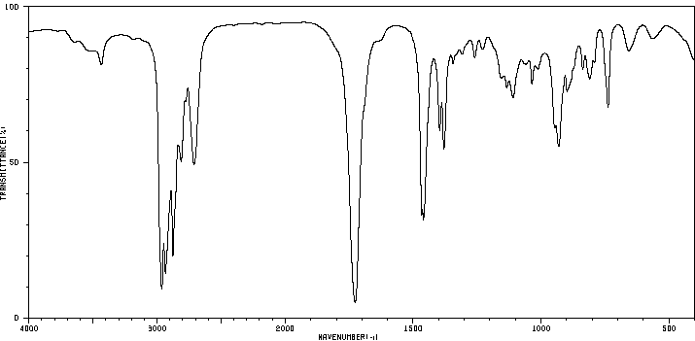
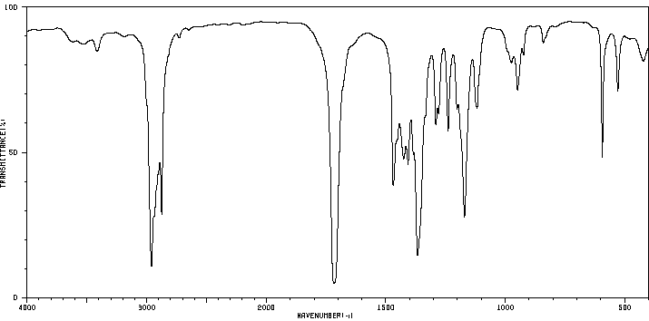
Aldehyde vs. Ketone
The carbonyl stretching frequencies for ketones and aldehydes fall into the same range.
One difference is the ν(CHO) doublet which is only found in aldehydes.
Aliphatic ketones display a ν_{as}(CCC) mode in the range of ν= 1140-1230 cm⁻¹.
ν_{as}(CCC)
ν(CHO)
ν(CO)
ν(CO)

Slide 16
Infrared Table I
Group | Type of Vibration | Frequency (cm⁻¹) | Intensity
C—H | Alkanes (stretch) | 3000-2850 | m-s
 | —CH₃ (bend) | 1450 and 1375 | m
 | —CH₂— (bend) | 1465 | m
 | Alkenes (stretch) | 3100‑3000 | w-m
 | (out-of-plane bend) | 700‑1000 | m-s
 | Aromatics (stretch) | 3150‑3050 | w-m
 | (out‑of‑plane bend) | 700-1000 | m-s
 | Alkyne (stretch) | ca. 3300 | s
 | Aldehyde | 2850‑2800 | w-m
 |  | 2750‑2700 | w-m
C=C | Alkene | 1680-1600 | m-w
 | Aromatic | 1600±20, 1500±20 | m-w
S-H | Thiols | 2550 | m
C≡C | Alkyne | 2250‑2100 | m-w
C≡N | Nitriles | 2260‑2240 | s
C=N | Imine | 1600-1650 | s

Slide 17
Infrared Table II
Group | Type of Vibration | Frequency (cm⁻¹) | Intensity
C=O | Aldehyde | 1740‑1690 | s
 | Ketone (acyclic) | 1750‑1680 | s
 | Carboxylic acid | 1780‑1700 | s
 | Ester | 1750‑1730 | s
 | Amide | 1700‑1640 | s
 | Anhydride | 1820-1740 | s
C—O | Alcohols, ethers, esters, | 1300-1000 | s
 | carboxylic acids
O—H | Alcohol, phenols
 | Free | 3650-3600 | m-s
 | H-Bonded | 3400-3200 | m-s
 | Carboxylic acids | 3300-2500 | m, broad
N—H | Primary and secondary amines | 3300-3500 | m
 | Primary Amine (bend) | ~1600 | m-s, br

Slide 18
Infrared Table III
Group | Type of Vibration | Frequency (cm⁻¹) | Intensity
N=O | Nitro (R—NO₂) | 1600‑1500 (asym) | s
 |  | 1400‑1300 (sym) | s
 |  | 600-630 (bend) | m
 | Nitroso (R-NO) | 1500-1600 | s
S=O | Sulfone (R-SO₂X) | 1300-1400 (asym) | s
 |  | 1140-1200 (sym) | s
 | Sulfoxide (RSOR) | 1050-1000 | s
P=O | Phosphorus oxides | 1210-1140 | s
C—X | Fluoride | 1250‑1000 | s
 | Chloride | 800‑600 | m-s
 | Bromide, iodide | < 600 | w-m

Slide 19
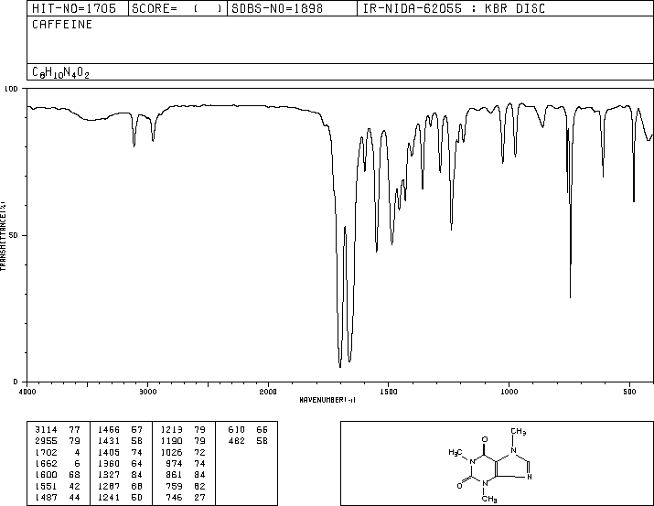
Caffeine
ν(CH, sp²)
ν(CH, sp³)
δ(CH₃)
ν(CO)

Slide 20
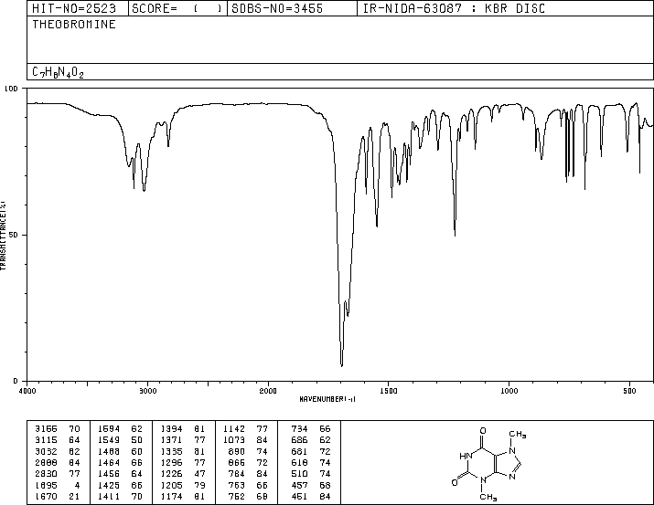
Theobromine
ν(NH)
ν(CH, sp³)
ν(CH, sp²)
δ(CH₃)
ν(CO)

