Slide 1
Lecture 3b
UV-Vis Spectroscopy

Slide 2
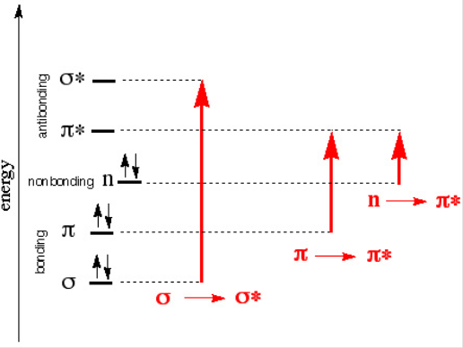
Electronic Transitions
Most molecules absorb electromagnetic radiation in the visible and/or the ultraviolet range.
The absorption of electromagnetic radiation causes electrons to
be excited, which results in a promotion from a bonding or non-bonding orbitals to an anti-bonding orbitals i.e., n-π*, π-π*.
The larger the energy gap is, the higher the frequency and the shorter the wavelength of the radiation required is (h= Planck’s constant).
Allowed transitions i.e., π-π* are usually
strong (large ε) while forbidden transitions
(low ε) i.e., n-π*are much weaker.
Many transition metal compounds are
colored because the d-d transitions fall in
the visible range (note that the d-orbitals
are not shown to keep the diagram simple).
h= 6.626*10⁻³⁴ J*s
c= 3.00*10⁸ m/s

Slide 3
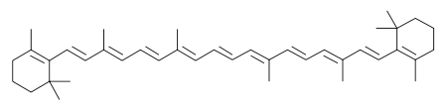
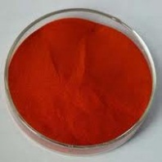
What determines the wavelength?
Compound | λ_{max}(nm) | ε(cm⁻¹*mol⁻¹*L) | Chromophore
1,4-Pentadiene | 178 | 26000 | isolated C=C
2-Pentanone | 180 | 900 | isolated C=O
β-Carotene | 480 | 133000 | conjugated C=C
3-Pentenone | 224 | 12590 | conjugated C=O
Acetophenone | 246 | 9800 | conjugated C=O
Most simple alkenes and ketones absorb in the UV-range because the π−π* and the n-π* energy gaps are quite large.
Conjugation causes a bathochromic shift (red shift).
Increased conjugation often also increases the peak size
as well (hyperchromic).

Slide 4
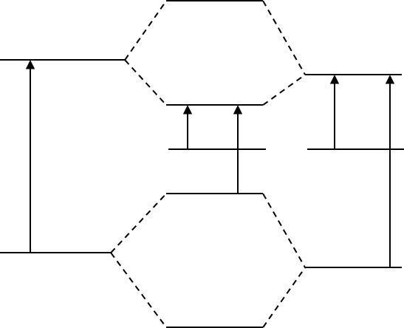
Conjugation
The π-π* energy gap in a C=C bond is fairly large.
The π-π* and the n-π* energy gap in a C=O bond are both
fairly large as well.
The combination of these two
groups affords a new orbital
set where n-π* and the π-π*
gaps are much smaller.
If less energy is required to
excite the electrons, a shift to
higher wavelengths for the
excitation will be observed
i.e., λ(n-π*) > λ(π-π*).
π∗
π∗
π∗
π∗
n
n
π
π
π
π
C=C
C=C-C=O
C=O

Slide 5


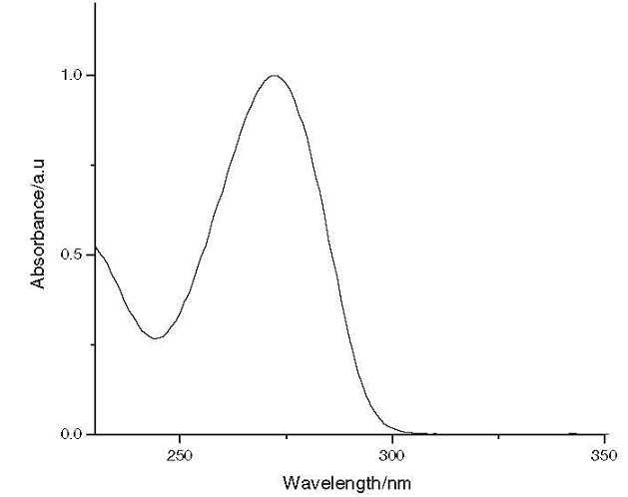
Caffeine Spectrum
Caffeine is aromatic because the partial double bond between the carbon atom of the carbonyl group and nitrogen atom.
UV-Vis spectrum in water shows one peak: 272 nm (8810 L/(mol*cm)).
UV-Vis can be used to determine the amount of caffeine in coffee beans (A. Belay et al. Food Chemistry 2008, 108, 310) and other caffeine containing beverages (i.e., cola).

Slide 6
Beer Lambert Law I
Fundamental law regarding absorbance of electromagnetic radiation.
The cell dimension (l) is usually 1 cm.
The ε-value is wavelength dependent  a spectrum is a plot of the
ε-values as the function of the wavelength.
The larger the ε-value is, the larger the peak is going to be.
The data given in the literature only list the wavelengths and ε-values (or its log value) of the peak maxima i.e., 331 (6460).
The desirable concentration of the sample is determined by the largest and smallest ε-values of the peaks in the spectral window to be measured.

Slide 7
Beer Lambert Law II
The absorbance readings for the sample have to be in the range from A_{min}=0.1 and A_{max}=1 in order to be reliable.
Concentration limitations are due:
  Association at higher concentrations (c>10⁻⁴ M)
  Linear response of the detector in the UV-spectrophotometer
Absorbance
1.0
Linear range
0.1
c_{min}
c_{max}
Concentration

Slide 8
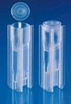
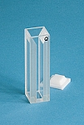
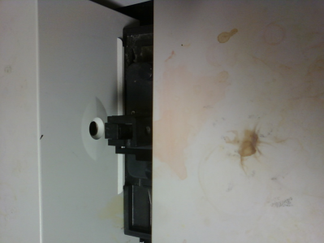
Practical Aspects of UV-Vis I
Cuvette
  It cannot absorb in the measurement window:
    Plastic cuvettes absorb more or less in the UV-range already.
    Most test tubes (borosilicates) start to absorb around 340 nm.
    Quartz cuvettes have a larger optical window, but are very expensive (~$100 each).
  It has to be stable towards the solvent and the compound:
    Most plastic cuvettes are etched or dissolved by low polarity solvents and can only be used with alcohols or water.
    Quartz cuvettes are stable when used with most organic solvents.
Polystyrene
Polymethacrylate
Quartz
front
Polyethylene
cuvette

Slide 9
Practical Aspects of UV-Vis II
Solvent
Hydrocarbons and alcohols possess the largest optical windows.
Note that “spectrograde” solvents should be used whenever
possible because many non-spectrograde solvents contain
additives i.e., 95 % ethanol contains aromatics that are active
in the UV range!
Solvent | Lower limit (λ in nm) | Absorbance for l=1 cm
Acetone | 330 | 335 (0.30), 340 (0.08), 350 (0.003)
Acetonitrile | 190 | 200 (0.10), 210 (0.046), 230 (0.009)
Chloroform | 265 | 250 (0.40), 260 (0.05), 270 (0.006)
Cyclohexane | 210 | 210 (0.70), 220 (0.32), 230 (0.11), 240 (0.04)
Dichloromethane | 235 | 230 (1.30), 240 (0.15), 250 (0.02)
Ethanol (abs.) | 210 | 210 (0.70), 220 (0.4), 240 (0.1), 260 (0.009)
Hexane | 210 | 210 (0.30), 220 (0.1), 230 (0.03), 240 (0.016)
Methanol | 210 | 220 (0.22), 230 (0.1), 240 (0.046), 250 (0.02)
Water | 191

Slide 10
Practical Aspects of UV-Vis III
Important Pointers
  Since most measurements require a serial dilution, it is imperative that the entire compound is dissolved when preparing the stock solution.
  For the calculation of the new concentration, the student needs to keep in mind that the total volume is important
  i.e., if 1 mL of the stock solution was used and 9 mL of additional solvent, the concentration is one tenth of the original concentration.
  The student is supposed to run a full spectrum, which requires the software to be set to “spectrum” mode and
  not to “fixed wavelength” mode (see pop down window
  in the upper left hand corner).

Slide 11
Example I
Problem: A compound displays two absorptions in the UV-Vis range, at 280 (20000) and 450 (3000). Which concentration(s) are appropriate to measure the range from 200-750 nm?
Solution: The maximum concentration is given assuming a cell length of 1 cm and A_{max}= 1.0
  C_{max}=1/(20000*1 cm)= 5.00*10⁻⁵ M
  Using this concentration, the second peak displays
  an absorbance of A₄₅₀= 5.00*10⁻⁵ M * 3000= 0.150
  which is above the lower limit of A_{min}=0.100

Slide 12
Example I
Question: How can the transitions in the example be assigned? Which color does this compound display?
Answer: The transition at λ=280 nm is most likely a π-π* transition, while the peak at λ=450 nm is due to a n-π* transition. This means that the compound most likely contains a highly conjugated carbonyl function.
The compound is dark-orange in color.

