Slide 1
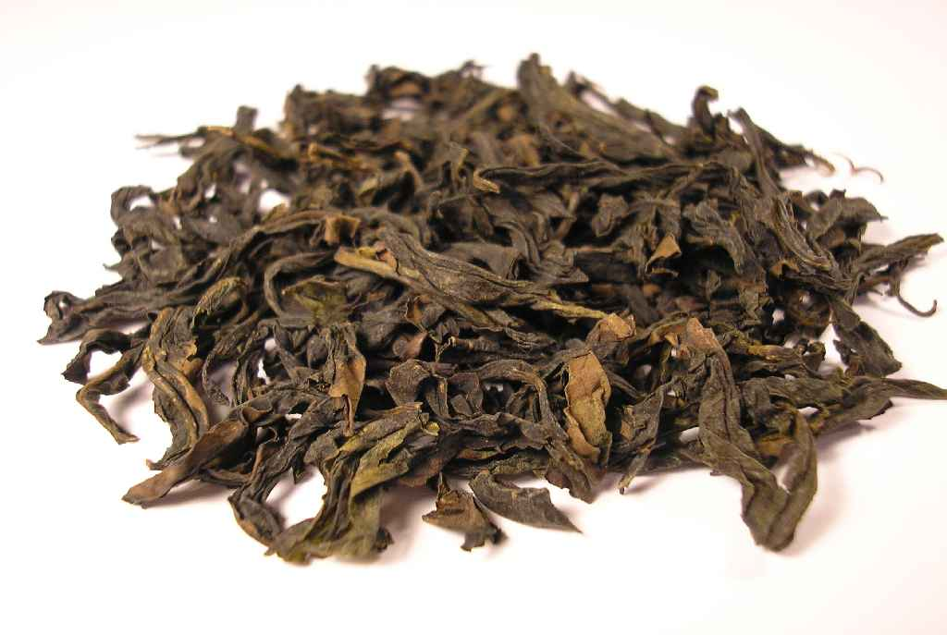
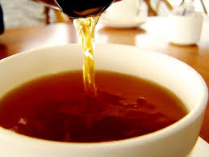
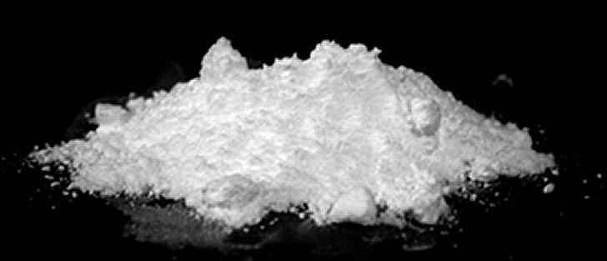
Lecture 3a
Extraction of Caffeine from Tea Leaves

Slide 2
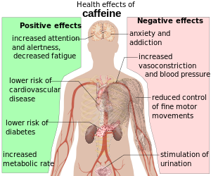
Caffeine - Background
Caffeine is a naturally occurring alkaloid that belongs to a class of compounds called xanthines.
It is found in varying quantities in the seeds, leaves, and fruits of some plants.
It is the world’s most widely consumed psychoactive drug.
In humans, caffeine acts as a central nervous system stimulant, temporarily warding off drowsiness and restoring alertness.
It acts as a natural pesticide that paralyzes and kills certain insects feeding on the plants, as well as enhancing the reward memory of pollinators.
Caffeine was first isolated by F. Runge in 1819 from coffee as “Kaffebase”.
H. E. Fischer first synthesized caffeine in 1895.
Reference: http://www.caffeineinformer.com/
Drink | mg/fl oz
Coffee Brewed | 20
Tea (black) | 5.2
Tea (green) | 3.1
Expresso | 51
Coca-Cola | 2.8
Red Bull | 9.5
5 Hour Energy, Rockstar | 100

Slide 3
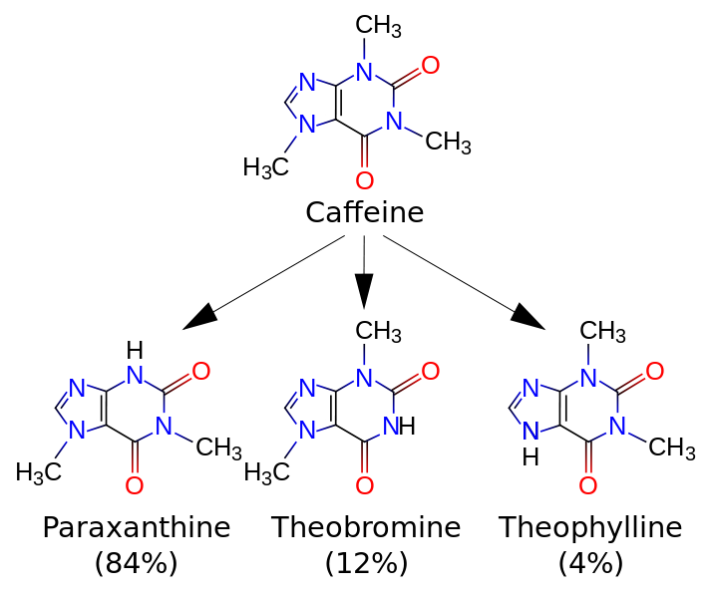
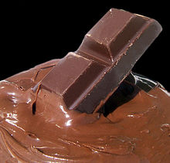
Caffeine - Metabolism
Caffeine (1,3,7-trimethylpurine-2,6-dione) is metabolized in the liver by cytochrome P450 oxidase, which causes a demethylation in different positions:
Principal alkaloid in cocoa bean

Slide 4
Extraction I
Extraction is a very commonly used technique in organic chemistry, which involves the selective isolation of products from mixtures of substances.
The most common type of extraction in chemistry is liquid-liquid extraction that is often based on acid-base chemistry to change the solubility of the compound.
The solute is extracted from one solvent into the other because the solute is (usually) more soluble in the second solvent than in the first.
It is one way to facilitate the isolation of the target compound:
Extraction: aims at the target compound
Washing: removes impurities from the organic layer

Slide 5
Extraction II
If an organic compound is extracted from an aqueous layer or a solid, the chosen solvent has to meet certain requirements for an efficient extraction:
The target compound should dissolve very well in the solvent at room temperature (“like dissolves like” rule applies)  a large difference in solubility leads to a large value for the partition coefficient (also called distribution coefficient), which is important for an efficient extraction.
The solvent should not or only slightly be miscible with “aqueous phase” to be extracted.
The solvent should have a low or moderately low boiling point for easy removal at a later stage of the product isolation.

Slide 6
Distribution Coefficient I
The extraction process can be quantified using the partition coefficient K (also called distribution coefficient):
Using this partition coefficient, one could determine how much of the compound is extracted in each extraction or after n extractions:
K = Partition coefficient or distribution coefficient
V₁ = Volume of the organic layer in each extraction
V₂ = Original volume of water
n = number of extractions
W_{o} = Initial mass of solute

Slide 7
Distribution Coefficient II
The larger the K-value, the more efficient the extraction
For K=10, two extractions are sufficient to extract about 99.6 %.
For K=3, four extractions are required to accomplish the same degree of the extraction.

Slide 8
Distribution Coefficient III
Partition coefficients are defined in different solvent systems i.e., log K_{ow}, also called log P, which quantifies the distribution of a compound between octanol and water.
$logKow=log⁡(\frac{Coctanol}{cwater}$)
A negative value implies that the compound is polar and dissolves better in water than in octanol.
Log K_{ow}-values are used to characterize the polarity of organic compounds like drugs i.e., caffeine (-0.07), acetaminophen (0.27), lidocaine (2.44), ibuprofen (3.79).
Compound | Log K_{ow} | Water solubility at 20 ºC
Benzoic acid | 1.90 | Poorly (3 g/L)
Sodium benzoate | -2.27 | Highly (556 g/L)
Phenol | 1.46 | Soluble (83 g/L)
Sodium phenolate | -1.17 | Highly (530 g/L)
Triethylamine | 1.45 | Soluble (130 g/L)
Triethylammonium chloride | -1.26 | Highly (1370 g/L)

Slide 9
Solvent Choice
Solubility issue (water=W, solvent=S)
The higher the dielectric constant (ε) of a compound (solvent) is the more soluble it is in water according to the “like-dissolves-like” rule.
The miscibility of solvents can be reduced by changing the polarity of the liquid phase.
Solvent | ε | Log K_{ow} | S in W | W in S | Flammable | Density
Chloroform | 1.5 | 1.97 | 0.8 % | 0.056 % | NO | 1.48 g/cm³
Dichloromethane | 8.9 | 1.25 | 1.3 % | 0.25 % | NO | 1.33 g/cm³
Diethyl ether | 4.3 | 0.89 | 6.9 % | 1.4 % | YES | 0.71 g/cm³
Ethyl acetate | 6.1 | 0.73 | 8.1 % | 3.0 % | YES | 0.90 g/cm³
Hexane | 1.9 | 3.90 | ~0 % | ~0 % | YES | 0.66 g/cm³
1-Propanol | 20.8 | 0.25 | ∞ | ∞ | YES | 0.80 g/cm³
Acetone | 21.0 | -0.24 | ∞ | ∞ | YES | 0.79 g/cm³

Slide 10
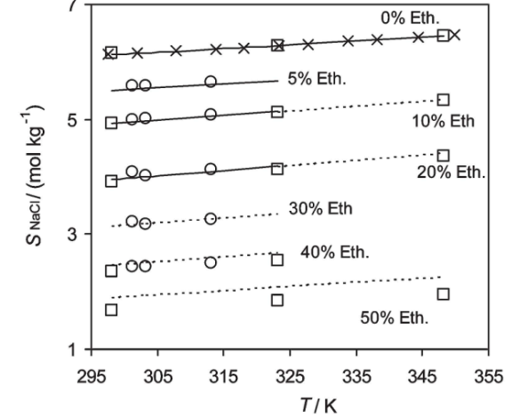
Salting Out
The addition of a salt increases the polarity of the aqueous layer:
It causes a decreased solubility of many organic compounds that are usually lower in polarity.
It “forces” the organic compound into the organic layer, thus increases the partition coefficient.
A solid will precipitate out while a liquid will become immiscible.
The addition of a lower polarity solvent to an aqueous layer will reduce the overall polarity of the solution:
It causes polar compounds like salts to precipitate from solution.
The solubility of sodium chloride in water will decrease if the ethanol is added to the solution.

Slide 11
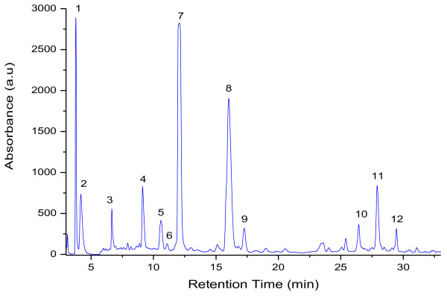
Green Tea Extract
Below is the HPLC of a Green Tea Extract
Column: C18-column
Flow rate: 0.5 mL/min
Mobile Phase: Gradient of 1 % formic acid in water (A) and acetonitrile (B) (A gradient run was started at 90 % gradient A, decreasing in 30 min to 75 %, further decreasing to 10 % in 5 min and then back to 90 % in 10 min)
Peak | R_{t}(min) | [M + H]⁺ (m/z) | Compound | Concentration mg/ml
1 | 3.77 | 335 | Galloylquinic acid | 6.18
2 | 4.17 | 171 | Gallic acid | 0.59
3 | 6.66 | 307 | Gallocatechin | 4.5
4 | 9.13 | 307 | Epigallocatechin | 7.13
5 | 10.60 | 340 | Dicaffeic acid | 0.32
6 | 11.09 | 291 | Catechin | 1.59
7 | 12.08 | 195 | Caffeine | 19.16
8 | 16.02 | 291 | Epicatechin | 3.34
9 | 17.26 | 459 | Epigallocatechingalate | 53.18
10 | 26.42 | 304 | Ellagic acid | 0.82
11 | 27.91 | 443 | Catechingallate | 3.29
12 | 29.45 | 466 | Quercetin glucoside | 0.35

Slide 12
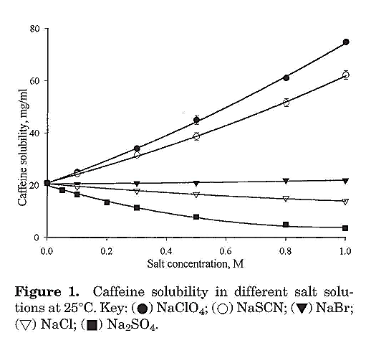
Caffeine Solubility
The solubility of caffeine differs greatly from solvent to solvent:
The solubility of caffeine changes a lot in water, being poor in cold water and very high at high temperatures.
The solubility is poorer in most organic solvents (i.e., ethanol, acetone, diethyl ether).
The addition of sodium chloride decreases the solubility by a factor 1.5 pro molarity of sodium chloride.
The addition of sodium sulfate would decrease the solubility of caffeine significantly more but it cannot be used because calcium ions are added afterwards leading to the formation of CaSO₄.
Solvent | Temperature | g/L
Water | 25 | 21
 | 80 | 200
 | 100 | 666
Ethanol | 25 | 15
 | 78 | 32
Acetone | 30 | 22
Diethyl ether | 25 | 1.9

Slide 13
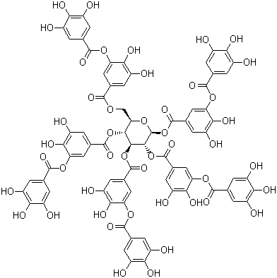
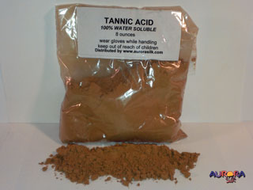
Tannic Acid
Tannic acid is very soluble in water (2850 g/L). Why?
The presence of tannins in the bark of redwood (Sequoia) is a strong natural defense against wildfire, decomposition and infestation by certain insects such as termites.
It is found in the seeds, bark, cones and heartwood.
The commercial tannic acid is a decagalloyl glucose.

Slide 14
Important Points
The caffeine is separated from the rest of the tea ingredients by several extraction steps.
The first step is a solid-liquid extraction using hot water (“brewing”).
In the liquid-liquid extraction, the aqueous layer that has been saturated with sodium chloride is extracted with propanol:
Normally, propanol-water mixtures are completely miscible.
Propanol-salt water mixtures are poorly miscible with the organic layer containing a large amount of water (~20 %).
The addition of the sodium chloride increases the polarity of the aqueous later, which reduces the solubility of the caffeine and 1-propanol in the aqueous layer.
Caffeine is better soluble in propanol than in the salt water solution resulting is a larger distribution coefficient (K=3.7).

Slide 15
Procedure I
Place two bags in hot water
Allow the solution to cool down
Add solid sodium chloride to the solution
Add solid Ca(OH)₂
Remove the precipitate by vacuum filtration
What is the purpose?
Why is sodium chloride added?
Why is calcium hydroxide added?
What is the best way of doing this?
Extraction of all the water-soluble components of the tea (peptides, sugars, tannins, pigments)
It increases the polarity of the solution but keeps the caffeine in solution
It causes the tannic acid and other colored impurities to precipitate as calcium salts
The liquid is decanted first before the solid is transferred into the funnel

Slide 16
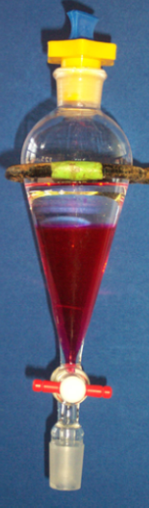
Procedure II
Extract the caffeine into 1-propanol
Separate the two layers using a separatory funnel
Add anhydrous sodium sulfate to organic layer
Remove the anhydrous sodium sulfate
Wash the solid with a small amount of 1-propanol
Which layer contains the caffeine?
What is the student looking for here?
How is accomplished?
Why is this step necessary?
Why is the drying agent removed?
The organic layer=top layer
1. Some free flowing drying agent
2. A transparent solution
By decanting or using a pipette to transfer the solution
To recover some of the absorbed product
1. The drying process is reversible
2. The product and the drying agents are both white solids which makes it impossible to separate them later!

Slide 17
Procedure III
Place the solution in a beaker of appropriate size on the hot plate, add a boiling stick and evaporate the propanol carefully
Add acetone to remaining solid
Remove the liquid (E1)
Repeat the extraction step (E2)
Remove the solvent from the combined organic layers (E1+E2) like before
The dry product is collected and stored in a closed vial
The sublimation of the product is skipped
Why is a boiling stick added here?
Careful: Propanol is flammable!
Caffeine will dissolve in acetone while any sodium chloride will remain undissolved
Careful: Acetone is flammable!
To allow for a smoother boiling without bumping

