Slide 1
Lecture 2b
Beer’s Lambert Law

Slide 2
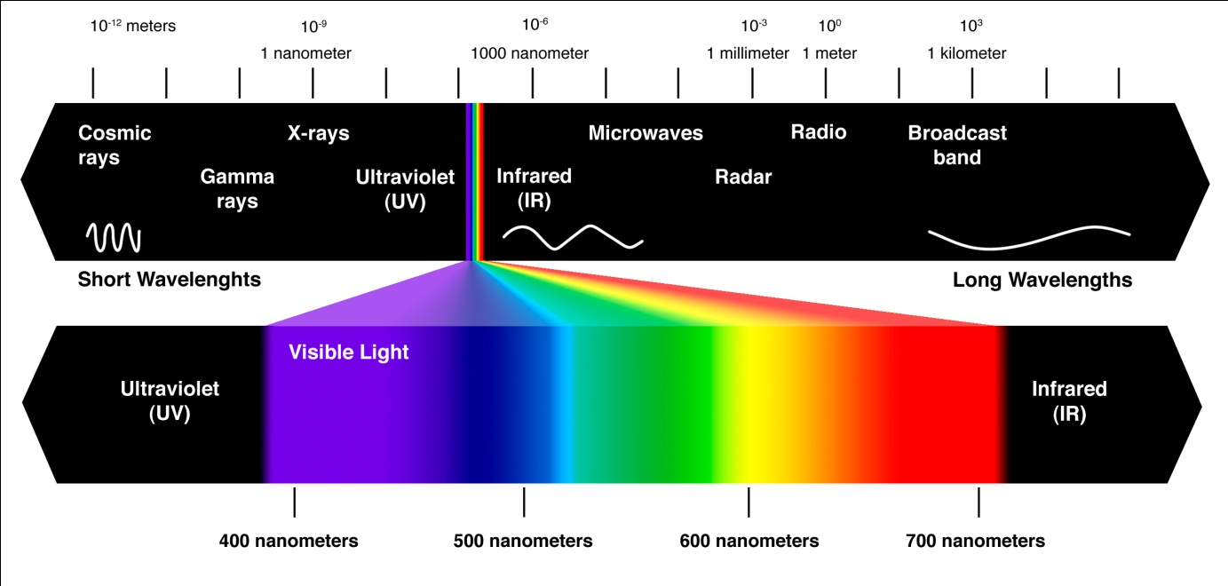
Electromagnetic Spectrum
Electromagnetic Spectrum
Visible range: λ=380-750 nm
Ultraviolet: λ=190-380 nm
High energy
Low energy

Slide 3
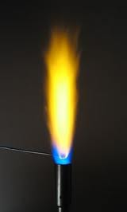
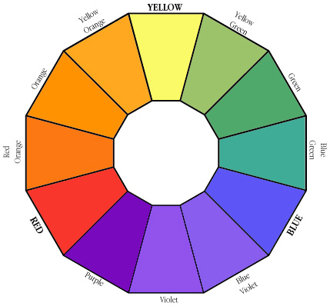
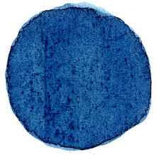
Emission vs. Absorption
When determining a color, one has to know if the process
that causes the color is due to emission or due to absorption
of electromagnetic radiation.
Example 1: Sodium atoms emit light at λ=589 nm
resulting in a yellow-orange flame.
Example 2: Indigo absorbs light at λ=605 nm that |
is in the orange range  the compound assumes
the complementary color (blue-purple)

Slide 4
Beer’s Law
Fundamental law regarding absorbance of electromagnetic radiation:
The cell dimension (l) is usually 1 cm (for standard cuvettes).
The ε-value is wavelength dependent. Thus, a spectrum is a plot of
the ε-values as the function of the wavelength (unit for ε: M⁻¹*cm⁻¹).
The larger the ε-value is, the larger the peak is going to be.
The data given in the literature only list the wavelengths and ε-values (or its log value) of the peak maxima i.e., 331 (6460 or 3.81).
The desirable concentration of the sample is determined by the
largest and smallest ε-values of the peaks in the spectral window
to be measured.

Slide 5
Practical Aspects
The absorbance readings for the sample have to be in the range from A_{min}=0.1 and A_{max}=1 in order to be reliable.
Concentration limitations are due:
  Association at higher concentrations (c>10⁻⁴ M)
  Linear response of the detector in the UV-spectrophotometer
Absorbance
1.0
Linear range for absorbance
0.1
c_{min}
c_{max}
Concentration
Linear concentration range

Slide 6
Iron Determination I
The reaction of Fe²⁺-ions with bipyridyl (2,2’-bipyridine) leads to the
red-violet complex.
The complex is chiral and consists of equal amounts of the Δ- and Λ-isomer.
Note that only Fe²⁺-ions form the complex but not Fe³⁺-ions (λ=620 nm, ε=220). Thus, any Fe³⁺-ions have to be reduced first (with ascorbic acid) prior to the measurement.
The absorbance of the sample (via the transmission) at the wavelength of λ=520 nm (ε= ~8660) can be used to determine the concentration of the Fe²⁺-ions in solution.

Slide 7
Iron Determination II
However, the proper response has to determined first by using standards to establish a calibration curve:
  The student prepares several Fe²⁺- solution with known concentration and obtains the absorbance readings for the Fe²⁺-complex.
  It is important to blank the spectrophotometer before each measurement (Why?).
  The slope of the best-fit line (Absorbance vs. concentration) should be close to the molar extinction coefficient.

