Slide 1
Lecture 9b
Gas Chromatography

Slide 2
Introduction
Gas chromatography is used in many research labs, industrial labs (quality control), forensic (arson and drug analysis, toxicology, etc.), environmental labs (water, soil, air), and even in the popular TV culture (crime shows like NCIS (Major Mass Spec), CSI, etc.).
  Used for the quantitation of compounds.
  Often combined with a mass spectrometer for identification.
Traditional equipment requires the use of compounds that are stable enough to be vaporized without decomposition.
  Mainly useful for small or non-polar molecules.
  Not useful for large molecules i.e., proteins, polymers, etc.
  Sometimes polar molecules can be converted into derivatives by
  using i.e., trifluoromethyl groups to make them more volatile.

Slide 3
Basic Setup
Parts: Injection block, column, oven, detector, carrier gas, printer
The temperature of the injection block has to be above 200 ºC to ensure
a rapid evaporation of the injected sample.
The temperature of the detector has to be 20-30 ºC above the final column temperature to prevent condensation of the compounds.

Slide 4
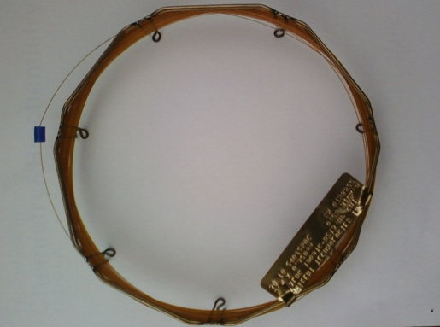
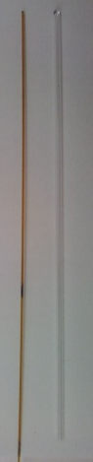
Theory of Gas Chromatography I
Like in many chromatographic techniques, the separation of compounds
in a mixture is based on different polarities in a direct (interaction with stationary phase) or indirect way (physical properties i.e., boiling point).
The gas chromatography column consists of solid support that is covered with a high-boiling liquid in a thin capillary tube.
In the example above, compound “X” has a higher
affinity towards the stationary phase compared to
compound “O”.
Compound “O” elutes before compound “X” off
the column because of the weaker interaction with
the stationary phase.
‖
O X
time

Slide 5
Theory of Gas Chromatography II
What influences the outcome in the gas chromatography run?
  The vapor pressure of the compound
    The higher the boiling point is, the lower the vapor pressure of the compound is and the slower the compound is going to migrate through the column resulting in a longer retention time.
  The polarity of the compound compared to the polarity of
  the column
    The more the polarities are alike, the stronger the interaction of the compound with the stationary phase is going to be, which increases
    the retention time particularly for more polar compounds.
  The column temperature
    A lower temperature allows for more interaction of the compound with the stationary phase, thus longer retention times with better separation will be observed.

Slide 6
Theory of Gas chromatography III
  Carrier gas flow rate
    A higher flow rate allows for less interaction with the stationary phase, thus shorter retention times with poorer separation will be observed.
  Column length
    A longer retention time with better separation will be observed but also peak broadening due to increased longitudinal diffusion.
  Amount of the material injected
    If too much material is injected, close peaks will overlap, which makes the identification (i.e., mass spectrometry) and quantitation more difficult if not impossible.
  The conditions have to be adjusted for each separation problem which will be very difficult if the compounds
  to be separated have similar very properties. The goal
  is to optimize the separation and the retention time.

Slide 7
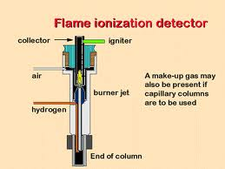
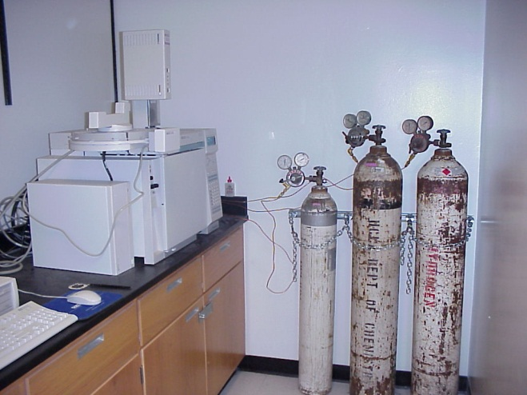
Detectors I
FID (Flame Ionization Detector)
  Advantages:
    It is very sensitive for most organic compounds (1 pg/s)
    Low sensitivity for small molecules i.e., N₂, CO, CO₂, H₂O
  Disadvantages:
    The sample is destroyed ☹
    It requires three gases (carrier gas (i.e., helium, argon, nitrogen), hydrogen and air/oxygen)

Slide 8
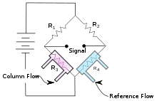
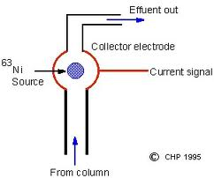
Detectors II
TCD (Thermal Conductivity Detector)
  Advantages:
    The sample is not destroyed and can be
    collected after passing through the column.
    Only one gas with a high thermal conductivity
    needed i.e., helium, hydrogen.
  Disadvantages:
    The method possesses a significantly lower sensitivity compared to FID.
ECD (Electron Capture Detector)
  Advantages:
    It is very sensitive for chlorinated compounds
    i.e., TCDD, PCB, etc.
  Disadvantages:
    It requires a radioactive source and special license
    to operate these sources! ☹
    Several carrier gases needed for the ionization
    i.e., argon/methane.

Slide 9
Sample Identification
Mass spectrometer
Spiking: the sample is run with and without the addition of a spike, which is an authentic sample of compound to be identified.
Original spectrum
Spike B added
If compound A was added as the spike, peak A would increase in area.
If the spike was not a compound in the mixture, an additional peak would be observed.
This method is semi-quantitative.
A
B

Slide 10
Experiment
In this week lab, after distillation, the teaching assistant will inject ~ 1 µl into the GC (Not more than that because it will overload the GC and render it useless!)
The period following injection that is required for a compound to pass through
the column is called the retention time.
The GC will separate the two liquids and the computer attached to the GC plots
the peak(s) for each liquid.
A typical gas chromatogram looks like shown below.
The area under a gas chromatograph peak is proportional to the amount (moles)
of the compound eluted. Hence, the molar percentage composition of a mixture
can be approximated by comparing relative peak areas.
The simplest method of measuring the area of a peak is by geometrical approximation using a triangle.
  Approximate area = h*w_{½}
Where, h is the height of the peak above
the base line and w_{½} is the width of the
peak at half of its height.

