Slide 1
Lecture 8a
Oxidation of (-)-Borneol to (-)-Camphor

Slide 2
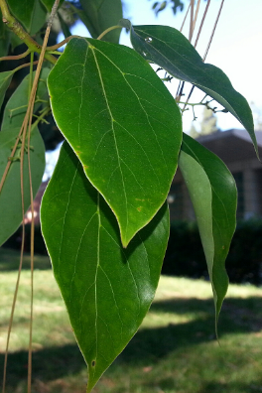
Introduction
Camphor is a terpenoid that can be isolated from camphor laurel (picture on the right shows the leaves of a tree on Gayley Avenue), the kapur
tree, camphor basil or rosemary leaves.
In biosynthesis, it is obtained from geranyl pyrophosphate via cyclization. The hydrolysis
of bornyl pyrophosphate and the oxidation of borneol affords D-(+)-camphor.
Industrially, it can be obtained from α-pinene
by two rearrangements reactions. The hydrolysis
of the isobornyl acetate leads to borneol that is oxidized to form racemic camphor.

Slide 3
Oxidation in Organic Chemistry
The following experiment illustrates the oxidation of a secondary alcohol to a ketone.
This could be accomplished using different oxidants, i.e., oxone (KHSO₅), dichromate, PCC, oxalyl chloride/DMSO (Swern oxidation).
In this course, hypochlorous acid (HOCl) is used.
It obtained from the reaction of hypochlorite (from bleach) and acetic acid.
  OCl⁻ + CH₃COOH HOCl + CH₃COO⁻

Slide 4
Oxidation of (-)-Borneol
The oxidation of (-)-borneol with hypochlorous acid results in the formation of (-)-camphor.
The crude product is purified by sublimation.

Slide 5
Experimental I
Dissolve (-)-borneol in glacial acetic acid in a
25 mL Erlenmeyer flask with swirling at room temperature
Add fresh household bleach solution in one batch with swirling
The solution will become noticeably warm and the product will precipitate.
Why do we use such a small flask?
What is household bleach?
Why does the reaction warm up?
Handling small amount of material
Bleach is a solution of 5.25 % NaOCl
(0.7 M NaOCl)
The reaction itself is exothermic

Slide 6
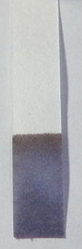
Experimental II
Over the next 15 minutes swirl the mixture occasionally
Test the sample after
10 minutes by placing a drop on wet potassium iodide-starch paper.
Dilute the reaction mixture with water and transfer it to a separatory funnel with the help of some diethyl ether.
A blue color indicates excess hypochlorite because an triiodide-starch complex was formed.
If the test is negative, add a small amount (~0.5 mL) of additional hypochlorite solution and swirl. After 5 minutes, test again.

Slide 7
Experimental III
Add some saturated sodium bisulfite solution and shake the mixture for at least
20 seconds before draining
the lower layer.
Wash the organic layer with
about 8 mL of saturated sodium bicarbonate solution. Make sure to vent frequently.
What does the bisulfite do?
Why is it important to vent frequently?
Make sure that the aqueous layer is basic. If neutral or acidic, this step has to be repeated with sodium bicarbonate solution.
It reduces the excess of the
hypochlorous acid.
The reaction of the acetic acid with the bicarbonate results in the formation of carbon dioxide.

Slide 8
Experimental IV
Drain off the lower aqueous layer, and transfer the organic layer to a small, dry Erlenmeyer flask.
Rinse the separatory funnel with some diethyl ether.
Dry the combined organic solutions over a small amount of anhydrous sodium sulfate (Na₂SO₄).
How is this done?
How do we know that the solution is dry?
By removing the plug on the
top and open the stopcock on
the bottom
1. Some free flowing drying agent
2. A transparent solution

Slide 9
Experimental V
Clean your filter flask if necessary with a small amount of acetone. Do not clean it with water. Make sure the filter flask is dry and clean before you transfer the dried organic layer to it.
Pre-weigh the flask
Decant the dry organic layer from the drying agent directly into the clean, filter flask. You will use the same filter flask for the sublimation in the next step of the assignment.
There are two procedures for evaporating the diethyl ether without losing the product work well.
Why not cleaning with water?
Why do we pre-weight the flask?
.
Consult the teaching assistant as to which one you should use.
The flask has to be very dry.
It will be easier to determine the crude
yield of camphor. Be sure to record this
weight in your notebook
Either vacuum or air stream

Slide 10
Experimental VI
Using a small spatula, consolidate the crude in the center of the filter flask so that it will be just underneath the cold-finger test tube (see diagram).
Attach the test tube cold finger and tightly position it in the neck of the flask. Do not place water in the tube, yet. Position the bottom of the test tube 0.5-1 cm above the crude product minimizing the gap but not touching the crude.
Wrap a piece of aluminum foil around the side of the flask leaving an opening at the front so that you can watch the progress of the sublimation.
This will minimize the amount of product that sublimes on to the sides of the flask.
Place a small amount of crude in a vial for reserve in case no product is isolated after the sublimation.

Slide 11
Experimental VII
Place the sublimation setup on a hot plate and turn the heat on low (1-2). Heat the flask only very gently.
Place the ice in the test tube being careful to not let any water run down the outside of the tube and into the flask.
Carefully remove the cold finger and quickly scrape the sublimed product onto a weighing paper, watch glass or pre-weighed vial.
Determine the yield of the sublimed product.
Save the sublimed product in a vial.
Why do we use such a low setting?
Why do we not have water in the system?
Camphor is very volatile. Higher
temperatures make it difficult
to deposit.
Any water that runs down the cold-finger
make the product wet and can cause the
filter flask to crack.

Slide 12
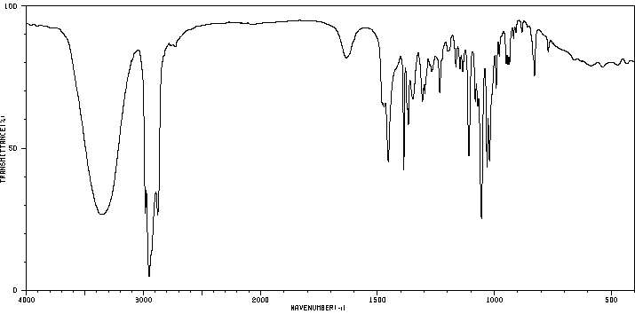
Characterization I
Borneol (KBr)
  ν(OH)=3200-3400 cm⁻¹
  ν(C-OH)=1055 cm⁻¹
  (strong)
Camphor (KBr)
  ν(C=O)=1744 cm⁻¹
ν(OH)
ν(C-OH)
ν(C=O)

