Slide 1
Lecture 7a
Chromatography I

Slide 2
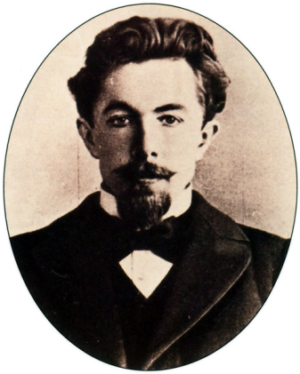
Introduction
Chromatography was discovered by Russian
botanist Mikhail Semyonovich Tsvett, who
separated plant pigments using calcium
carbonate columns (1901)
Martin and Synge (NP 1952) established many
of the basic techniques in partition chromatography i.e., paper chromatography, gas chromatography, HPLC, etc.

Slide 3
Introduction
Chromatography is used in the separation and purification of smaller quantities whereas distillation and recrystallization is used for large scale separations and purifications:
  The sample is (completely) adsorbed on the stationary phase before the mobile phase (the solvent) moves across the stationary phase.
  The strength of interaction of the compound with the stationary phase,
  the solubility of the compound in the mobile phase as well as the eluting power of the mobile phase will dictate the degree of migration and the quality of separation.
  The separation of compounds in a mixture is based on the different affinities for the stationary phase and the mobile phase. Thus, each compound has a different partition coefficient between these two phases.
  The higher the affinity of the compound towards the stationary phase
  and the lower affinity for the mobile phase (=solubility), the less the compound will migrate resulting in a later elution from the stationary phase (CC) or lower R_{f}-value (in TLC).

Slide 4
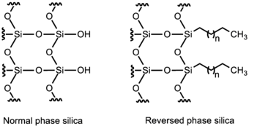
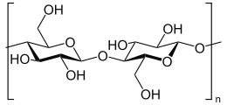
Stationary Phase I
Commonly used are silica, alumina, cellulose (i.e., paper chromatography), etc.
These stationary phases are considered polar because of the presence of hydroxyl groups on the surface.
They can be modified by attaching non-polar groups to the hydroxyl functions i.e., long hydrocarbon chains (C8, C18).
Silica coated TLC plates are primarily used in organic labs because most
of the compounds analyzed in the lab are (weakly) polar due to the presence of carbonyl groups, hydroxyl functions, etc.
The type of stationary phase used in a given separation problem depends
on the polarity of compounds and the separation mechanism.

Slide 5
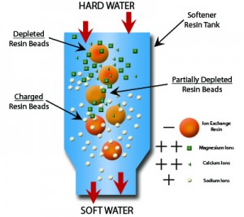
Stationary Phase II
By reacting these stationary phases with a silyl compound or a long-chain hydrocarbon (C-18), the polarity of the stationary phase can be reversed (heavily used on HPLC).
Sugar or amino acid derivatives are used as stationary phase to separate chiral compounds
i.e., enantiomers of camphor in HPLC or GC, chiral epoxides, etc.
However, not every chromatographic process is based on adsorption of the compound on
a stationary phase. In GC, partition chromatography is used, where the solute equilibrates between the stationary, liquid phase and the mobile phase, the carrier gas.
Ion-exchange chromatography utilizes resins
that have sulfon (-SO₃⁻) or ammonium groups
(-NR₃⁺) on their surface that can bind ions
using electrostatic forces (i.e., water purification),

Slide 6
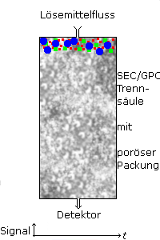
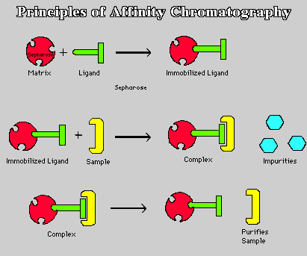
Stationary Phase III
In molecular exclusion chromatography, molecules are separated by size. Larger molecules pass through the column more quickly because they are too large for the
pores to diffuse into them.
Finally, affinity chromatography employs the specific interaction of the solute with a second molecule that is covalently attached to the stationary phase i.e., antibody.

Slide 7
Mobile Phase
Mobile phase=solvent
  The eluting power of the mobile phase depends on the polarity of the solvent vs. the polarity
  f the stationary phase:
  Polar solvents i.e., alcohols have a high eluting power on polar stationary phases because they interact strongly with the polar stationary phase via being a hydrogen bonding donor and a hydrogen bond acceptor).
  Solvents like acetone, ethyl acetate and diethyl ether are only hydrogen bond acceptors.
  Non-polar solvents i.e., toluene, hexane, etc. have a low eluting power on polar stationary phases because their interaction with polar stationary phase is weak  weakly polar compounds interact stronger with the stationary phase than the solvent.
  The general affinity of functional groups towards silica is:
  ionic > acids/bases > amides > alcohols > ketones > aldehydes > esters > ethers >
  halides > unsaturated hydrocarbons > saturated hydrocarbons

Slide 8

Column Chromatography-Theory
The stationary phase is placed leveled in a tube (pipette, burette or large glass column).
The compounds (A and B) that have to be separated are dissolved in a suitable solvent (low polarity for polar stationary phases) and the solution is applied to the stationary phase.
The solution migrates through the column due to the gravity and separates the compound based their different interaction with the stationary phase.
In this example, compound B interacts stronger with the stationary phase and therefore elutes later (the grey tubes are just filled with the mobile phase).
A+B
B
Stationary Phase
A
1 2 3 4 5 6 7

Slide 9
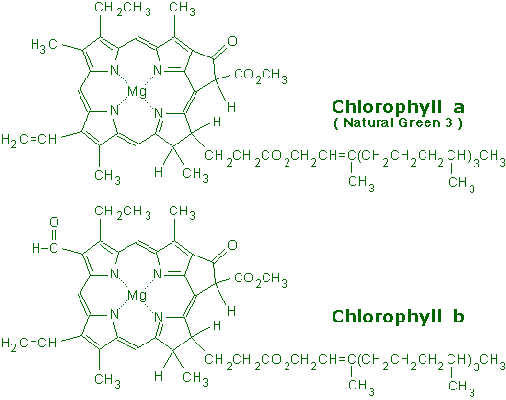

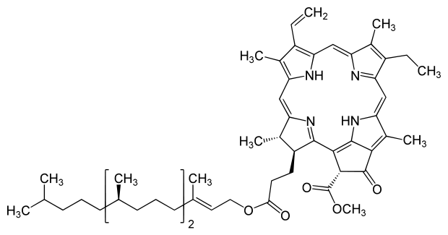
Carotenoids
Spinach leaves contain chlorophyll a and chlorophyll b and β-carotene as major pigments. Chlorophylls a and b are the chlorin pigments that make plants look green.
The two forms of chlorophyll differ by the one group: chlorophyll a has a methyl group in the place where chlorophyll b has an aldehyde function.
Carotenoids are part of a larger collection of plant-derived compounds called terpenes. These naturally occurring compounds contain 10, 15, 20, 25, 30 and 40 carbon atoms, which suggest that there is a compound with five carbon atoms that serves as their building block (isoprene).
Note that β-carotene is a hydrocarbon and is nonpolar.
Both chlorophylls contain C-O and C-N bonds, which are polar, and also contain magnesium bonded to nitrogen, which is such a polar bond it is almost ionic.
Both chlorophylls are much more polar than β-carotene.
Pheophytin a is chlorophyll a without the Mg-ion.
Pheophytin a

Slide 10
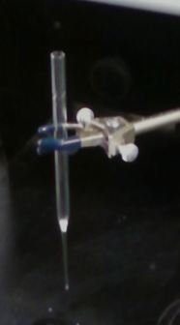
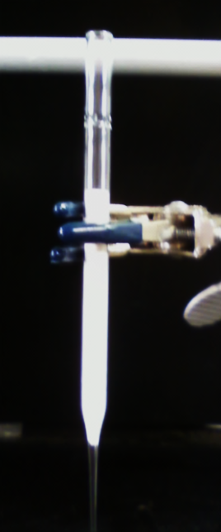
Column Chromatography-Experimental I
In this experiment we will isolate and separate the spinach pigments using different polarity solvents
We can follow this separation visually because the
isolated pigments (fractions) have different colors
Purification by column chromatography
  Place a small cotton ball loosely in the tip of the pipette (smaller than shown in the picture!)
  Add alumina to the pipette (up to ~ 1 cm from the top,
  hint: scoop the alumina in!)
  Clamp a 5.25’’ Pasteur pipette straight and securely
  Wet the column with hexane
  Make sure that there are no cracks or bubbles in the column
  When the solvent reaches the top, add the sample solution
  (all of it in small batches!)
1 cm

Slide 11
Column Chromatography-Experimental II
While running the column, different solvents will be used that display different eluting powers. When using a polar stationary phase, the student should start with the non-polar (low polarity) solvent and increase the polarity slowly.
  1. Hexane
  2. Hexane:Acetone (70:30) (by volume)
  3. Acetone
  4. Acetone:Methanol (80:20) (by volume)
Important: Once the chromatography procedure is started, it should not be stopped. The alumina must be kept wet with solvent all the time to avoid the formation of cracks in the stationary phase.

Slide 12
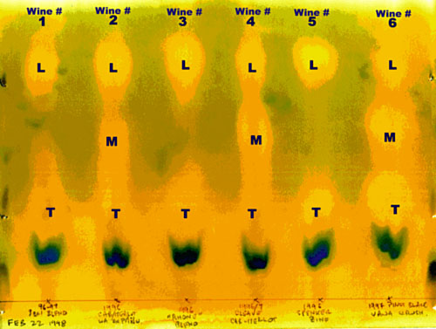

Applications (TLC)
Uses
  Monitor the progress of reactions
  Identify compounds in a mixture
  Determine the purity of a compound
  Optimizing a solvent mixture
Applications
  Separation of dyes in pen ink (on paper)
  Separation and determination of pigments in plants
  Monitor the progress of fermentation in wine making
  (T=tartaric acid, M=malic acid, L=lactic acid)

Slide 13
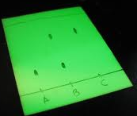

Thin Layer Chromatography-Theory I
TLC plate
  The plate is coated with a very thin layer (~0.25 mm) of
  a mixture of a stationary phase and a binder i.e., gypsum
  The stationary phase often also contains a fluorescent indicator (zinc silicate, zinc cadmium sulfide),
  which appears bright green when exposed to
  short wavelengths (λ=254 nm)
  Preparation of the TLC plate
    Do not touch the plate on the white surface!
    Generate a very thin start line with pencil or mark the plate
    on the lower end on each side (0.5-1 cm from the bottom)
    Do not use a pen for this step!

Slide 14
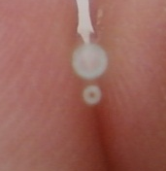
Thin Layer Chromatography-Experimental I
Spotting
  A capillary spotter (drawn from a Pasteur pipette) or a commercial spotter should be used for spotting (top: melting point capillary, bottom: commercial spotter).
  Melting point capillaries, syringe needles, etc. (as is) are
  not suitable for the spotting process because they produce
  a huge spot that overloads the plate (=tailing, see also last slide)!
  The spots have to be equally spread at the starting line and not be located too close to the outer edges.
  The spots have to be small in diameter (~ 1-2 mm).
  A diluted solution of the compound in a low-boiling, low polarity solvent i.e., diethyl ether, hexane, etc. has to be used (5 mg/mL).
  If the compound cannot be detected with the naked eye, the TLC
  plate has to be dried and then be inspected under the UV-lamp
  prior to development i.e., colorless or weakly colored compounds
  in low concentrations.

Slide 15
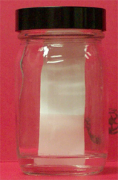
Thin Layer Chromatography-Experimental II
Developing the plate
  A jar or a small beaker covered with a watch glass is used as development chamber, lining the walls with wet filter paper is usually not necessary if the jar is kept close
  The solvent level in the jar has to be below the starting line
  Once the TLC plate is placed straight in the chamber, the chamber has to be left undisturbed
  The compounds move up the plate at different rates (if the proper mobile phase is used)
  Note that the rate of movement is not constant (Why?)
  The solvent front is allowed to move up the plate until ~1 cm from the top
  The plate is then removed and the solvent front immediately marked
Purple: mixture
Blue: compound A
Red: compound B
t=0 min
t=1 min
t=2 min
t=5 min

Slide 16
Thin Layer Chromatography-Experimental III
Visualization
  First the plate has to dried thoroughly
  UV light: only useful if the compounds are UV active and the stationary phase contains a fluorescent indicator
  Iodine: used for unsaturated and aromatic compounds (brown,
  not permanent)
  Vanillin: good for hydroxyl and carbonyl compounds (appear
  in different colors)
  Ceric staining: good for hydroxyl, carbonyl, epoxides (dark blue)
  Ninhydrin: amino acids, amines (often pink or purple)
  Bromocresol green: carboxylic acids
The spots have to be marked with pencil and transfer the diagram into the notebook and take picture with your cell phone. Do not take the TLC plate home! The silica will rub
off and will be all over the place!

Slide 17
Data Analysis
Determination of R_{f}-value
  Measure the distance of the center of the spot from
  the starting line (r, b).
  Measure the distance of the solvent front from the
  starting line (s).
  The R_{f}-value is defined as the ratio of the
  travel distances:
  The R_{f}-value is a ratio and thus a
  unitless number.
  The R_{f}-value has to be between 0 and 1.
b
s
r

Slide 18
Solvent Effect
Changes in the mobile phase have an impact on the movement of
all compounds (with varying degree though):
The eluting power the mobile phase (the darker the color of letters) has, the more the compounds move because the mobile phase absorbs stronger on the stationary phase, which makes it more difficult for the compounds to interact!
hexane
toluene
chloroform

Slide 19
Common Problems
Problem 1: All spots are grouped together on the lower (upper) end of the plate
Solution 1: The eluting power of the solvent was too low (high) for this separation problem. A more polar (less polar) solvent should be added to
the mobile phase (see previous slide).
Problem 2: The spot is spread over a large part of the lane or does
not look round.
Solution 2: The student spotted too much of the sample on the plate
that lead to tailing. Less sample should be spotted using the proper
spotter.
Problem 3: The spot has a crescent shape after the development.
Solution 3: The solvent used to dissolve the sample was too polar
and was not allowed to evaporate completely.
Problem 4: The spots seem to run into each other on the top.
Solution 4: Either the spots were to close at the start line or the
TLC plate was not placed straight in the jar.

Slide 20
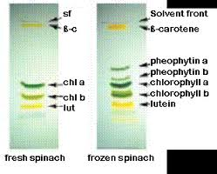
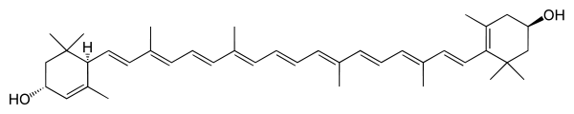
Experiment
The TLC of different spinach samples looks like on the right:
  Stationary phase: silica
  Mobile phase: 60 % petroleum ether
  (b.p.: 35–60 ºC), 16 % cyclohexane,
  10 % ethyl acetate, 10 % acetone,
  4 % methanol
Note that the frozen spinach contains more pheophytins, which are degradation products of chlorophyll (weak acid).
Lutein (lut), which is considered a xanthophyll, is a dihydroxylated form
of carotene. The two hydroxyl groups make the compound much more polar!
Ref.: Quach, H. T.; Steeper, R L.; Griffin, G. W. J.
Chem. Educ. 2004, 81, 385-7.

