Slide 1
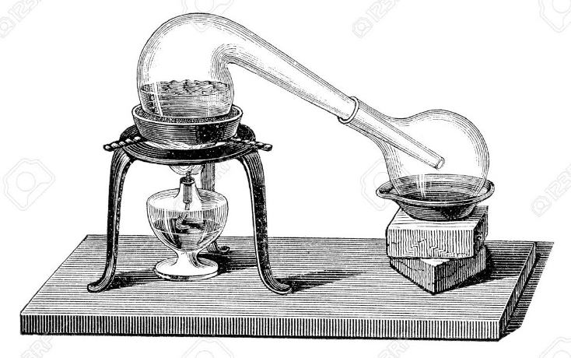
Lecture 9a
Distillation

Slide 2
Introduction
What is distillation?
  A distillation is the process that includes the vaporizing a liquid from a pot and the subsequent condensation of the vapor and collecting the condensate in a receiver.
  The evaporation is an endothermic process and requires heat (external or internal). The heat of vaporization is much lower
  than the bond energies (i.e., water: ΔH_{vap}= 40.7 kJ/mol,
  Dº(O-H)= 460 kJ/mol).
  The condensation is an exothermic process and therefore requires cooling (i.e., condenser to remove the heat).
  This technique is very useful for separating a liquid mixture when the components have sufficiently different boiling points.

Slide 3
Introduction
Four distillation methods are available to the chemist:
1. Simple distillation
  Separating liquids boiling below 150 ˚C at 1 atm. The liquids should dissolve in each other and the difference in boiling point between various liquid components should be
  at least 25 ˚C (i.e., water from salt water solution).
2. Vacuum distillation
  Separating a liquid mixture boiling with boiling points above 150˚C at 1 atm.
3. Fractional distillation
  Separating liquid mixtures in which boiling points of the volatile components differ
  by less than 25˚C from each other (i.e., gasoline).
4. Steam distillation
  This technique is mainly used to isolate oils from natural compounds (i.e., eugenol
  from cloves, eucalyptus oil from eucalyptus leaves, D-limonene from orange).

Slide 4
What determines the Boiling Point of a Compound?
Which factors influence the boiling point in general?
1. Molecular weight
  The higher the molecular weight, the higher boiling point is as the following sequence shows:
  While butane is a gas at ambient pressure (that is why it is stored in pressurized metal containers), pentane and hexane are low boiling liquids
  As a rule of thumb, each additional carbon
  atoms increases the boiling point by 20-40 ºC
  in a homologous series because large molecules
  are easier to polarize than small molecules,
  which results in a larger instantaneous dipole
  moment (LDF)

Slide 5
What determines the Boiling Point of a Compound?
2. Functional groups
  The more polar a compound is, the higher its boiling point is going to be.
  Most hydrocarbons are non-polar or weakly polar, while molecules containing heteroatoms with high electronegativity values (i.e., O, Cl, N, F) possess a larger permanent dipole moment.
  The compounds above have similar molecular weights. Thus, the compounds with the higher boiling points must experience stronger intermolecular forces
  in the liquid state:
    The alcohol and the carboxylic acid exhibit very strong hydrogen bonding between the molecules resulting in very high boiling points.
    The primary amine experience this force but to a much lesser degree because of the lower E-H bond polarity.
    The phosphine and the thiol display E-H bonds, but do not display intermolecular hydrogen bonding that increase the boiling point.
    Chloroethane does not exhibit hydrogen bonding and therefore displays a greatly reduced boiling point because the dominating intermolecular force in this case is the dipole-dipole interaction (μ=2.06 D).
    The low boiling point of butane is a result of weak London dispersion forces.
CH₃CH₂CH₂CH₃ CH₃CH₂CH₂OH CH₃COOH CH₃CH₂CH₂NH₂ CH₃CH₂PH₂ CH₃CH₂SH CH₃CH₂Cl
mw=58 mw=60 mw=60 mw=59 mw=62 mw=62 mw=64
b.p.: -0.4 ºC 118 ºC 118 ºC 48 ºC 25 ºC 35 ºC 12 ºC

Slide 6
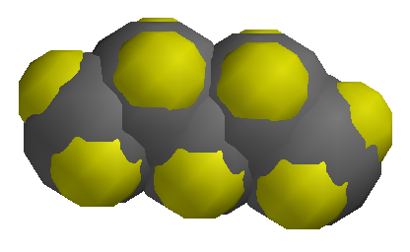
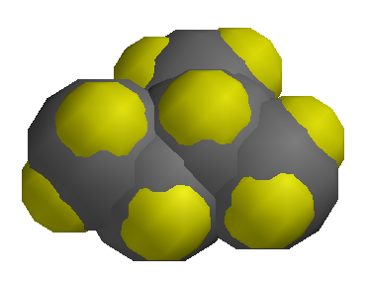
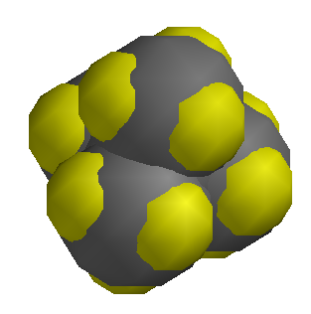
What determines the Boiling Point of a Compound?
3. Branching
  Straight chain molecules usually display a higher boiling point than branched molecules. Since this applies to both, polar and non-polar compounds, London dispersion forces must contribute to a significant degree to the intermolecular forces which determine the boiling point.
  For instance, n-butanol boils at 118 ºC while tert.-butanol boils at 85 ºC, or n-hexane exhibits
  a boiling point of 69 ºC while 2,2-dimethylbutane boils at 50 ºC already. In both cases, the molecule that exhibits the longer chain has the higher boiling point. The decrease of surface
  area of the molecule and the inability to form an instantaneous dipole causes less intermolecular interaction of the molecules, which in turn lowers the boiling point.
  The boiling point also decreases as shown in the following sequence for the three constitutional isomers of pentane.
Surface area (AM1): 133.12 Å² 130.88 Å² 128.75 Å²
Volume (AM1): 107.02 Å³ 106.70 Å³ 106.18 Å³

Slide 7
What determines the Boiling Point of a Compound?
4. E/Z-isomers
  The Z-isomers often have a higher boiling point than the E-isomers even when the two groups attached to the double bond are similar (or identical) in their electron-donating or electron-withdrawing effect (i.e., Z-dichloroethene: 60.2 ºC, E-dichloroethene: 48.5 ºC; Z-2-butene: 3.9 ºC, E-2-butene: 0.8 ºC)
5. Conjugation
  Conjugated systems frequently have a higher boiling point than non-conjugated systems because they can exhibit a larger charge separation due to the conjugation (i.e., 1,3-pentadiene: 42 ºC, 1,4-pentadiene: 26 ºC)
6. Cyclic vs. Acyclic Compounds
  Cyclic compounds are often more polar than acyclic compounds. The main reason is that cyclic compounds usually have less flexibility in compensating the dipole moment (i.e., diethyl ether: 36.5 ºC, tetrahydrofuran: 65 ºC; diethylamine: 55 ºC, pyrrolidine: 87 ºC, pyrrole: 130 ºC)
7. Pressure
  The lower the surrounding pressure is, the lower
  the boiling point of a compound is i.e., water boils
  has a normal boiling point of 100 ºC but it boils
  at 67 ºC at p=200 torr and at 34 ºC at p=40 torr.

Slide 8
Distillation Theory I
The normal boiling point is the temperature at which the vapor pressure of the liquid is exactly 1 atm (760 torr).
  Examples: diethyl ether: 36 ºC, hexane: b.p.: 69˚C, toluene: 111˚C
What about the boiling point of a mixture of hexane and toluene?
Dalton’s Law of Partial Pressures: The total pressure of
the system is equal to the sum of the partial vapor pressure
of each component.
This means,
  P_{hexane} + P_{toluene} = 760 torr
How do we determine P_{hexane} and P_{toluene}?

Slide 9
Distillation Theory II
Raoult Law: The partial vapor pressure of component A (P_{A}) in the solution is equal to the vapor pressure of pure A (P˚_{A}) multiplied by its mole fraction (X_{A}).
Mathematically, P_{A} = P˚_{A} X_{A}
P_{hexane} = P˚_{hexane} X_{hexane} and P_{toluene} = P˚_{toluene} X_{toluene}
What is X_{hexane} and X_{toluene} ??
Remember that X is the mole fraction of the compound and can be found from:
X_{hexane} = (moles hexane in the solution) / total moles;
X_{toluene} = (moles toluene in the solution) / total moles
Substitute these definitions into original equation, one obtains:
P˚_{hexane} X_{hexane} + P˚_{toluene} X_{toluene} = 760 torr

Slide 10
Distillation Theory III
How do we use this equation?
If one knows the PURE vapor pressure of toluene and hexane at a specific temperature (Remember that vapor pressure is temperature dependent!)
Suppose we have the following individual vapor pressures at T_{b}=80.8 ˚C
P˚_{toluene}= 350 torr and P˚_{hexane} = 1170 torr (note that p>760 torr because the temperature is above the boiling point for hexane)
So the above equation becomes:
(1170 torr) X_{hexane} + (350 torr) X_{toluene} = 760 torr
BUT X_{toluene} = 1 – X_{hexane}  (1170 torr) X_{hexane} + (350 torr) (1 - X_{hexane}) = 760 torr
Isolating X_{hexane} gives: X_{hexane} = 0.5  X_{toluene}= 0.5
Conclusion:
  The mixture of hexane and toluene that boils at T_{b}=80.8˚C is a 50:50 mixture
  of these two compounds.

Slide 11
Distillation Theory IV
What is the composition of the vapor?
From Dalton’s law of partial pressure, we know that P_{hexane} + P_{toluene} = 760 torr
This is the same as
This means that:
Substitute the pure vapor pressure at T_{b}=80.8˚C for hexane:
Conclusion:
  Hexane comprises 77 % of the vapor composition at T_{b}=80.8˚C
  The vapor is enriched with the LOWER boiling component compared to the liquid.

Slide 12
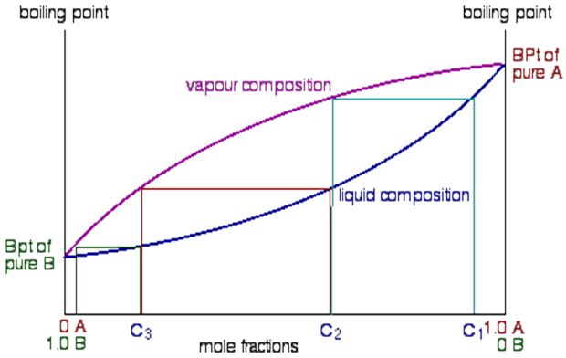
Distillation Theory V
On this diagram, the horizontal lines represent constant T. The upper curve represents vapor composition, the lower curve represents liquid composition.
The composition is given as a mole % of A and mole % B in the mixture. Pure A boils at T_{A} and pure B boils at T_{B}. For either pure A or pure B, the vapor and liquid curves meet at the boiling points.
A solution with the initial concentration of L₁ (A:B=0.4:0.6) is in equilibrium
with vapor V₁ (A:B=0.2:0.8). As the vapor V₁ condenses, the liquid L₂ is formed that has the same composition as V₁. Note that the vapor of for L₁ contains more
of the lower boiling liquid B.
T_{A}
V₁
L₁
T_{B}
L₂

Slide 13
Distillation Theory VI
Non Ideal System:
  Azeotrope: A liquid mixture of two or more substances that retains the same composition in the vapor state as in the liquid state when distilled
  or partially evaporated under a certain pressure.
  The minimum and maximum points in the phase diagrams on the next slide are corresponding to constant boiling mixture called azeotrope.
  Azeotropes are often found when compounds in the solution interact strongly with each other i.e., via hydrogen bonding, etc.

Slide 14
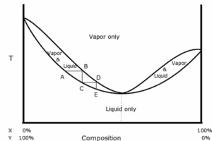
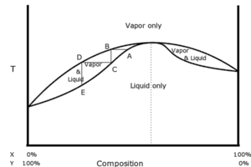
Distillation Theory VII
Minimum boiling point azeotrope
  The azeotrope of water and ethanol boils at 78.15 ºC and has a composition of 95.6 % of EtOH and 4.4 % of water (by weight)
  Other azeotropic mixtures are water:benzene (b.p.= 69.2 ºC, 9:91),
  water:toluene (b.p.= 84.2 ºC, 20:80), ethanol:benzene (b.p.= 68.2 ºC, 32:68)
Maximum boiling point azeotrope
  A mixture of water and formic acid forms a maximum boiling point azeotrope (77.5 %) that boils at 107.3 ºC, while water and formic acid boiling at 100.0 ºC and 100.7 ºC
  Concentrated nitric acid (68 %) is another example for a maximum boiling azeotrope (b.p.= 120.5 ºC), while pure nitric acid boils at 83 ºC. This means that diluted nitric acid can be concentrated by removing the water by distillation.
  Perchloric acid (71.6 %, 203 ºC), sulfuric acid (98.3 %, 338 ºC) and hydrochloric acid (20.2 %, 110 ºC) also form maximum boiling azeotropes.
Minimum boiling azeotrope
Maximum boiling azeotrope

Slide 15
Experiment I
Setup
  Parts: Heating mantle with control unit, pot, distillation column, three-way distilling head, thermometer, Liebig condenser, vacuum adapter, collection flask
Important Pointers
  A spin bar has to be added to the pot to reduce bumping.
  The bulb of the thermometer has to be placed below the side arm as shown in the diagram.
  The water enters the condenser on the low end and exist on the upper end. The thin-walled tubing has to be properly attached to avoid a flood.
  The heating mantle cannot be plugged straight into the wall outlet because there is no temperature control. You will also adjust the Power-Mite setting to 45 during the experiment. Power-Mite is the knob that controls the heating rate of the heating mantle.
out
in

Slide 16
Experiment II
Instead of toluene/ethyl acetate mixture as stated in the lab manual experiment 9, the students will be provided with an UNKNOWN mixture.
Possible components of your unknown are ethyl acetate,
n-propyl acetate, 2-butanone, and 2-pentanone. Use 15 mL of this unknown mixture for the distillation.
You will collect the fractions at the following temperatures instead of the ones listed in the manual:
  Fraction #1 between 55 – 65 ºC.
  Fraction #2 between 65 – 75 ºC.
  Fraction #3 between 75 – 85 ºC
  Fraction #4 between 85 – 100 ºC
Depending on the unknown, you may NOT see fraction #1 or #4.

